Slide 1
Embryo Transfer
The way to produce large number of offspring from selected dams
Accelerate selection
Decrease generation interval

Slide 2
Embryo Transfer
Selection of donor and recipients
Superovulation of donor and synchronization of recipients
Insemination of donor
Collection and evaluation of embryos
Embryo transfer

Slide 3
Superovulation
FSH injections
Progesteron
sponge
2 mg
1,5 mg
1 mg
0,5 mg
2 mg
1,5 mg
1 mg
0,5 mg
Progesteron
sponge
PMSG injection
Sponge removal
48 hours
500 IU
Notes:
Insemination 24 h after sponge removal

Slide 4
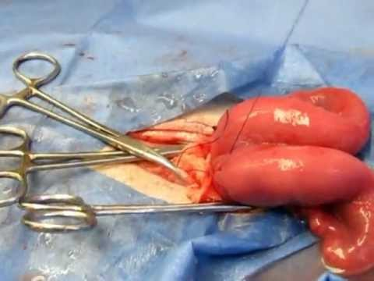
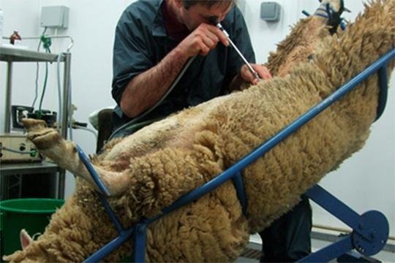
Embryo Collection
Surgical
(Laparotomy)
Long preparation period
Operative trauma, adhesions
Repeatability is limited
Non-surgical
(Laparoscopy or Trans-cervical passage)
Relatively short preparation
Fast donor recovery
Minimize stress and drug
Repeatablility

Slide 5
Transfer
Transfers may be done at 4-6th day after inseminations.
Embryos must be in morula or balstocyst stage

Slide 6
Hints to attent
PMSG may result in lower numbers of embryo than FSH.
Non-surgical embryo collection sould be performed because of their multiple adventages.

