Slide 1
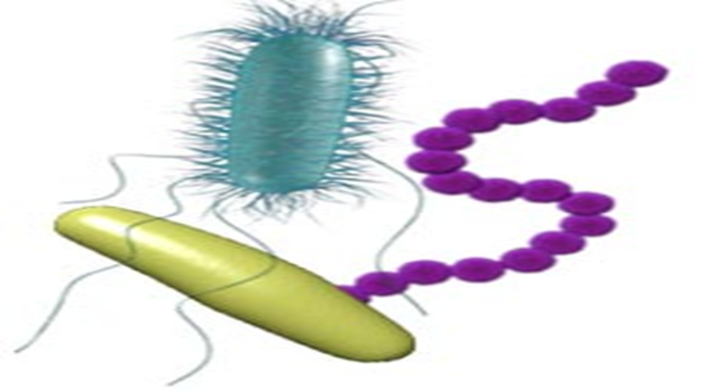
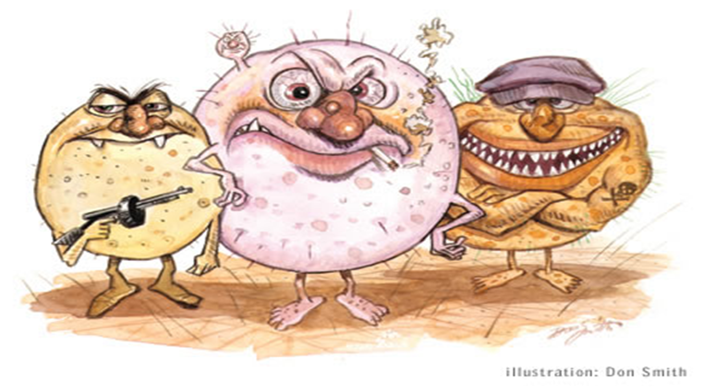
Introduction To Microbiology
And
Classification Of Microorganisms

Slide 2
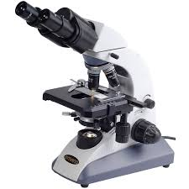
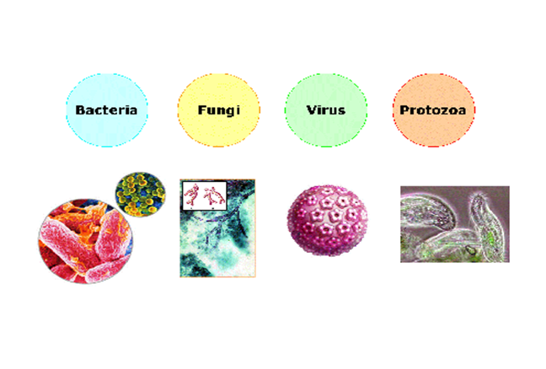
Microbiology is the science that deals with
tiny organisms that can’t be seen by naked eye
Micro = tiny, bio= alive, logy (logos-latin) = science

Slide 3
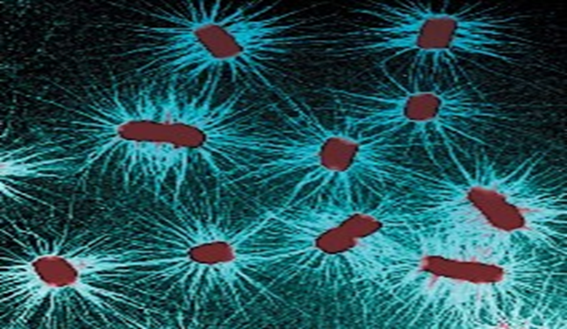
In general we call this part of science : Microbiology
Organisms called : Microorganisms or microbes- these microscopic organisms
Microorganisms also called “germs ( rapidly growing cell), viruses, agents…” but not all cause disease and many more are useful or essential for human life
Microorganisms are widely distributed
in nature and some of them are beneficial
to man (saprophyte) and
some of them are harmful (pathogenic; cause diseases)

Slide 4
When microbes were identified ?
Leeuwenhoek’s microorganisms grouped into six categories as follows:
Fungi
Protozoa
Algae
Bacteria
Archaea
Small animals

Slide 6
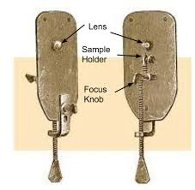
Anton van Leeuwenhoek (1632-1723)
(Duch) was the first microbiologist and
the first person to observe bacteria
using a single-lens microscope
of his own design.
He described live microorganisms that
he observed in teeth scrapings,
rain water and peppercorn infusions.

Slide 7
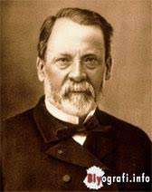
What Causes Disease?
Louis Pasteur (1822-1895) considered
the father of Modern Microbiology
Developed a process( today known as
pasteurisation) to kill microbes.
Pasteurisation is accomplished by heating liquids
to 63-65 C for 30 minutes or 73-75 C for 15 seconds
Contributed best in microbiology
Sterilisation
Hot Air oven
Autoclave
Antrax vaccine (coined the word)
Rabbies vaccine
Built the Pasteur institute

Slide 8
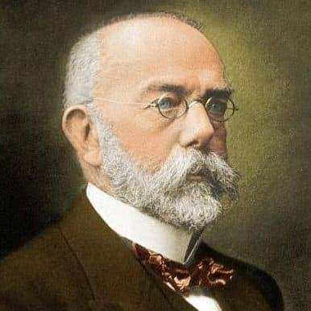
Robert Koch ( 1843- 1910) German scientist,
was a pioneer in medical microbiology.
Examined colonies of Microorganisms.
Formulated bacteriological techiques
Staining methods
Discovered Tuberculosis agent and Vibrio cholera
Worked Anthrax
He was awarded a Nobel prize in 1905
(Koch postulates) he set out criteria to test.

Slide 9
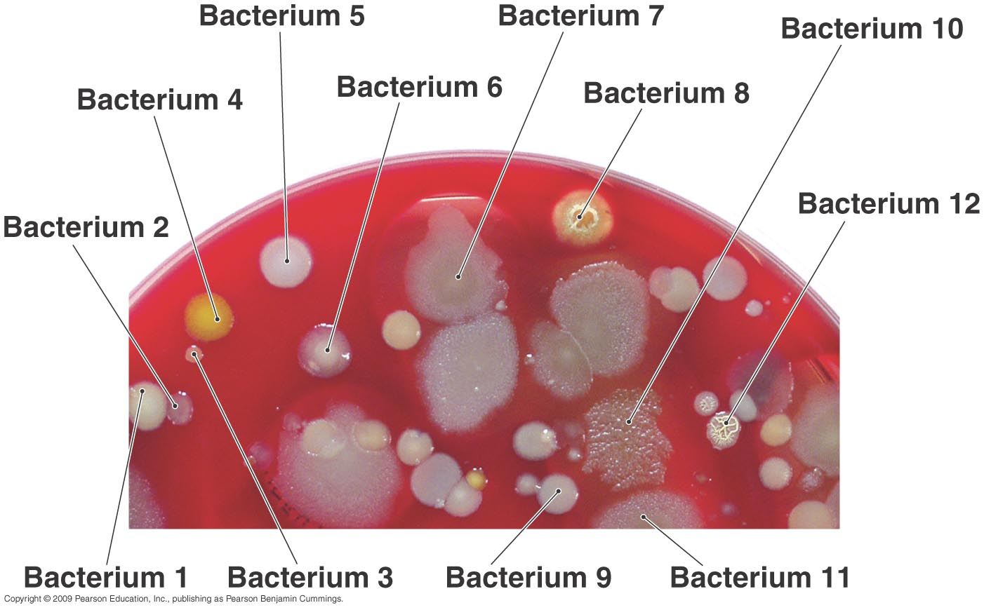
Koch’s Experiments
Simple staining techniques
First photomicrograph of bacteria
First photomicrograph of bacteria in diseased tissue
Techniques for estimating CFU/ml
Use of steam to sterilize media
Use of Petri dishes
Aseptic techniques
Bacteria as distinct species
Koch’s Postulates

Slide 12
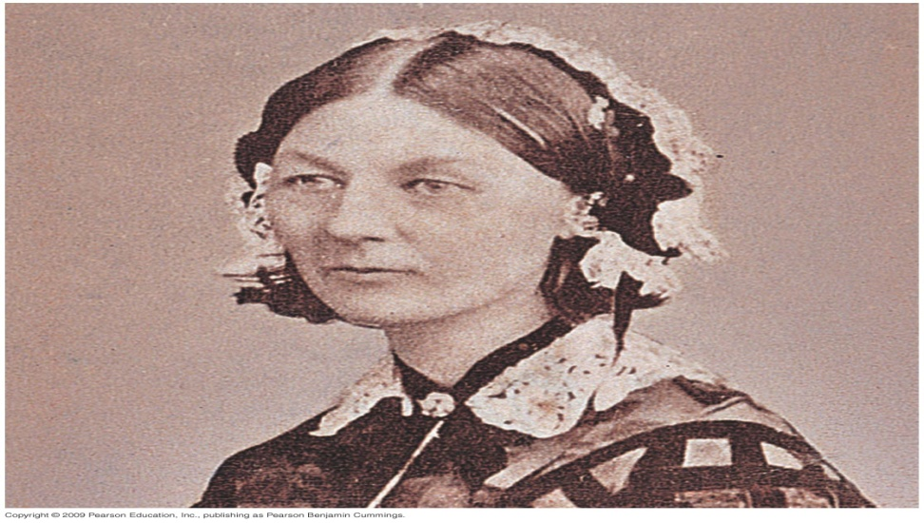
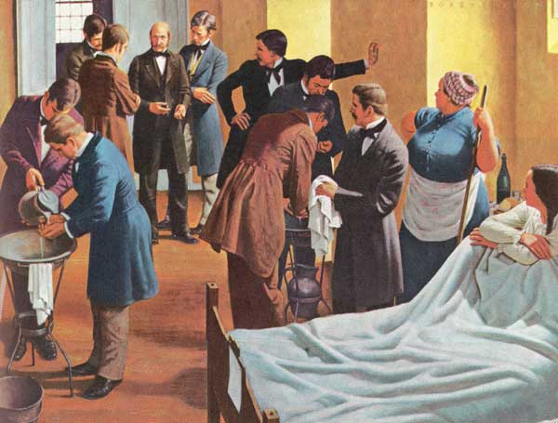
How Can We Prevent Infection and Disease?
Ignaz Semmelweis 1840 advocated
Handwashing to prevent transmission of puerperal
Fever from one patient to another
Lister’s antiseptic technique
Nightingale and nursing
Snow – infection control and epidemiology
Jenner’s vaccine – field of immunology
Ehrlich’s “magic bullets” – field of chemotherapy

Slide 13
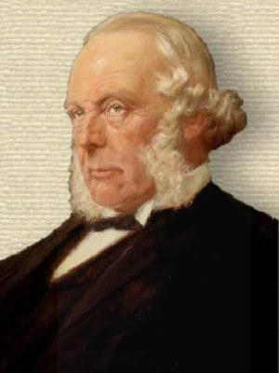
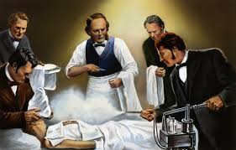
Joseph Lister 1860s, used a chemical
disinfectant to prevent surgical wound
infections after looking at Pasteur’s work
showing microbes are in the air,spoil,food,and
cause animal diseases

Slide 15
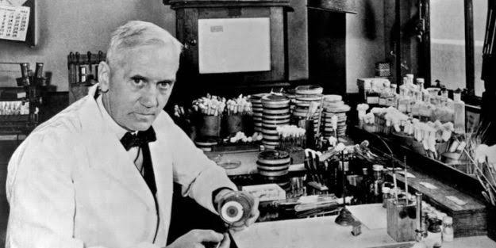
Alexander Fleming, 1928 ,discovered the
first antibiotic.
He observed that Penicillium fungus made
an antibiotic, penicillin, that killed S.aureus.
1940s: Penicillin as tested clinically
and mass produced

Slide 17
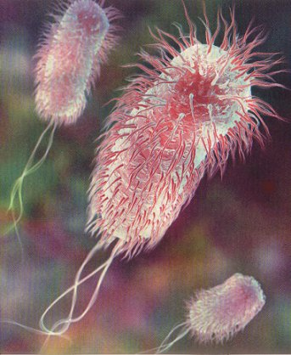
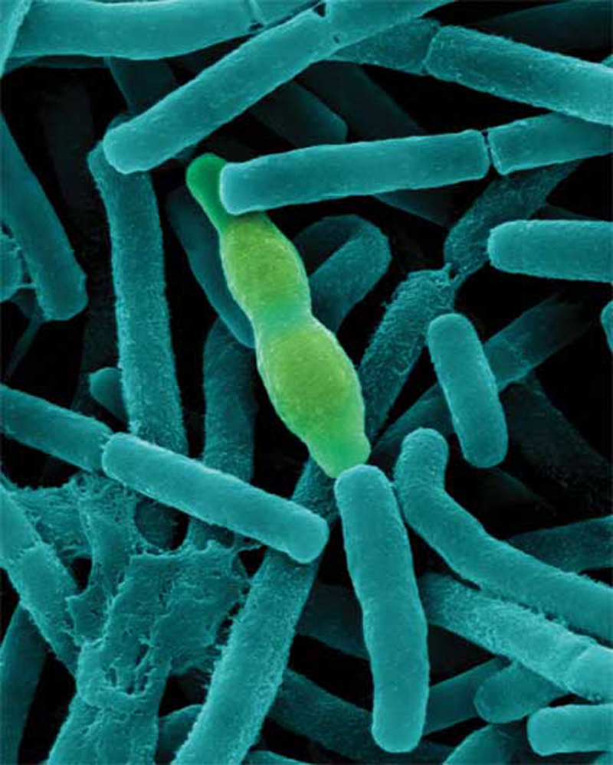

Slide 18
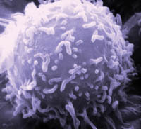
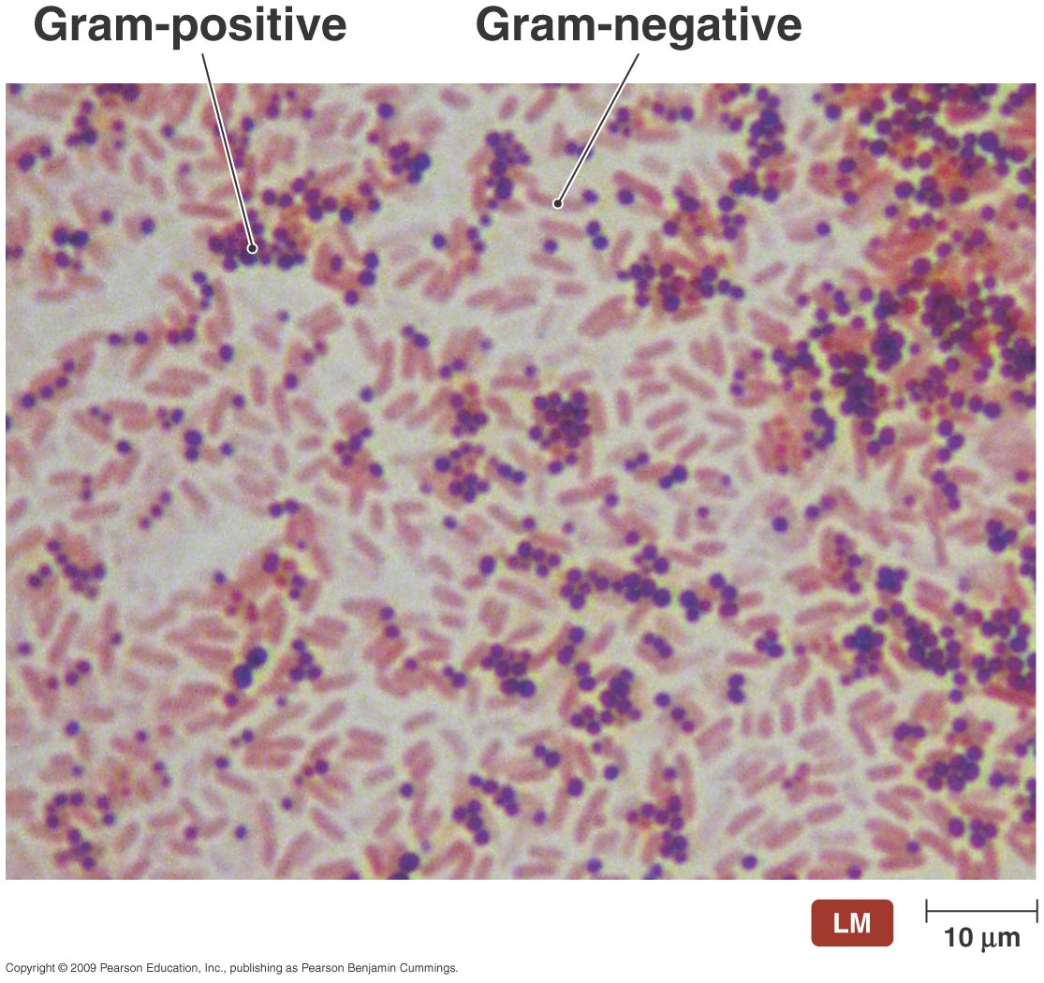

Slide 20
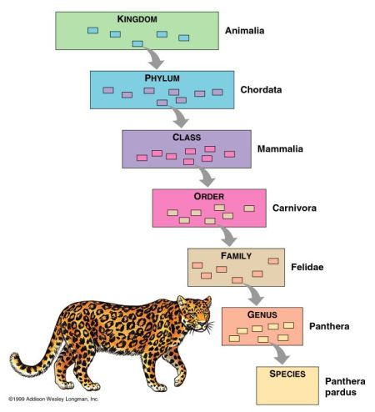
Taxonomy: Naming, Classifying, and Identifying Microorganisms
Microbial nomenclature- naming microorganisms
Taxonomy- classifying living things
Identification- discovering and recording the traits
of organisms so they can be named and classified

Slide 21
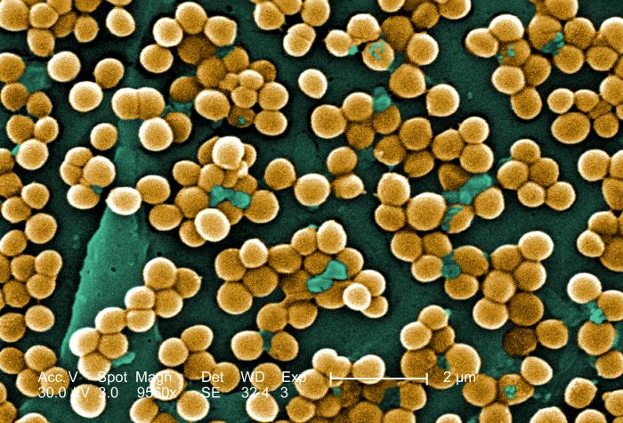
Assigning Specific Names
The binomial system of nomenclature
The generic (genus) name followed
by the species name
Generic part is capitalized, species is lowercase
Both are italicized or underlined if italics aren’t available
Staphylococcus aureus

Slide 22
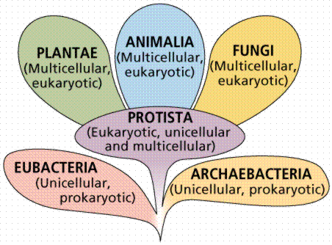
Traditional Whittaker Classification
Five Kingdoms
Prokaryotae (Monera)
Protista
Fungae
Plantae
Animalia
Based on:
Morphology
Metabolism (Biochemical Activity)
Molecular Techniques
Fatty Acid Profiles
Protein Differentiation
DNA Finger Printing

Slide 24
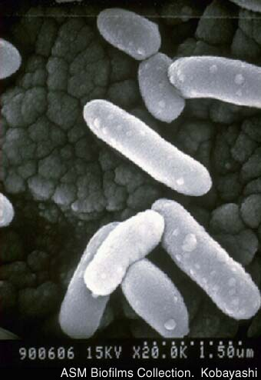
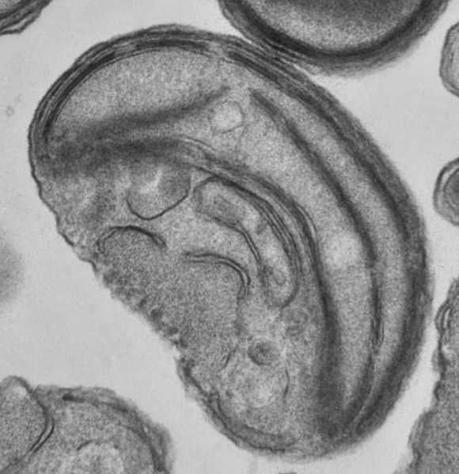
Cellular Organization
Prokaryotic Eukaryotic

Slide 27
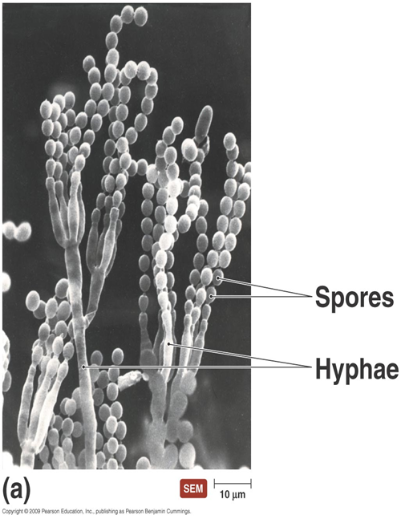
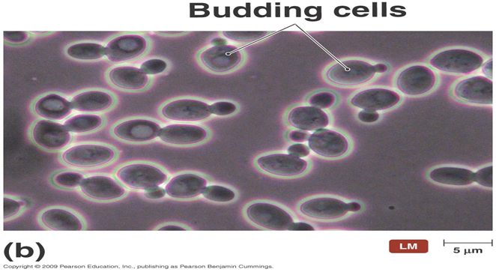
Fungi
Eukaryotic (have membrane-bound nucleus)
Obtain food from other organisms
Possess cell walls
Composed of
Molds – multicellular; have hyphae;
reproduce by sexual and asexual spores
Yeasts – unicellular; reproduce asexually
by budding; some produce sexual spores

Slide 28
Protozoa
Single-celled eukaryotes
Similar to animals in nutrient needs and
cellular structure
Live freely in water; some live in animal hosts
Asexual (most) and sexual reproduction
Most are capable of locomotion

Slide 29
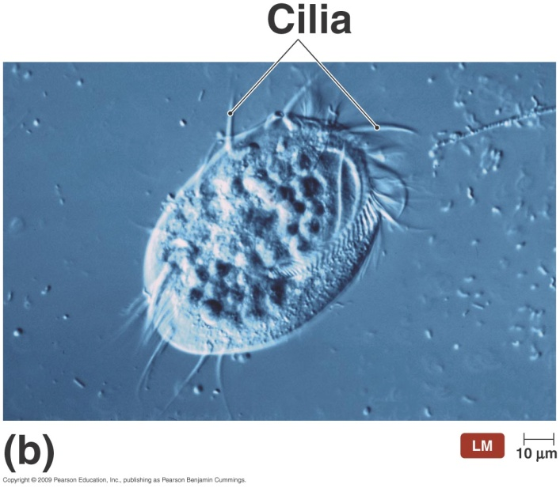
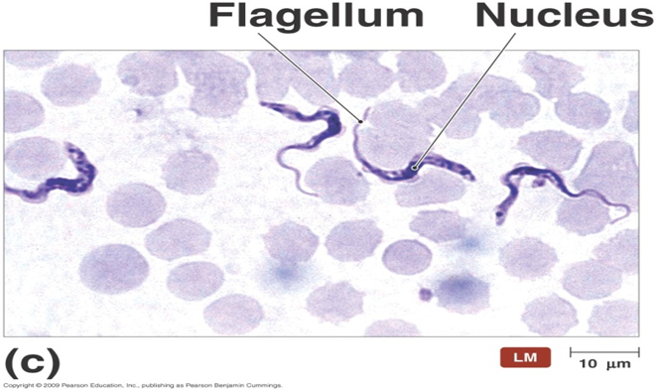
They have
Pseudopodia – cell extensions that flow
in direction of travel
Cilia – numerous, short, hair-like protrusions
that propel organisms through environment
Flagella – extensions of a cell that are
fewer,longer, and more whiplike than cilia

Slide 30
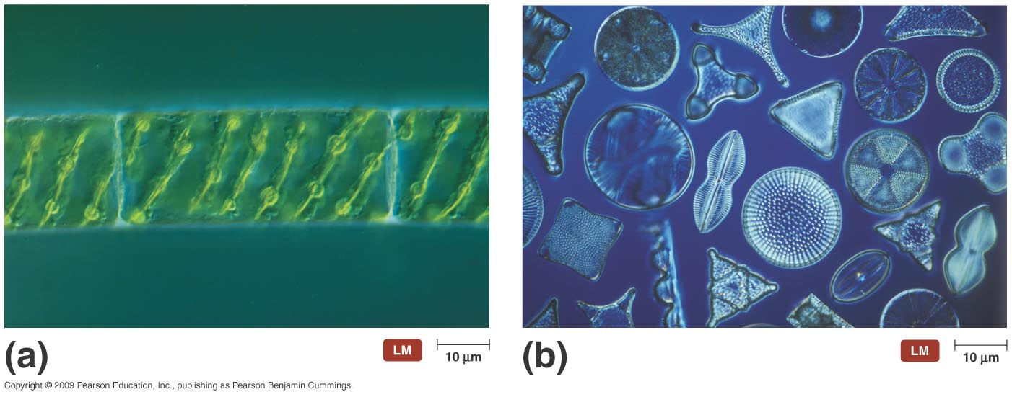
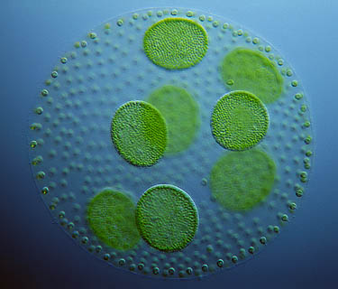
Algae
Unicellular or multicellular
Photosynthetic
Simple reproductive structures
Categorized on the basis of pigmentation,
storage products, and composition of cell wall

Slide 31
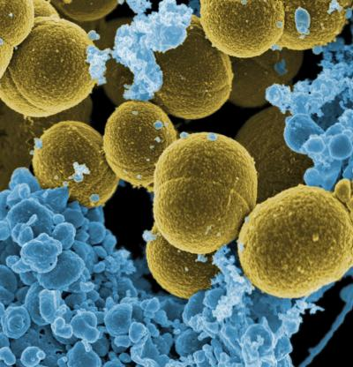
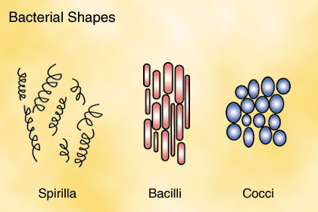
Bacteria and Archaea
Unicellular and lack nuclei
Much smaller than eukaryotes
Found everywhere there is sufficient moisture;
some found in extreme environments
Reproduce asexually
Two kinds
Bacteria – cell walls contain peptidoglycan; some lack cell walls; most do not cause disease and some are beneficial
Archaea – cell walls composed of polymers other than peptidoglycan

Slide 32
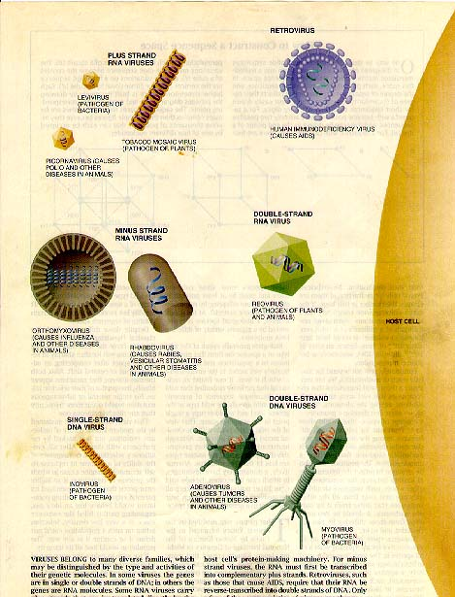
Viruses
Not independently living cellular organisms
Much simpler than cells- basically a small
amount of DNA or RNA wrapped in
protein and sometimes by a lipid membrane
Individuals are called a virus particle or virion
Depend on the infected cell’s machinery to multiply and disperse

Slide 34
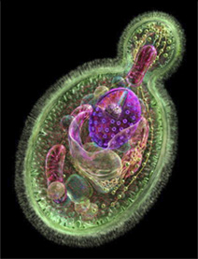
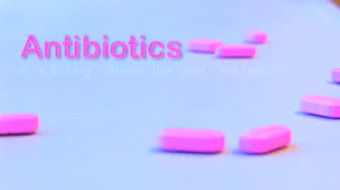

Slide 35
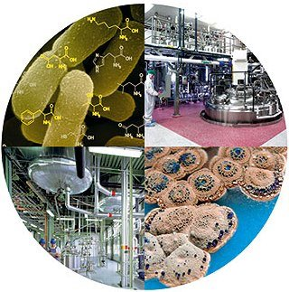
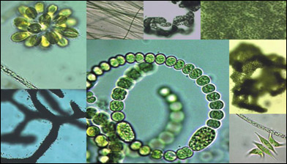

Slide 36
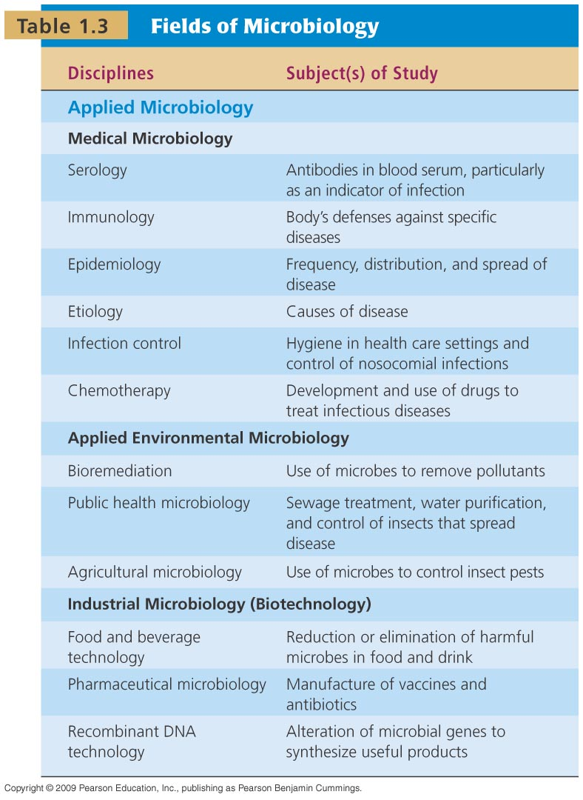

Slide 37
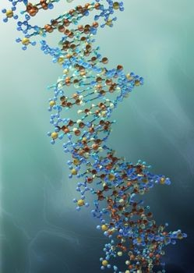
The Modern Age of Microbiology
How Do Genes Work?
Microbial genetics
Molecular biology
Recombinant DNA technology
Gene therapy

Slide 38
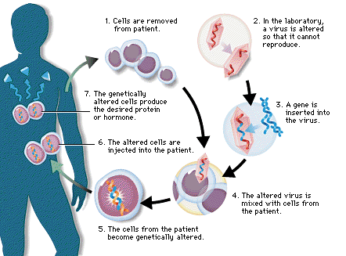
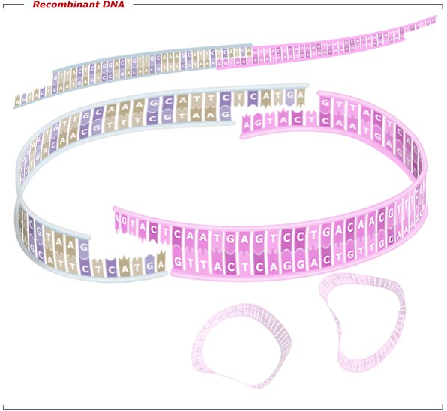
Recombinant DNA Technology
Genes in microbes, plants, and animals manipulated for practical applications
Production of human blood-clotting factor by E. coli to aid hemophiliacs
Gene Therapy
Inserting a missing gene or repairing a defective one in humans by inserting desired gene into host cells

Slide 39
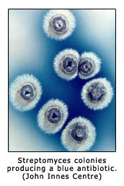
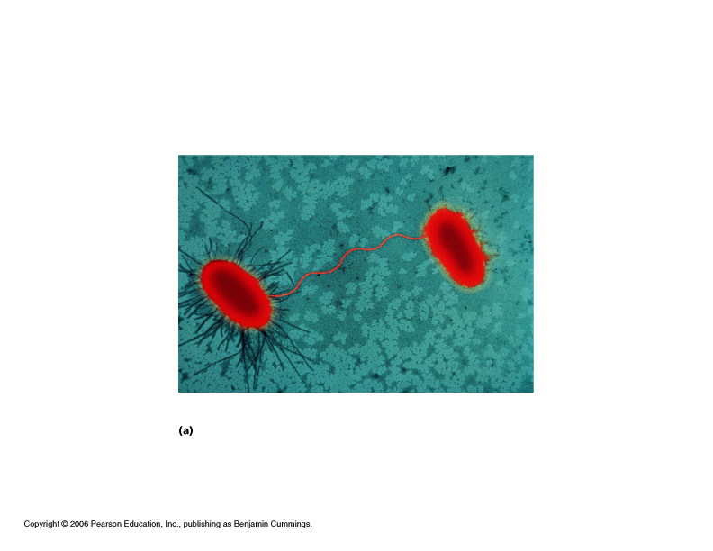
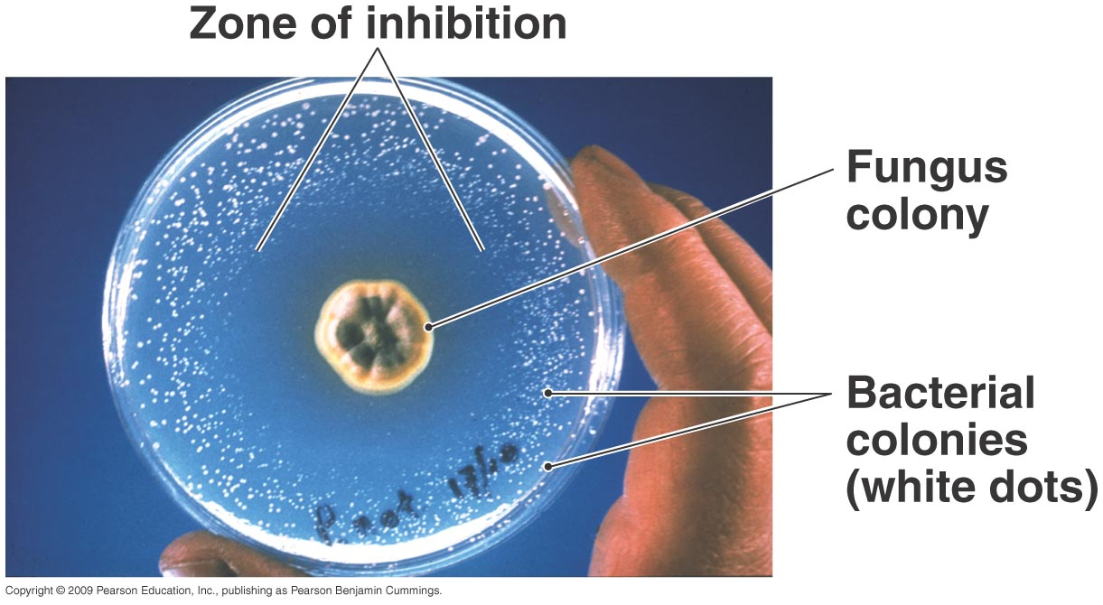
What Will the Future Hold?
Microbiology is built on asking and answering questions
The more questions we answer, the more questions
we have

Slide 40
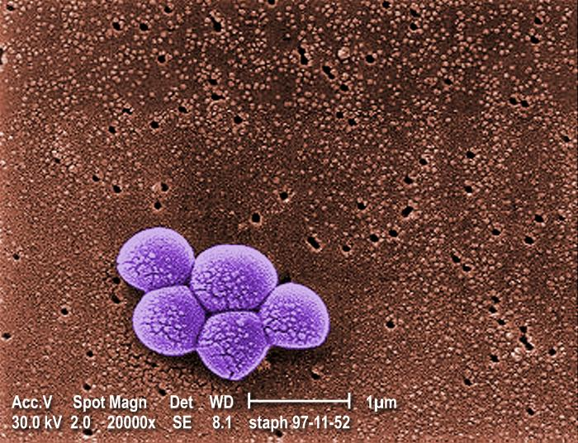
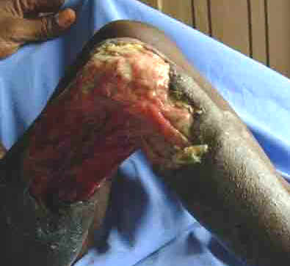
Worldwide Infectious Diseases Affecting Health Sciences
Increasing number of drug resistant strains including Nosocomial and Community Acquired microorganisms
MRSA Methicillin Resistant Staphylococcus aureus
VRE Vancomycin Resistant Enterococcus
VRSA Vancomycin Resistant Staphylococcus aureus
MDR-TB Multidrug Resistant Tuberculosis

Slide 41
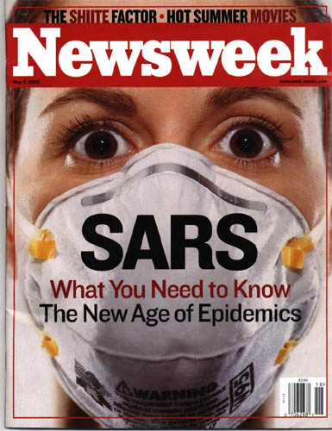
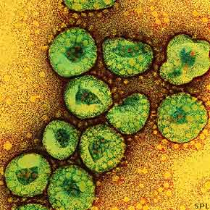
Increasing number of emerging diseases (SARS, AIDS, hepatitis C, viral encephalitis)
Other diseases previously not linked to microorganisms now are (gastric ulcers, certain cancers, multiple sclerosis)

Slide 53
References
Medical Microbiology, Murray,Rosenthal,Pfaller (Eds), 8th edition, Elsevier, 2016
Mims’ Medical Microbiology, Goering,Dockrell,Zuckerman,Roitt,Chiodini (Eds), 5th edition Elsevier, 2014
https://www.slideshare.net/doctortvrao/medical-microbiologyrevisiting-the-history-by-drtvrao-md-medical-microbiology
https://www.austincc.edu › materials › unit1 › Int...
http://opencourses.emu.edu.tr/course/view.php?id=158

