Slide 1
BLM258
Chapter 8: Enhanced Entity-Relationship (EER) Model

Slide 2
Outline
Subclasses, Superclasses and Inheritance
Specialization and Generalization
Constraints and Characteristics of Specialization and Generalization Hierarchies

Slide 3
Subclasses, Superclasses and Inheritance
Enhanced ER (EER) model
It is used to design more detailed database schemas
Constraints reflected more accurately
More complex requirements can be handled

Slide 4
Subclasses, Superclasses and Inheritance
Enhanced ER (EER) model includes all modeling issues in ER.
EER also has the following concepts:
Subclasses and superclasses
Specialization and generalization
Category
Attribute and relationship inheritance

Slide 5
Subclasses, Superclasses and Inheritance
Subclass of an entity type
Meaningful subgroupings
Subclass entity inherits all attributes and relationships of superclass
They are represented because they have significance in mini word.

Slide 6
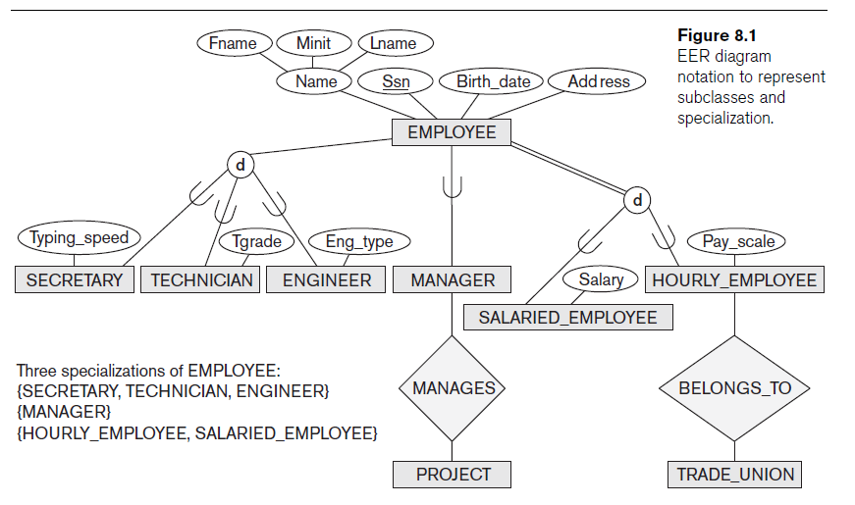
Subclasses, Superclasses and Inheritance

Slide 7
Specialization and Generalization
Specialization
Defining a set of subclasses
Subclass can define
Specific attributes
Specific relationship types

Slide 8
Specialization and Generalization
Some of attributes may apply on aly a subset of our superclass
In the same way, some of our relationships may be participated by members of subclass.

Slide 9
Specialization and Generalization
Generalization is the reverse process of specialization
More than one class generalized into one superclass
In this process, original entity types are subclasses
It can be considered as the process of defining a generalized entity type from the given entity types.

Slide 10
Constraints and Characteristics of Specialization and Generalization Hierarchies
Constraints on single specialization or on single generalization.
Lattices and Hierarchies
There can be one or more than one subclass

Slide 11
Constraints and Characteristics of Specialization and Generalization Hierarchies
Disjointness constraint
The subclasses must be disjoint
Completeness constraint
Total
Partial
Those constraints are independent.

Slide 12
Constraints and Characteristics of Specialization and Generalization Hierarchies
Specialization hierarchy
Each subclass participates in only one superclass/subclass relationship
Produce tree structure
On the other hand, in specialization lattice a subclass can be in more than one superclass/subclass relationship

Slide 13
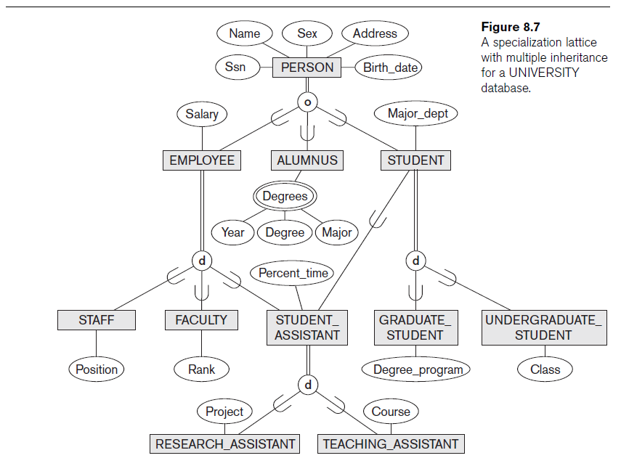
Constraints and Characteristics of Specialization and Generalization Hierarchies

Slide 14
Constraints and Characteristics of Specialization and Generalization Hierarchies
Multiple Inheritance
There are subclasses with more than one superclass
Single Inheritance
Each subclass has only one superclass

