Slide 1
Isomerism

Slide 2
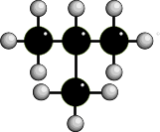
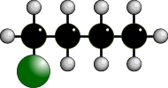
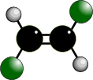
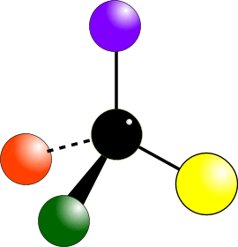
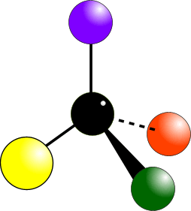
TYPES OF ISOMERISM
CHAIN ISOMERISM
STRUCTURAL ISOMERISM
POSITION ISOMERISM
Same molecular formula but different structural formulae
FUNCTIONAL GROUP ISOMERISM
GEOMETRICAL ISOMERISM
Occurs due to the restricted rotation of C=C double bonds... two forms – E and Z
STEREOISOMERISM
Same molecular formula but atoms occupy different positions in space.
OPTICAL ISOMERISM
Occurs when molecules have a chiral centre. Get two non-superimposable mirror images. Not covered in AS Chemistry.

Slide 3
STRUCTURAL ISOMERISM - INTRODUCTION
COMPOUNDS HAVE THE SAME MOLECULAR FORMULA
BUT DIFFERENT STRUCTURAL FORMULA
Chain different arrangements of the carbon skeleton
similar chemical properties
slightly different physical properties
more branching = lower boiling point

Slide 4
This alkane has four carbon atoms.

Slide 5
It is butane.

Slide 6
This alkane also has four carbon atoms but they are arranged differently from
butane.

Slide 7
It has a branch containing one carbon atom. This is called a methyl group.

Slide 8
The longest chain has three carbon atoms, like propane.

Slide 9
So the branched alkane is called methylpropane. It is a chain isomer
of butane.

Slide 10
STRUCTURAL ISOMERISM - CHAIN
caused by different arrangements of the carbon skeleton
similar chemical properties
slightly different physical properties
more branching = lower boiling point
There are two structural isomers of C₄H₁₀. One is a straight chain molecule where all the carbon atoms are in a single row. The other is a branched molecule where three carbon atoms are in a row and one carbon atom sticks out of the main chain.
BUTANE
straight chain
2-METHYLPROPANE
branched
C₄H₁₀

Slide 11
STRUCTURAL ISOMERISM - CHAIN
DIFFERENCES BETWEEN CHAIN ISOMERS
Chemical Isomers show similar chemical properties because
the same functional group is present.
Physical Properties such as density and boiling point show trends according
to the of the degree of branching
Boiling Point “straight” chain isomers have higher values than branched ones
the greater the degree of branching the lower the boiling point
branching decreases the effectiveness of intermolecular forces
less energy has to be put in to separate the molecules
- 0.5°C
straight chain
- 11.7°C
branched
greater branching
= lower boiling point

Slide 12
STRUCTURAL ISOMERISM - POSITION
COMPOUNDS HAVE THE SAME MOLECULAR FORMULA
BUT DIFFERENT STRUCTURAL FORMULA
Positional same carbon skeleton
same functional group
functional group is in a different position
similar chemical properties - slightly different physical properties

Slide 13
This is 1-bromobutane.

Slide 14
This is 1-bromobutane.

Slide 15
It has a position isomer where the bromine atom is on a different carbon atom.

Slide 16
This is 2-bromobutane. These two compounds are position isomers.

Slide 17
This is butan-1-ol.

Slide 18
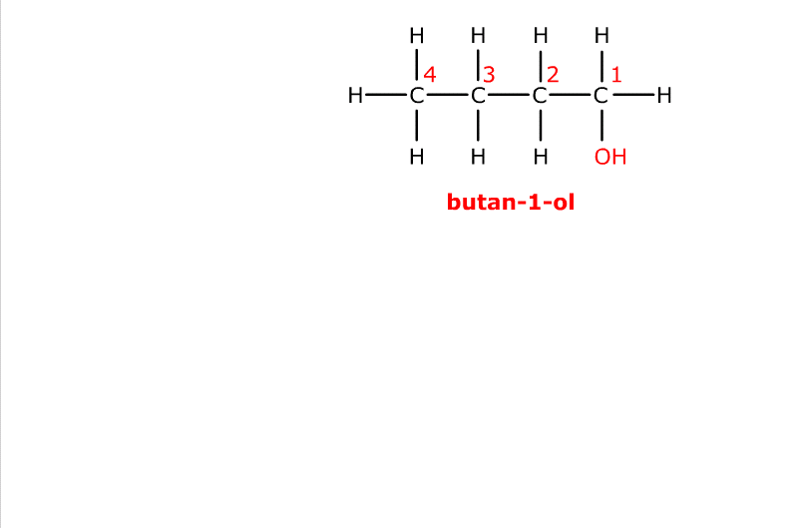
This is butan-1-ol.

Slide 19
It has a position isomer where the hydroxyl group is on a different carbon atom.

Slide 20
This is butan-2-ol. These two compounds are position isomers.

Slide 21
This is 1,2-dichlorobenzene.

Slide 22
This is 1,2-dichlorobenzene.

Slide 23
It has two position isomers where one of the chlorine atoms is on a different carbon atom.

Slide 24
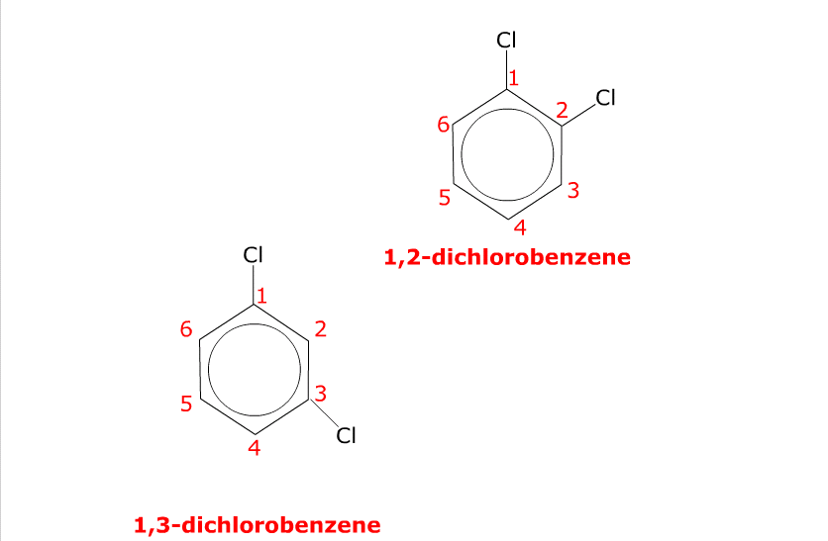
This is 1,3-dichlorobenzene.

Slide 25
There is another position isomer.

Slide 26
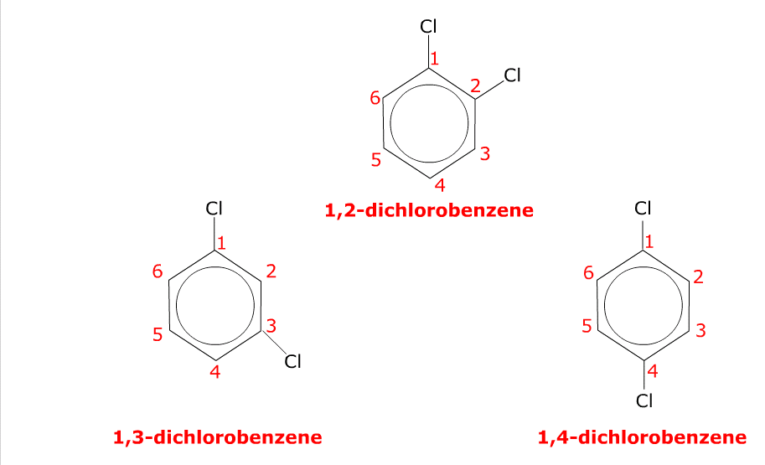
This is 1,4-dichlorobenzene. These three compounds are position isomers.

Slide 27
This is but-1-ene.

Slide 28
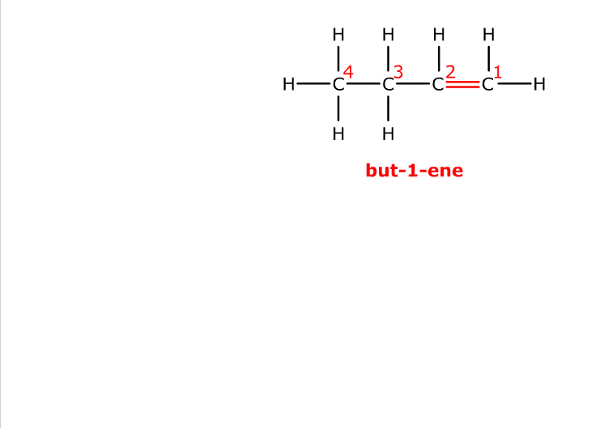
This is but-1-ene.

Slide 29
It has a position isomer where the double bond is between two different carbon atoms.

Slide 30
It has a position isomer where the double bond is between two different carbon atoms.

Slide 31
It has a position isomer where the double bond is between two different carbon atoms.

Slide 32
This is but-2-ene. These two compounds are position isomers.

Slide 33
This is but-2-ene. These two compounds are position isomers.

Slide 34
STRUCTURAL ISOMERISM - POSITIONAL
molecule has the same carbon skeleton
molecule has the same same functional group... BUT
the functional group is in a different position
have similar chemical properties / different physical properties
Example 1
POSITION OF A DOUBLE BOND IN ALKENES
1
2
2
3
PENT-1-ENE
double bond between carbons 1 and 2
PENT-2-ENE
double bond between carbons 2 and 3
There are no other isomers with five C’s in the longest chain but there are three other structural isomers with a chain of four carbons plus one in a branch.

Slide 35
STRUCTURAL ISOMERISM - POSITIONAL
molecule has the same carbon skeleton
molecule has the same same functional group... BUT
the functional group is in a different position
have similar chemical properties / different physical properties
Example 2
POSITION OF A HALOGEN IN A HALOALKANE
1
2
BUT
2
1-CHLOROBUTANE
halogen on carbon 1
2-CHLOROBUTANE
halogen on carbon 2
is NOT
3-CHLOROBUTANE
Moving the chlorine along the chain makes new isomers; the position is measured from the end nearest the functional group... the third example is 2- NOT 3-chlorobutane.
There are 2 more structural isomers of C₄H₉Cl but they have a longest chain of 3

Slide 36
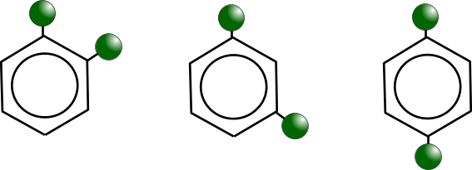
STRUCTURAL ISOMERISM - POSITIONAL
molecule has the same carbon skeleton
molecule has the same same functional group... BUT
the functional group is in a different position
have similar chemical properties / different physical properties
Example 3
RELATIVE POSITIONS ON A BENZENE RING
1,2-DICHLOROBENZENE
ortho dichlorobenzene
1,3-DICHLOROBENZENE
meta dichlorobenzene
1,4-DICHLOROBENZENE
para dichlorobenzene

Slide 37
STRUCTURAL ISOMERISM - INTRODUCTION
Functional Group different functional group
different chemical properties
different physical properties

Slide 38
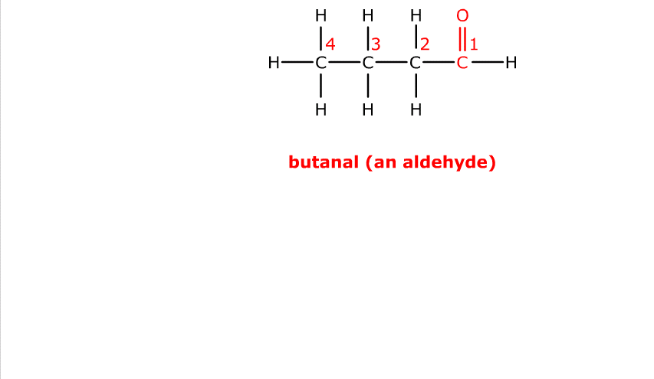
This is butanal, an aldehyde.

Slide 39
It has a functional group isomer where the carbonyl group, C=O, is on
a different carbon atom.

Slide 40
It has a functional group isomer where the carbonyl group, C=O, is on
a different carbon atom.

Slide 41
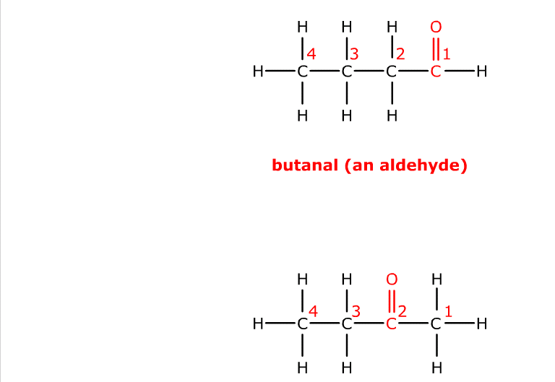
It has a functional group isomer where the carbonyl group, C=O, is on
a different carbon atom.

Slide 42
This is butanone, a ketone.
These two compounds are functional group isomers.

Slide 43
These two compounds are functional group isomers of C₄H₈O.

Slide 44
This is butan-1-ol, an alcohol.

Slide 45
It has a functional group isomer involving the oxygen atom.

Slide 46
It has a functional group isomer involving the oxygen atom.

Slide 47
This is ethoxyethane, an ether.
These two compounds are functional group isomers.

Slide 48
These two compounds are functional group isomers of C₄H₁₀O.

Slide 49
This is butene, an alkene.

Slide 50
It has a functional group isomer where the double bond is absent.

Slide 51
This is cyclobutane, a cyclic alkane.
These two compounds are functional group isomers.

Slide 52
These two compounds are functional group isomers of C₄H₈.

Slide 53
STRUCTURAL ISOMERISM – FUNCTIONAL GROUP
molecules have same molecular formula
molecules have different functional groups
molecules have different chemical properties
molecules have different physical properties
ALCOHOLS and ETHERS
ALDEHYDES and KETONES
ACIDS and ESTERS

Slide 54
STRUCTURAL ISOMERISM – FUNCTIONAL GROUP
ALCOHOLS and ETHERS
Name ETHANOL METHOXYMETHANE
Classification ALCOHOL ETHER
Functional Group R-OH R-O-R
Physical properties polar O-H bond gives rise No hydrogen bonding
to hydrogen bonding. low boiling point
get higher boiling point insoluble in water
and solubility in water
Chemical properties Lewis base Inert
Wide range of reactions

Slide 55
STRUCTURAL ISOMERISM – FUNCTIONAL GROUP
ALDEHYDES and KETONES
Name PROPANAL PROPANONE
Classification ALDEHYDE KETONE
Functional Group R-CHO R-CO-R
Physical properties polar C=O bond gives polar C=O bond gives dipole-dipole interaction dipole-dipole interaction
Chemical properties easily oxidised to acids of undergo oxidation under
same number of carbons extreme conditions only
reduced to 1° alcohols reduced to 1° alcohols

Slide 56
STRUCTURAL ISOMERISM – FUNCTIONAL GROUP
CARBOXYLIC ACIDS and ESTERS
Name PROPANOIC ACID METHYL ETHANOATE
Classification CARBOXYLIC ACID ESTER
Functional Group R-COOH R-COOR
Physical properties O-H bond gives rise No hydrogen bonding
to hydrogen bonding. insoluble in water
get higher boiling point
and solubility in water
Chemical properties acidic fairly unreactive
reacts with alcohols hydrolysed to acids

Slide 57
STRUCTURAL ISOMERISM - Summary
COMPOUNDS HAVE THE SAME MOLECULAR FORMULA
BUT DIFFERENT STRUCTURAL FORMULA
Chain different arrangements of the carbon skeleton
similar chemical properties
slightly different physical properties
more branching = lower boiling point
Positional same carbon skeleton
same functional group
functional group is in a different position
similar chemical properties - slightly different physical properties
Functional Group different functional group
different chemical properties
different physical properties
Sometimes more than one type of isomerism occurs in the same molecule.
The more carbon atoms there are, the greater the number of possible isomers

Slide 58
STEREOISOMERISM
Molecules have the SAME MOLECULAR FORMULA but the atoms are joined to each other in a DIFFERENT SPACIAL ARRANGEMENT - they occupy a different position in 3-dimensional space.
There are two types...
• GEOMETRICAL ISOMERISM (E/Z)
• OPTICAL ISOMERISM (not studied at AS)

Slide 59
GEOMETRICAL ISOMERISM IN ALKENES
Introduction
an example of stereoisomersim
found in some, but not all, alkenes
occurs due to the RESTRICTED ROTATION OF C=C bonds
get two forms....

Slide 60
Naming Geometrical Stereoisomers
Substituent groups are assigned a PRIORITY using the Cahn-Ingold-Prelog system
Essentially atoms with a higher atomic mass have the higher priority
In a tie-break you move to the next atom along in the chain.
Let us consider this example, the white sphere representing hydrogen; green, chlorine; orange, bromine; and purple, iodine.
Z
The groups/atoms with the highest priorities are on the
SAME SIDE of the double bond
E
Groups/atoms with the highest priotrities are on OPPOSITE SIDES across the double bond

Slide 61
Naming Geometrical Stereoisomers
Substituent groups are assigned a PRIORITY using the Cahn-Ingold-Prelog system
Essentially atoms with a higher atomic mass have the higher priority
In a tie-break you move to the next atom along in the chain.
Let us consider this example, the white sphere representing hydrogen; green, chlorine; orange, bromine; and purple, iodine.
Z
The groups/atoms with the highest priorities are on the
SAME SIDE of the double bond
E
Groups/atoms with the highest priotrities are on OPPOSITE SIDES across the double bond
Zame Zide
Epposite

Slide 62
cis- and trans- nomenclature
When two of the substituents are the SAME as each other the cis- trans- nomenclature can be used.....
cis
Groups/atoms are on the
SAME SIDE of the double bond
trans
Groups/atoms are on OPPOSITE SIDES across the double bond
Isomers - have different physical properties - e.g. boiling points, density
- have similar chemical properties - in most cases

Slide 63
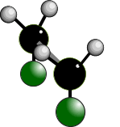
GEOMETRICAL ISOMERISM
RESTRICTED ROTATION OF C=C BONDS
Single covalent bonds can easily rotate. What appears to be a different structure in an alkane is not. Due to the way structures are written out, they are the same.
ALL THESE STRUCTURES ARE THE SAME BECAUSE C-C BONDS HAVE ‘FREE’ ROTATION

Slide 64
GEOMETRICAL ISOMERISM
RESTRICTED ROTATION OF C=C BONDS
C=C bonds have restricted rotation so the groups on either end of the bond are ‘frozen’ in one position; it isn’t easy to flip between the two.
This produces two possibilities. The two structures cannot interchange easily so the atoms in the two molecules occupy different positions in space.

Slide 65
GEOMETRICAL ISOMERISM
How to tell if it exists
Two different atoms/groups attached
Two different atoms/groups attached
✓
GEOMETRICAL ISOMERISM
Two similar atoms/groups attached
Two similar atoms/groups attached

Once you get two similar atoms/groups attached to one end of a C=C, you cannot have geometrical isomerism
Two similar atoms/groups attached
Two different atoms/groups attached

Two different atoms/groups attached
Two different atoms/groups attached
✓
GEOMETRICAL ISOMERISM

Slide 66
GEOMETRICAL ISOMERISM
Isomerism in butene
There are 3 structural isomers of C₄H₈ that are alkenes*. Of these ONLY ONE exhibits geometrical isomerism.
BUT-1-ENE
cis BUT-2-ENE
trans BUT-2-ENE
2-METHYLPROPENE
* YOU CAN GET ALKANES WITH FORMULA C₄H₈ IF THE CARBON ATOMS ARE IN A RING

