Slide 1
ANKARA UNIVERSITY
DEPARTMENT OF ENERGY ENGINEERING
NUMERICAL METHODS
INSTRUCTOR
DR. ÖZGÜR SELİMOĞLU

Slide 2
CONTENTS
Introduction To Numerical Methods
Python Software
Mean Error in Numerical Method

Slide 3
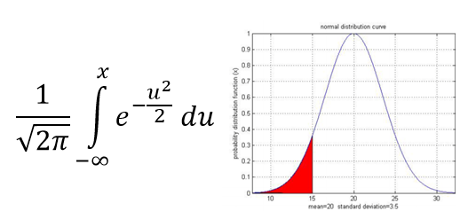
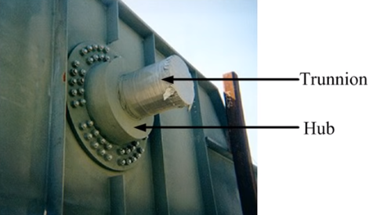
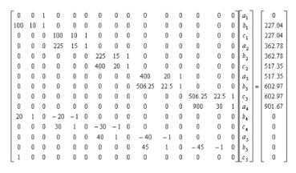
INTRODUCTION TO NUMERICAL METHODS
Why use The Numerical Methods ?
To solve problems that cannot be solved exactly
To solve problems that are intractable to solve exactly ! What if you had to solve a set of 1000 simultaneous linear equations with 1000 unknowns ?
To learn approximately how to solve mathematical models.

Slide 4
HOW DO WE SOLVE AN ENGINEERING PROBLEM ?
Problem Description
Mathematical Model
Solution of Mathematical Model
Using the Solution

Slide 5
https://youtu.be/We6zrqc9e18

Slide 6
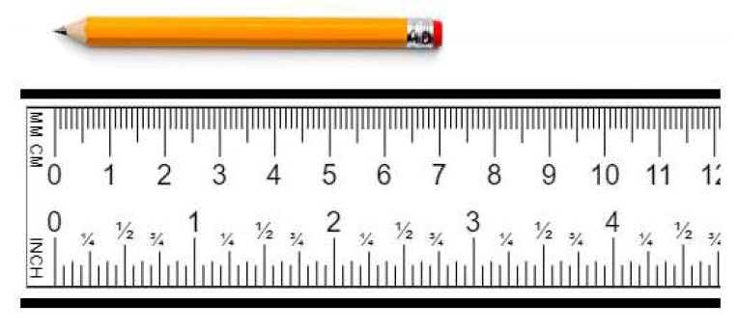
APROXIMATIONS AND ROUND-OFF ERROR
Significant Figures
The concept of significant figures has been developed to officially determine the reliability of
numerical value. The important digits of a number are the numbers that can be used safely. The
significant digits of numbers correspond to a certain number of digits, plus a predicted number.
It is conventional to adjust the estimated figure in half of the smallest scale section in the measurement device.
We can say that the length of the pencil is equal to 71 mm, but not 71.15 according to the ruler
we used to measure the pencil.

Slide 7
Accuracy And Precision
Errors in both calculations and measurements can be characterized in terms of accuracy and precision.
Accuracy shows how well a calculated or measured value is in line with the true value.
Precision means how closely the individual calculated or measured values are close to each other.
Example: Three groups of students measure the length of the pencil as follows:
Group 1: 13.5: 13.3; 13.6; 13.7 (Accurate and precise)
Group 2: 16.4; 16.3; 16.7; 16.5 (Precise, but inaccurate)
Group 3: 10.7; 13.8; 17.1; 9.8 (Inaccurate and imprecise)
According to the measurements of the student groups; Group 1 took an accurate and precise
measurement; Group 2 took a precise, but inaccurate measurement; and the last group took an inaccurate and imprecise measurement.

Slide 8
MEASURING ERRORS
True Error
Defined as the difference between the true value in a calculation and the approximate value found using a numerical method etc.
Relative True Error = Defined as the ratio between the true error, and the true value.

Slide 10
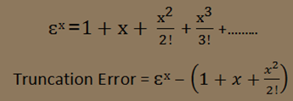
Error Types
Round off errors= Arise from the fact that computers can only represent/store quantities with a finite number of digits.
π=3.14159265358979.........the omission of the remaining digits by the computer is called Round-off error.
Truncation errors= Result from applying numerical methods which employ approximations to represent exact mathematical operations and quantities.
Taking only a few terms of a series to e^{x}

Slide 11
Taylor Series
Function of a Single Variable=Taylor series expansion of a function f(x) about the point x = a is the infinite series
In the special case a = 0 the series is also known as the MacLaurin series. It can be shown that Taylor series expansion is unique in the sense that no two functions have identical Taylor series.
A Taylor series is meaningful only if all the derivatives of f(x) exist at x = a and the series converges. In general, convergence occurs only if x is sufficiently close to a; that is, if |x − a| ≤ ε, where ε is called the radius of convergence. In many cases ε is infinite.

Slide 13
https://www.youtube.com/watch?v=jlaDfg8qDdQ

Slide 14
https://www.youtube.com/watch?v=3d6DsjIBzJ4

Slide 15
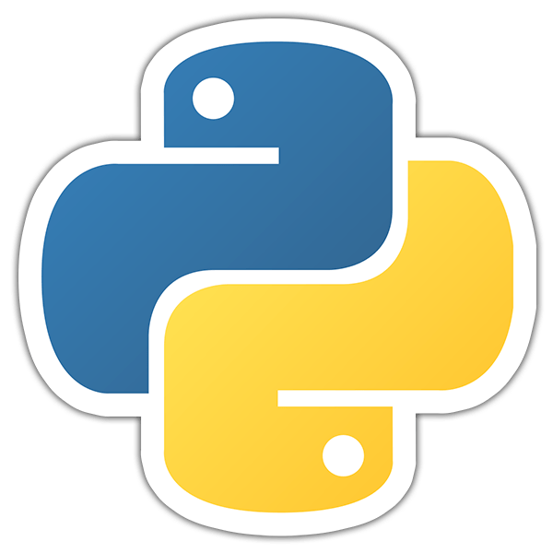
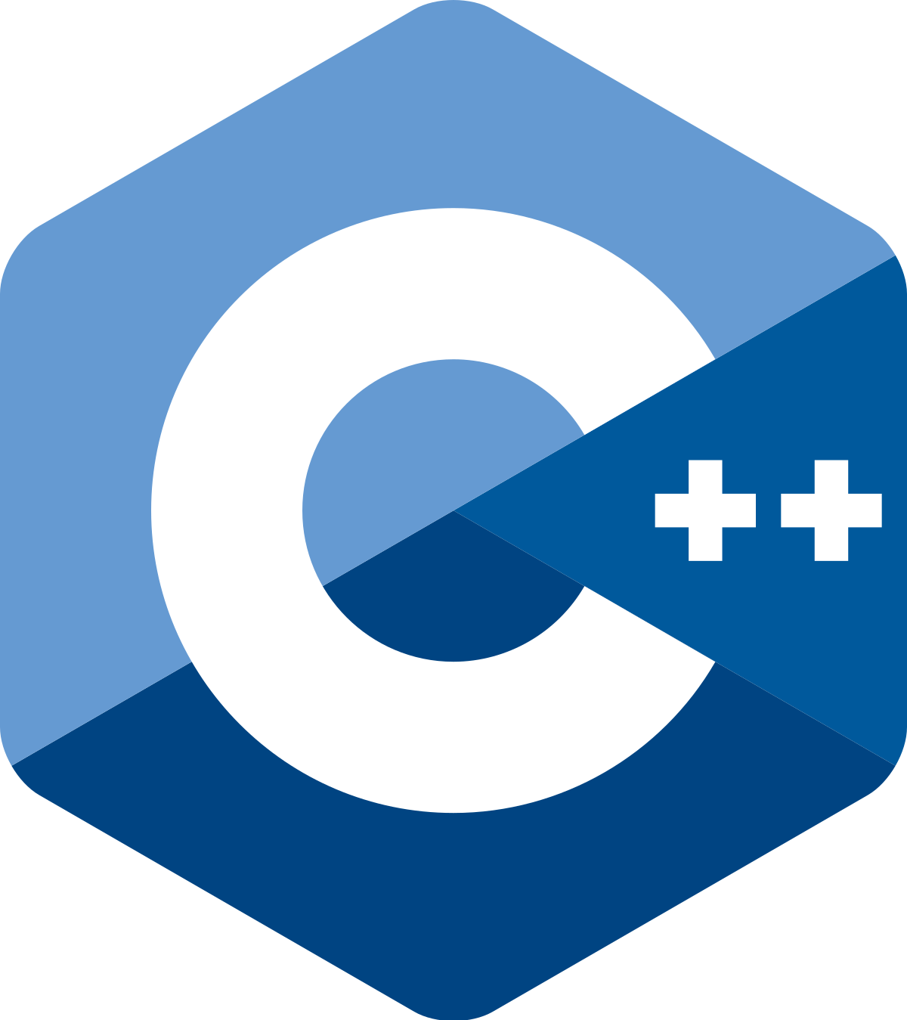
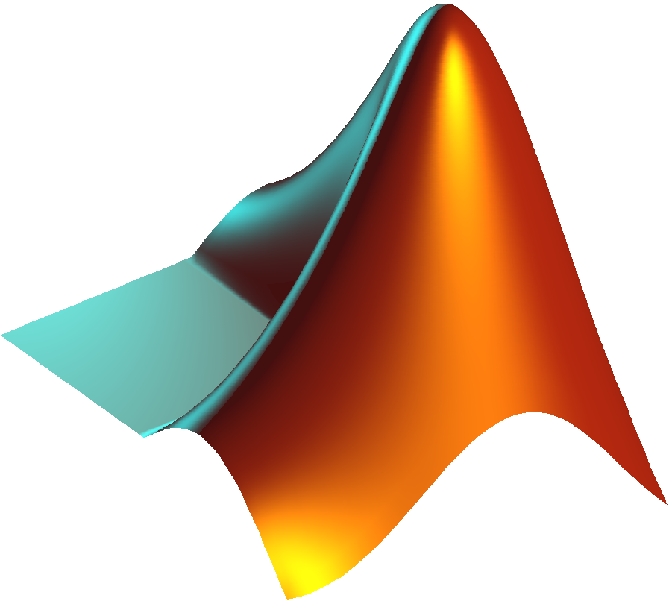
The Fastest Of Programs That Facilitate These Complex Problems
These programs differ according to their level and working principles.
This differences affects performance and usage scope.

Slide 16
PYTHON SOFTWARE
Why Python?
Python is a high-level programming language
Open source and community driven
Python is also called as Interpreted language
Dynamic typed - Source can be compiled or run just in time
Python's run model: source code you type is translated to byte code, which is run by the Python Virtual Machine. After your code is automatically compiled, it is interpreted.

Slide 17
What can I do with Python ?
System Programming
Game Programming
Network Programming
Database Application
Web Programming
Application Development
Artificial İntelligence
Solve Mathematical Equation

Slide 18
https://www.youtube.com/watch?v=hxGB7LU4i1I

Slide 19
https://www.youtube.com/watch?v=Y8Tko2YC5hA

Slide 20
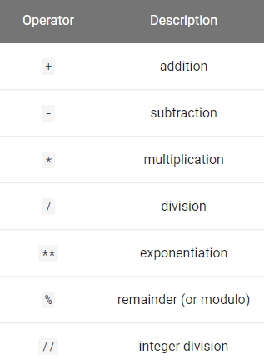
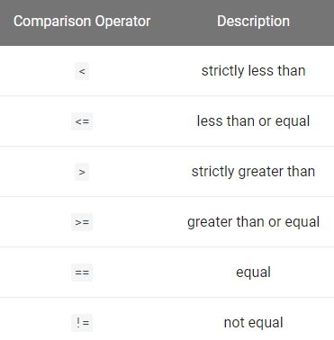
Arithmetic Operators
The syntax for arithmetic operators in Python are:
Comparison Operators
The result is a boolean value True or False.
MATH OPERATOR IN PYTHON

Slide 21
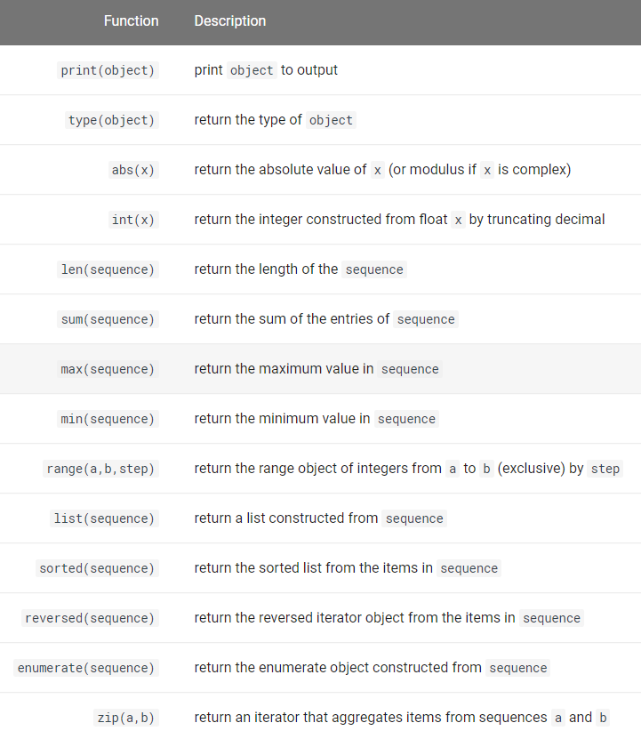
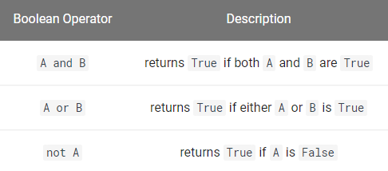
Built-in Functions
Functions give us an efficient way to save and reuse a block of code over and over again with different input values. In this section, we summarize the built-in functions in the standard Python library and then we discuss how to define our own functions.
Boolean Operators
We combine logical expressions using boolean operators; and, or and not.

Slide 22
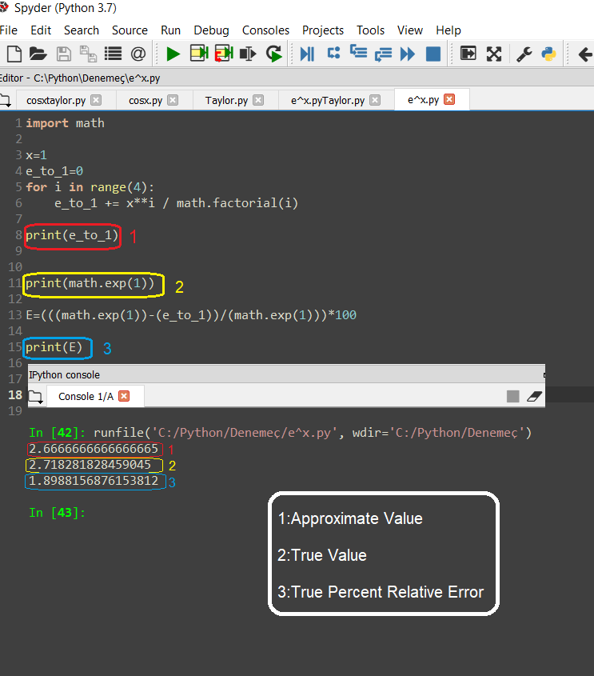
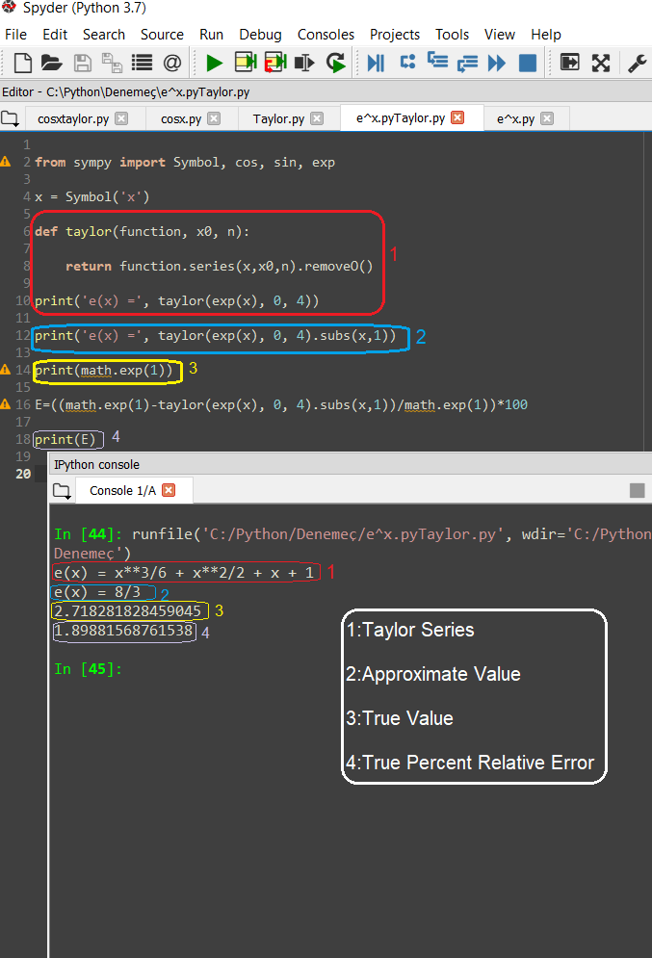
Example = Use the first 4 terms of the Taylor series expansion of f(x)=e^{x} about MacLourin series and calculate true percent relative error in x=1.
Solution 1= Range solution Solution 2= Taylor series solution
Notes:
*** Solution -2 çalışıyor mu? Kontrol edelim.

Slide 23
REFERENCES
S.C. Chapra and R.P. Canale, “Numerical Methods for Engineers”, 6th ed., McGraw-Hill,, NY, 2010
Richard L. Burden and J. Douglas Faires, “Numerical Analysis”, 9th ed., Brooks/Cole, Cengage Learning, Canada.
Jaan Kiusalaas, “Numerical Methods in Engineering with Python 3”,3rd Edition, Cambridge, NY, 2013
www.python.org

