Slide 1
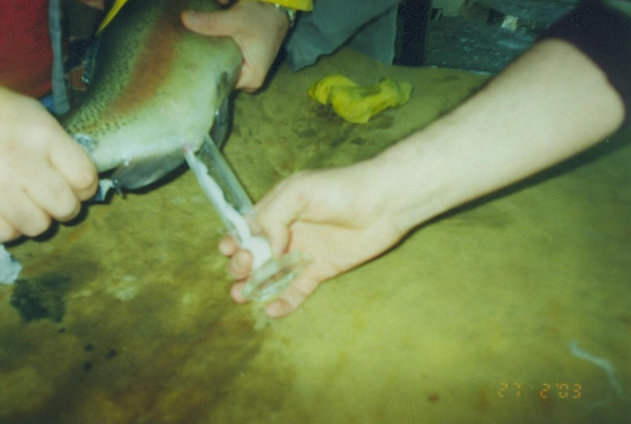
ARTIFICIAL PROPAGATION

Slide 2
SEMEN COLLECTION
ABDOMINAL MASSAGE
COLLECTION by AIR PRESSURE
VACUUM PUMP
OPERATIVE
Males may be stripped for milt several times with 3 or 4 day intervals between stripping.
Fish are fasted 48 h prior to semen collection.
Their abdomens and urogenital papillas are dried before stripping.
Samples contaminated with faecal material or urine are discarded
Have to avoid water contamination
Adult males aging between 2 and 5 years old must used because of semen quality.
Sperm, extenders, glassware, and equipment coming into contact with sperm should kept on ice to avoid temperature shock during handling.

Slide 3
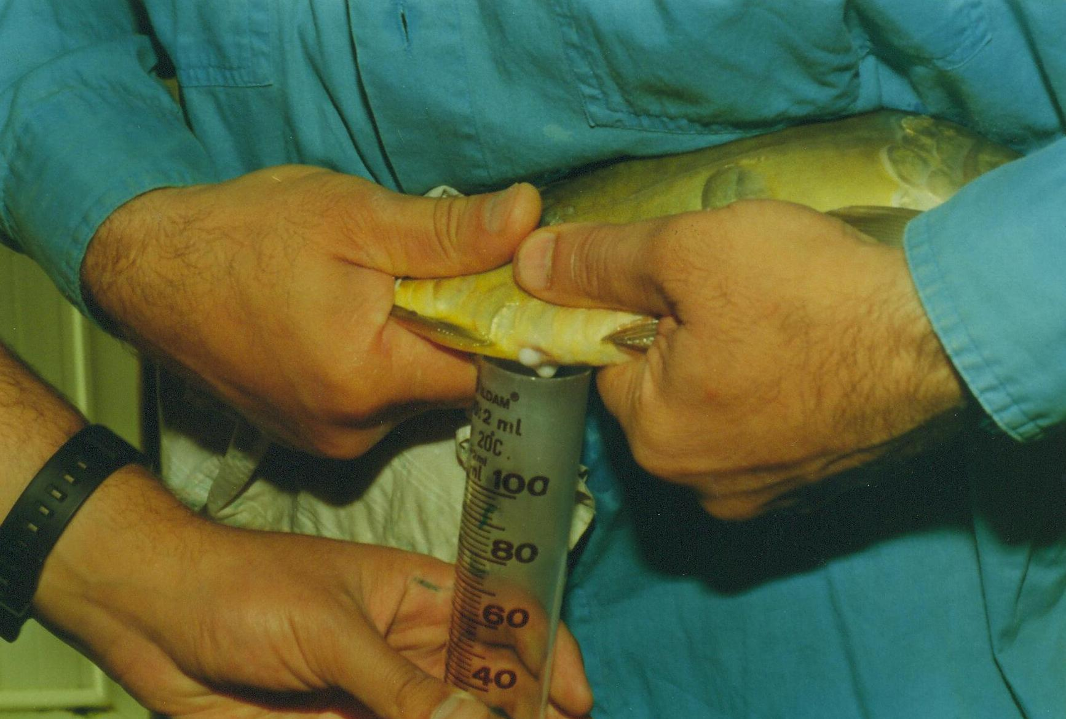
SEMEN COLLECTION FROM CARP
Semen could be collected from anesthetized (0.1 g/l MS 222) males by manual abdominal stripping
12 h after a single injection of 2 mg/kg of carp pituitary extract (CPE) or 1000 IU HCG at 20-22 °C water temperature.
Anaesthesia
Chlorbutanol
Phenoxyethanol
Tricaine methane sulphonat
(MS-222, 15-300 ppm in water)

Slide 4
SPERMATOLOGICAL EVALUATIONS
COLOUR, VISCOSITY (White-cream, viscous)
VOLUME (ML)
CONCENTRATION (x10⁹ sp/ml)
Hemacytometer
Spectrophotometer
MOTILITY (cold table, dilution rate, osmotic pressure)
In numerous fish species with external fertilization, the duration of sperm motility is very short (30-60 sec).
The highest motility of the sperm is observed at the height of the breeding season.
Sperm motility is an important component of a insemination and preservation program in order to prevent poor quality semen samples prior to freezing and to estimate the fertility of the stored sperm after thawing.
Scala method (+, -) Subjective or visual (%) CASA (%)

Slide 5
SEMEN PRESERVATION
Several methods have been described for the short-term storage and cryopreservation of trout and carp semen.
Differences in diluents, cryoprotectants and freezing techniques make it difficult to get variable estimations of the efficiency of various procedures. (A simple, easy and applicable method is a effective method)
DILUTION
TYPES OF EXTENDERS
Sugar-based (0.3 M glucose, 0.6 M sucrose), ionic, complex, seminal plasma mimicking
Additives
External cryoprotectants (egg yolk, BSA)
Internal cryoprotectants (DMSO, DMA, Glycerol) Mostly dimethyl sulfoxide is used as the permeating cryoprotective agent for cryopreservation, but other cryoprotectants, like dimethyl acetamide (DMA), ethylene glycol, glycerol and DMSO-glycerol mixture, are also efficient.
Antioxydants (Vitamin A, E, GSH, Taurine etc.)

Slide 6
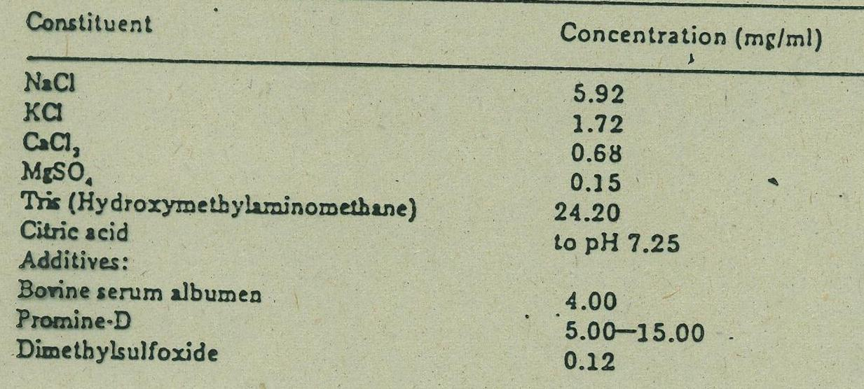
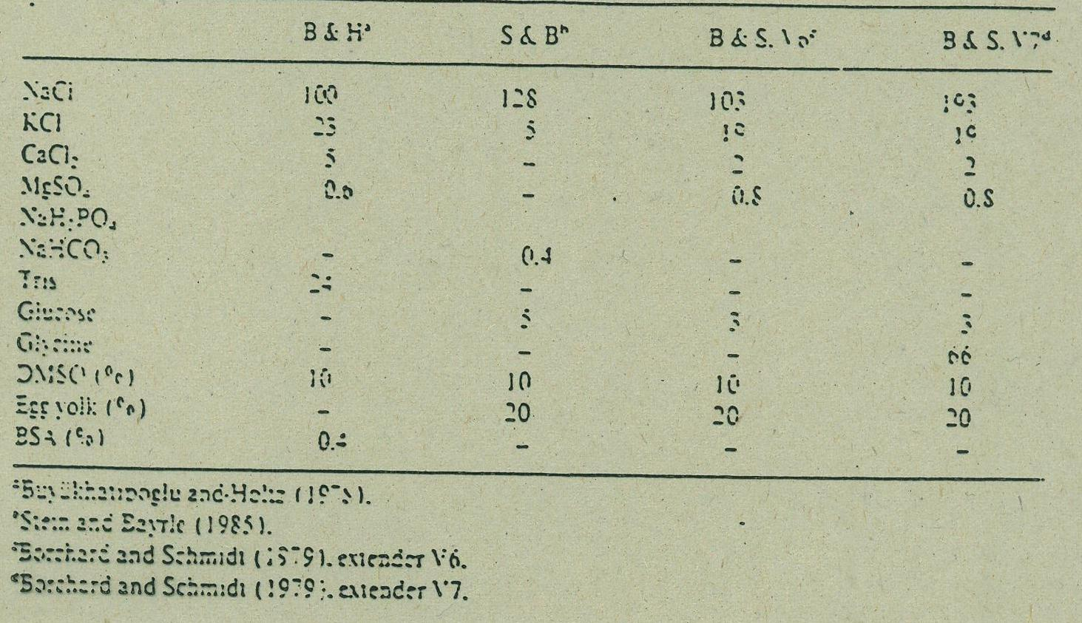
DILUTION RATE
(1/1, 1/2, 1/3): Lower dilution rates should be used
When diluting the semen
Attention !
Osmotic pressure (250-300 mOsm)
pH (7-9)
Temperature (Environment, extender, semen)
EQUILIBRATION ? Conflicted subject !
Freezing is applied immediately after dilution of the spermatozoa or after an equilibration time.
Immediate freezing reduces the toxic effects of cryoprotectants, and equilibration increases the rate of penetration.

Slide 7
CRYOPRESERVATION
The spermatozoa diluted with extenders are usually frozen as pellets on dry ice, they can also be frozen straws or ampoules in liquid nitrogen vapour.
PELLET
Dry ice (Solid CO₂)
for 5 min at -79ºC
STRAW (Pailette)
LN vapour
above 3-5 cm for 10 mins at -120ºC
Automatic freezer
can apply different protocols (from 4ºC
-35ºC / min)

Slide 8
THAWING
PELLETS THAWING
Thawing in own extender
Thawing in activation solution (A solution which is under 100 mOsm)
(hatchery water, 0.3 M NaCl, 3 g of urea, 4 g of NaCl in 1 l of water).
STRAW THAWING
In a water bath
Trout
At 30^{O}C for 15-20 sec (0.5 ml straw)
At 35-40ºC for 5 sec
At 5ºC for 90 sec
Carp
At 30 °C for 30 s
At 35-40ºC for 10-15 sec
*FINAL TEMPERATURE MUST BE 5-10 ^{O}C FOR TROUT SEMEN

