Slide 1
COM337 Computer Graphics
Geometric Transformations
1/2

Slide 2
Change of Coordinate Systems
In our examples, we mostly used a single coordinate system (origin and x, y, z directions/vectors)
Only in an interaction example, we talked about a different coordinate system (mouse coordinates)
Frequently, we use different reference frames for coordinates. For example,
an object can be specified using a coordinate system that makes specification easy (object or modelling coordinates);
different objects are brought together in a common system when setting up a scene (world coordinates);
at some point, we calculate everything with respect to the camera’s reference frame (camera or eye coordinates)
…

Slide 3
Geometric Transformations
Translation
Rotation
Scaling
Reflection
Shearing

Slide 4
Different Vector Bases
When we write ${\left(x, y, z\right)}^{T}$ to represent a vector, we are actually using 3 orthogonal vectors as basis
${\left(1,0,0\right)}^{T}$, ${\left(0,1,0\right)}^{T}$, ${\left(0,0,1\right)}^{T}$
Imagine that we have two different bases $\left(v_{1},v_{2},v_{3}\right)$ and $\left(u_{1},u_{2},u_{3}\right)$
Each basis vector $u_{i}$ can be expressed using $v_{i}$ as follows
$$u_{1}=γ_{11}v_{1}+γ_{12}v_{2}+γ_{13}v_{3}$$
$$u_{2}=γ_{21}v_{1}+γ_{22}v_{2}+γ_{23}v_{3}$$
$$u_{3}=γ_{31}v_{1}+γ_{32}v_{2}+γ_{33}v_{3}$$
where 9 $γ_{ij}$ are scalar components

Slide 5
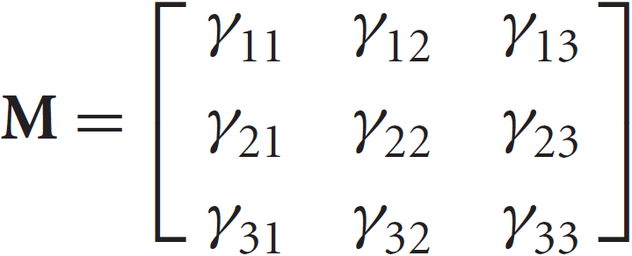
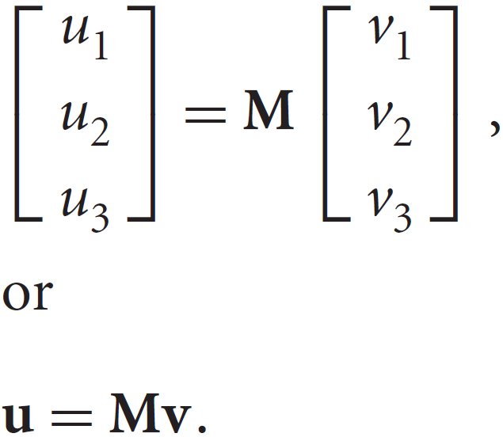
Different Vector Bases
If we write these as a 3x3 matrix
we can write the equations as

Slide 6
Different Vector Bases
Matrix $M$ contains the information to go from a representation in one basis to the other
If $a=\left(α_{1},α_{2},α_{3}\right)$ is the representation of vector $w$ with respect to $\left(v_{1},v_{2},v_{3}\right)$, and $b=\left(β_{1},β_{2},β_{3}\right)$ is the same vector w.r.t. $\left(u_{1},u_{2},u_{3}\right)$, we can easily find that
$$a=M^{T}b$$
and
$$b={\left(M^{T}\right)}^{−1}a$$

Slide 7
Example
Suppose we have a vector $a={\left(1,2,3\right)}^{T}$ in some basis
Now suppose we want to find coordinates of the same position with new axes $x′$, $y′$, and $z′$ where
$$x^{′}=\left(1,1,0\right)$$
$$y^{′}=\left(−1,1,0\right)$$
$$z^{′}=z$$
$$y$$
$$x′$$
$$y′$$
$$x$$
$$z^{′}=z$$

Slide 8
Example
Matrix $M$ is
$$M=\left[\begin{matrix}1 & 1 & 0 \\ −1 & 1 & 0 \\ 0 & 0 & 1\end{matrix}\right]$$
so,
$${\left(M^{T}\right)}^{−1}={\left[\begin{matrix}1 & −1 & 0 \\ 1 & 1 & 0 \\ 0 & 0 & 1\end{matrix}\right]}^{−1}=\left[\begin{matrix}0.5 & 0.5 & 0 \\ −0.5 & 0.5 & 0 \\ 0 & 0 & 1\end{matrix}\right]$$
In the new system, vector $a={\left(1,2,3\right)}^{T}$ is
$${\left(M^{T}\right)}^{−1}a=\left[\begin{matrix}0.5 & 0.5 & 0 \\ −0.5 & 0.5 & 0 \\ 0 & 0 & 1\end{matrix}\right]\left[\begin{matrix}1 \\ 2 \\ 3\end{matrix}\right]=\left[\begin{matrix}1.5 \\ 0.5 \\ 3\end{matrix}\right]$$

Slide 9
Different Vector Bases
We can use basis change (3x3 matrices) to represent rotation and scaling
But it leaves the origin unchanged, so, it cannot be used to represent translation

Slide 10
2D Translations
P’
P

Slide 11
2D Scaling from the origin.
P’
P

Slide 12
2D Rotation about the origin.
y
θ
P’(x’,y’)
P(x,y)
r
r
x

Slide 13
2D Rotation about the origin.
y
P’(x’,y’)
P(x,y)
r
θ
y
φ
r
x
x

Slide 14
2D Rotation about the origin.
y
P’(x’,y’)
P(x,y)
r
θ
y
φ
r
x
x

Slide 15
2D Rotation about the origin.
Substituting for r :
Gives us :

Slide 16
2D Rotation about the origin.
Rewriting in matrix form gives us :

Slide 17
Transformations.
Translation.
P′=T + P
Scale
P′=S ⋅ P
Rotation
P′=R ⋅ P
We would like all transformations to be multiplications so we can concatenate them ⇒ express points in homogenous coordinates.

Slide 18
Homogeneous coordinates
Add an extra coordinate, W, to a point.
P(x,y,W).
Two sets of homogeneous coordinates represent the same point if they are a multiple of each other.
(2,5,3) and (4,10,6) represent the same point.
At least one component must be non-zero ⇒ (0,0,0) is not defined.
If W≠ 0 , divide by it to get Cartesian coordinates of point (x/W,y/W,1).
If W=0, point is said to be at infinity.

Slide 19
Homogeneous coordinates
If we represent (x,y,W) in 3-space, all triples representing the same point describe a line passing through the origin.
If we homogenize the point, we get a point of form (x,y,1)
homogenised points form a plane at W=1.
W
P
W=1 plane
X
Y

Slide 20
Translation using homogenised coordinates
Transformation matrices for 2D translation are now 3x3.

Slide 21
Concatenation.
We perform 2 translations on the same point:

Slide 22
Concatenation.
Matrix product is variously referred to as compounding, concatenation, or composition

Slide 23
Concatenation.
Matrix product is variously referred to as compounding, concatenation, or composition.
This single matrix is called the Coordinate Transformation Matrix or CTM.

Slide 24
Properties of translations.
Note : 3. translation matrices are commutative.

Slide 25
Homogeneous form of scale.
Recall the (x,y) form of Scale :
In homogeneous coordinates :

Slide 26
Concatenation of scales.

Slide 27
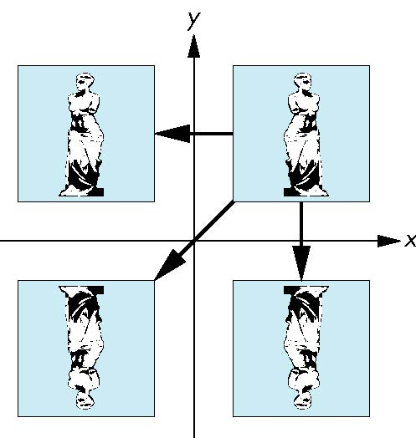
Reflection
corresponds to negative scale factors
s_{x} = -1 s_{y} = 1
original
s_{x} = -1 s_{y} = -1
s_{x} = 1 s_{y} = -1

Slide 28
Homogeneous form of rotation.
i.e. the inverse is the transpose

Slide 29
Orthogonality of rotation matrices.

Slide 30
Other properties of rotation.

Slide 32
2D Composite Transformations
Combine transformations of different type
translate, rotate, translate
translate, scale, translate
translate, reflect, translate
Use to rotate or scale an object w.r.t. a point that is not the origin
Implement by multiplication of the corresponding homogeneous matrices

Slide 33
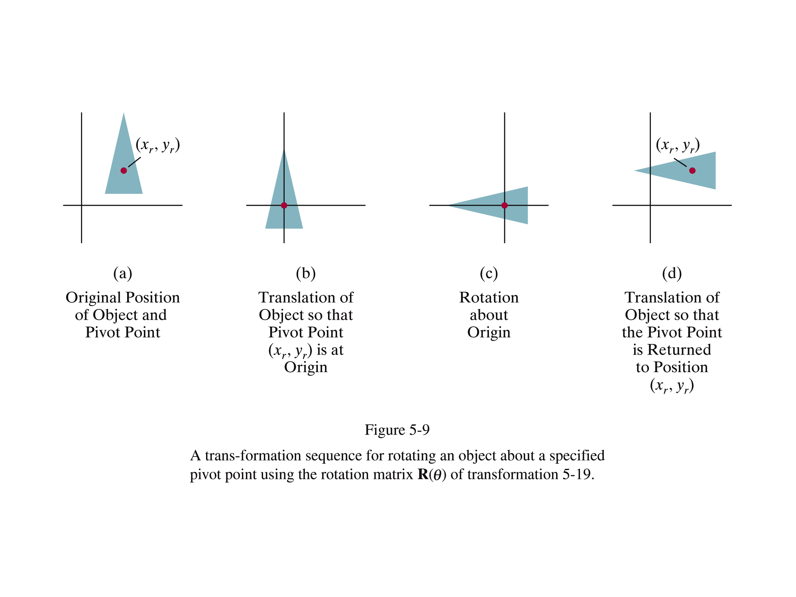

Slide 35
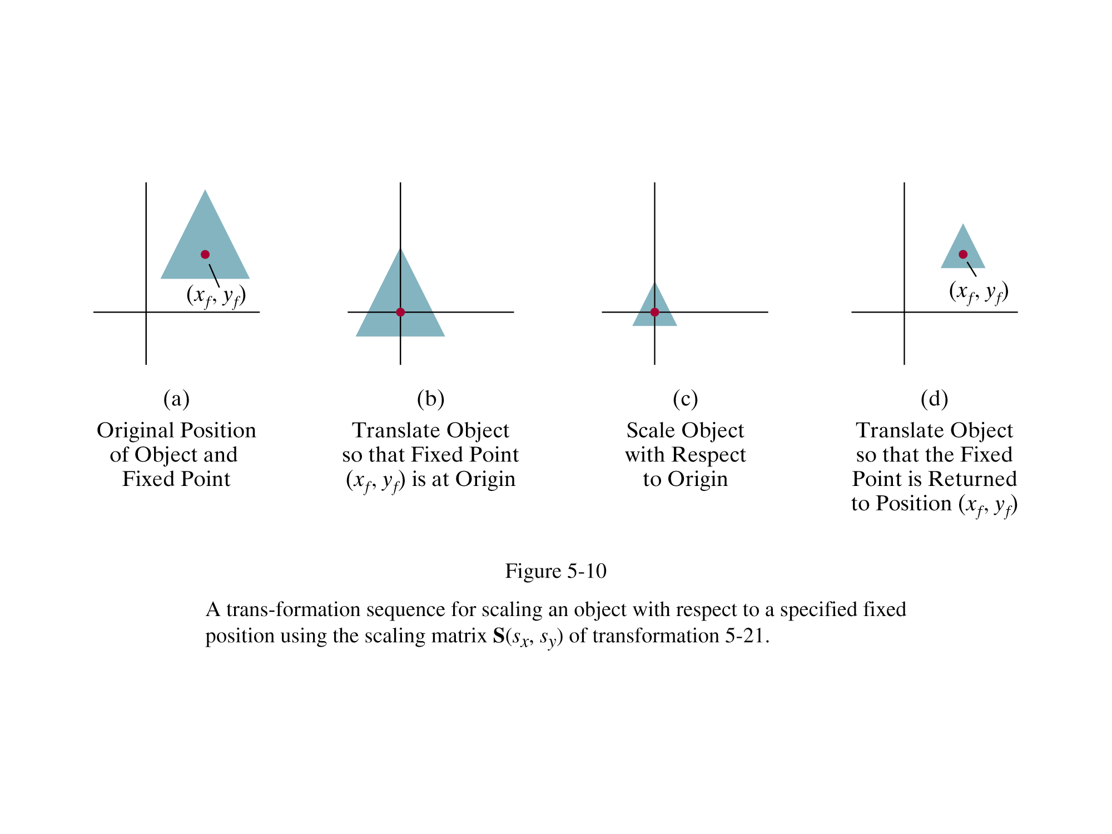

Slide 37
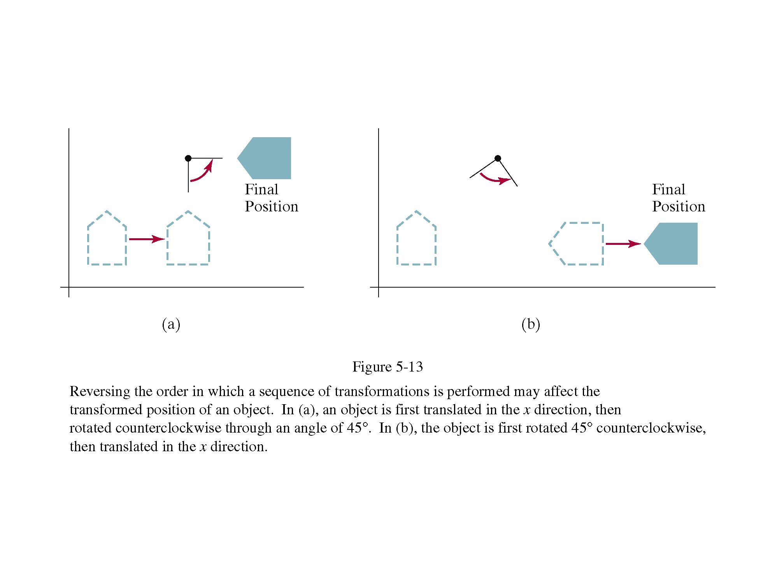

Slide 38
reflection in x and y axes
reflection in origin

Slide 39
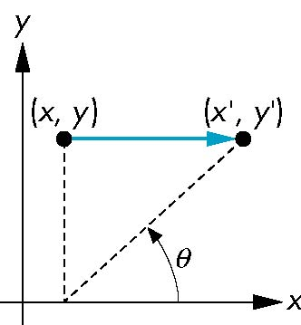
Sh_{x} gives the slope of a vertical line after shear, as dx/dy

Slide 40
Example 1
S

Slide 41
Example 1
S

Slide 42
Example 1
T(S)

Slide 43
Example 2
S

Slide 44
Example 2
S

Slide 45
Example 2
T(S)

Slide 46
Summary
Shear in x:
Shear in y:

Slide 47
Double Shear: not commutative!

