Slide 1
Al-Quds

Slide 3
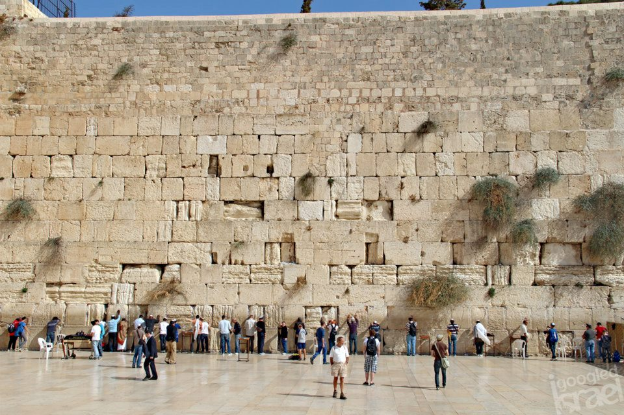
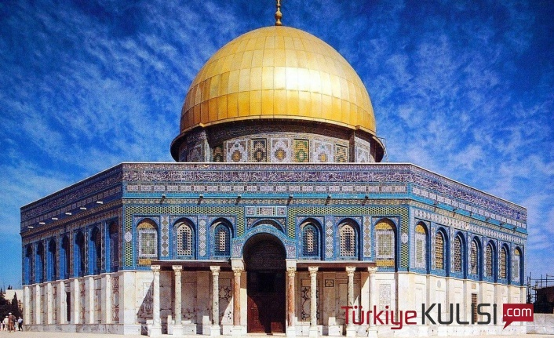
Famous Buildings in Al-Quds
WESTERN WALL Dome Of The Rock (TEMPLE MOUNT )
( WAILING WALL)

Slide 5
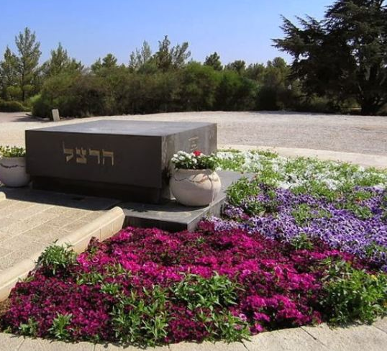
Theodore Herzl's Tomb

Slide 7
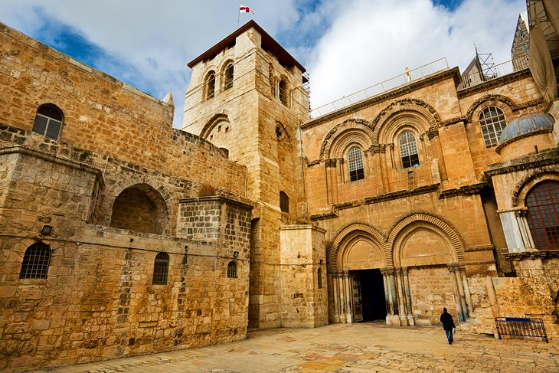

Slide 8
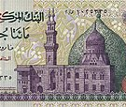
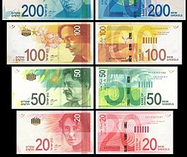
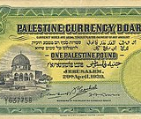
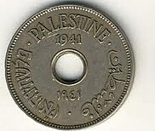
Geographical Features Of Al-Quds COUNRTY: PALESTINE REGION: MIDDLE EAST CONTINENT:ASIA LANGUAGE:ARABIC AND HEBREW CURRENCY: EGYPTIAN POUND(EGP),PALESTIAN POUND, ISREALI NEW SHEKEL an pound

Slide 9
Geographical Features Of Al-Quds
ECONOMY:A major source of livelihood in Jerusalem is government and public service employment. Since 1967 business activity and investment in the city have been stimulated by the housing boom and the ever-increasing influx of pilgrims and tourists—except in periods of high political tension and violence, such as the two Palestinian uprisings known as intifadahs (1987–93 and 2000–05) and when conflicts escalate along the Lebanese and Gazan borders.
CLIMATE:Summers are dry and hot in Jerusalem. The rain falls only in December, January and February. The average annual rainfall is around 1000 mm. The annual average temperature is between 24-32 ° C in summer and between 7 and 16 ° C in winter.

Slide 10
