Slide 1
Atomic and Ionic Arrangements
OBJECTIVES
Miller indices for directions and planes within a unit cell
X-ray Diffraction

Slide 2
Unit Cell Geometry
Miller indices: can be used to describe crystallographic directions and planes.
Directions in the Unit Cell
Certain direction in the unit cell are of particular importance
Metals deform in closely packed directions
Repeat distance: The distance between lattice points along the direction.
Linear density: The number of lattice points per unit length along a direction.
Packing fraction: The fraction of a direction (linear-packing fraction) or a plane (planar-packing factor) that is covered by atoms or ions.

Slide 3
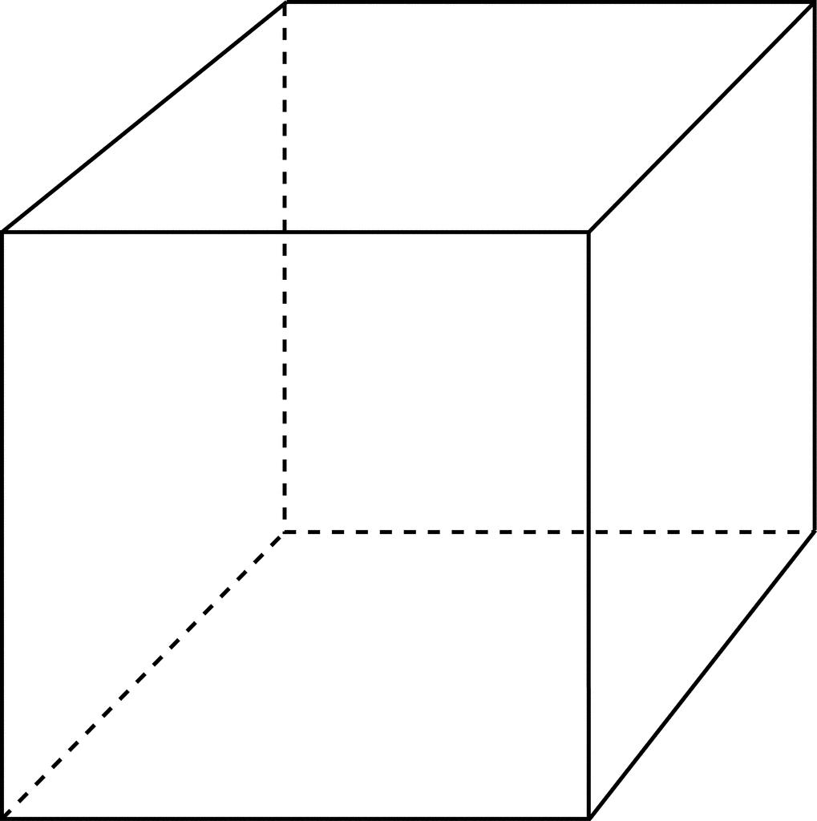
Unit Cell Geometry
Points
Every points within a unit cell can be identified in terms of the coefficients along the three coordinate axes.
The origin is 0,0,0
The center of UC at $\frac{a}{2},$ $\frac{b}{2}$, $\frac{c}{2}$ $\frac{1}{2}$ ,$\frac{1}{2}$, $\frac{1}{2}$
indices
z
Point Number | Point Coordinates
1 | 000
2 | 100
3 | 110
4 | 010
5 | ½ ½ ½
6 | 001
7 | 101
8 | 111
9 | 011
6
9
7
8
5
1
4
y
2
3
x
BCC

Slide 4
Crystallographic Directions
Many properties are directional.
A direction is defined as a line between two points/vector.
Subtract the tail from the head and reduce to the smallest integer values
The origin is 0,0,0
Miller indices are [uvw]
Use upper bar for negative values
All parallel directions use the same label and index
z
[001]
[111]
y
[110]
x

Slide 5
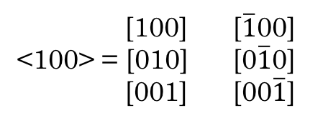
Family of Directions
A group of directions that are equivalent through symmetry.
Non-parallel directions with different indices
Use a special brackets < > to show the collection of directions.
z
[100] [$\overline{1}$00]
<100> = [010] [0$\overline{1}$0]
[001] [00$\overline{1}$]
y
x

Slide 6

Crystal Planes
A crystal contains planes of atoms.
Some properties of materials are determined by specific planes in the crystals.
Miller indices are (hkl), the reciprocals of the three intercepts, cleared of fractions and common multipliers.
z
Intersections
x = $∞$
y = 1
z = 1/2
($∞$ 1 ½)
Reciprocals
(012)
y
x

Slide 7
Crystal Planes
Close-packed directions and planes
Structure | Directions | Planes
SC | <100> | None
BCC | <111> | None
FCC | <110> | {111}
HCP | <100>, <110> | (0001), (0002)
Interplanar Spacing (d_{hkl}) is the distance between two adjacent parallel planes of atoms with the same Miller indices.
Cubic Materials
$$d_{hkl}= \frac{a_{o}}{\sqrt{h^{2}+k^{2}+l^{2}}}$$
a_{o} is the lattice parameter
h,k,l are the Miller indices

Slide 8
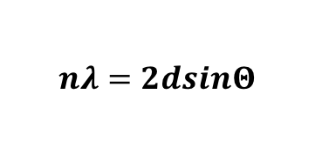
Diffraction Techniques for Crystal Structure Characterization
Bragg's Law describes the interactions of x-rays with crystalline solids
$$nλ=2dsinΘ$$
$λ$ : wavelength of the x-rays
$Θ$: angle between the incident rays and surface of the crystals
d: interlayer spacing
n: 1,2,3
Electron Diffraction and Microscopy

Slide 9
References
Donald R. Askeland, Pradeep P. Fulay, Wendelin J. Wright, The Science and Engineering of Materials, Sixth Edition
William D. Callister, David G. Rethwisch, Materials Science and Engineering, Eighth Edition, Wiley, 2011.

