Slide 1
Evrim, Kurumlar ve İktisat Kuramı Göç
Altug Yalcintas
Ankara University
altug.yalcintas@politics.ankara.edu.tr

Slide 2
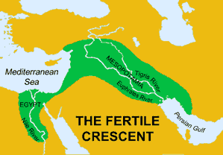
Migration as a Mechanism of Survival
Previously in this course:
Diffusion of Farming:
About 10,000 years ago,
After dramatic changes in the climate
People started to migrate
Mostly following the East – West axis
Source: Eupedia.com

Slide 3
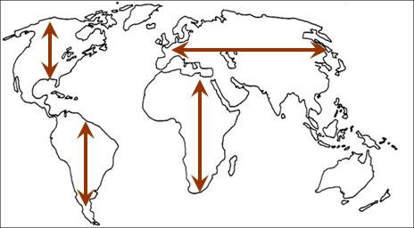
Migration as a Mechanism of Survival
Previously in this course:
Migrating in East-West axis (latitude) means:
Similar climate, similar environmental
conditions (plants and animals)
Continuation of farming activity

Slide 4
Migration as a Mechanism of Survival
Previously in this course:
Bob Marley «Buffalo Soldier»
«… Stolen from Africa,
Going to America
Fighting on arrival
Fighting for survival …»

Slide 5
Migration as a Mechanism of Survival
How many of you were not born in Ankara (or Turkey)?
How many of your parents were not born in Ankara (or Turkey)?
How many of your grand parents were not born in Ankara (or Turkey)?
How much do you know about your ancestors?
Are there migrants in your family?

Slide 6
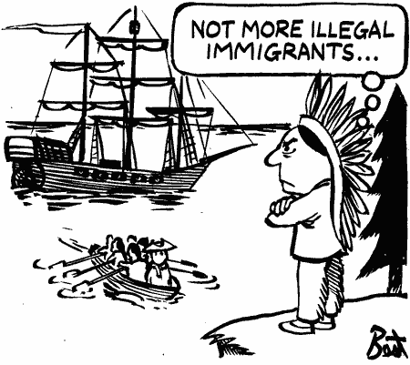
Migration as a Mechanism of Survival
A definition of politico-legal migration:
Moving of peoples from one place to another,
with the intention to settle
permenantly or temporarily
often, with the motivation of
finding better conditions of living

Slide 7
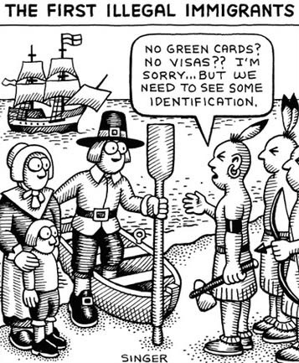
Migration as a Mechanism of Survival
Politico-legal migration is:
A social and political issue not only for the present day
A typical behaviour not only typical of humans

Slide 8
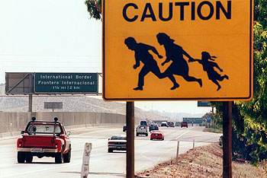
Migration as a Mechanism of Survival
Migration as a politico-legal issue:
Emigration: Leaving one’s native country
Immigration: Moving from one country to another
Both with the intent to settle permanently or temporarily
National borders matter
And other legal issues (visas, work and residence permit)
matter, too.

Slide 9
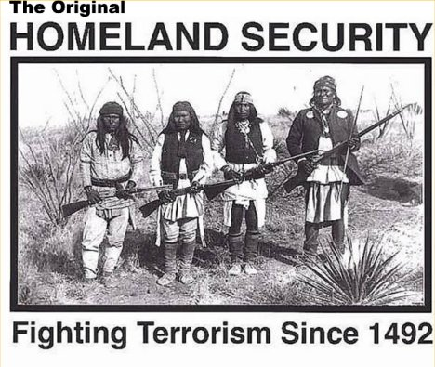
Migration as a Mechanism of Survival
Types of Migration:
Involuntary migration
Migration within a nation
Seasonal migration
Circular migration

Slide 10
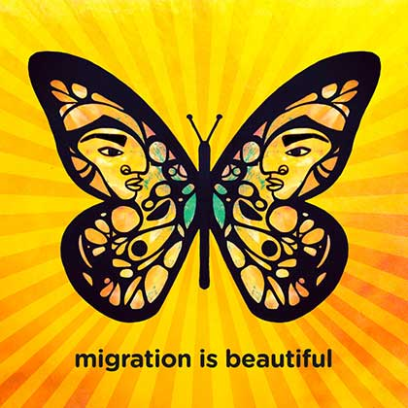
Migration as a Mechanism of Survival
The migrant culture (or the culture of migrants)
No or limited social and political securities
«apetite for risk»
Awareness of self-identity
Tolerance for differences
Migrant virtues: Emphaty and solidarity
…
A new class (in substitute of traditional
working class)?
Source: migrationisbeautiful.com

Slide 11
Migration as a Mechanism of Survival
From Q1: «Why do people migrate?»
Desire for a better living and for making more money
Desire for enjoying a freer society and social rights
Natural disasters, economic depressions etc.
…
As of 2013, 232 million migrants around the globe
Source: The Guardian, 11 September 2013, based on UN data
http://www.theguardian.com/news/datablog/2013/sep/11/on-the-move-232-million-migrants-in-the-World

Slide 12
Migration as a Mechanism of Survival
Migration Routes (Present Day)

Slide 13
Migration as a Mechanism of Survival
Migration Routes (Present Day)
Source: G. Giller. 2014. «Global Migrant Flows» Scientific American March

Slide 14
Migration as a Mechanism of Survival
Migration Routes (1820-1995)

Slide 15
Migration as a Mechanism of Survival
Migration Routes (1492-1522)

Slide 16
Migration as a Mechanism of Survival
Migration Routes (10,000 BC)

Slide 17
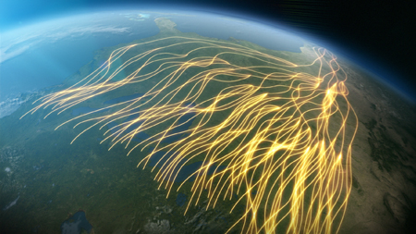
Migration as a Mechanism of Survival
Is it only humans that migrate? No! Many species migrate, too!
To Q2: «Why do species migrate?»
For better environmental conditions
Often times, instinctive (for instance: mating)
Butterflies, zebras, albatros, crabs, whales,
elephants seals, penguins, etc.
Source: Great Migrations (2010, National Geographic)

Slide 18
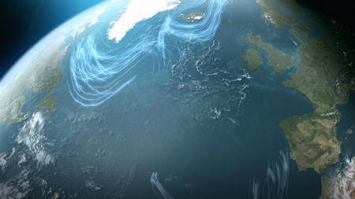
Migration as a Mechanism of Survival
Migration as an evolutionary mechanism:
A survival mechanism existent for millions of years
Darwinian in the extreme
Causing diversification amonst species
Contingencies playin the biggest role
on the pathways of migrations
Source: Great Migrations (2010, National Geographic)

Slide 19
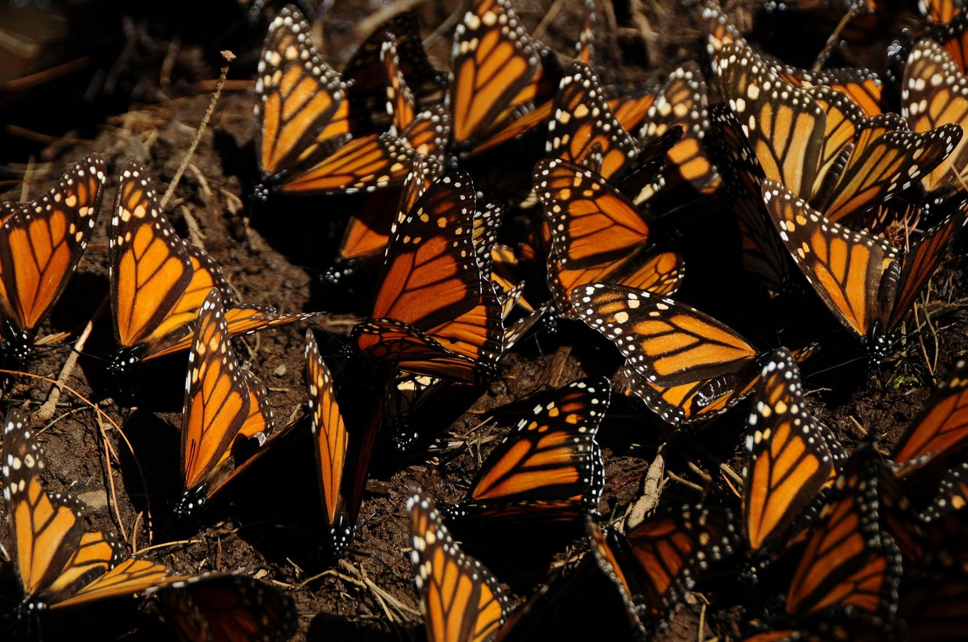
Migration as a Mechanism of Survival
Migration as an evolutionary mechanism:
Butterflies:
Instincts to move on
Reproduce on their ways
Four generation to complete a circular journey
Multi-generational migrtion loops
Source: Great Migrations (2010, National Geographic)

Slide 20
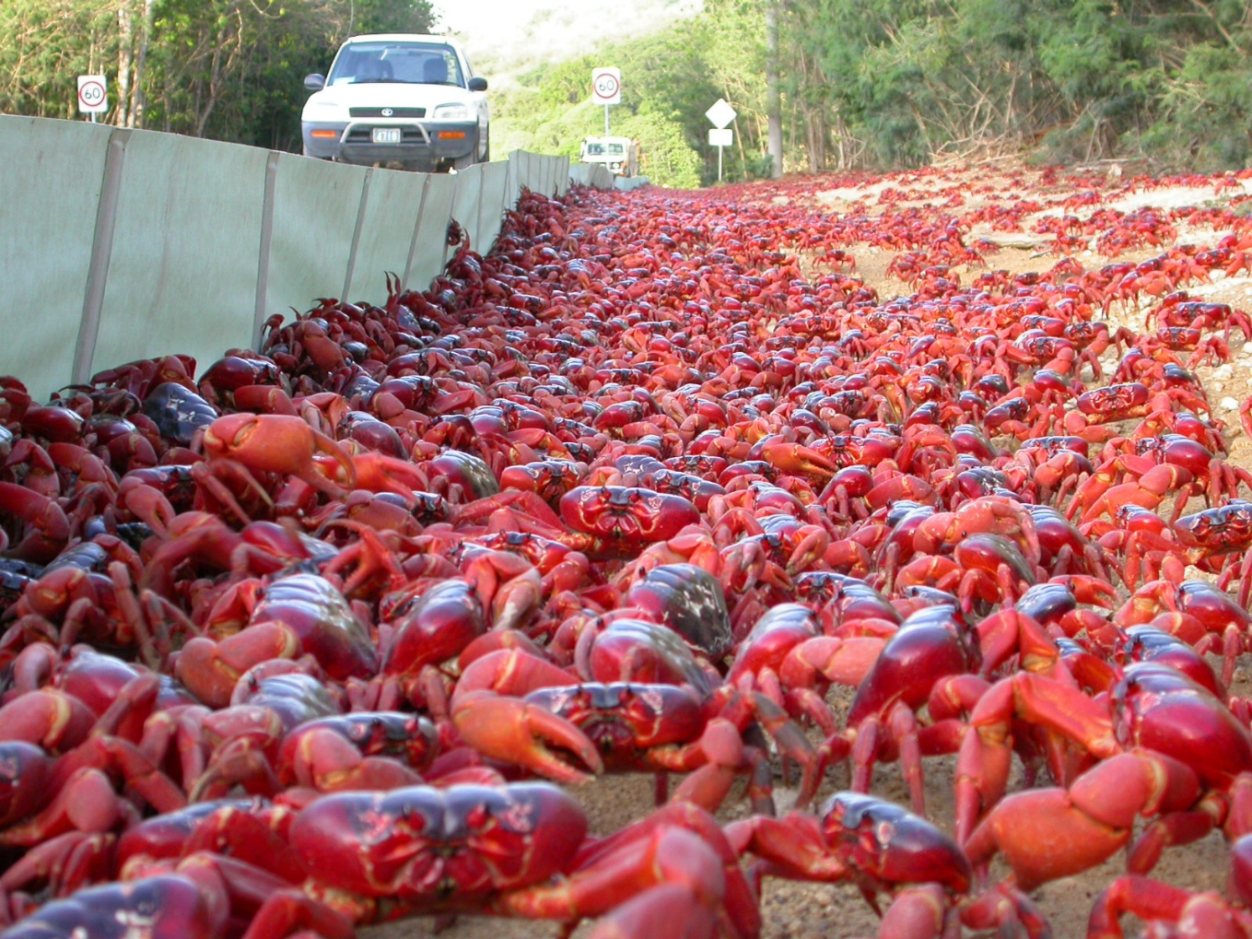
Migration as a Mechanism of Survival
Migration as an evolutionary mechanism:
Crabs:
From inland forests to beaches
Instincts to reproduce
Pray to ants, birds, and other species
on their ways
Source: Great Migrations (2010, National Geographic)

Slide 21
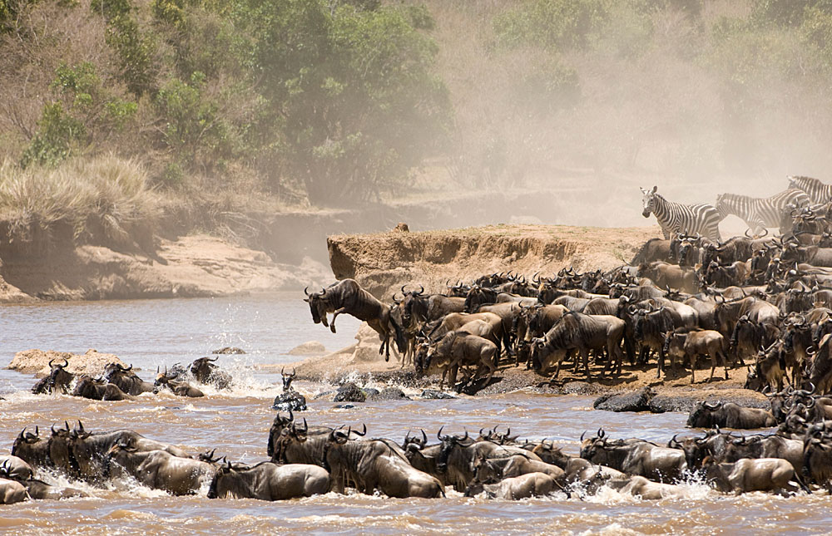
Migration as a Mechanism of Survival
Migration as an evolutionary mechanism:
Zebras:
In search for rain and green grass
Reproducing on their routes
Instinct to stay together
And instincts to move on
Source: Great Migrations (2010, National Geographic)

Slide 22
Migration as a Mechanism of Survival
Migration as an evolutionary mechanism:
Predators waiting for the prays
Crocidiles hunting for zebras, ants for crabs
Species to mate
Whales in the Atlantic
An economics of migrating species
Competition, division of labour amongst the individuals of a species

Slide 23
Migration as a Mechanism of Survival
Aren’t humans like butterflies, born to move?
Cultural and political selection vs. natural selection
Lack of trust and tolerance to differences
From anti-migration to racism and fascism

Slide 24
Migration as a Mechanism of Survival
Insert: Grapes of Wrath.

Slide 25
Migration as a Mechanism of Survival
Aren’t humans like butterflies, born to move?
Nation states operating to restrict migration
However, no restriction on the migration of
Money
Commodities
A select group of people

Slide 26
Migration as a Mechanism of Survival
Is our view of history so human-centered?
Migration
Competition
Divison of labour
Language
Agriculture
Engineering
Sex
War

Slide 27
Migration as a Mechanism of Survival
What (who?) is a human, anyway?
How distinct is human culture from the cultures of other species in the living nature?

