Slide 1
BIO 206 PLANT MORPHOLOGY
LECTURE NOTES
11th WEEK
DR. AYDAN ACAR ŞAHİN

Slide 2
Root Modifications
Roots sometimes have special functions to perform and in such cases their form and structure differ from those of normal roots.
The modified roots may be underground or aerial

Slide 3
Underground Root Modifications
Taproot and adventitious roots may undergo certain modifications to perform the function of storage and vegetative propagation

Slide 4
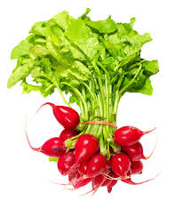
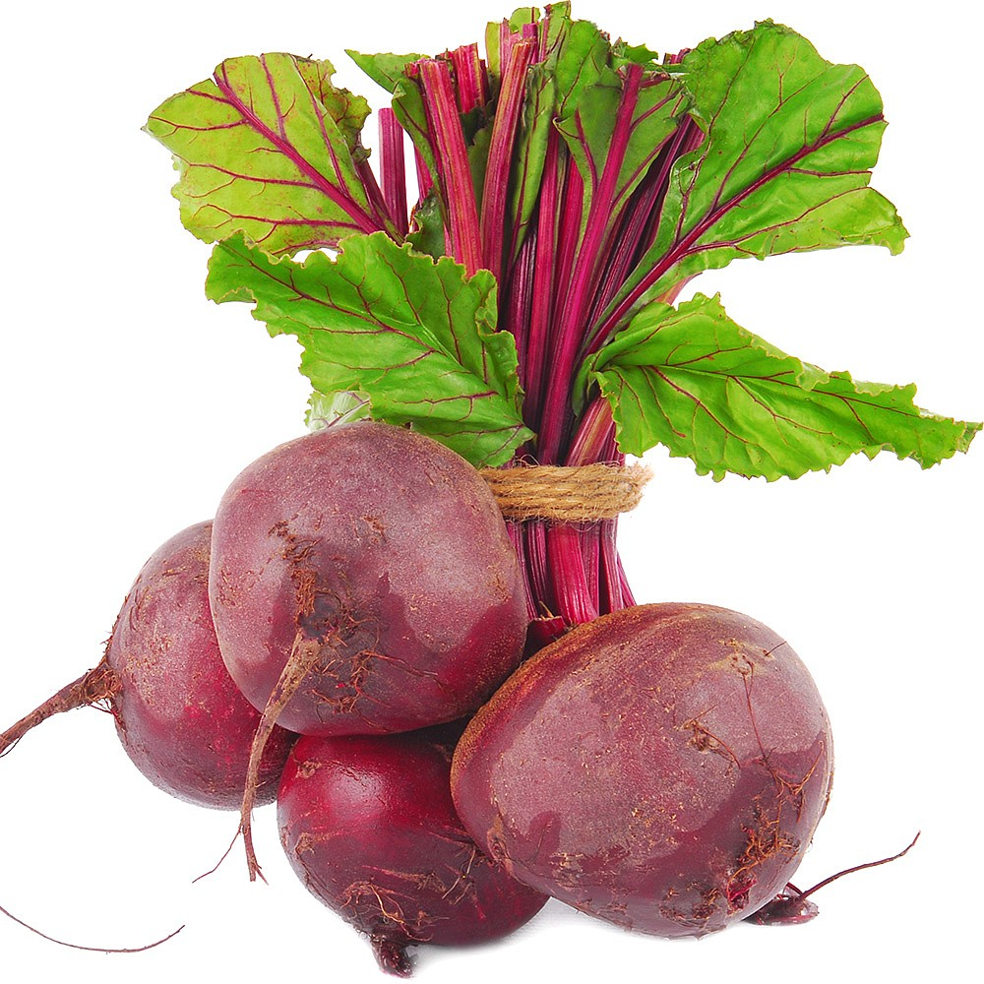
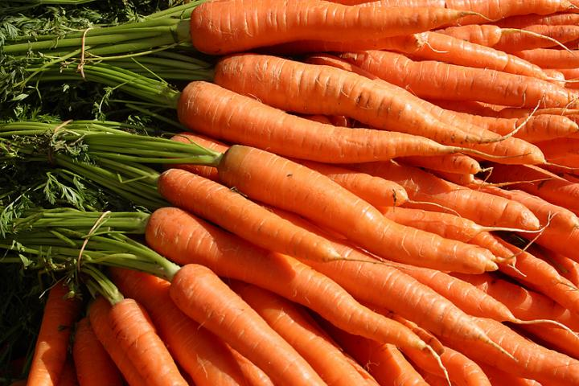
Tap Root Modifications (for storage of food)
In some plants the tap roots store reserve food for which they become swollen and assume different shapes. There are three types:
Fusiform
Napiform
Conical
Tuberous or Tubecular
Pneumatophores

Slide 5
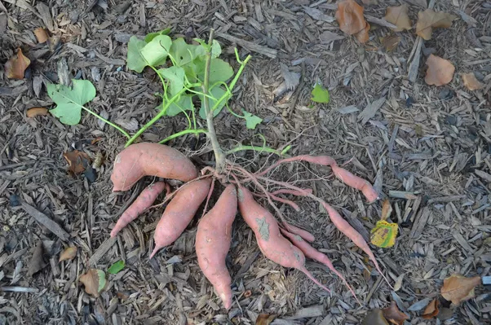
Adventitious Root Modifications
Tuberous or tubercular root : , e.g., Ipomoea batotas ( Sweet potato )
Here, the modified adventitious root is swollen without any definite shape. It is always produced singly and not in clusters.

Slide 6
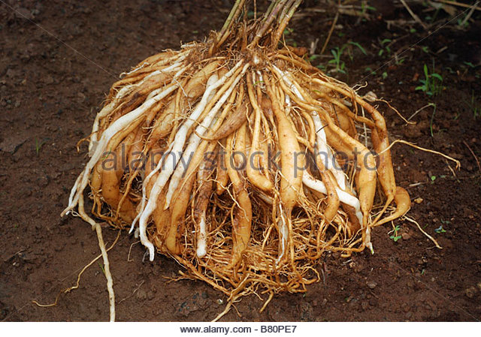
Fasciculated roots e.g., Asparagus, Dahlia
In Dahlia and Asparagus a number of adventitious roots arise as a cluster, from almost the same level at the base of the stem.

Slide 7
Adventitious Root Modifications
Nodulose roots e.g., Curcuma amada, ( mango ginger ) Here, the root becomes swollen at its tip.
Moniliform Roots: e.g., Momordica. Here, the roots shos beadlike swellings at frequent intervals.
Annulated roots e.g., Ipecac. Here, the adventitious roots have series of ring-like swelling on their surface.

Slide 8
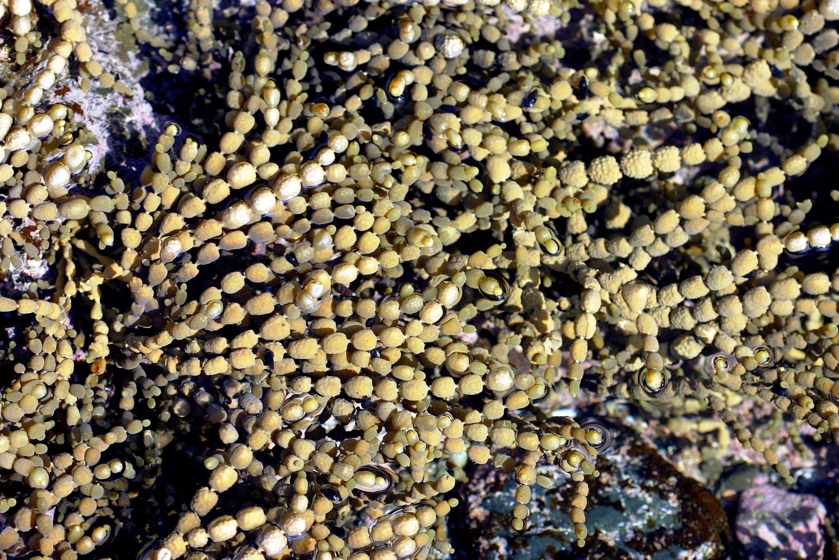
Annulated roots: moniliform root:

Slide 9
nodulose root:

Slide 10
Aerial Root Modifications
Aerial roots are adventitious roots which develop from the aerial parts of the plant to perform various functions.
A) For mechanical support
Prop roots
Stilt roots
Climbing root
B) For vital functions
Haustoria or sucking roots
Respiratory roots or breathing roots or pneumtophores
Floating roots
Epiphtic roots

Slide 11
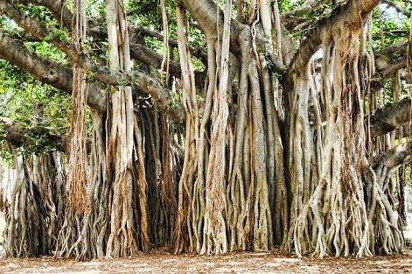
Prop roots
E.g., Ficus benghalensis (Banyan): In banyan the andvenititious roots arise from the horizontal branches and grow vertically downwards. After reaching the soil they become thick and woody. Thus, they function as pillars gibing mechanical support to the branches. Hence, they are also known as columnar roots

Slide 12
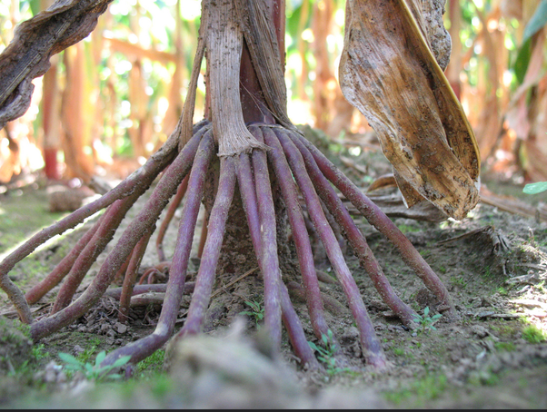
Stilt roots:
E.g., Pandanus : In Pnadanus the andevtitious roots arise from the lower part of the main stem and grow obliquely towards the soil. They serve to keep the plant erect by giving additional support

Slide 13
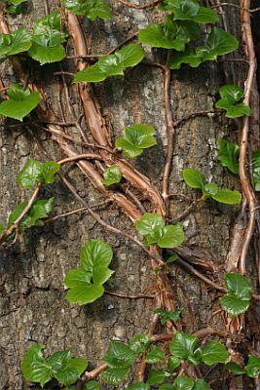
Climbing roots or clinging roots:
E.g., Piper betel. Pothos,
Etc : These roots arise from the nodes and help in attaching the climbing stem firmly to a support like a tree or a Wall, by various mechanisms.

Slide 14
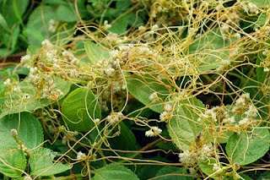
Haustoria or sucking roots:
E.g., Cuscuta : Parasites like Cuscuta develp a kind of root which penetrates into the tissue of the host plant and help to draw nutrients from the host by sucking it. The parasitic plants are not completely equipped to prepare their food. Hence, such plants have to depend on host plants for nutrients.

Slide 15
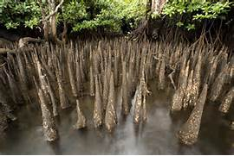
Respiratory roots or breating roots or pneumtophores
E.g., Avicennia, Rhizophora. A number of plants growing in marshy water-logged soil which contain almost no air, develop some branches which grow vertically upwards into the air. These roots are called breathing roots or pneumatophores. Each such root is provided towards the upper end with numerous pores thorugh which gases diffuse in and out

Slide 16
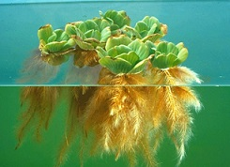
Floating roots:
E.g., Jussiea: In Jussiea which is an aquatic plant, special spongy roots called floating or respiratory roots arise from the plant. They are adventitious and enclose a tissue called aerenchyma. These roots usually develop above the level of water and serve to store up air and help in buoyancy of the plant. In addition, the floating roots may also perform the respiratory function.

Slide 17
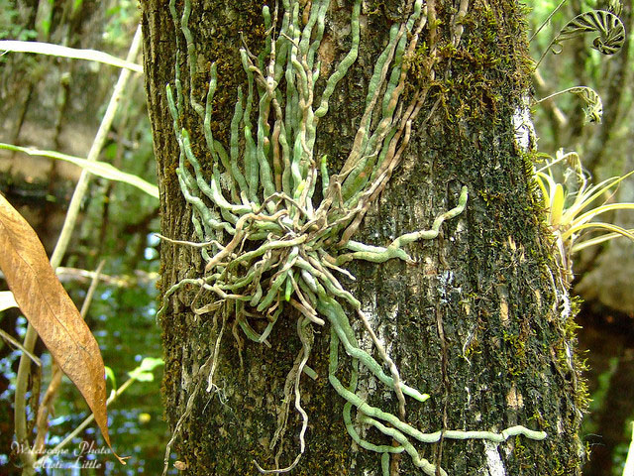
Epiphytic roots: e.g., Vanda : In epiphytes like orchids which grow on other plants, special adventititous roots called epiphytic roots are produced. The outer region of the root is made up of a special tissue called the velamen. This tissue absorbs moisture from the air and makes it available to the plant. These roots do not penetrate the host tissue like parasitic roots.

