Slide 1
GALVANIC BATTERIES
Devices that can give an electric current as a result of an electrochemical reaction and are made up of two electrons, that is, those that turn into a chemical energy electrical energy, are called a galvanic batery.
A batery is established with a Cu rod immerse into CuSO₄ solution and a Zn rod immerse into ZnSO₄ solutions. If these two rods bond with a wire each other, an electrical current could be observed. After that, a thinning is observed in the zinc rod, whereas a thickening occurs in the cupper rod.

Slide 2
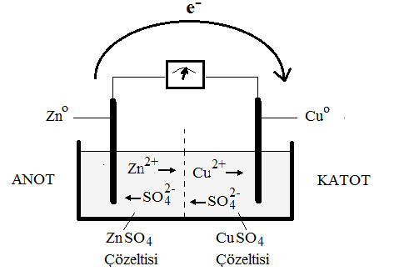

Slide 3
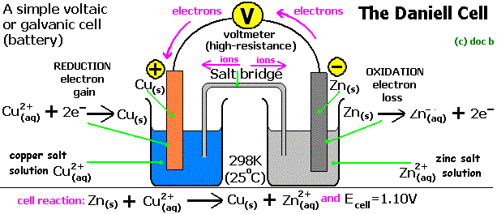

Slide 4
When the metal bars immersed in these solutions are connected to each other by a wire, an electrical current is generated spontaneously. Electrons begin to pass from the Zn system to the Cu system automatically. This is the potential difference that spontaneously arises between the two systems.
Znº  Zn²⁺ + 2e– Oxidation
Cu²⁺ + 2e–  Cuº Reduction
Znº + Cu²⁺_{(aq)}  Zn²⁺_{(aq)} + Cuº
In this system Zn cell is anode and Cu cell is cathode

Slide 5
The anodal sign on a batery is "-", the cathodical sign is "+". This is different from electrolysis cell
The metal rods immersed in two separate solution baths are connected with a wire and the two solution vessels are combined with a salt bridge from the 3% agar which is usually saturated with KCl to provide load balance
Oxidation is electron loss and reduction is the electron gain. Reducing agent is the substance that reduces the opposite but the substance that is oxidized by itself, whereas the oxidizing substance is the substance that oxidizes itself but is reduced by itself. The reduction or oxidation reaction can never be carried out by itself, but only when two of them are together.

Slide 6
An oxidation or reduction system is called a semi-reaction (or semi-cell) system. A redox reaction; oxidation and reduction of the two semi-reactions come together. Thus, a full reaction (full cell or battery) occurs.
When half-cells come together, the formation of a complete cell spontaneously takes place, resulting in a potential. This is called battery potential or electromotor force (emk). Each half-cell has a potential, but this alone can not be measured. However, it can be measured by combining with another half cell. Only under these conditions can there be electron transfer.

Slide 7
For the determination of the potentials of all the semicells, the reading and ordering against a standard was found to be appropriate and the standard hydrogen electrode was selected as the standard for this purpose. The potential of the standard hydrogen electrode is arbitrarily set to zero.
Standard hydrogen electrode: Electrode with hydrogen gas under 1 atm pressure on a platinum plate coated with a solution of immersion platinum black containing 1M H + (aH + = 1)
2H⁺ + 2e–  H₂

Slide 8
