Slide 1
Diversity And Classification of Flowering Plants: Amborellales, Nymphaeales, Austrobaileyales, Magnoliids, Ceratophyllales

Slide 3
Angiosperm Phylogeny Group (APG III) system - 2009

Slide 5
Floral Formulas

Slide 6
Floral Diagrams Cross-sectional representation of a flower

Slide 7
Amborellales - the most basal, extant angiosperm lineage

Slide 8
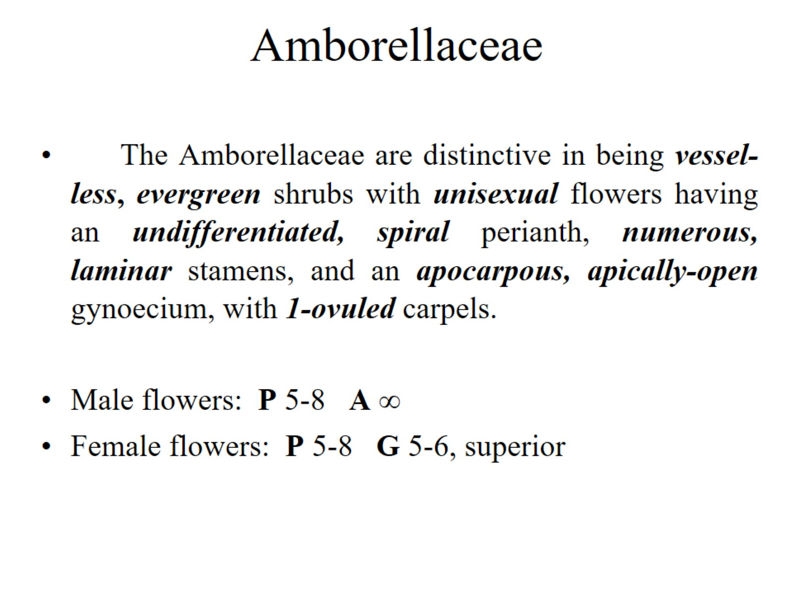
Amborellaceae

Slide 9
Amborella, if it represents a “primitive” angiosperm:

Slide 10
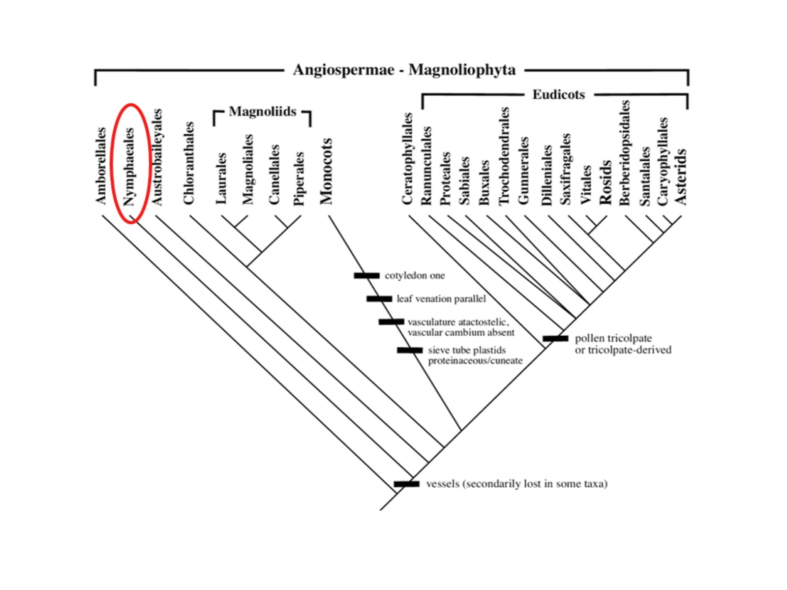

Slide 11
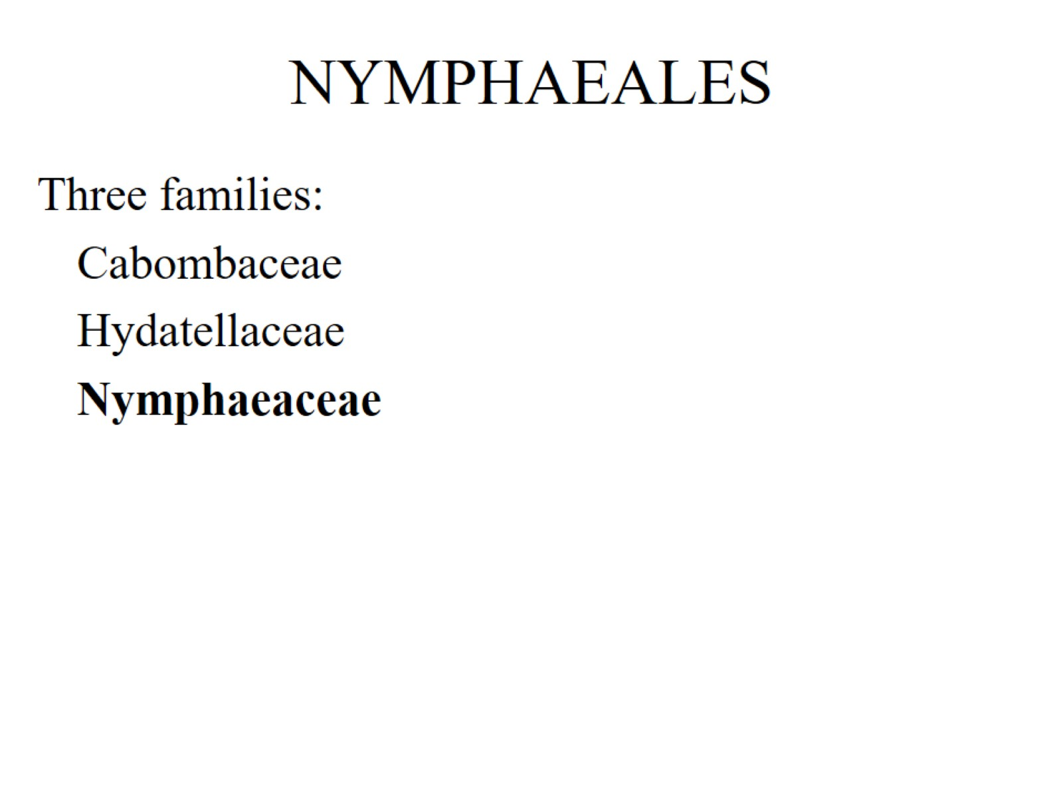
NYMPHAEALES

Slide 12
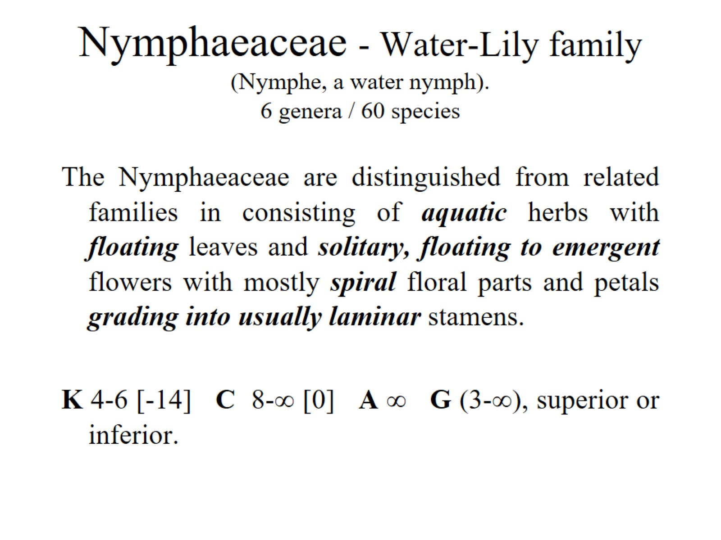
Nymphaeaceae - Water-Lily family (Nymphe, a water nymph). 6 genera / 60 species

Slide 13
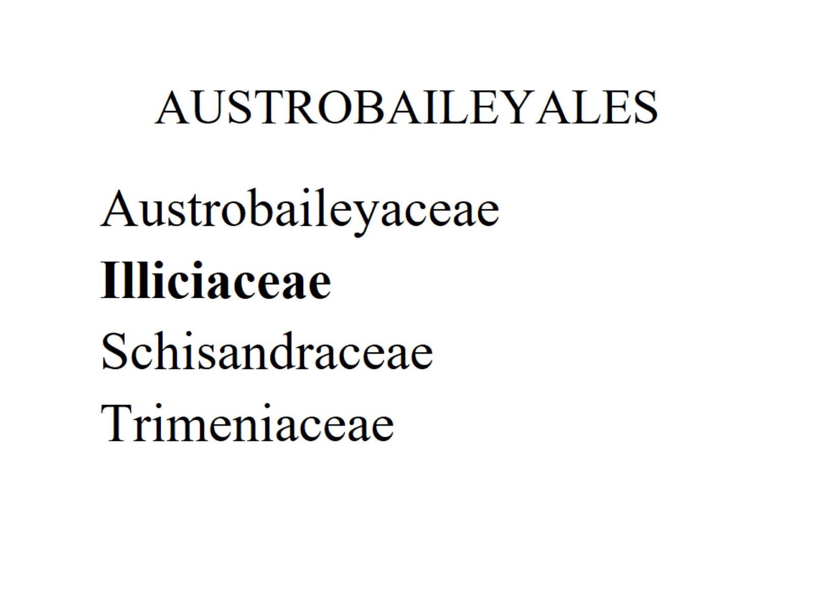
AUSTROBAILEYALES

Slide 14
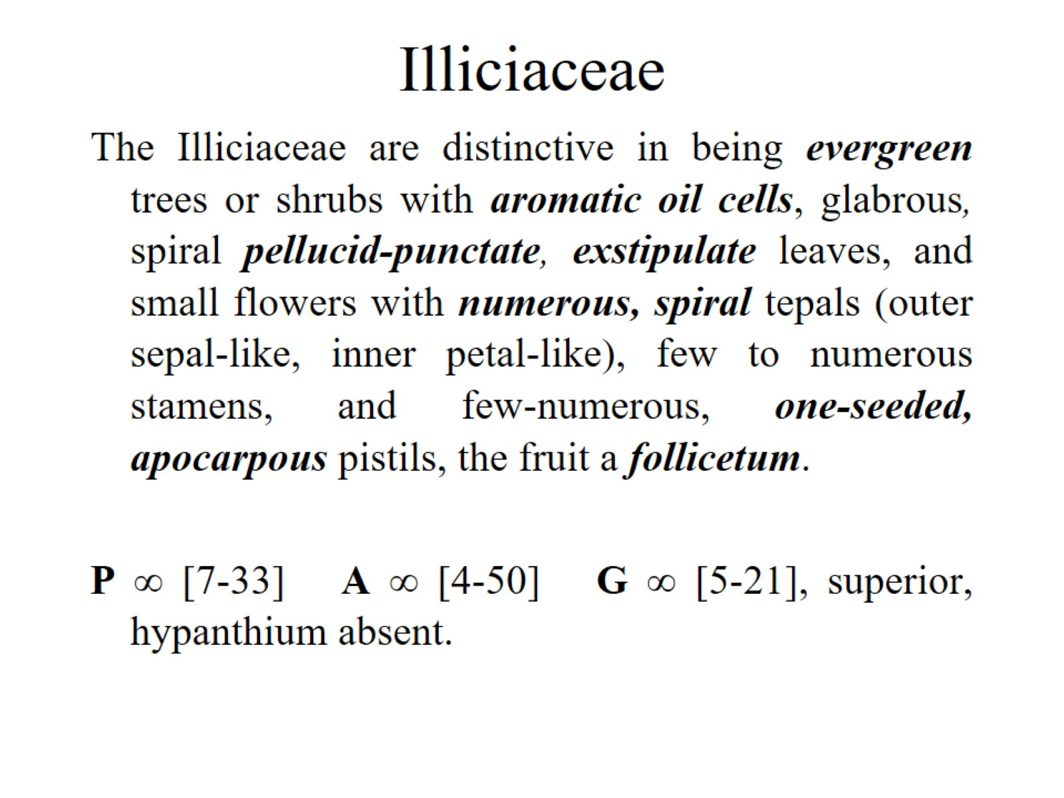
Illiciaceae

Slide 15
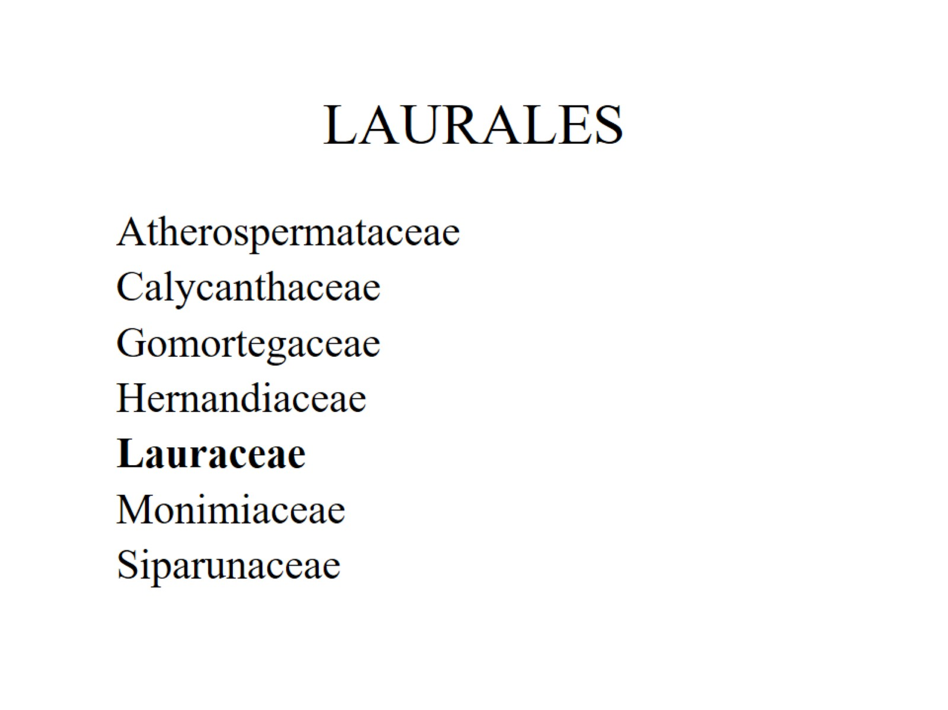
LAURALES

Slide 16
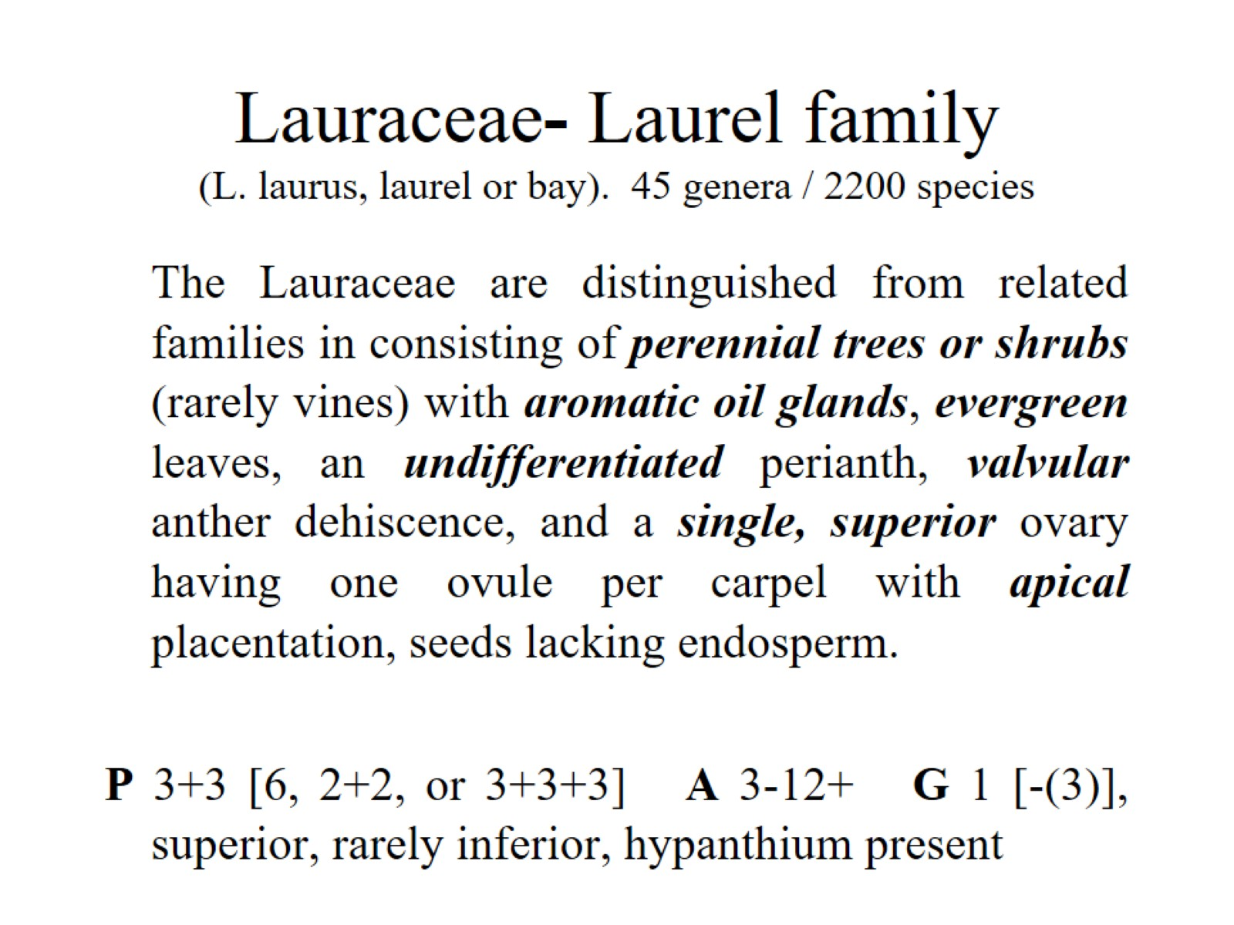
Lauraceae- Laurel family (L. laurus, laurel or bay). 45 genera / 2200 species

Slide 17
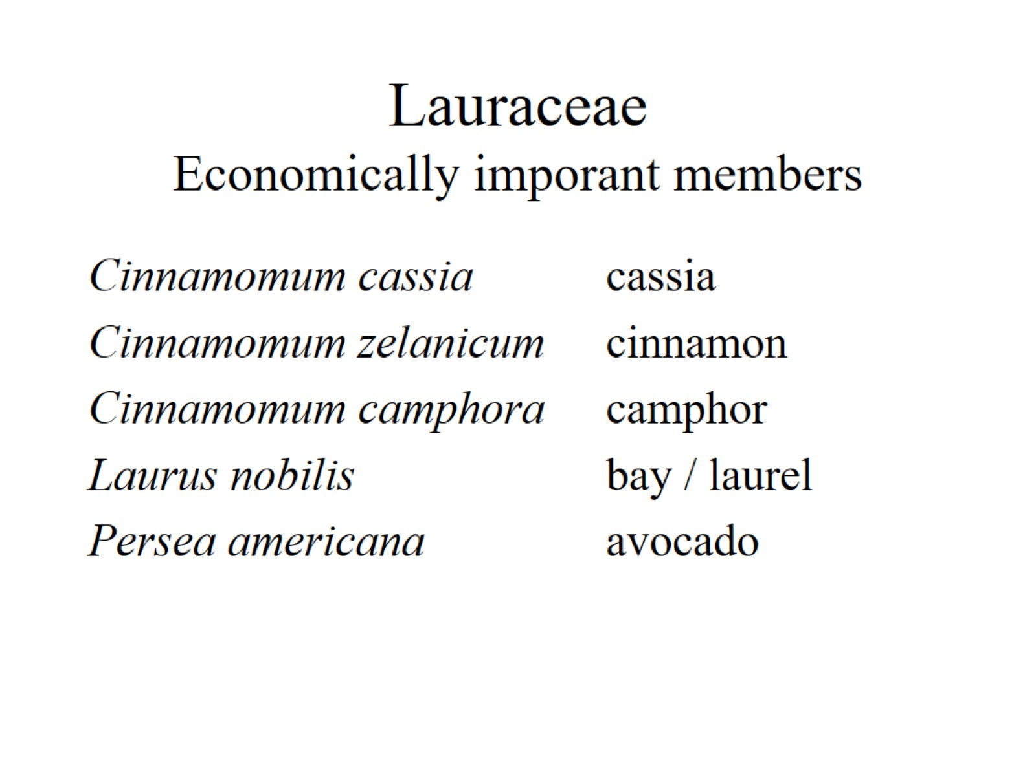
Lauraceae Economically imporant members

Slide 18
MAGNOLIALES

Slide 19
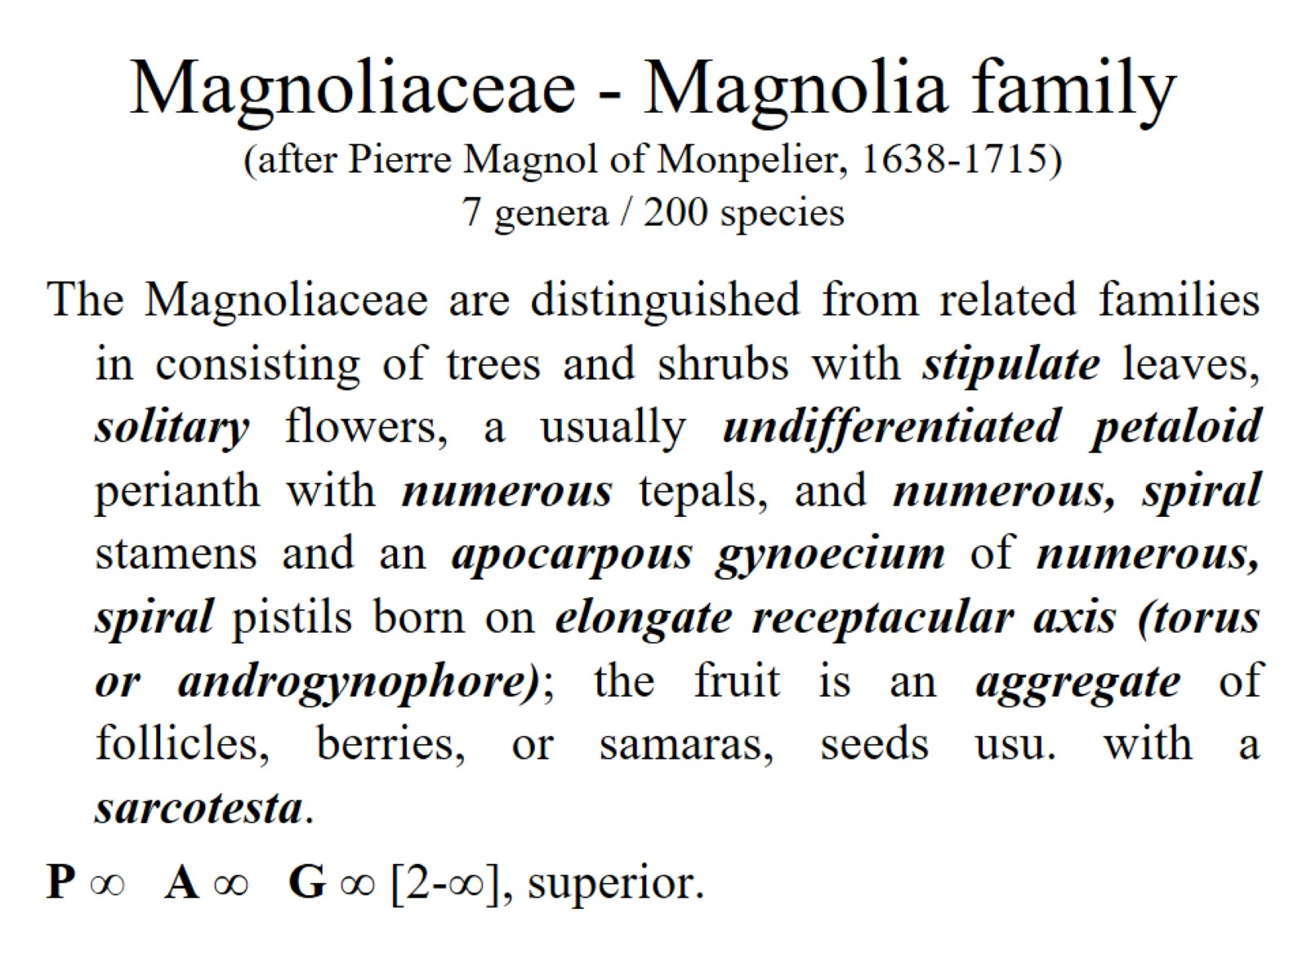
Magnoliaceae - Magnolia family (after Pierre Magnol of Monpelier, 1638-1715) 7 genera / 200 species

Slide 20
PIPERALES

Slide 21
Aristolochiaceae - Birthwort family (Gr. aristos, best + lochia, childbirth, from resemblance of a species of Aristolochia to the correct fetal position). 5-8 genera / 465-480 species

Slide 22
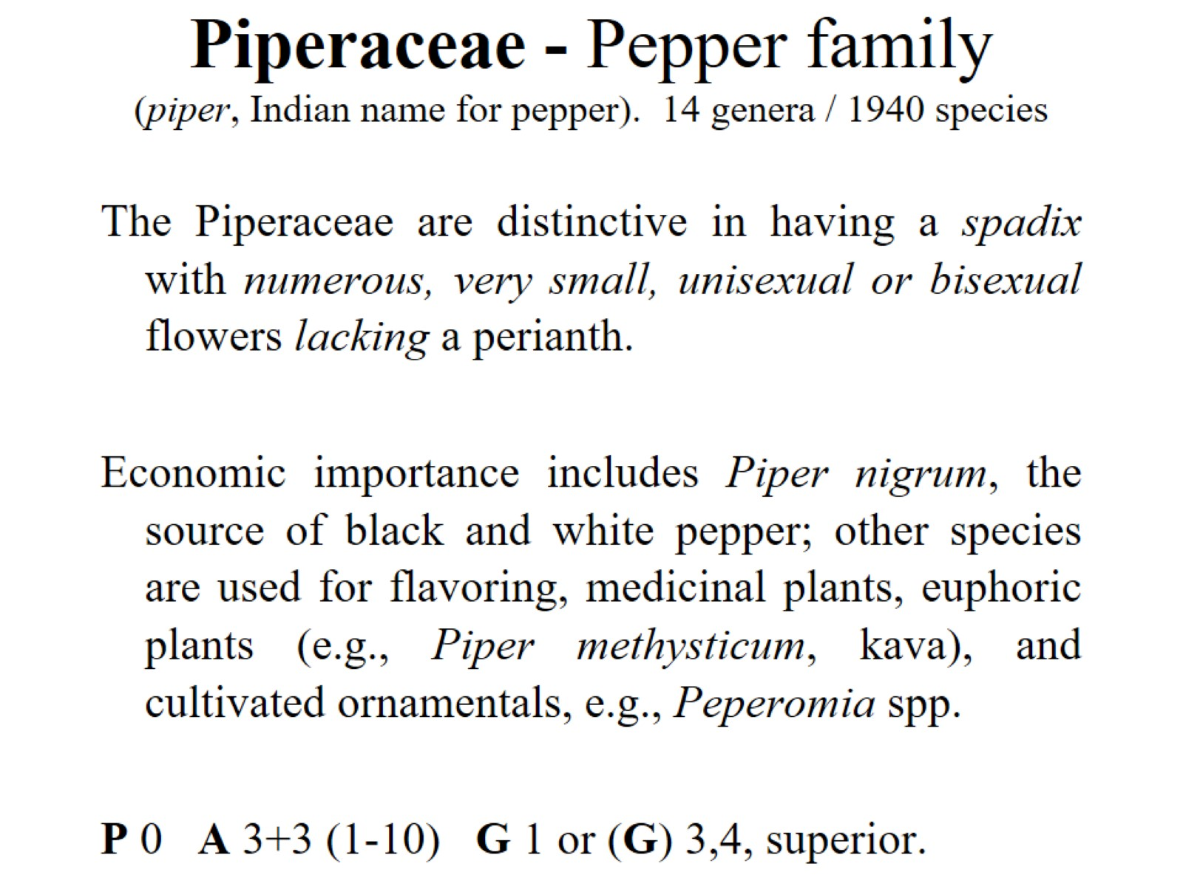
Piperaceae - Pepper family (piper, Indian name for pepper). 14 genera / 1940 species

Slide 23
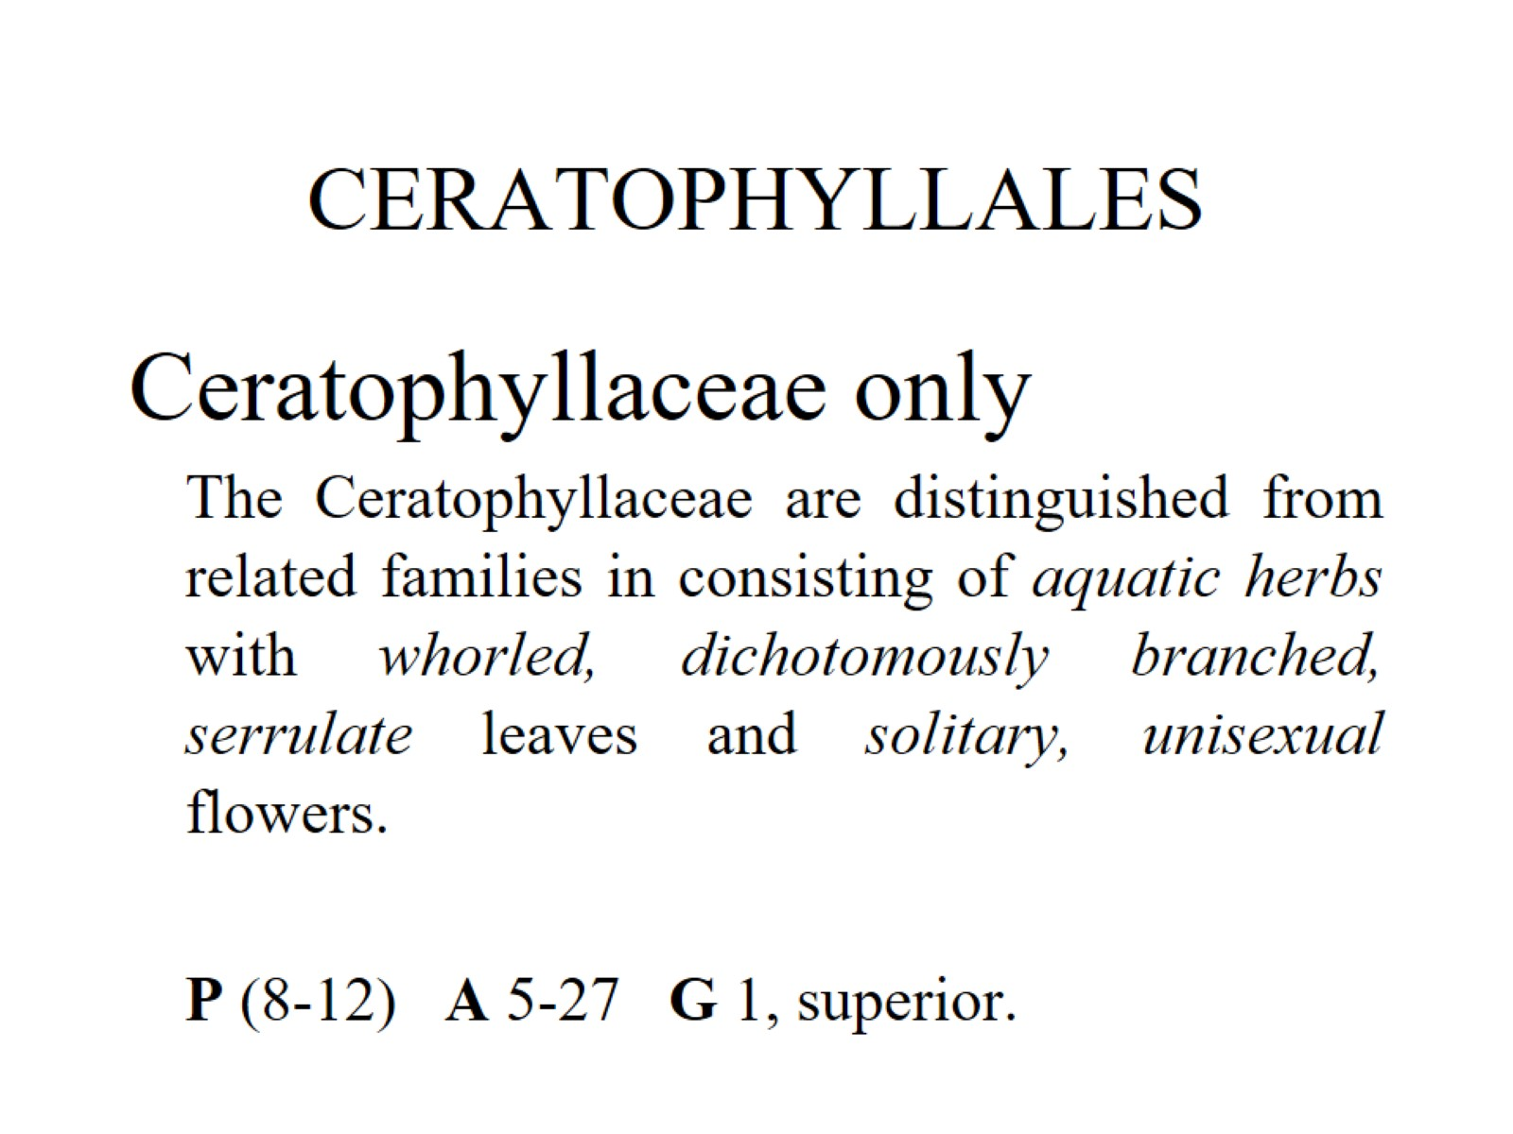
CERATOPHYLLALES

