Slide 1
Lecture 5: What CDC Is Doing These Days?

Slide 3
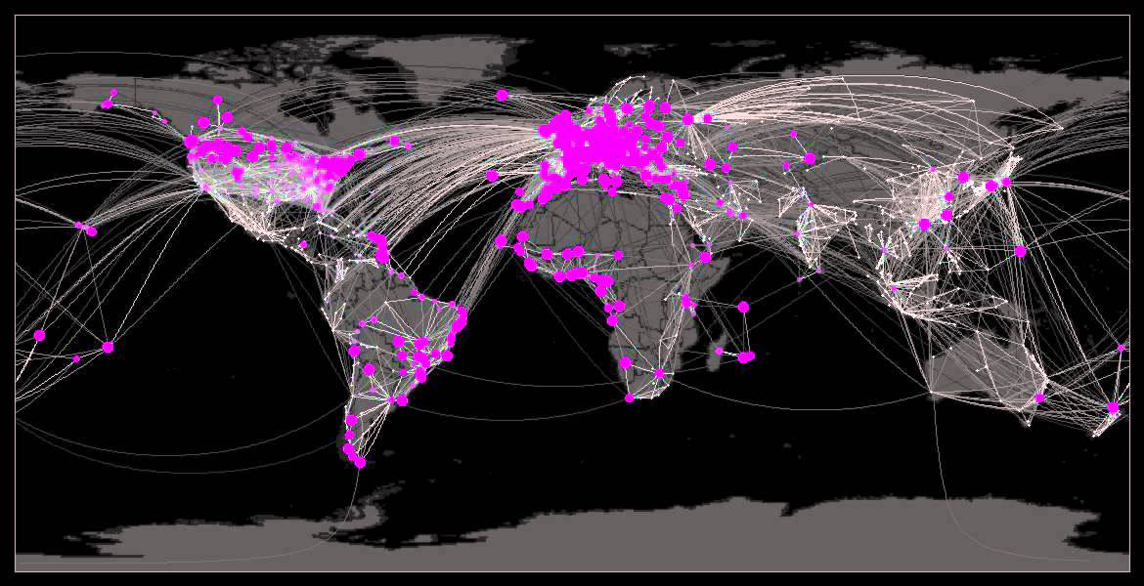
CDC works worldwide 24/7 to protect the U.S. from disease threats.
Disease knows no borders.
In today’s interconnected world, a disease threat anywhere can become a health threat.
We know that disease exploits even the smallest gap to spread and grow.
The goal → Finding the most effective – and cost effective – way to protect people from known and unknown health threats.

Slide 4
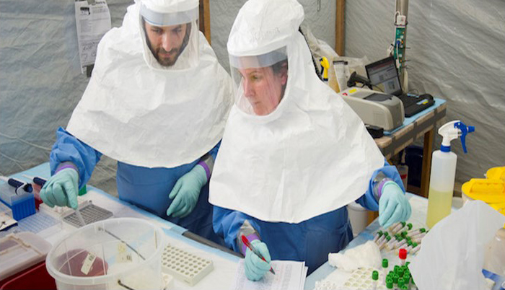
CDC works worldwide 24/7 to protect the U.S. from disease threats.
CDC’s global activities protect Americans from major health threats such as Ebola, Zika, and pandemic influenza.
CDC detects and controls outbreaks at their source, saving lives and reducing healthcare costs.
Importantly, CDC helps other countries build capacity to prevent, detect, and respond to their health threats through our work.
The goal is to stop diseases where they occur as soon as they start.

Slide 5
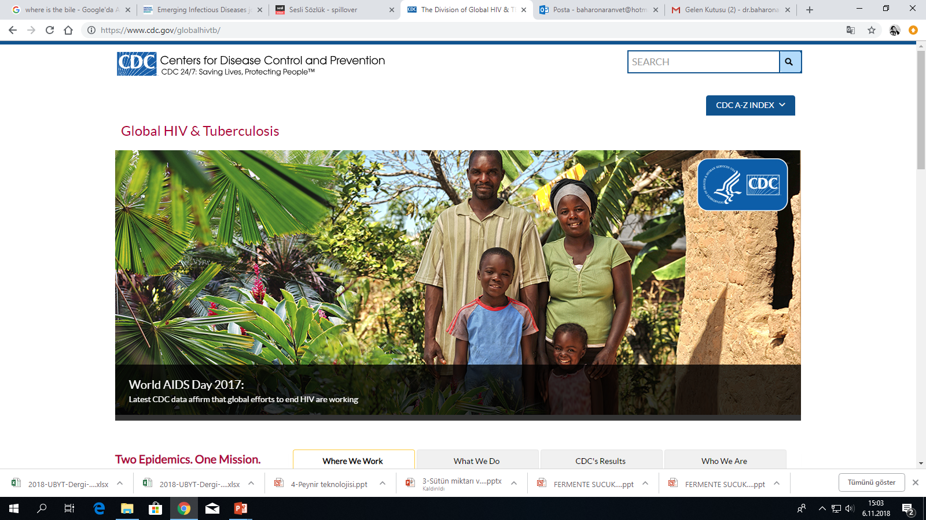

Slide 6
HIV and Tuberculosis (TB)
are the world’s two most deadly infectious diseases.
these two epidemics are tragically interconnected, as TB is the leading cause of death for those living with HIV.
Division of Global HIV & TB (DGHT) experts are working on the front lines in more than 45 countries and regions around the globe, focused on a single mission:
→to fight these diseases and, ultimately, bring an end to the dual epidemics of HIV and TB worldwide.

Slide 8
New Data Highlights CDC’s Contributions, 2018

Slide 9
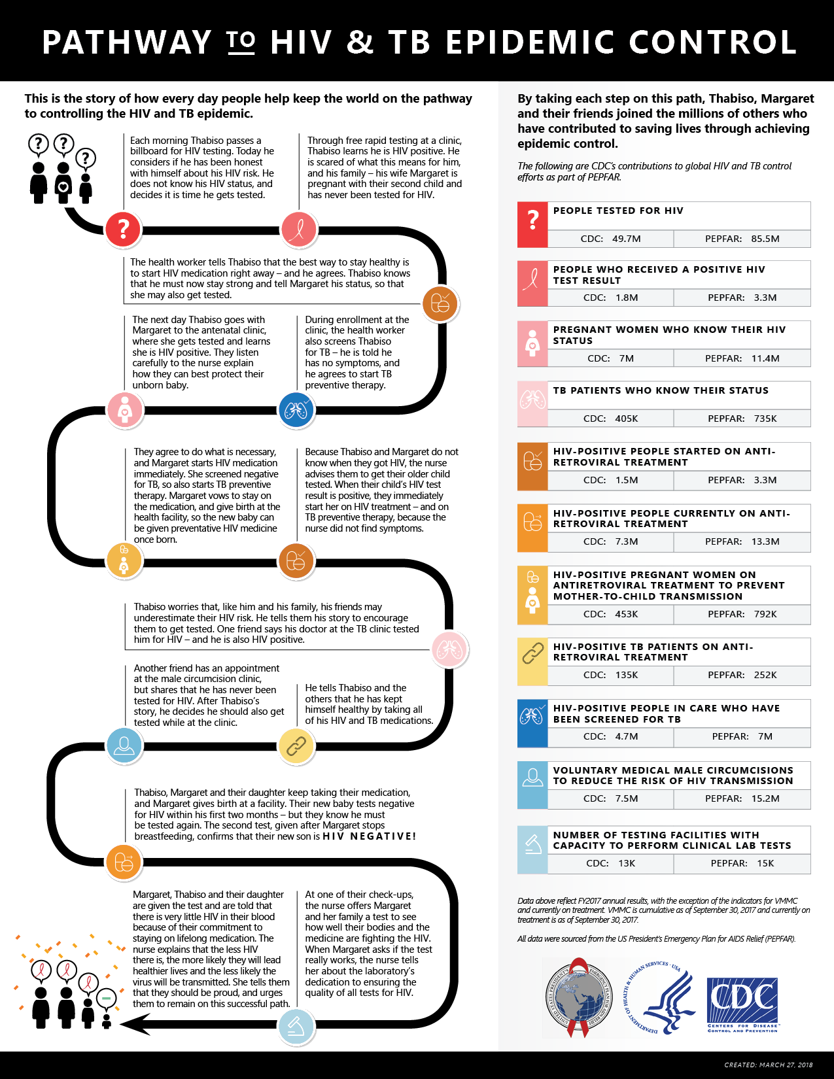
Through stories and data – how CDC is making an impact in the global fight against HIV and TB and saving lives.

Slide 10
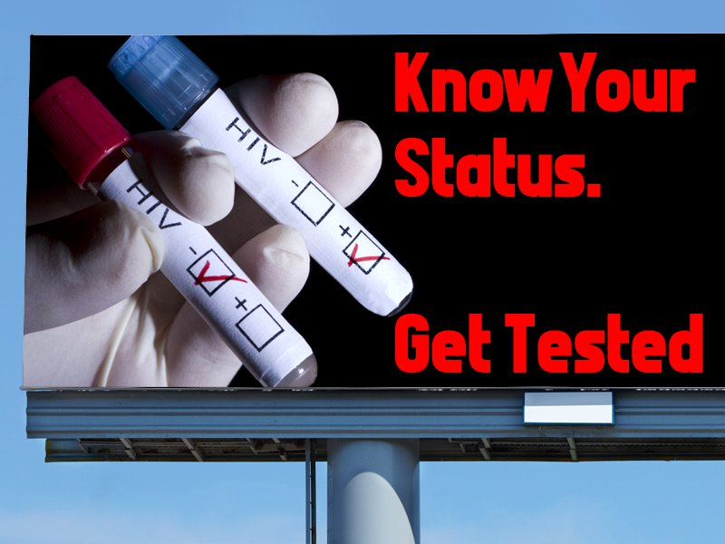
PATHWAY TO HIV & TB EPIDEMIC CONTROL
This is the story of how everyday people help keep the world on the pathway to controlling the HIV and TB epidemic.
Each morning Thabiso passes a billboard for HIV testing. Today he considers if he has been honest with himself about his HIV risk. He does not know his HIV status, and decides it is time he gets tested.

Slide 11
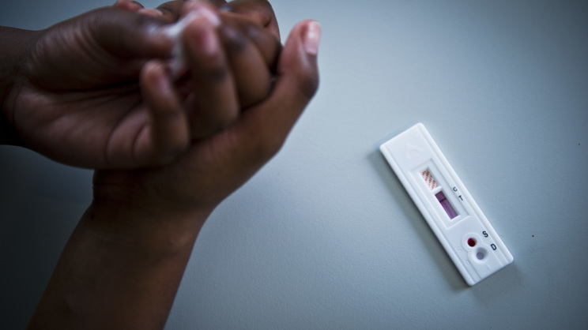
Through free rapid testing at a clinic, Thabiso learns he is HIV positive. He is scared of what this means for him, and his family – his wife Margaret is pregnant with their second child and has never been tested for HIV.
The health worker tells Thabiso that the best way to stay healthy is to start HIV medication right away – and he agrees. Thabiso knows that he must now stay strong and tell Margaret his status, so that she may also get tested.

Slide 12
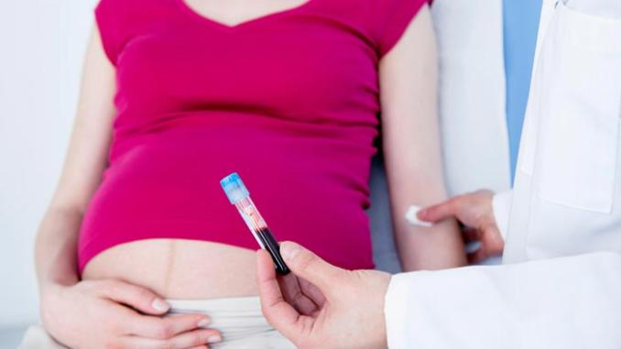
The next day Thabiso goes with Margaret to the antenatal clinic, where she gets tested and learns she is HIV positive. They listen carefully to the nurse explain how they can best protect their unborn baby.
During enrollment at the clinic, the health worker also screens Thabiso for TB – he is told he has no symptoms, and he agrees to start TB preventive therapy.
Because Thabiso and Margaret do not know when they got HIV, the nurse advises them to get their older child tested. When their child’s HIV test result is positive, they immediately start her on HIV treatment – and on TB preventive therapy, because the nurse did not find symptoms.

Slide 13
Thabiso worries that, like him and his family, his friends may underestimate their HIV risk. He tells them his story to encourage them to get tested. One friend says his doctor at the TB clinic tested him for HIV – and he is also HIV positive.

Slide 14
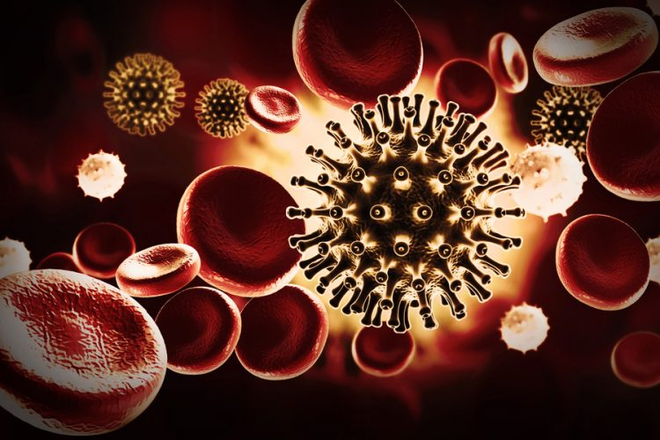
At one of their check-ups, the nurse offers Margaret and her family a test to see how well their bodies and the Medicine are fighting the HIV. When Margaret asks if the test really works, the nurse tells her about the laboratory’s dedication to ensuring the quality of all tests for HIV.
Margaret, Thabiso and their daughter are given the test and are told that there is very little HIV in their blood because of their commitment to staying on lifelong medication. The nurse explains that the less HIV there is, the more likely they will lead healthier lives and the less likely the virus will be transmitted. She tells them that they should be proud, and urges them to remain on this successful path.

Slide 15
Thabiso, Margaret and their daughter keep taking their medication, and Margaret gives birth at a facility. Their new baby tests negative for HIV within his first two months – but they know he must be tested again. The second test, given after Margaret stops breastfeeding, confirms that their new son is HIV NEGATIVE!
They agree to do what is necessary, and Margaret starts HIV medication immediately. She screened negative for TB, so also starts TB preventive therapy. Margaret vows to stay on the medication, and give birth at the health facility, so the new baby can be given preventative HIV medicine once born.
Data above reflect FY2017 annual results, with the exception of the indicators for VMMC and currently on treatment. VMMC is cumulative as of September 30, 2017 and currently on treatment is as of September 30, 2017. All data were sourced from the US President’s Emergency Plan for AIDS Relief (PEPFAR).

Slide 17
Malaria
Malaria is a mosquito-borne disease caused by a parasite.
People with malaria often experience fever, chills, and flu-like illness.
Left untreated, they may develop severe complications and die.
In 2016 an estimated 216 million cases of malaria occurred worldwide and 445,000 people died, mostly children in the African Region.
About 1,700 cases of malaria are diagnosed in the United States each year.
The vast majority of cases in the United States are in travelers and immigrants returning from countries where malaria transmission occurs, many from sub-Saharan Africa and South Asia.

Slide 18
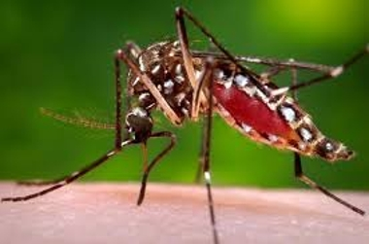
Transmission How is malaria transmitted?
Usually, people get malaria by being bitten by an infective female Anopheles mosquito.
Only Anopheles mosquitoes can transmit malaria and they must have been infected through a previous blood meal taken from an infected person.
When a mosquito bites an infected person, a small amount of blood is taken in which contains microscopic malaria parasites.
About 1 week later, when the mosquito takes its next blood meal, these parasites mix with the mosquito’s saliva and are injected into the person being bitten.

Slide 19
Transmission How is malaria transmitted?
Because the malaria parasite is found in red blood cells of an infected person, malaria can also be transmitted through blood transfusion, organ transplant, or the shared use of needles or syringes contaminated with blood.
Malaria may also be transmitted from a mother to her unborn infant before or during delivery (“congenital” malaria).

Slide 20
Who is most at risk of getting very sick and dying from malaria?
Plasmodium falciparum is the type of malaria that most often causes severe and life-threatening malaria; this parasite is very common in many countries in Africa south of the Sahara desert.
People who have little or no immunity to malaria, such as young children and pregnant women or travelers coming from areas with no malaria, are more likely to become very sick and die.
Poor people living in rural areas who lack access to health care are at greater risk for this disease.
As a result of all these factors, an estimated 90% of deaths due to malaria occur in Africa south of the Sahara; most of these deaths occur in children under 5 years of age.

Slide 21
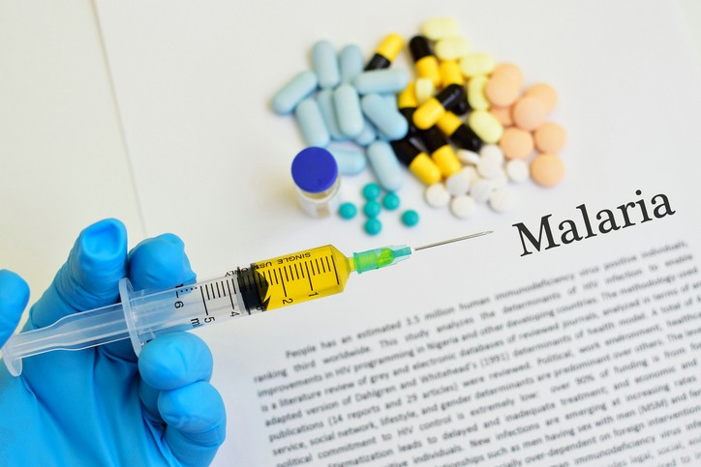
Preventing Malaria During Travel
I will be traveling outside to an area with malaria. How do I find out what is the best drug to take to prevent malaria?
CDC has a list of all the places in the world where malaria transmission occurs and the malaria drugs that are recommended for prevention in each place.
Many effective antimalarial drugs are available. Your health-care provider and you will decide on the best drug for you, if any, based on your travel plans, medical history, age, drug allergies, pregnancy status, and other factors.

Slide 22
Isn’t there a malaria vaccine?
And if not, why?
Attempts at producing an effective malaria vaccine and vaccine clinical trials are ongoing.
In addition, scientists do not yet totally understand the complex immune responses that protect humans against malaria.
However, many scientists all over the world are working on developing an effective vaccine.
Because other methods of fighting malaria, including drugs, insecticides, and insecticide-treated bed nets, have not succeeded in eliminating the disease, the search for a vaccine is considered to be one of the most important research projects in public health.

Slide 23
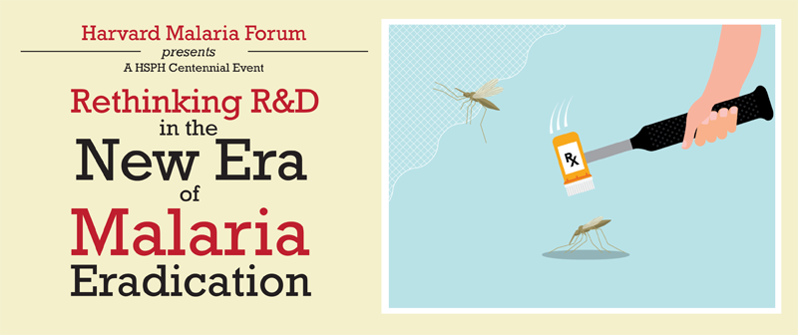
Wasn’t malaria eradicated years ago?
No.
Eradication means that no more malaria exists in the world.
Malaria has been eliminated from many developed countries with temperate climates.
However, the disease remains a major health problem in many developing countries, in tropical and subtropical parts of the world.
An eradication campaign was started in the 1950s, but it failed globally because of problems including the resistance of mosquitoes to insecticides used to kill them, the resistance of malaria parasites to drugs used to treat them, and administrative issues.
In addition, the eradication campaign never involved most of Africa, where malaria is the most common.

Slide 24
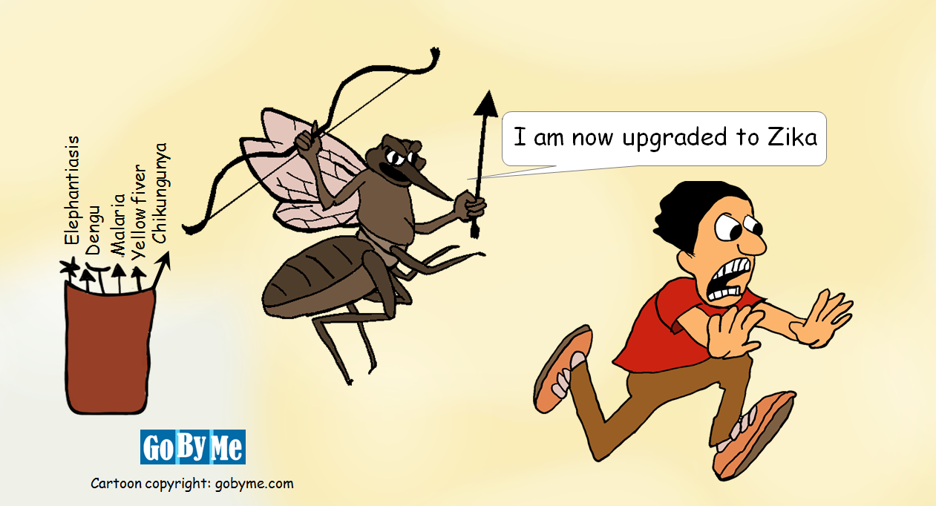
Other mosquito-borne diseases?
Dengue
Zika
Chikungunya
West nile fever

