Slide 1
ANTIHYPERTENSIVE DRUGS
Ebru Arioglu Inan, PhD

Slide 2
Aims
General principals of cardiovascular system
Clarifying the mechanisms which regulate blood pressure
Clarifying “hypertension” and the pathophysiological factors of the disease
Clarifying nonpharmacological treatment strategies for hypertension
Classification of antihypertensive drugs
Defining indication-pharmacokinetic/pharmacodynamic features-contrindication profile of antihypertensive drugs
Clarifying management of hypertension emergency and treatment strategies for it.

Slide 3
Contents
Basic terms for cardiovascular system
Physiological regulation of blood pressure
Pathophysiology of hypertension
Prevalance and risk factors for hypertension
Pharmacological and nonpharmacological treatment strategies for hypertension
Diuretics
ACE inhibitors
ARBs
Ca++ Channel blockers
Beta blockers
Alfa blockers
Adrenergic neuron blockers
Central sympatholitics
K+ channel openers
Drugs for hypertension emergency
Drugs for preeclampsia

Slide 4
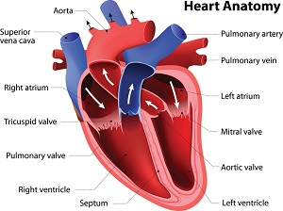
https://www.nia.nih.gov/health/heart-health-and-aging

Slide 5
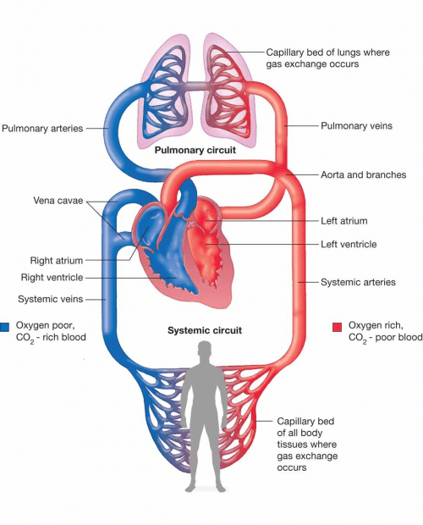
https://difference.guru/difference-between-pulmonary-and-systemic-circulation/

Slide 6
Cardiac conduction system:
SA node
AV node
AV bundle (Bundle of his)
Purkinje fibers

Slide 7
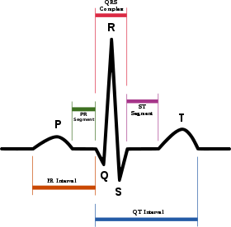
P wave, atrial depolarisation
QRS complex, atrial repolarization, ventricular depolarization
T wave, ventricular repolarisation
https://en.wikipedia.org/wiki/Electrocardiography

Slide 8
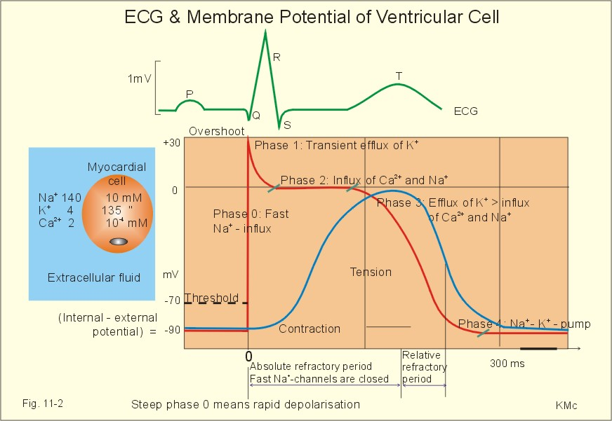
https://www.zuniv.net/physiology/book/chapter11.html

Slide 9
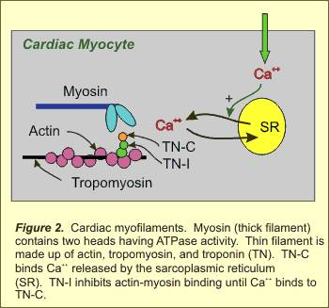
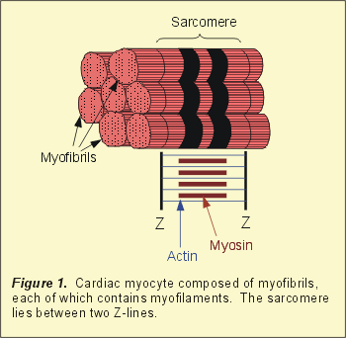
Cardiac contraction:
Ca++ increase in cytasole
Ca++ binds to troponin
Troponin enables cross bridge between actin and myosin

Slide 10
Stroke volume (SV): Blood volume ejected from ventricles during systole
End diastolic volume (EDV): Ventricular blood volume after diastole
End systolic volume (ESV): Ventricular blood volume after ejection
SV= EDV-ESV
(70=135-65ml)

Slide 11
Cardiac Output: Blood volume pumped from ventricles per minute (L/min)
CO=HRxSV
CO=72x0.07=5 L/min

Slide 12
The factors which affect stroke volume;
1.Change in EDV (preload)
2.Changes in stimuli which come from CNS
3. afterload (the resistance that heart has to overcome to pump the blood to aorta)

Slide 13
Ejection fraction (EF), a parameter for systolic function
EF=SV/EDV
0,52 =70/135

Slide 14
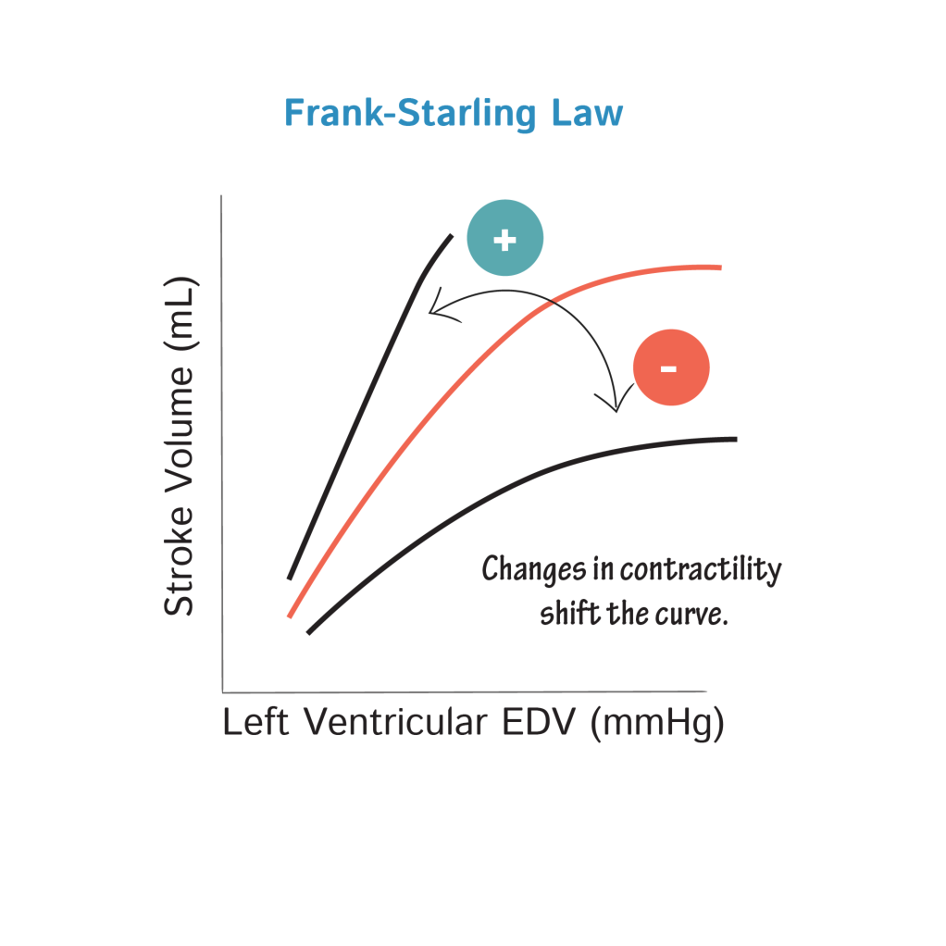
FRANK STARLING Mechanism
The relation between EDV and SV
https://www.drawittoknowit.com/course/physiology/glossary/physiological-process/frank-starling-law

Slide 15
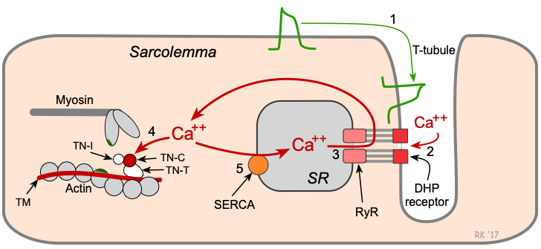
https://www.cvphysiology.com/uploads/images/cf022-e-c-coupling_c1582564749.png

Slide 16
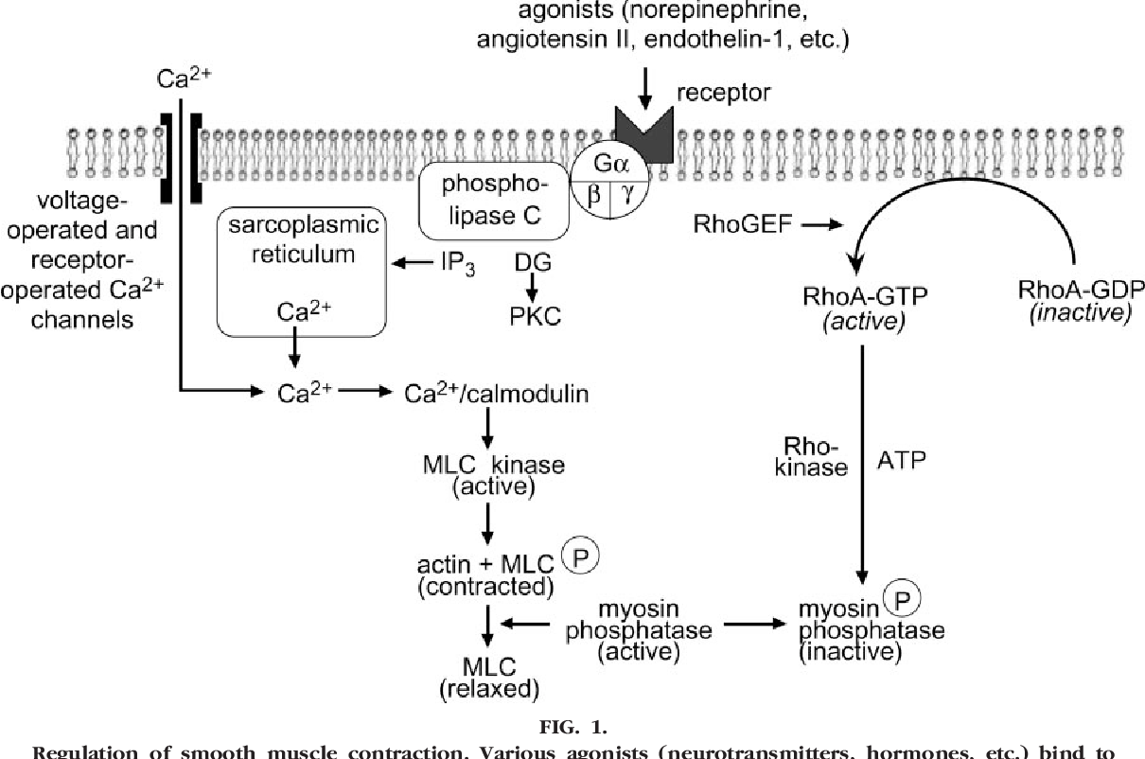
https://www.semanticscholar.org/paper/Smooth-muscle-contraction-and-relaxation.-Webb/f0345a33fe844bbccb9517cf725f1d6b0a5c3989

Slide 17
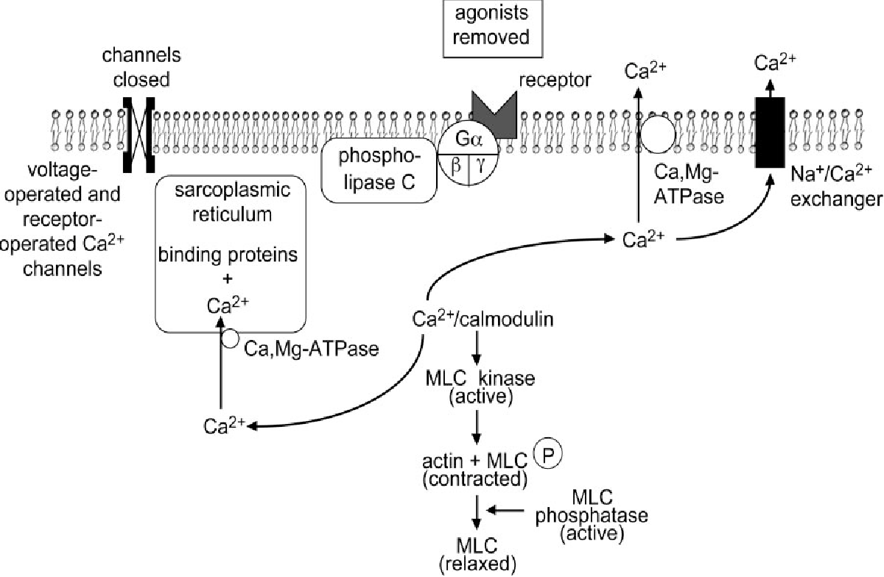
https://www.semanticscholar.org/paper/Smooth-muscle-contraction-and-relaxation.-Webb/f0345a33fe844bbccb9517cf725f1d6b0a5c3989

Slide 18
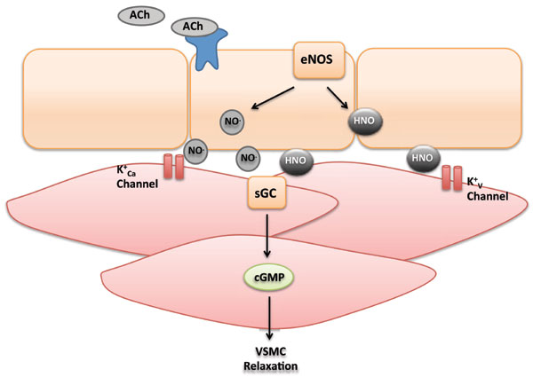
https://www.eurekaselect.com/154471/article

Slide 19
Regulation of blood pressure:
CO
Peripheral vascular resistance (PVR)
RAAS
NO (vasodilator)
Endothelin (vasoconstrictor)
ANP (vasodilator)
Bradykinin (vasodilator)
Antidiuretic hormone (vasoconstrictor)

Slide 20
Lippincott Illustrated reviews Pharmacology, 6th edition, 2015

Slide 21
Lippincott Illustrated reviews Pharmacology, 6th edition, 2015

Slide 22
BP= CO x PVR
BP: blood pressure
CO: cardiac output
PVR: peripheral vascular resistance

Slide 23
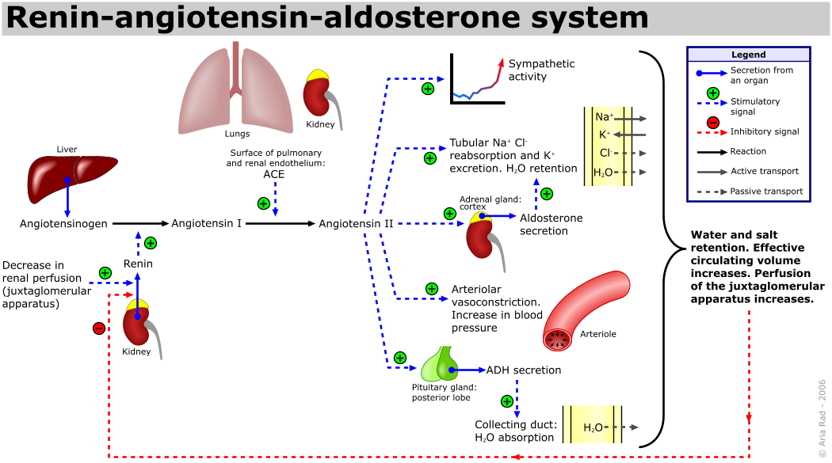
https://en.wikipedia.org/wiki/Renin%E2%80%93angiotensin_system

Slide 24
Diagnosis of hypertension
Confirmation of increased blood pressure by several measurements
Wei FF, Zhang ZY, Huang QF, Staessen JA. Diagnosis and management of resistant hypertension: state of the art. Nat Rev Nephrol. 2018 Jul;14(7):428-441.

Slide 25
Prevalence
1 of 3, in population older than 18
1 of 2, in population older than 50
%31.8 in Turkey (2017) (%36.1, women; %27.5, men)

Slide 26
Lippincott Illustrated reviews Pharmacology, 6th edition, 2015

Slide 27
Blood pressure measurement
Use the arm with higher blood pressure values
Patient should be calm
Both by sitting and upright position
Arm should be supported at heart level
Cuff size
Follow

Slide 28
Lippincott Illustrated reviews Pharmacology, 6th edition, 2015

Slide 29
Why should we regulate blood pressure?
End organ damage risk even if the hypertension is mild (140-90mmHg)
every 20-10mmHg increase in BP doubles the risk for CV risk

Slide 30
End Organ Damage due to hypertension
Stroke
MI
Heart Failure
Renal Failure
Aneurysms
Retinopathy

Slide 31
Etiology of hypertension
In most cases (%90-95), there is no underlying disease that causes hypertension.
This situation is called as “essential hypertension”.

Slide 32
Essential Hypertension

Slide 33
Secondary hypertension
Renal artery constriction
Pheochromocytoma
Cushing’s disease
Primary aldosteronism
Diabetes
Thyroid dysfunction
Stress
Atherosclerosis

Slide 34
https://www.grepmed.com/images/8485/differential-hypertension-cardiology-algorithm-diagnosis-secondary-primary

Slide 35
Malign hypertension
Urgent
Sudden increase in BP
Acute damage risk in kidney, heart, brain
Systolic>220 mmHg, diastolic>120 mmHg
Needs hospitalization
Systolic 180, diastolic 120 mmHg, hypertensive emergency

Slide 36
Risk factors for hypertension
Afroamerican race, high risk
Premenapausal women, low risk
Smoking
Metabolic syndrome (obesity, dyslipidemia, diabetes)
Family history
Sedantary life style
Excess salt intake
Excess alcohol intake

Slide 37
Clinical signs:
Headache
Insomnia
Confusion
Visual abnormalities
Nausea-vomiting
Fatigue
Tinnitus
Anxiety and anger
Nosebleeding
Palpitation
Dizziness

Slide 38
Nonpharmacological treatment strategies
*weight loss
Diet (fruit, vegetable, dairy with low fat, fish, less meat, poultry with low fat, grains
*less salt (max 6g per day)
*exercise (3 time a week, 30 min each)
*no smoking

Slide 39
Wei FF, Zhang ZY, Huang QF, Staessen JA. Diagnosis and management of resistant hypertension: state of the art. Nat Rev Nephrol. 2018 Jul;14(7):428-441.

Slide 40
Lippincott Illustrated reviews Pharmacology, 6th edition, 2015

Slide 41
Lippincott Illustrated reviews Pharmacology, 6th edition, 2015

Slide 42
Lippincott Illustrated reviews Pharmacology, 6th edition, 2015

Slide 43
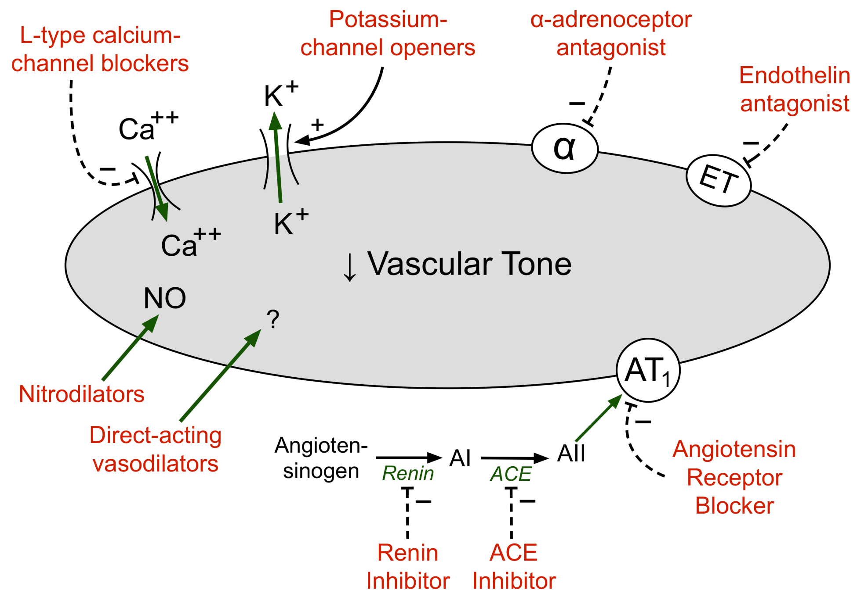
https://www.cvpharmacology.com/uploads/images/vasodilator%20drugs.png

Slide 44
Diuretics
At the beginning of the treatment; Na+ depletion, decreased blood volume, reduced CO
After 6-8 weeks, CO returns toward normal, peripheral vascular resistance decreases
10-15 mmHg decrease
Efective in mild and moderate hypertension

Slide 45
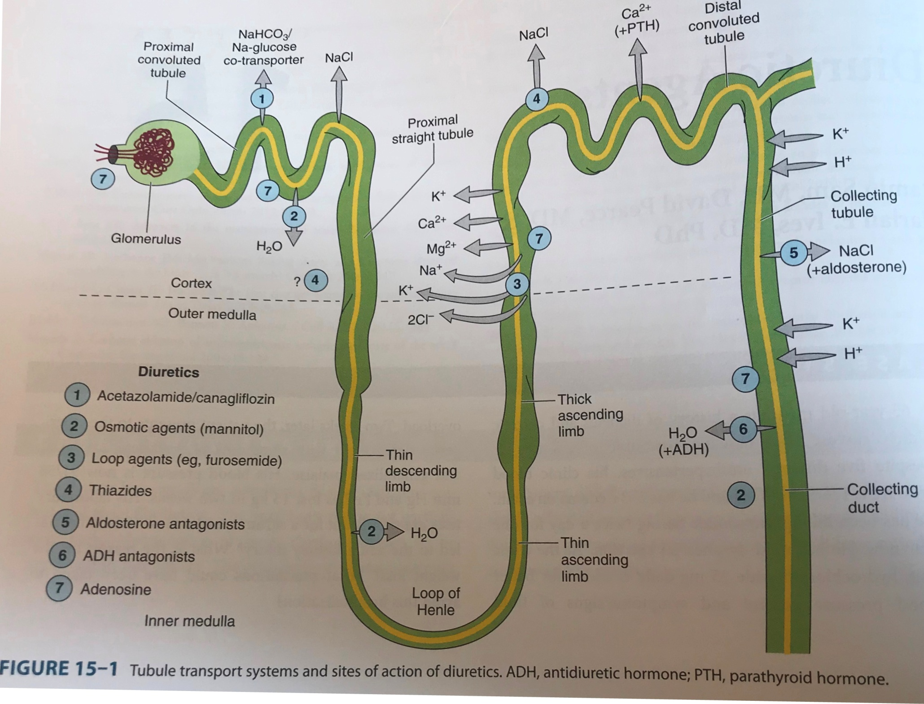
Basic and Clinical Pharmacology, Katzung & Trevor, 13th edition

Slide 46
Diuretics
loop diuretics:
Bumetanide
Etacrynic acide
Furosemide
Torsemide
Thiazides:
Chlorothiazide
Hydrochlorothiazide
Methychlorothiazide
Trichlorothiazide
Diuretics similar to thiazides:
Chlorthalidone
Indapamide
Metozalone
Quinetazone
Potassium sparing diuretics::
Spirinolaktone
Triamterene
Eplerenone
Amiloride
Lippincott Illustrated reviews Pharmacology, 6th edition, 2015

Slide 47
Thiazides (Na+ Cl- simport inhibitor)
Efective in mild or moderate hypertension
Chlorothalidone is prefered (decreases CV risk, longer half life)

Slide 48
Lippincott Illustrated reviews Pharmacology, 6th edition, 2015

Slide 49
Thiazides
Advers effects:
Hyponatremia
Hyperlipidemia
Impaired glucose tolerance
Hyperuricemia
Hypokalemic metabolic alkalosis
Alergic reactions

Slide 50
Thiazides
Advantages:
Once a day
Cheap
Decreases the risk for stroke, HF or RF
Less adverse effects
Increases the efficacy of the other antihypertensive groups as it prevents sodium –salt retention

Slide 51
Loop diuretics ( Na+ K+ 2Cl- simport inhibitor)
Affects loop of henle
In severe hypertension
In case of renal failure (GFR<30-40 mL/min)
In case of heart failure
In case of cirrhosis

Slide 52
Loop diuretics
Advers effects:
Hypokalemic metabolic alkalosis
Ototoxicity
Hyperuricemia
Hypomagnesemia
Alergy

Slide 53
Hypokalemia;
In patients with digitalis treatments
In patients with chronic arrhytmia
In patinets with acute MI or LV dysfunction
Could be dangerous!!!

Slide 54
K+ sparing diuretics (renal epithelial Na+ channel inhibitor)
Useful to prevent excessive potasium depletion
To increase effect of other diuretics
Aldosteron antagonists are beneficial in patients with heart failure

Slide 55
K+ sparing diuretics (renal epithelial Na+ channel inhibitor)
Triamterene
Amiloride

Slide 56
K+ sparing diuretics
Advers effects:
Hyperkalemia
Hyperchloremic metabolic alkalosis
Gynecomastia
Acute kidney failure
Kidney stone

Slide 57
Aldosterone receptor antagonists
Spirinolactone, Eplerenone
K+ sparing effect
Hiperkalemia risk!
Beneficial for the treatment of resistant hypertension due to primary hyperaldosteronism
Drug of choice for the patients with hepatic cirrhosis
Used also in HF

Slide 58
The drugs that target RAAS
ACE inhibitors
ARBs
Renin inhibitors

Slide 59
Angiotensin II, one of the strongest vasoconstrictors
Na+ sparing effect
Stimulates aldosteron secretion

Slide 60
Lippincott Illustrated reviews Pharmacology, 6th edition, 2015

Slide 61
Basic and Clinical Pharmacology, Katzung & Trevor, 13th edition

Slide 62
ACE inhibitors
Inhibits ACE
Angiotensin II production is blocked
Bradykinin is not inactivated
PVR is decreased, CO and HR are not significantly changed
Do not cause sympathetic activation
Pro drug

Slide 63
ACE inhibitors
More effective in patients with high renin activity
Particularly useful in patients with chronic renal disease (decrease proteinuria, stabilize kidney function
Used in diabetic patients (even normotensive patients) as protects the kidneys
Beneficial in HF treatment after MI

Slide 64
ACE inhibitors
The reason for their protective effect on kidney;
Improve intrarenal hemodynamics
Decerase glomerular efferent arteriolar resistance
Decrease intraglomerular capillary pressure

Slide 65
ACE inhibitors
Captopril
Enalapril
Lizinopril
Benzapril
Fosinopril
Perindopril
Quinapril
Ramipril
Trandolapril
Moexipril

Slide 66
Basic and Clinical Pharmacology, Katzung & Trevor, 13th edition

Slide 67
ACE inhibitors
Severe hypotension ( in hypovolemic patients due to use of diuretics, salt restriction or GI fluid loss)
Acute renal failure (in patients with bilateral renal artery stenosis)
Hyperkalemia (more frequently in patients with renal failure or diabetes)
Dry cough (sometimes accompanied by wheezing. Bradykinin and substance P)
Angioedema (bradykinin and substance P)

Slide 68
ACE inhibitors
In 2. and 3. trimesters X (fetal hypotension, anuria, fetal malformation …)
Teratogenic risk in first trimester!
K+ sparing diuretics and K+ supplement X (hyperkalemia!)
NSAIs may impair the efficacy of ACE inhibitors (PG/bradikinin mediated vasodilatation !)

Slide 69
Lippincott Illustrated reviews Pharmacology, 6th edition, 2015

