Slide 1
Pharmacodynamics
Dose response relation
Efficacy
Potency
Therapeutic index

Slide 2
PHARMACODYNAMICS
What do drugs to the body?

Slide 3
To have a good fit to only one type of receptor;
Must be sufficiently unique in shape, charge and other properties
For selective binding, MW should be at least 100

Slide 4
Receptor:
The component of a cell or organism that interacts with a drug and iniates the chain of events leading to the drug’s observed effects

Slide 5
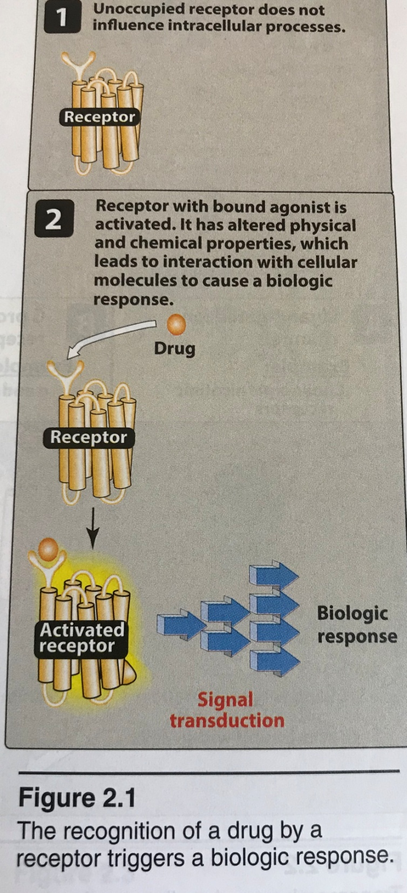
Lippincott Illustration Reviews Pharmacology, 6th edition

Slide 6
Receptors largely determine the quantitative relations between dose or concentration of drug and pharmacological effects
Receptors are responsible for selectivity of drug action
Receptors mediate the actions of pharmacological agonists and antagonists

Slide 7
Agonist:binds to receptor and activates it, it brings directly/indirectly an effect
Antagonist:binds to receptor, competes with and prevents binding by other molecules
Partial agonist:bind to the same receptor as full agonists and activates them, but does not evoke as great response (even with high concentrations). May act either as an agonist or antagonist
Inverse agonist: binds to receptor and reduces its constitutive activity

Slide 8
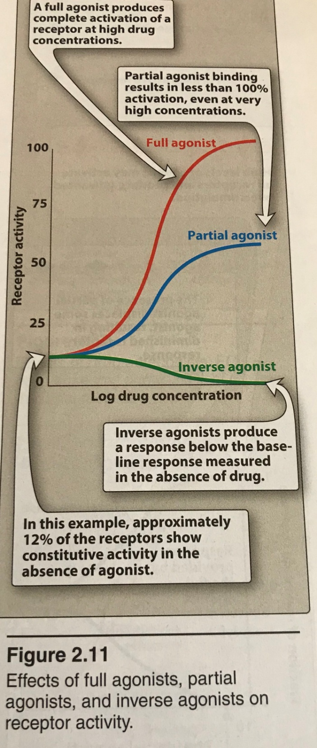
Lippincott Illustration Reviews Pharmacology, 6th edition

Slide 9
Lippincott Illustration Reviews Pharmacology, 6th edition

Slide 10
Potency
EC50 (the dose of the agonist at which %50 of the effect is produced in presence of antagonist

Slide 11
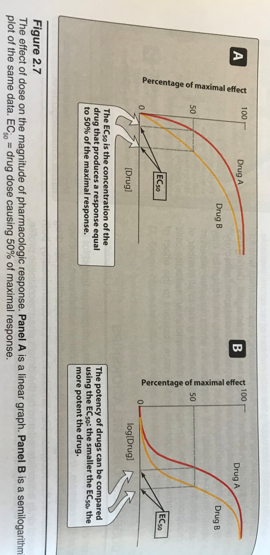
Lippincott Illustration Reviews Pharmacology, 6th edition

Slide 12
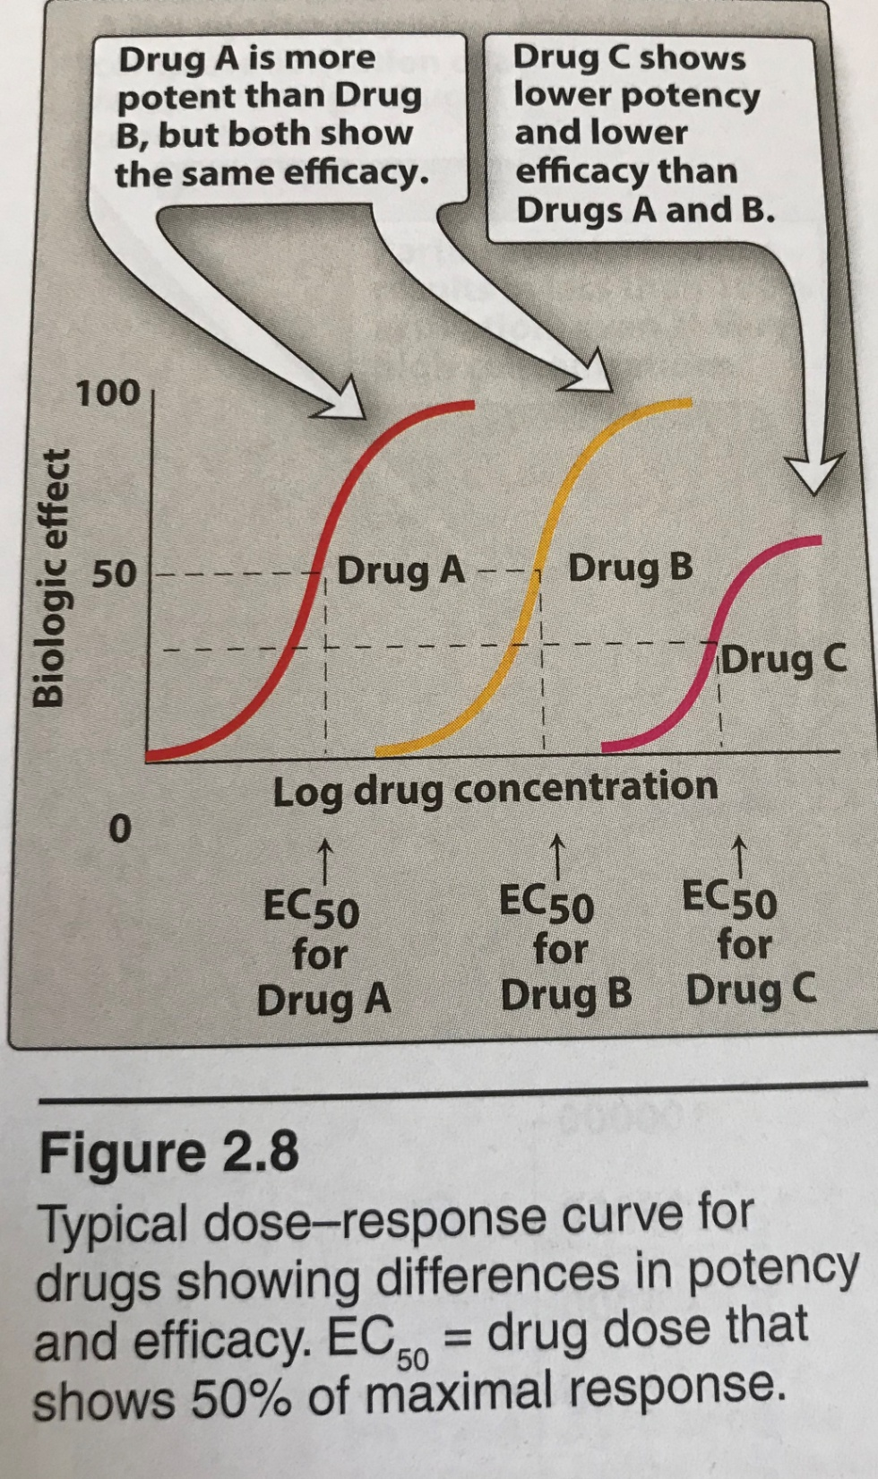
Lippincott Illustration Reviews Pharmacology, 6th edition

Slide 13
Efficacy
Emax

Slide 14
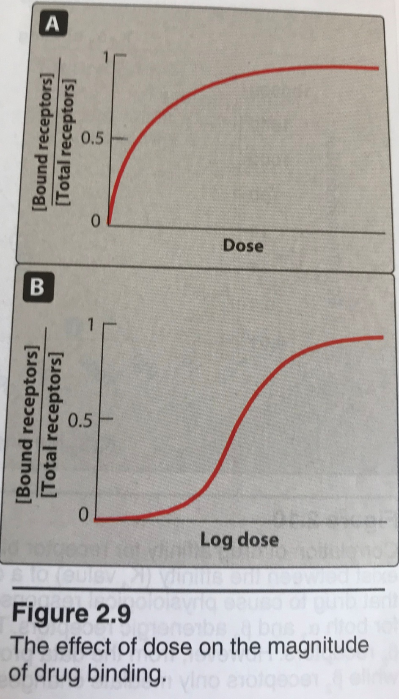
Lippincott Illustration Reviews Pharmacology, 6th edition

Slide 15
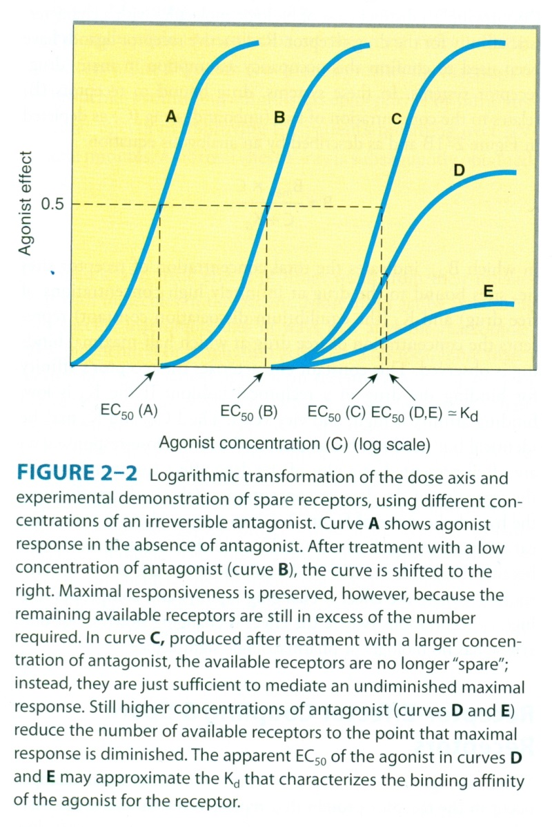
Katzung&Trevor Basic and Clinical Pharmacology, 13th edition

Slide 16
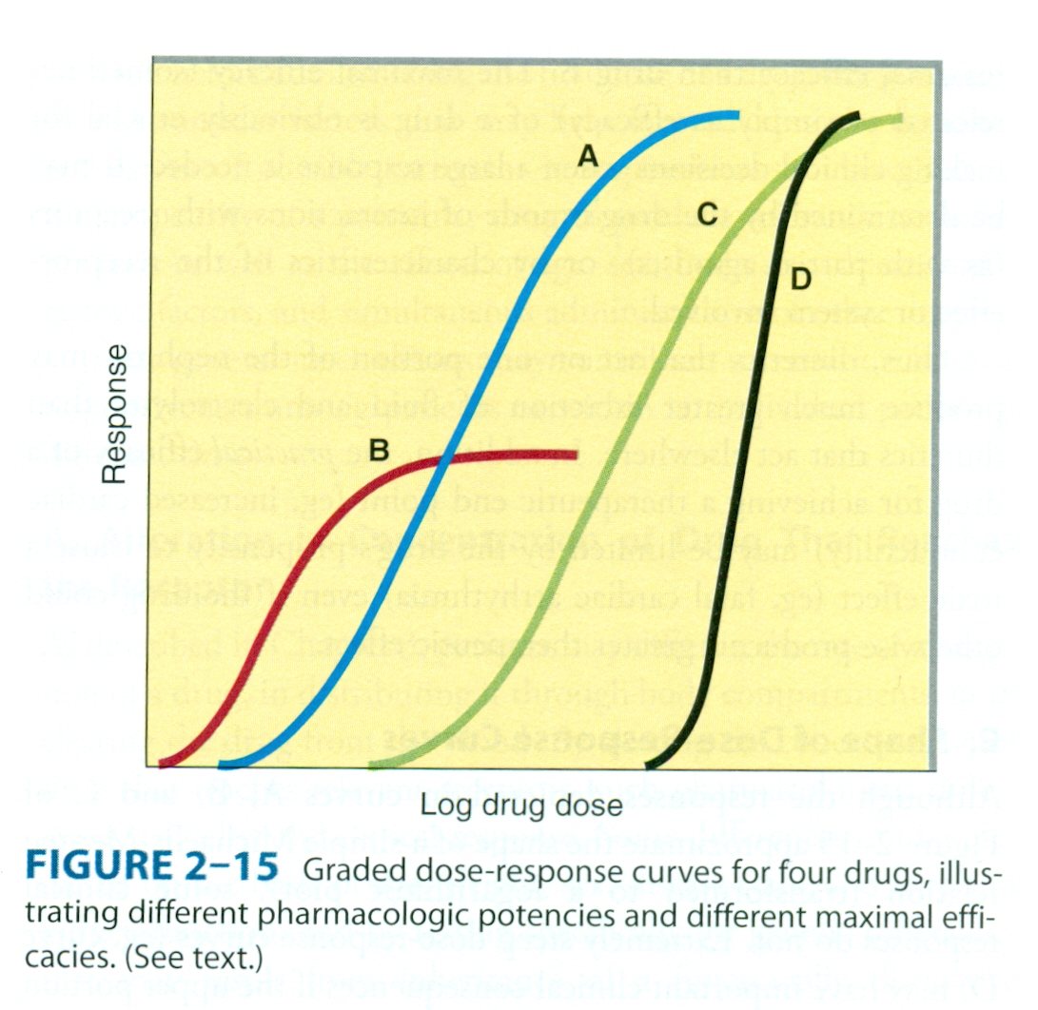
Katzung&Trevor Basic and Clinical Pharmacology, 13th edition

Slide 17
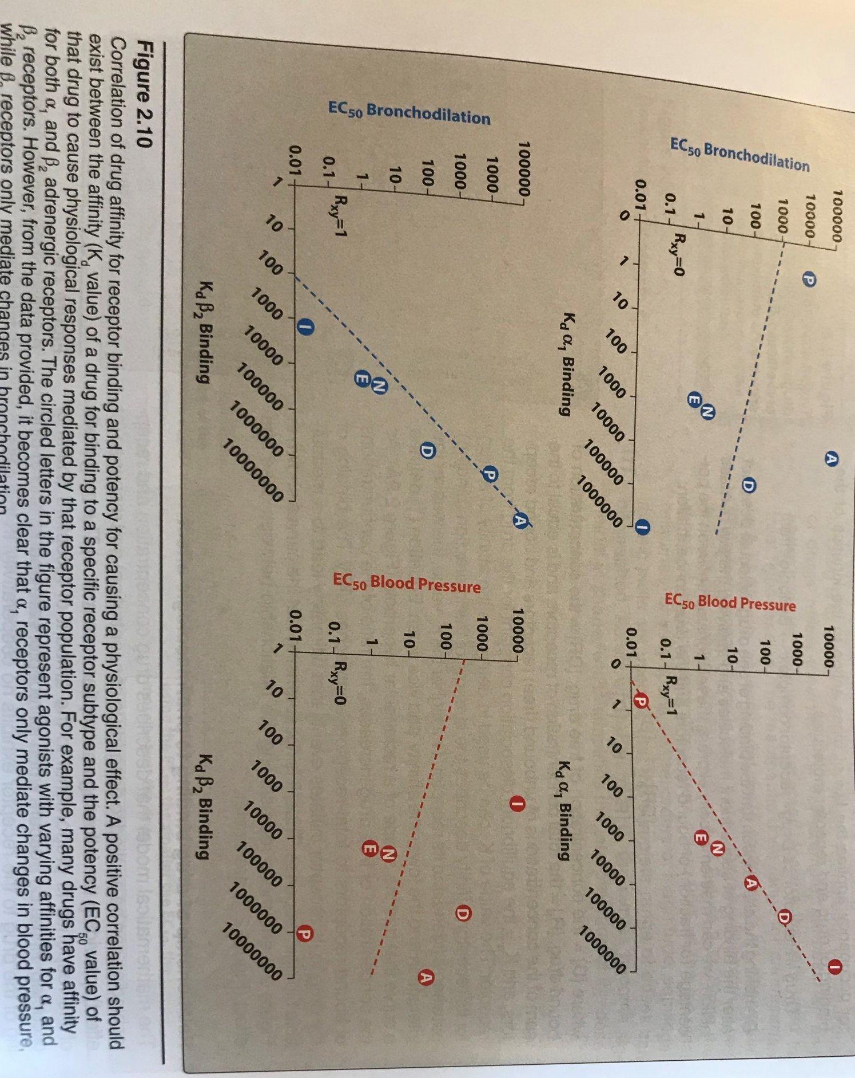
Lippincott Illustration Reviews Pharmacology, 6th edition

Slide 18
Potency vs efficacy
Potent
Efficacious
Efficacy refers to the effect of a drug. The more effect the more efficacious the drug
Potency refers to the concentration of a drug needed for the effect. The less the concentration required, the more potent the drug

Slide 19
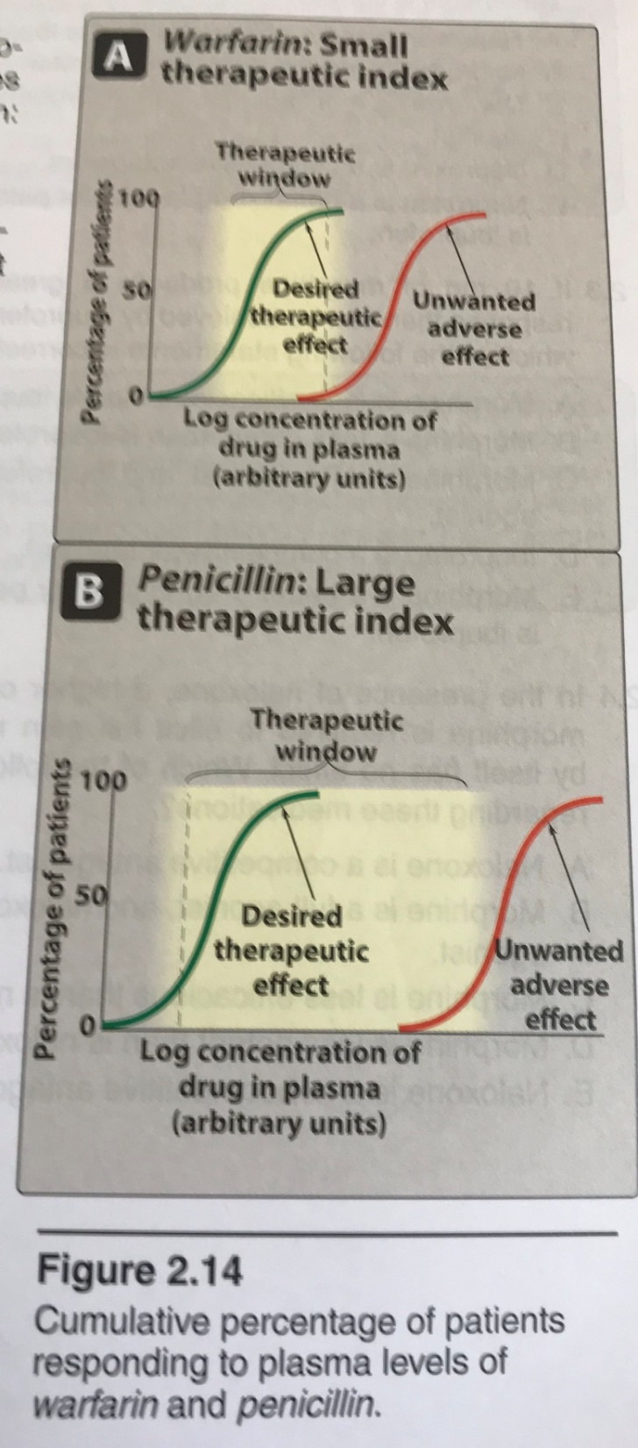
Therapeutic index
Therapeutic Index: LD₅₀/ED₅₀
Therapeutic Index: TD₅₀/ED₅₀
Lippincott Illustration Reviews Pharmacology, 6th edition

Slide 20
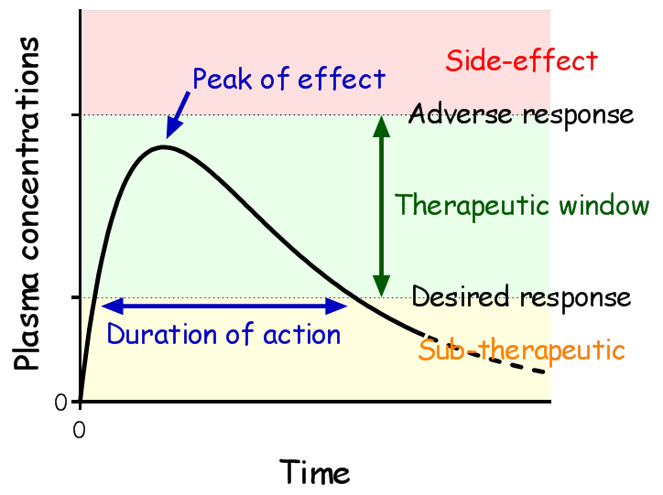
https://medimoon.com/2014/12/therapeutic-window-and-therapeutic-index/?__cf_chl_jschl_tk__=b64fd332f461472fed2faf8698915d26d8cf8c61-1601643189-0-AaDhxsSO7LNirelB1DKMXxrDuqPAWC7tLfUOyvW_JZ5cTkTjguElisPgLSIgcMJ1FbW7iAxO-Zyi5aX6ms7t0_9y7DyAKeMc8IRik7gv6UK8JR8jpol2Q5FB6zXJzbo5jg3CZAeRwqKVmvVpi0KnWKdq42ONgV2MslIk0Dvtc6_3HCZkdT379bHuY8qU-vEijL1SCXr1rd_-4mrDHV4N0YrK4df9UltWQYvmVx51AQxaUCmlX5Fca5VOjwLnYB5n1_kSgvkqrhx0P4ibGVqzghY7rSLlalGyMxsFvvMRNHTERoYHONY-o6xlC5EnSd7YOmPYfwUZ9ErY7rGucI8eYBU

Slide 21
Cumulative dose-reponse relation
In the absence of spare receptors, EC50 is equal to disociation constant of agonist-drug complex (Kd)

Slide 22
antagonism
Competetive
Antagonist competes with the agonistfor the same binding site of the receptor
binding is reversible
Antagonism can be overcome by increasing concentration of agonist or vice versa
Parallel shift of curve to right with increasing concentration of antagonist but maximum response remains same

Slide 23
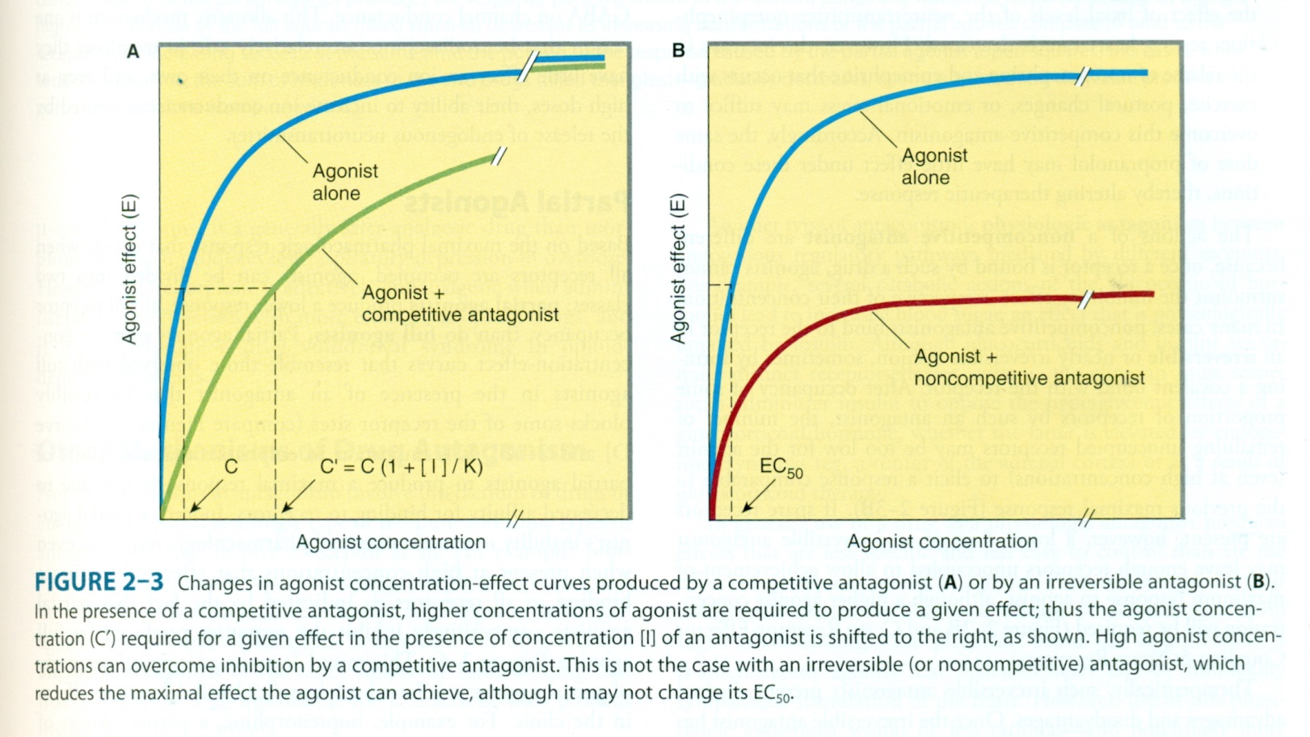
Katzung&Trevor Basic and Clinical Pharmacology, 13th edition

Slide 24
pD2
Measures the affinity of a noncompetetive as well as irreversible competetive antagonist for a spesific receptor
Defined as negative logarithm of the molar concentration of noncompetetive antagonist which will reduce the effect of an agonist to one half (%50) its maximum
pD2’=pDx+log[(E1/2)-1]
pDx, negative molar concentration of the antagonist
E1, E2 max contraction heights in the absence and presence of antagonist

Slide 25
Noncompetetive antagonism
Irreversible (covalent bounds)
When the dose of antagonist is increased, maximal response of antagonist will decrease
In the presence of high doses of antagonist, no effect of agonist could be seen

Slide 26
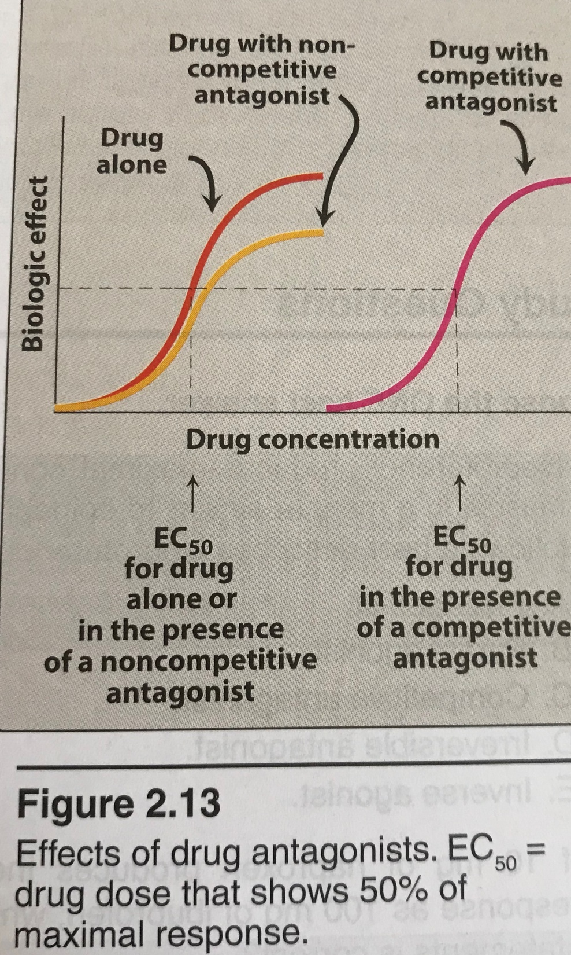
Lippincott Illustration Reviews Pharmacology, 6th edition

Slide 27
pA2
Measure of the affinity of a reversible competetive antagonist for a spesific receptor
Defined as the negative log of molar concentration of the antagonist which will reduce the effect of double dose of the agonist drug to that of a single dose
pA2=-log KB

Slide 28
Quantal dose response curve
Like a drug used to the pain
Either no effect (zero effect)
Or pain relieved (max effect)

Slide 29
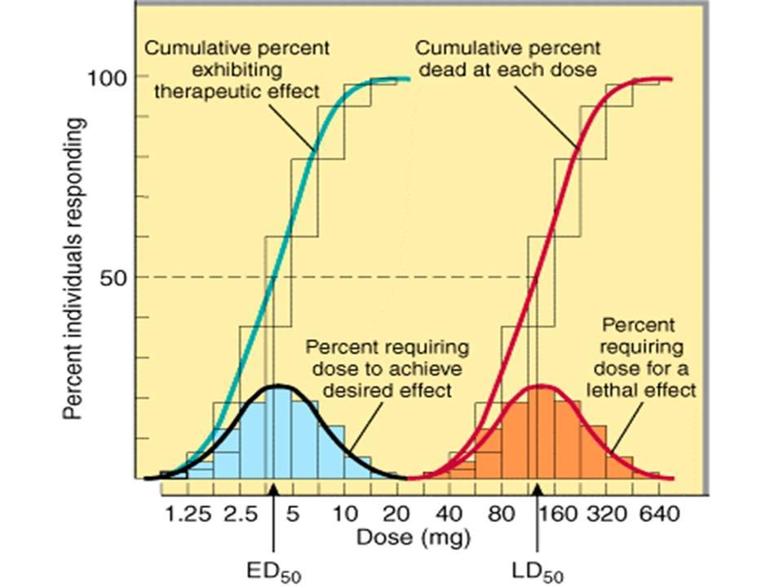
Katzung&Trevor Basic and Clinical Pharmacology, 13th edition

Slide 30
ED50:the dose of the drug required to achieve half of the expected response
TD50: the dose of the drug required to achieve toxicity in half of the subjects given the drug
LD50: the dose of the drug required to be lethal to half of the subjects given the drug
t1/2: half life, the amount of time required to lower the concentration for the drug by half

Slide 31
Signaling mechanisms Drug Action

Slide 32
Receptors
Regulatory proteins
Enzymes (dihydrofolate reductase, receptor for methotrexate)
Transport proteins( Na+-K+-ATPase, a receptor for digitalis glycosides)
Structural proteins (tubulin, a receptor for colchicine)

Slide 33
Receptors are responsible for selectivity of drug action

Slide 34
Orphan receptors
Their ligands are presently unknown (Farnesoid X receptor, Liver X receptor…)

Slide 35
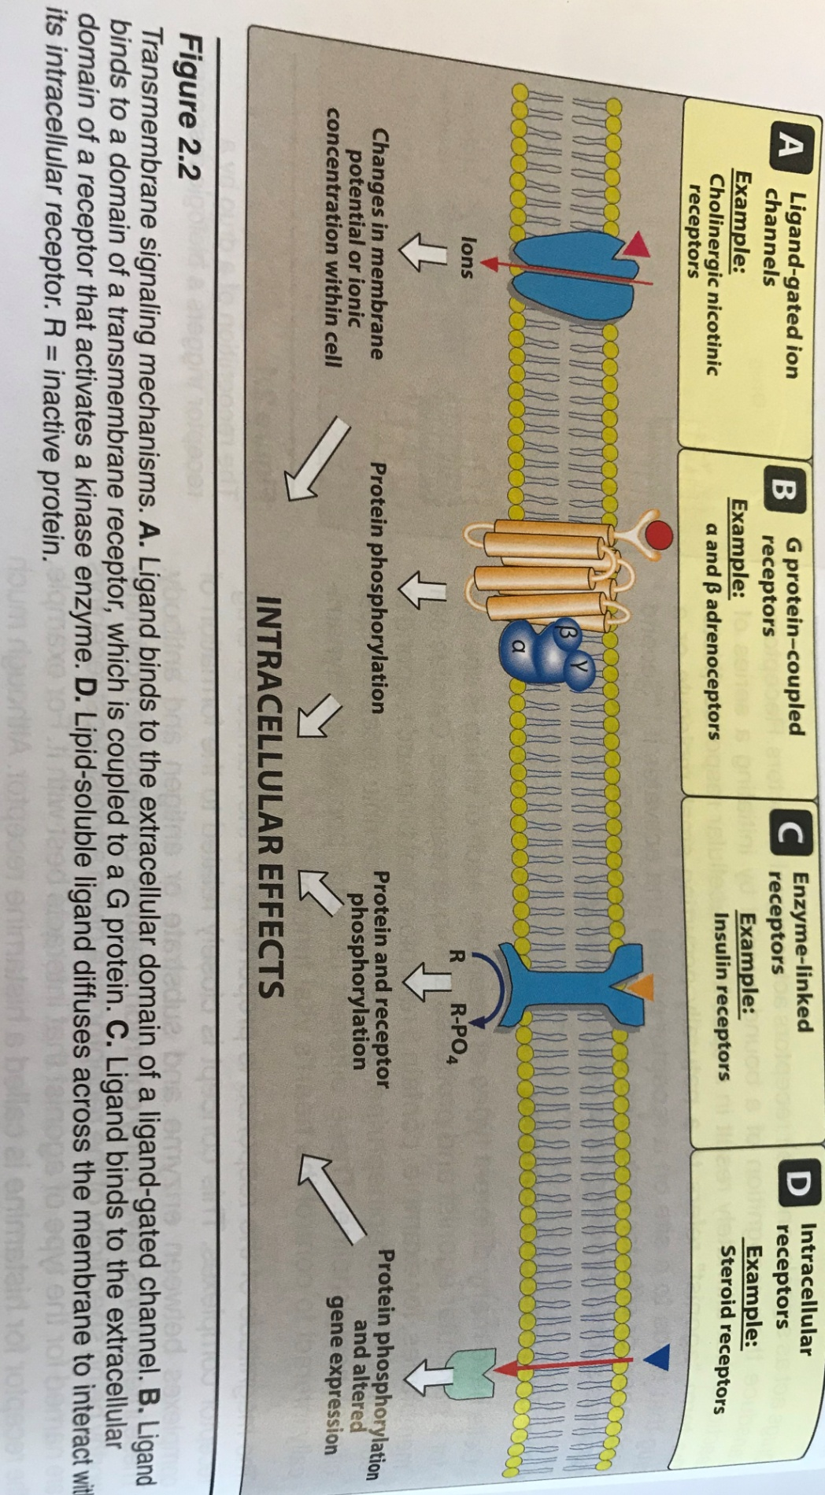
Lippincott Illustration Reviews Pharmacology, 6th edition

Slide 36
Lippincott Illustration Reviews Pharmacology, 6th edition

Slide 37
Lippincott Illustration Reviews Pharmacology, 6th edition

Slide 38
Lippincott Illustration Reviews Pharmacology, 6th edition

Slide 39
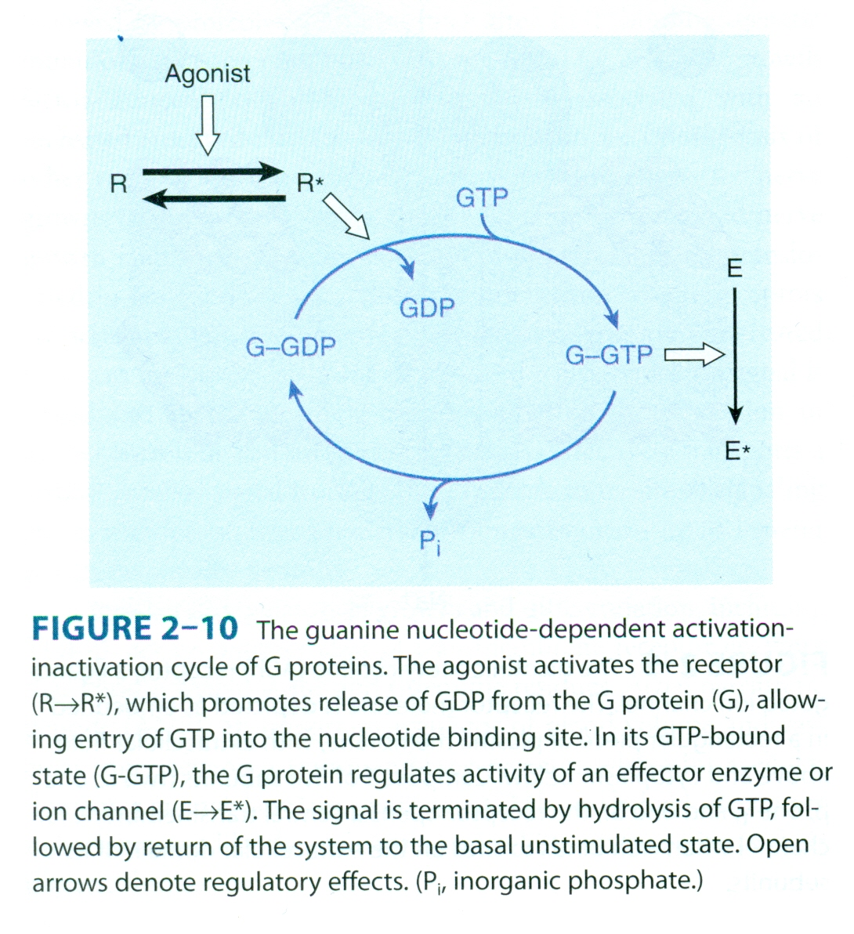
Katzung&Trevor Basic and Clinical Pharmacology, 13th edition

Slide 40
Katzung&Trevor Basic and Clinical Pharmacology, 13th edition

Slide 41
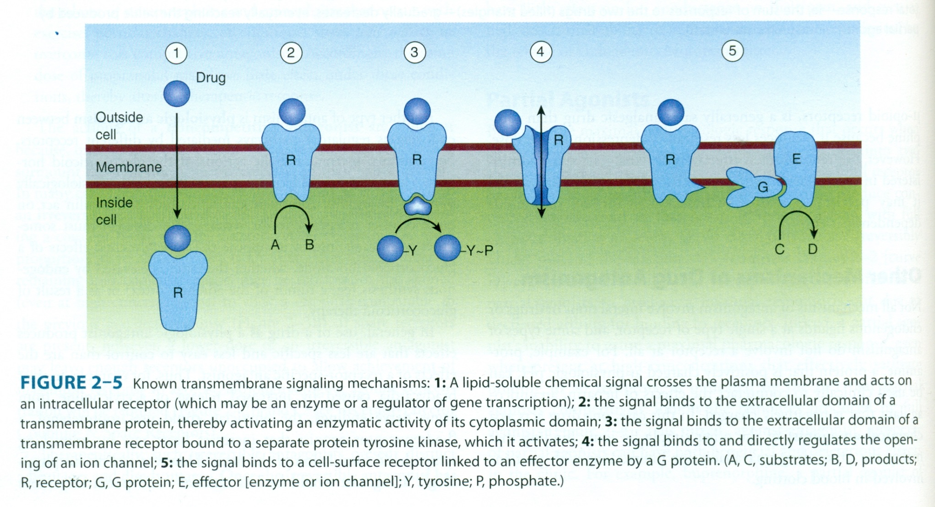
Katzung&Trevor Basic and Clinical Pharmacology, 13th edition

Slide 42
Katzung&Trevor Basic and Clinical Pharmacology, 13th edition

Slide 43
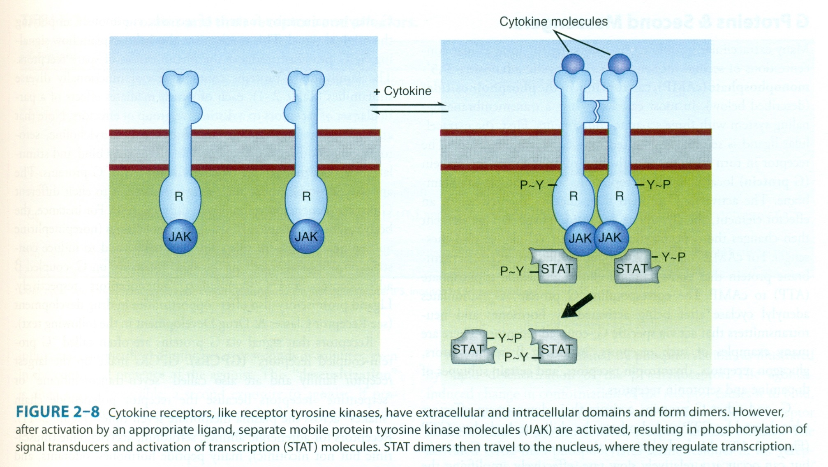
Katzung&Trevor Basic and Clinical Pharmacology, 13th edition

Slide 44
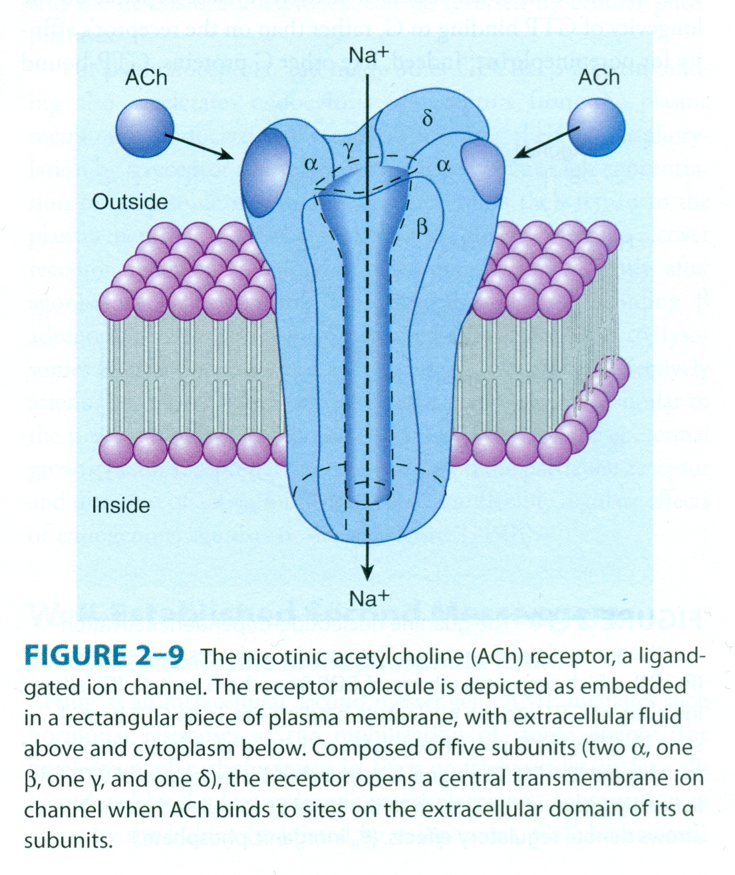
Katzung&Trevor Basic and Clinical Pharmacology, 13th edition

Slide 45
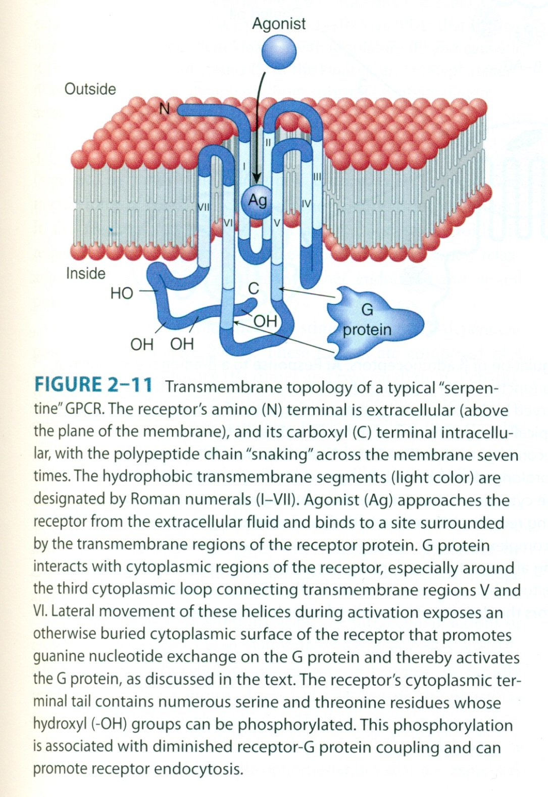
Katzung&Trevor Basic and Clinical Pharmacology, 13th edition

Slide 46
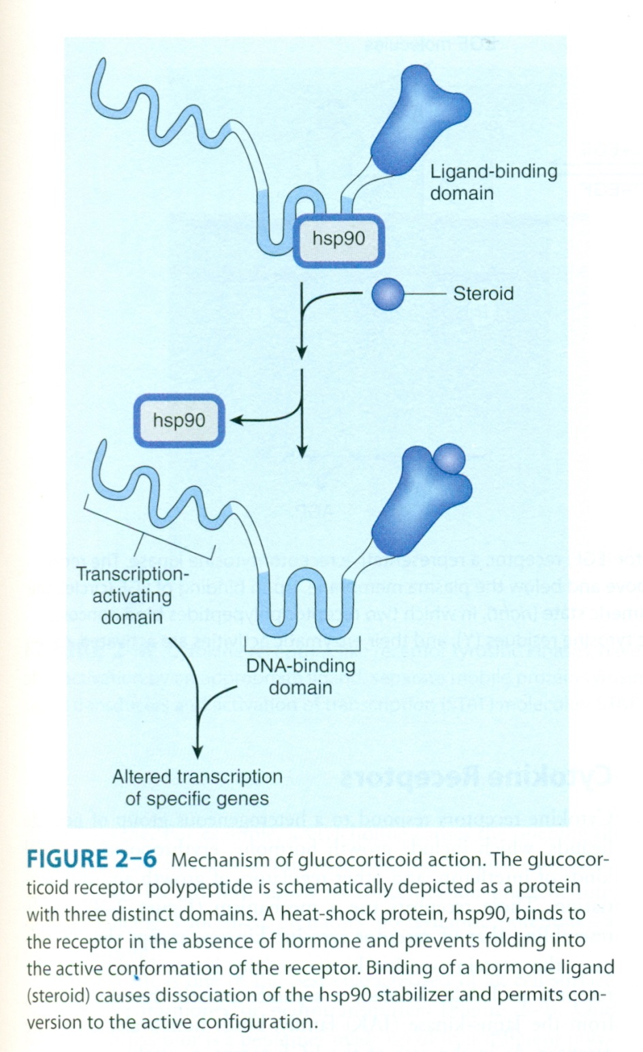
Katzung&Trevor Basic and Clinical Pharmacology, 13th edition

Slide 47
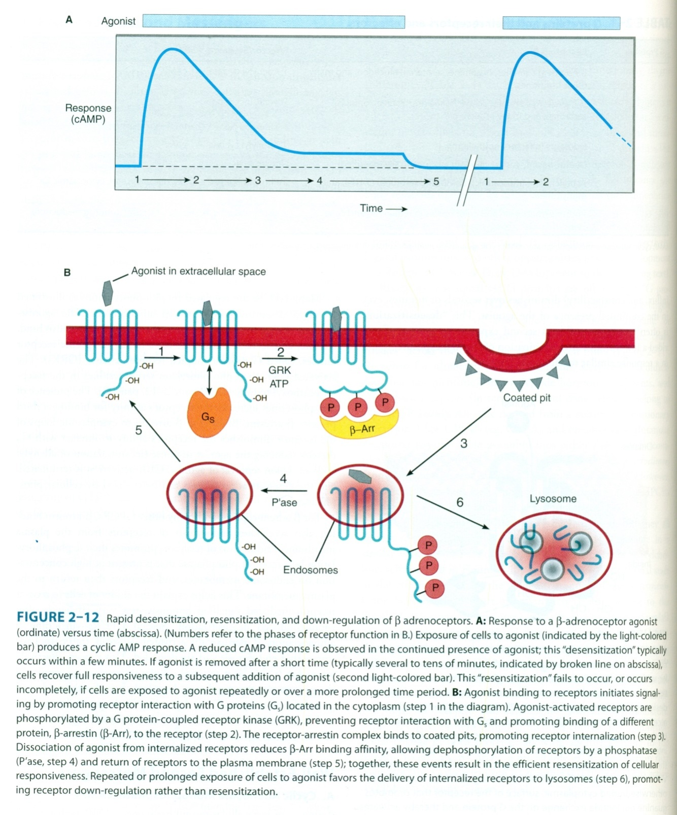
Katzung&Trevor Basic and Clinical Pharmacology, 13th edition

Slide 48
Katzung&Trevor Basic and Clinical Pharmacology, 13th edition

Slide 49
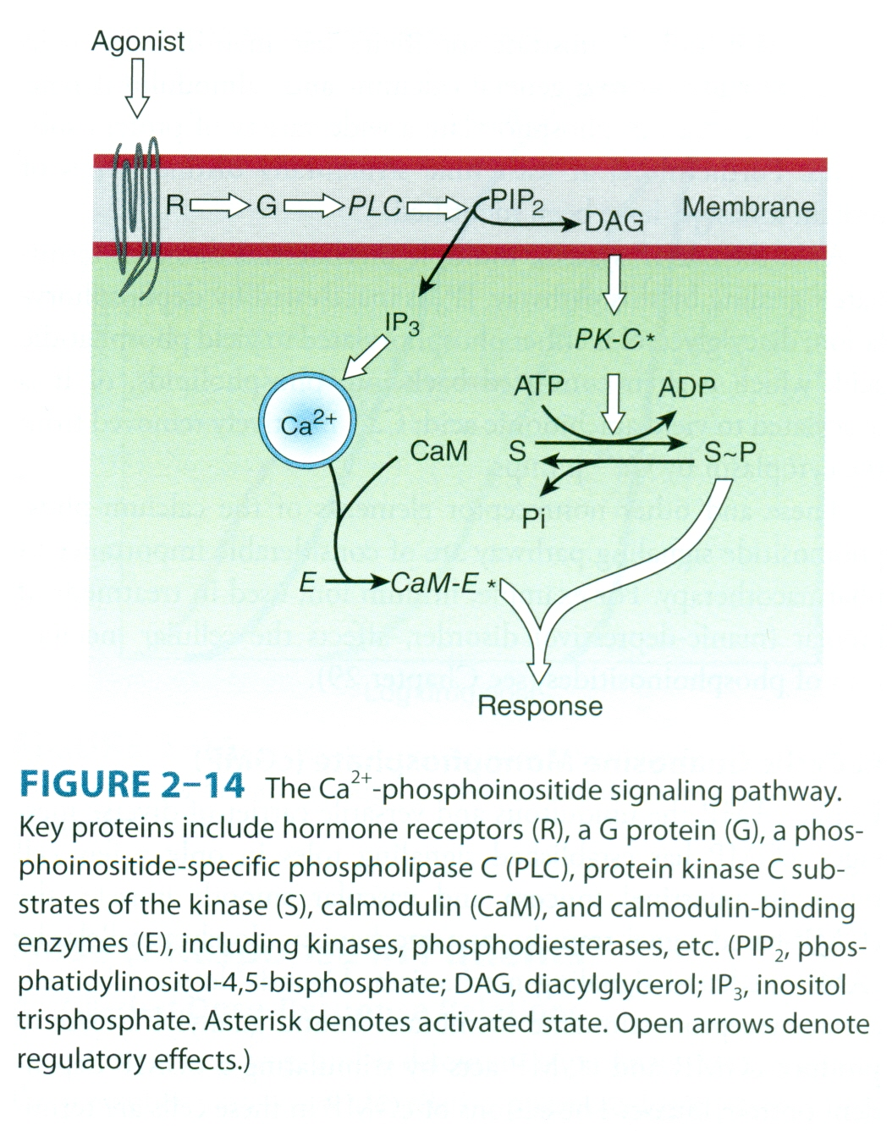
Katzung&Trevor Basic and Clinical Pharmacology, 13th edition

