Slide 1
BOVINE CORONAVIRUS

Slide 2
It is a local infectious that occurs in colon and small intestines in acute-onset, usually affects 5-21 days old calves.

Slide 3
Etiology
Coronaviridae- Coronavirus
RNA
Enveloped
Sensitive to Ether and Chloroform
HA
Virus replicates Fetal Cattle Kidney Cell Culture with CPE and create syncytium.
Cattle and small ruminants are susceptible

Slide 4
One of the pathogens that is associated with calf scour.
Infects the small intestinal & colonic enterocytes causing villus stunting, malabsorption and diarrhoea.
Also infects respiratory tract.

Slide 5
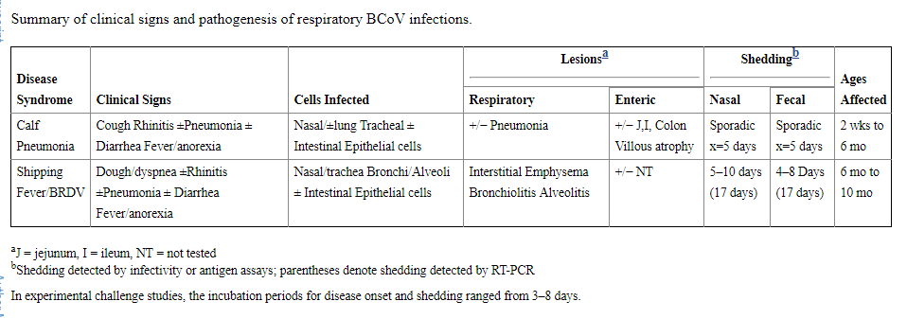
Clinical Signs
clinical signs develop in 18 - 24 hours in experimental Infections.
From 4th day, diarrhea occues and continues until death.
Saif, Linda J. "Bovine respiratory coronavirus." Veterinary Clinics of North America: Food Animal Practice 26.2 (2010): 349-364.

Slide 6
Diagnosis
Virus isolation from respiratory system secretions, small intesitines and feces.
Electron microscopy anf IF are used.
ELISA
PCR

Slide 7
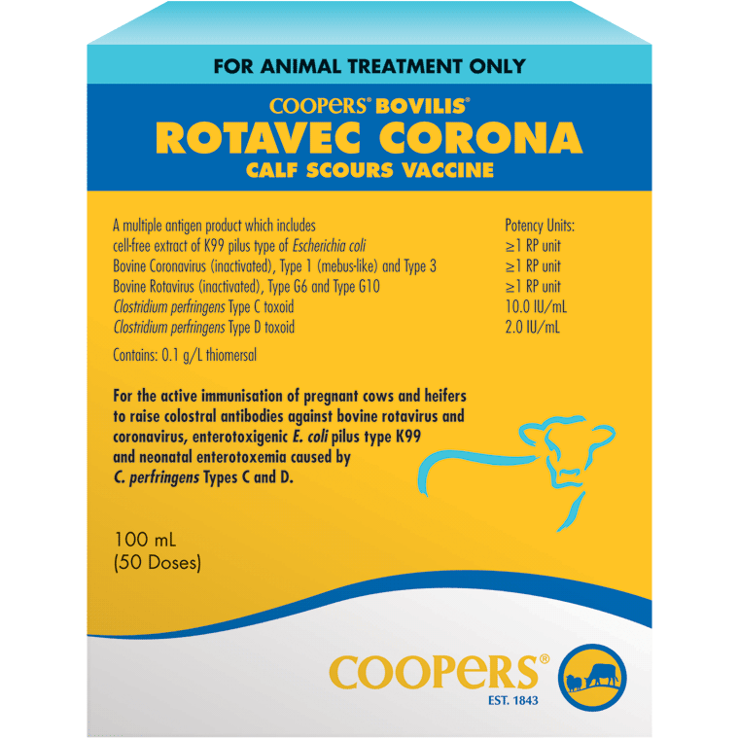
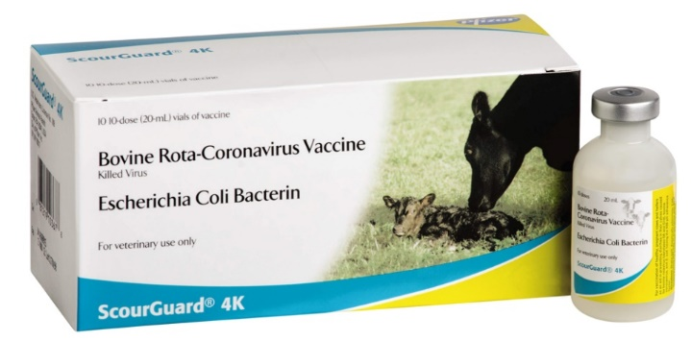
Immunity
Calves are immunized against re-infection.
Control
No vaccines for calf vaccination.
There are some dam vaccines to elevate and
prolong maternal antibody.

Slide 8
CORONAVIRUS INFECTIONS OF DOGS

Slide 9
Coronavirus causes intestinal infection in dogs, especially puppies.
Coronavirus is usually short-lived, but may cause considerable abdominal discomfort for a few days in infected dogs.

Slide 10
Ethiology
Coronaviridae- Coronavirus
RNA
Enveloped
Sensitive to Ether and Chloroform
HA
Virus inoculated in the Primer Cells of Dogs.
Virus is closely related with Transmissible Gastroenteritis Virus of pigs.

Slide 11
Transmission
Most cases of CCoV are transmitted by oral route via infected fecal material.
A dog may also become infected by eating from contaminated food bowls (indirect) or by direct contact with an infected dog.
https://vcahospitals.com/know-your-pet/coronavirus-disease-in-dogs

Slide 12
Pathology
Pathologically, there are atrophy and hemorrhage in the intestinal villous.
Unlike parvoviral enteritis, there is no leucopenia and no decrease in leukocyte count in this disease.
The intestines are filled with a green yellow liquid feces.
The intestinal mucosa is hemorrhagic.

Slide 14
Clinical Signs
Adult dogs often have few or very mild symptoms.
Occasionally an infection may cause more severe symptoms, particularly in young pups.
Watery diarrhea
Nausea Lack of appetite
Vomiting
Hard or bloated belly
Fever
Cough, sneezing and other respiratory symptoms
https://wagwalking.com/condition/canine-coronavirus-infection
https://vcahospitals.com/know-yovur-pet/coronavirus-disease-in-dogs

Slide 15
Diagnosis
E.M. could be used.
The virus is isolated from intestines.
Antibodies are serologically detected by indirect diagnostic methods.
PCR

Slide 16
Treatment
There is no specific treatment for coronavirus.
Antibiotics are ineffective against viruses, but may be useful in controlling secondary bacterial infections.
Early medical intervention is the key to successful treatment of severe cases.
Canine coronavirus vaccines are available. This vaccine is not recommended for all dogs and will be administered based on your dog's lifestyle and risk assessment.

Slide 17
FELINE INFECTIOUS PERITONITIS (FIP)

Slide 18
Feline infectious peritonitis (FIP) is a viral disease of cats caused by certain strains of a virus called the feline coronavirus (FCoV).
FIP is a fatal disease which occurs in around 5-10% of cats infected with the feline coronavirus.
Therefore most cats infected with FCoV do not develop FIP.
FIP is a subacute or chronic viral disease characterized by fatigue, ascites, lymphopenia or granulomatous changes in the internal organs, which can be seen in all ages.
http://www.pitt.edu/~super1/lecture/lec3831/index.htm

Slide 19
Etiology
Coronaviridae- Coronavirus
RNA
Enveloped
Sensitive to Ether and Chloroform
HA
The virus inoculated in primer and macrophage cell cultures of feline.
ANTIGENICITY: The virus associated with FIP is indistinguishable antigenically from the common enteric FCoV.
http://www.pitt.edu/~super1/lecture/lec3831/index.htm

Slide 20
Most strains of FCoV are avirulent, which means that they do not cause disease, and are referred to as feline enteric coronavirus.
Cats infected with a FCoV generally do not show any symptoms during the initial viral infection, and an immune response occurs with the development of antiviral antibodies.
In a small percent of infected cats (5 to 10 percent), either by a mutation of the virus or by an aberration of the immune response, the infection progresses into clinical FIP.
The virus is then referred to as feline infectious peritonitis virus (FIPV).

Slide 21
HOST RANGE: Domestic & wild cats.
EPIZOOTIOLOGY: Infection with FCoV is widespread throughout the world with the majority of animals showing sub-clinical seroconversion.
Infection is through ingestion/inhalation of oral/respiratory secretions, feces or urine. Spread is facilitated by close contact eg. in catteries.
Although the disease seems to be sporadic, it can be seen as epidemics in Europe and the Americas.
It is more common male cats than females.
http://www.pitt.edu/~super1/lecture/lec3831/index.htm

Slide 22
PATHOGENESIS
A slow death.
Some weeks, months or years after a localized primary infection with FCoV, cats who have failed to eliminate the virus can develop FIP.
http://www.pitt.edu/~super1/lecture/lec3831/index.htm

Slide 23
FCoV replicates in the gut but it is thought that in FIP a mutant spreads to major organs in macrophages and monocytes.
Immune complexes form within the walls of small blood vessels leading to an inflammatory response which damages vessels and permits the escape of fibrin-rich serum constituents into the intercellular spaces, giving the characteristic FIP fluid.
The presence of circulating anti-coronavirus antibodies potentiates the disease probably accelerating the uptake of virus into mononuclear cells as well as contributing to damaging immune complex formation.
Disease depends on multiple factors which are not fully understood. Probably a genetic element in susceptibility.
http://www.pitt.edu/~super1/lecture/lec3831/index.htm

Slide 24
Three forms are recognised:
Effusive (wet):Typical symptoms are
chronic weight loss,
depression,
anorexia,
fever
progressive abdominal enlargement caused by peritoneal and/or pleural effusions
Fluid is clear to slightly opaque and very viscous with fibrin strands and often clots when exposed to air.
There may be small necrotic lesions on the peritoneum and pleural surfaces.
http://www.pitt.edu/~super1/lecture/lec3831/index.htm

Slide 26
Non-effusive (dry): Clinical signs are more variable making this difficult to diagnose.
Most have
ocular abnormalities (eg corneal precipitates, bleeding into front of eye, iritis, colour change of iris)
Disseminated pyogranulomatous lesions are found in major organ(s) - kidneys, liver, CNS, eyes.
If a cat is ill and the reason is difficult to determine, dry FIP should be suspected.
Combinations of effusive and non-effusive.
http://www.pitt.edu/~super1/lecture/lec3831/index.htm

Slide 27
DIAGNOSIS
Clinical signs are indicative especially in purebred catteries & /multiple cat households in cats <4 years of age.
Laboratory diagnosis:
high FCoV antibody titres (note that many cats have FCoV antibody but do not develop FIP),
a low albumin : globulin ratio (because globulin levels are usually greatly raised in FIP),
low white cell counts.
Characteristic lesions in appropriate tissues at post-mortem.
Virus identification is not usually attempted ante-mortem but there are recent claims that PCR can be used to identify a FIPV-specific nucleotide sequence.
http://www.pitt.edu/~super1/lecture/lec3831/index.htm

Slide 28
CONTROL
A vaccine is available.
It will not protect cats already incubating FIP and kittens have to be isolated to prevent infection with FCoV before they are old enough to be vaccinated at 16 weeks.
Problems with vaccination: Antibodies do not protect from the disease and probably make it worse.
http://www.pitt.edu/~super1/lecture/lec3831/index.htm

Slide 29
RABIES

Slide 30
Rabies is an acute, viral infection that results in death. (Fatal Disease)
It is seen in various mammals and humans.
The disease is characterized by loss of consciousness, hydrophobia and paralysis.
Zoonotic
Notifiable

Slide 31
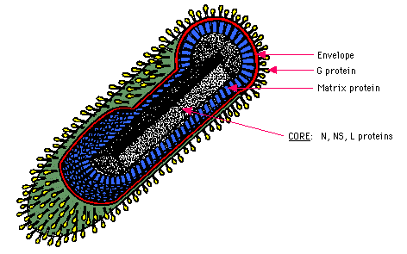
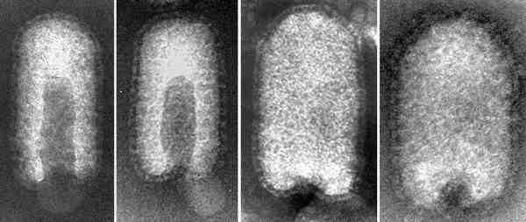
Rhabdoviridae Lyssavirus
RNA
Enveloped,
Bullet-shaped, with short glycoprotein spikes.
Sensitive to Ether and Chloroform
ANTIGENICITY: There is one type serologically. only one type required in vaccine
Moderately resistant; survive well in dark places at low temperatures (burrows, caves, soil).

Slide 32
the pathogenic rabies virus is STREET VIRUS
FIX VIRUS is obtained by passaging the STREET VIRUS in rabbit brain
FLURY strain is obtained by ECE passage of pathogenic virus.
Virus could be inoculated ECE, TC and CC.

Slide 33
DIFFERENCE BETWEEN STREET VIRUS AND FIX VIRUS
1-The Street virus exist in saliva, Fix Virus does not.
2-The Street virus causes Negri bodies, Fix virus does not.
3-The street virus is a pathogen for all mammals. Fix virus is pathogen only for rabbits.
4-The incubation period of street virus is 60-80 days. Fix virus is 4-6 days.

Slide 34
Epidemiology
All mammals are susceptible including bats
Transmitted by bites through infected saliva
(and by aerosols where high concentrations of virus eg: in caves where there are high concentrations of bats).
- Found throughout the world but some countries free.
- Wildlife act as important reservoir hosts; the species involved varies with continent:
Europe - Fox, [badger, weasel, stoat ]
Russia and the Middle East - Wolf [dog]
U.S.A. - Fox, skunk [ wildcat]
Africa, India - Dog
S. America - Bat - vampire.

Slide 35
Transmission
Rabies virus, is shedding with infected animal's saliva.
In dogs, virus exists in the saliva and sheds 5 days before the first clinical signs.
Transmission is via direct biting.
Virus also exists in urine, milk, gaita and blood.

Slide 36
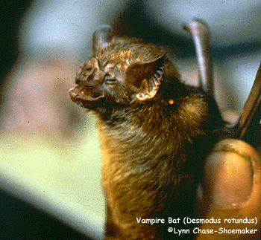
Rabies is transmitted through the saliva of an infected animal.
Infection occurs primarily via bite wounds,
or infected saliva entering an open cut or wound or mucous membrane, such as those in the mouth, nasal cavity or eyes.
Infection through inhalation of the virus has been documented, for example, in the environment of a densely populated bat cave.
Bats are susceptible to infection, may be persistently viraemic and shed virus in saliva.
They are the only species where rabies is always avirulent.
http://www.oie.int/fileadmin/Home/eng/Media_Center/docs/pdf/Disease_cards/RABIES-EN.pdf

Slide 37
Pathogenesis
Incubation period variable but can be long (10 days to 12 months (even 7 years); usually less than 3 months); increases with the distance of the bite from the CNS.
Primary replication occurs in the muscle fibres at the site of inoculation then gains access to the nerve fibres where the virus travels towards the brain (centripetal migration)
where it replicates followed by "centrifugal" migration down the cranial nerves replicating in the salivary gland and cornea.

Slide 38
Virus excretion in saliva and tears.
Virus may be shed before classical symptoms, that is, when there is fever, slight changes in temperament and dilation of pupils.
Obvious clinical signs develop after salivary excretion of virus.

Slide 39
Pathogenesis: infection and incubation period
bites
infection
other
(corneal transplants)
mucosal exposure
No antibody
(antibody can
prevent further
spread - post
exposure vaccination)
replication at site
Incubation period 14-90 days (7 years!)

Slide 40
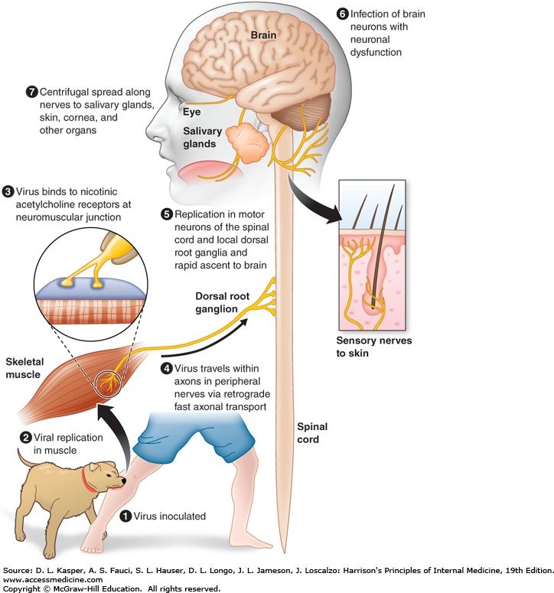

Slide 41
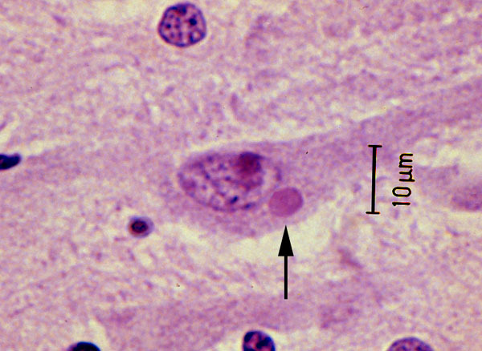
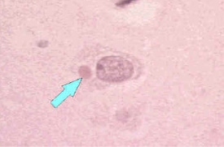
Pathogenesis in the brain
No gross signs
Negri bodies
Neuronal degeneration (apoptosis)
Infiltration by mononuclear cells

Slide 42
Clinical Signs
Nonspecific prodromal signs may be seen during the early stage of rabies.
They can include malaise, fever or headache, as well as discomfort, pain, pruritus or other sensory alterations at the site of virus entry.

Slide 43
After several days,
anxiety,
confusion and
agitation may appear,
and progress to insomnia,
abnormal behavior,
hypersensitivity to light and sound,
delirium,
hallucinations,
slight or partial paralysis,
hypersalivation,
difficulty swallowing,
pharyngeal spasms upon exposure to liquids,
convulsions and
other neurological signs.

Slide 44
There are two forms of the disease
1-Furious (fatal) rabies
Animals may be anxious, highly excitable and/or aggressive with intermittent periods of depression. With the loss of natural caution and fear of other animals and humans,
animals with this form of rabies may demonstrate sudden behaviour changes, and attack without provocation.
As the disease progresses, muscular weakness, incoordination and seizures are common. Death results from progressive paralysis.

Slide 45
2-Dumb Rabies (Paralytic)
Animals with this form of rabies may be depressed or unusually docile.
The animal will often have paralysis, generally of the face, throat and neck, causing abnormal facial expressions, drooling and inability to swallow. Paralysis may affect the body, first affecting the hind legs.
The paralysis progresses rapidly to the whole body with subsequent coma and death.
In humans, early signs can include fever or headache. As the disease progresses, symptoms may include confusion, depression, sleepiness, agitation or paralysis of the face, throat and neck.
Death generally results from progressive paralysis.

Slide 47
Diagnosis
1-Seller's staining Method:
rabies suspects specimens are stained with Seller stain and negri body is searched.
2-Fluorescent Antibody Method; (GOLD STANDARD)
Direct antigen detection. Used routinely.
3-Histopathological method:
Searching for Negri bodies.
4-Experimental Animals
inoculation to Infertile mice, IF and search for Negri bodies.
Currently, Cell culture are using.

Slide 48
Molecular methods,
such as the RT-PCR and other amplification techniques, are playing an increasingly important role in many countries but are not recommended currently for routine post-mortem diagnosis of rabies if brain tissue is available, when the FAT should be used.

Slide 49
Prevention and Control
Treatment of Rabies is not possible.
The animals with suspected rabies quarantine for 10 days.
Animals with rabies die within a maximum of 10 days from the first appearance of rabies symptoms.
Vaccination is the most effective way to deal with the disease.

Slide 50
Semple Vaccine
It is obtained by intracerabral inoculation of Fix Virus to the goats.
Kelev Vaccine
It is obtained by CAM inoculation of Kelev Strain to the ECE.
Modern cell-culture or embryonated-egg vaccine inactive
Number of doses: Three, one on each of days 0, 7 and 21 or 28, given i.m. (1 or 0.5 ml/dose depending on the vaccine) or i.d. (0.1 ml/inoculation site)

Slide 51
Two approaches in Europe
1-vaccination of domestic animals with inactivated or live attenuated vaccines
2a. control of the wildlife reservoir: population density of reservoir species reduced by gassing & shooting. It has been estimated that if the fox population was <1/4 sq.km. then virus does not spread.

Slide 52
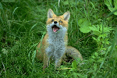
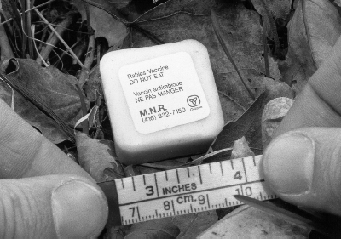
2b. Vaccination of wildlife. Has been effective in reducing the prevalence of rabies but as a consequence the fox population is increasing! Vaccines are either attenuated virus or a recombinant vaccinia vaccine. Fed in bait. A successful strategy in Europe.

Slide 53
Rabguard TC
Dogs, cats, cattle, horses, sheep
Rabvac 3
Dogs, cats, horses
Vaccinate at 3 months, boost at 1 year, every three years after that (in high risk areas may require annual vaccinations)
Cattle and horses - vaccinate annually

Slide 54
Rabies in Humans
Zoonotic disease.
Incubation period lasts 30-90 days.
The first symptoms are pruritus, burning, and pain.
Larynx and Pharynx spasm results in Hydrophobia, Aerophobia, Photophobia and Strong Salivation

Slide 55
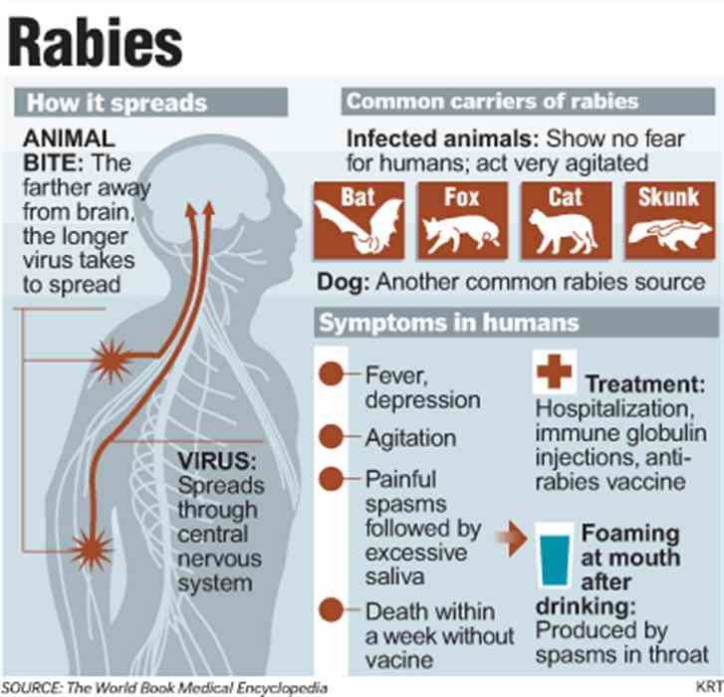
Wound treatment is applied to people bitten by animals suspected of rabies.
The wound should be washed with soapy warm water and disinfected with Alcohol and Iodine.
NO Stitches.

Slide 57
Applications for humans infected with rabies
1-According to the decision that doctor, there is no vaccination against contact without any lesions.
2- For, people have skin wounds and abrasions it is decided after the 10-day quarantine.
3-Large and near-head bite in contact with saliva of rabies suspect animal serum and vaccine are applied.

