Slide 1
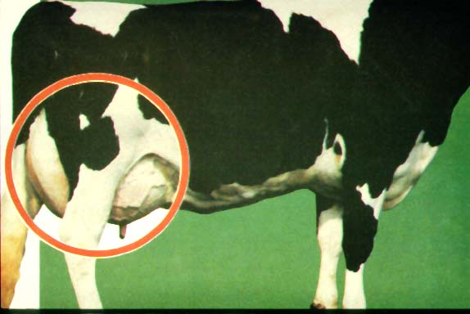
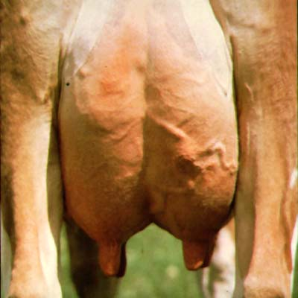

Slide 2
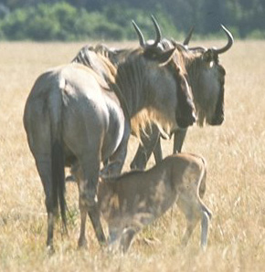
The mammary gland nourishes the neonate
Exocrine gland; common to all mammals
Function: nourish the neonate
Food source: fat, protein, sugar (CHO), vitamins, minerals, water
Protection: immunoglobulins (first Ab protection; absorbed via intestinal tract

Slide 3
The mammary gland is part the reproductive system
The mammary gland is loosely considered part of the reproductive system:
Serves a “reproductive function”; nourishment of the neonate = survival of species.
Relies on same endocrine (hormonal) support for development and function.
Example: gonadal steroids, prolactin, etc.

Slide 4
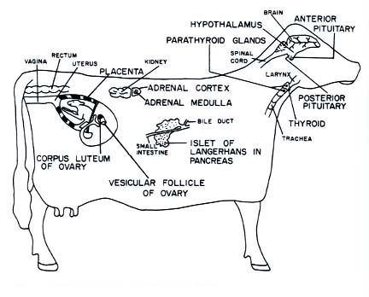
Endocrine Glands Affect Mammary Function

Slide 5
Mammary Gland Structure
Udder consists of four separate glands
A teat hangs from each quarter
Bottom of teat closed by sphincter muscle known as streak canal
Can have extra nonfunctional teats
Called supernumerary teats
Removed when calf is young
Conformation of teats
Vary in shape from cylindrical to conical
Rear teats are usually shorter
Each teat has one streak canal
Teats should be moderately sized and located centrally on each quarter
Sphincter in each teat should be tight enough to prevent leakage
Teats are hairless

Slide 6
Mammary Gland Structure
Support system = Stroma (connective tissue)
Glandular; secreting tissue = Parenchyma
Alveoli- secreting epithelial cells
Duct system- lined by epithelial cells
Lobules & lobes- clusters of alveolar tissue supported by connective tissue

Slide 7
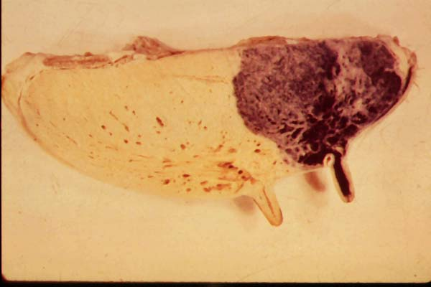
Separate Mammary Glands-Quarters
60%
40%

Slide 8
Mammary Gland Structure/Suspension
Intermammary groove separates left and right halves of the udder
Udder can weigh anywhere from 7 to 165 pounds
May support up to 80 pounds of milk
Rear quarters secrete 60% of the milk
Udder continues to grow in size until cow is 6 years of age
Well attached udder fits snugly against the abdominal wall in front and on the sides
Extends high between thighs in rear
3 major supporting structures
Skin
Median suspensory ligament
Lateral suspensory ligament

Slide 9
Mammary Gland Suspension
Skin
Minor role in support
Median suspensory ligament
Separates right and left halves of udder
Connects udder to abdominal wall
Lamellae
Elastic tissue which responds to weight of milk in udder
Lateral suspensory ligament
Inflexible
Surround the outer wall of udder
Attached to prepubic and subpubic tendons
Intermammary groove formed where lateral suspensory ligament and median suspensory ligament meets

Slide 11
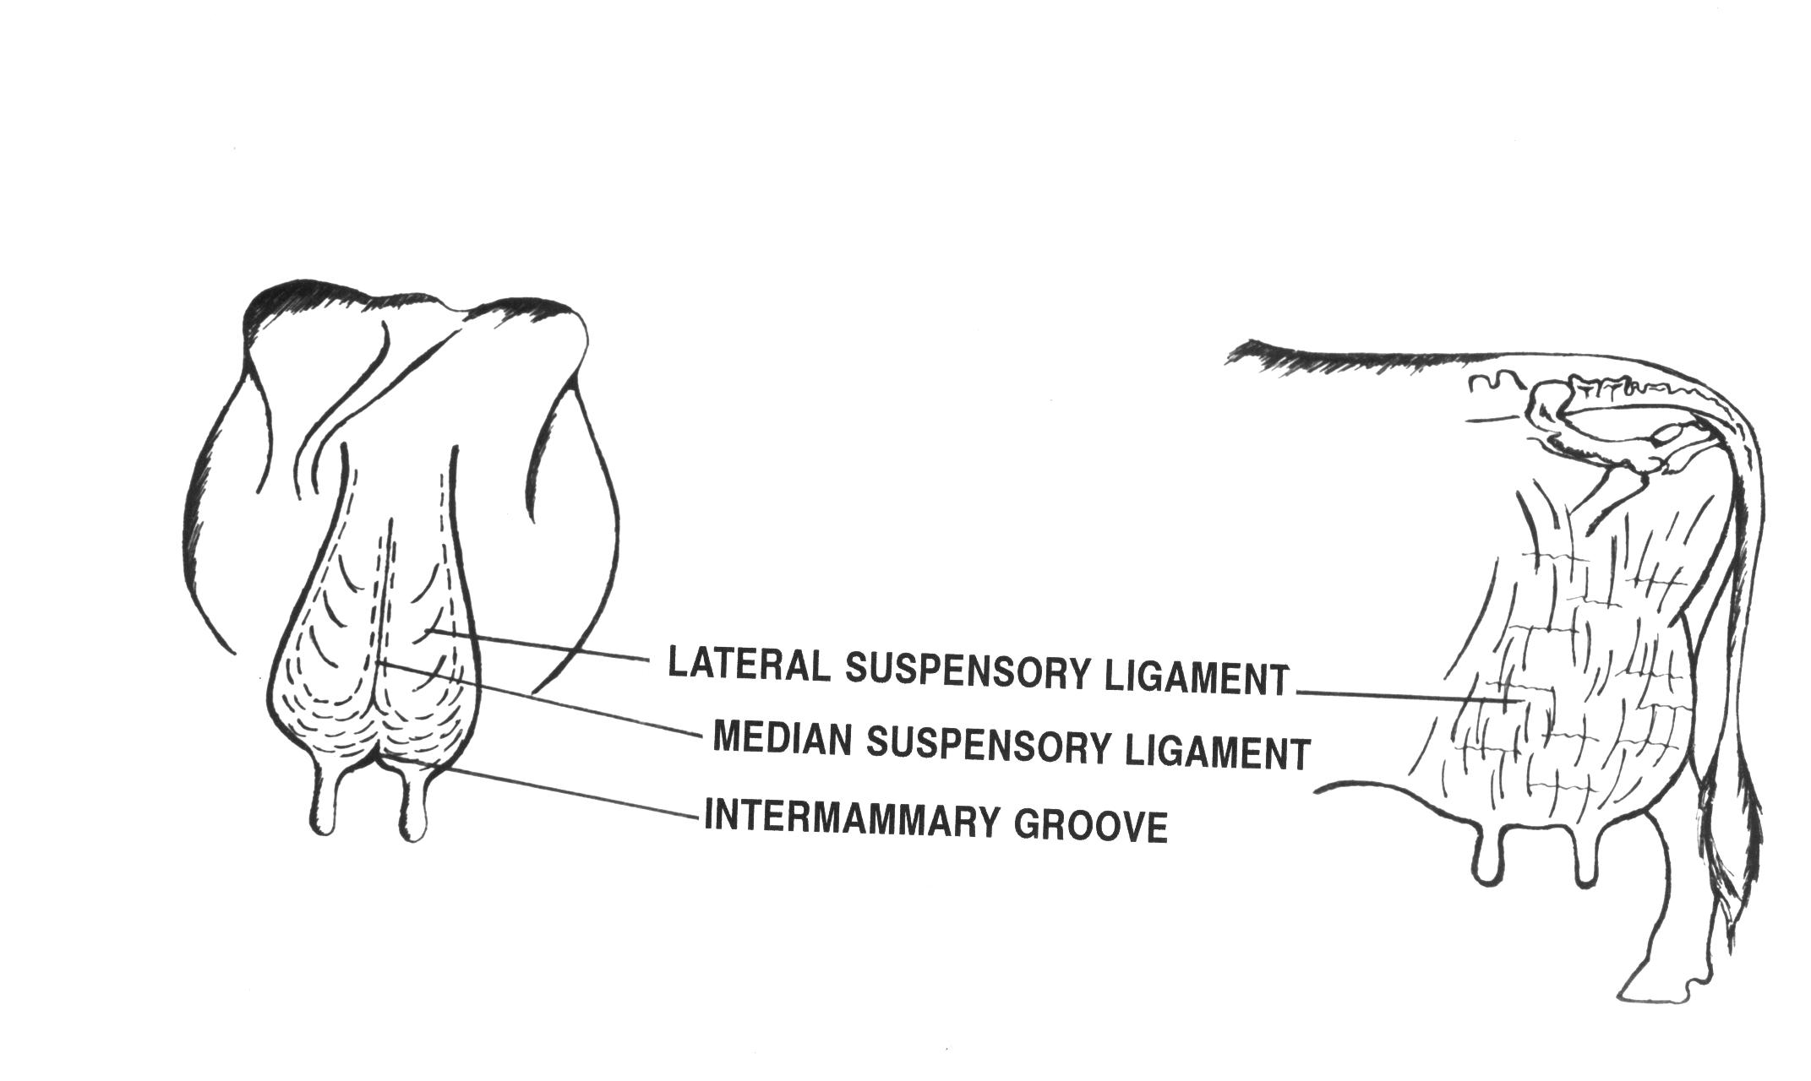
Fig 29-3. An illustrated view of the ligaments that permit udder suspension (Courtesy of Iowa State University)

Slide 12
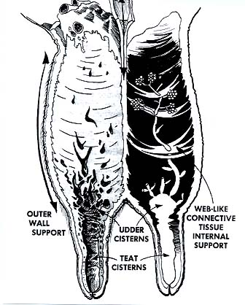
Mammary Gland Support
Medial suspensory
ligament

Slide 13
Internal Anatomy
Streak canal
Functions to keep milk in udder and bacteria out of udder
Teat cistern
Duct in teat with capacity of 30-45 milliliters
Separated from streak canal by folds of tissue called Furstenberg’s rosettes
Gland cistern
Separated from teat cistern by the cricoid fold
Holds up to 400 milliliters of milk
Collecting area for the mammary ducts
From this branches the mammary ducts

Slide 14
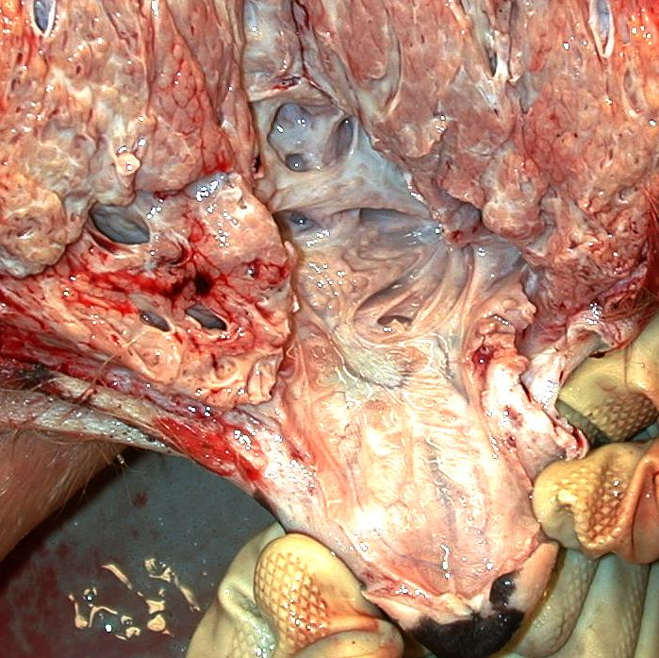
Fig 29-4. A dissected mammary gland showing the gland cistern, teat cistern and streak canal (Courtesy of Mark Kirkpatrick)

Slide 15
Alveoli and Duct System
Alveoli is the basic milk producing unit
Small bulb-shaped structure with hollow center
Lined with epithelial cells that secrete milk
Each cubic inch of udder tissue contains 1 million alveoli
Each alveoli surrounded by network of capillaries and myoepithelial cell
Contraction of myoepithelial cell stimulates milk ejection
Groups of alveoli empty into a duct forming a unit called a lobule
Several lobules create a lobe
Ducts of lobe empty into a galatophore, which empties into the gland cistern
Ducts provide storage area for milk and a means for transporting it outside
Lined by two layers of epithelium
Myoepithelial cells are arranged in longitudinal pattern
Shorten to increase diameter to facilitate flow of milk

Slide 16
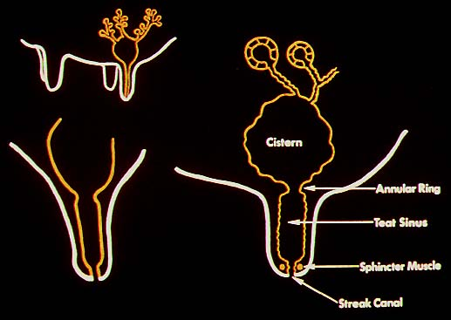
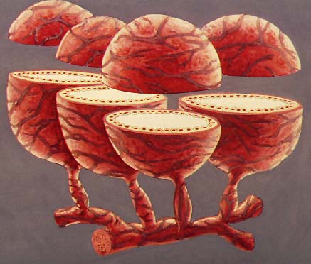
Alveoli and Duct System

Slide 17
Alveolar Products
Alveolus:
basic secretory unit; lined by epithelial cells which synthesize and/or secrete:
lipid - triglycerides & free fatty acids (FFA)
protein - caseins
lactose - disaccharide; major CHO; osmoreactive molecule (draws water)
minerals & vitamins - Ca, P, K; Vits. A, B, C, D
water

Slide 18
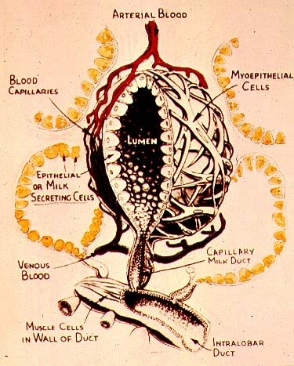
Alveolar Structure
Alveolar components & function:
epithelial cells - milk synthesis & secretion
lumen - collect milk components & water
myoepithelial cells - milk ejection
basement membrane - selective transfer
terminal duct - milk transport out of alveoli
capillary system - supply milk precursors and deliver hormones

Slide 20
Mammary Cell Function
Alveolar milk component synthesis:
RER > lipid, caseins
Golgi apparatus > lactose
(also packages lactose,
caseins, minerals, water)

Slide 21
Circulation
One gallon of milk requires 400 gallons of blood being passed through udder
Ratio may increase in low producing cows
Blood enters the udder through external pudic arteries
Blood exiting udder from veins at the base of udder blood can travel through two routes
Via external pudic veins
Via subcutaneous abdominal veins

Slide 22
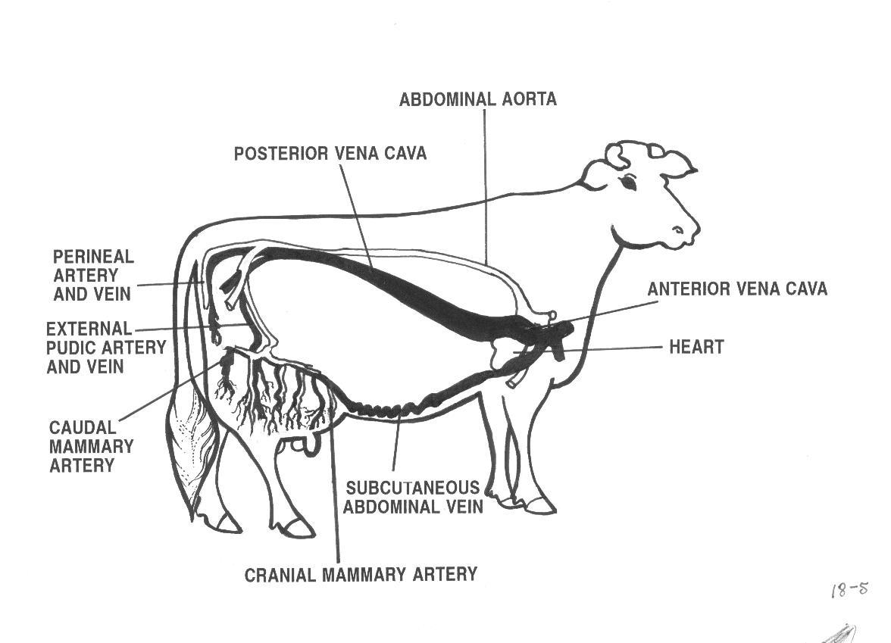
Fig 29-6. Blood flow to and from the mammary gland determines milk producing capability of the cow (Courtesy of Iowa State University)

Slide 23
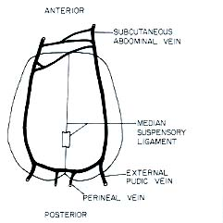
Mammary Venous Circle
Cranial Mammary
Vein

Slide 24
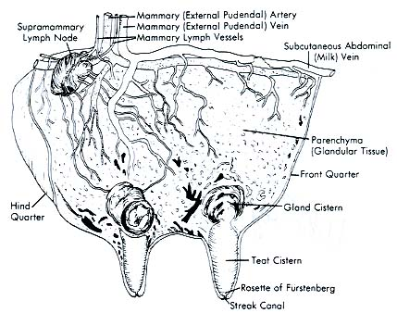
Mammary Vessels

Slide 25
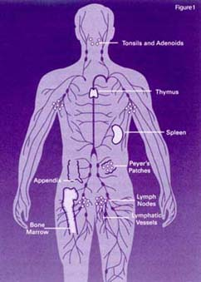
Lymphatic System
Lymph is clear, colorless
contains less protein than blood plasma
contains high [ ] of lymphocytes (WBC’s) which play a role in immune defense
contains few RBC’s
carries glucose, salts, fat (chylomicra from intestine)
dissipates heat
carrier of fibrinogen (clotting protein)

Slide 26
Lymphatic System
Movement of lymph is passive:
lymph moves through vessels by:
muscle movement (exercise, etc.)
breathing
heart beat
tissue massage

Slide 27
Lymphatic System
Helps regulate proper fluid balance within udder and combat infection
Fluid drained from tissue only travels away from udder
Blood capillary pressure
Contraction of muscles surrounding the lymph vessels
Valves that prevent backflow of lymph
Mechanical action of breathing
Lymph travels from udder to the thoracic duct and empties into blood system
Flow rates of lymph depend on physiological status of the cow

Slide 28
Lymphatic System
Fluid enters the lymph system through open-ended vessels called lacteals

Slide 29
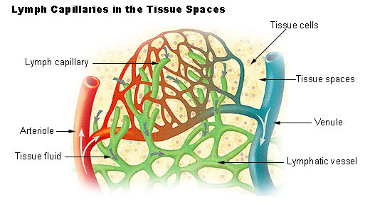
Function of the Lymphatic System

Slide 30
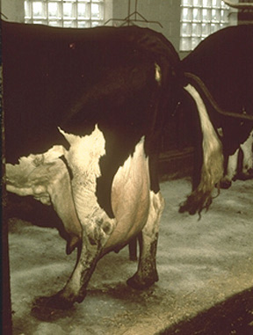
Lymphatic System- Edema
Edema:
low pressure, passive system fed by a high pressure vascular system!
this situation results in pooling of interstitial fluid if evacuation of lymph is impaired
Example: tissue trauma; increased mammary blood flow at parturition

Slide 31
Alleviating Mammary Edema
Preparturient milking may be helpful
store colostrum from healthy cows to feed calves
Frequent milkout to reduce mammary pressure
Diuretics, corticoids to reduce swelling
Mammary massage, icing
work fluid towards supramammary lymph nodes
Reduce salt intake
Don’t feed too much, too early before calving

