Slide 1
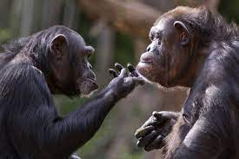
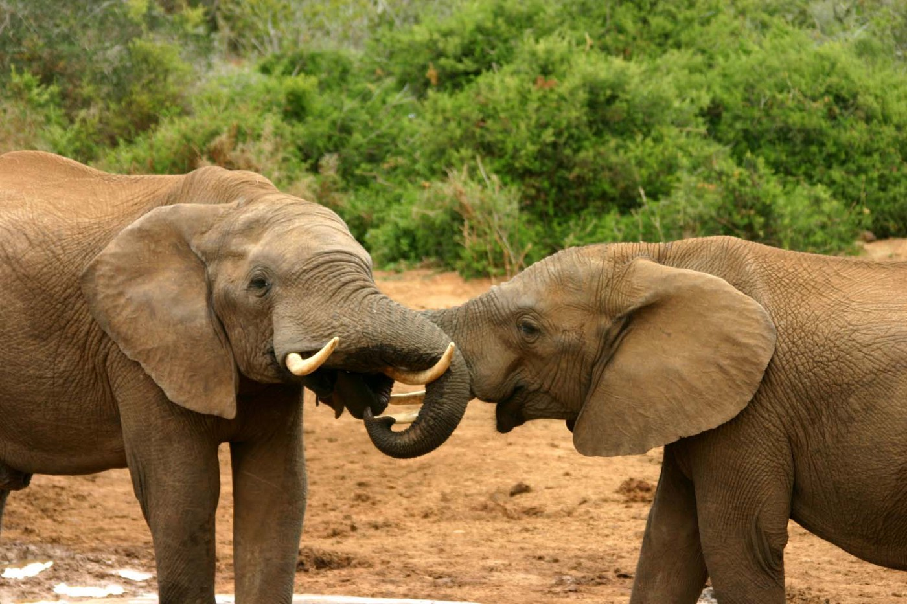
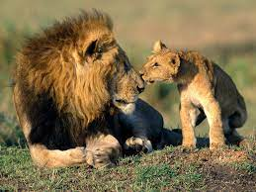
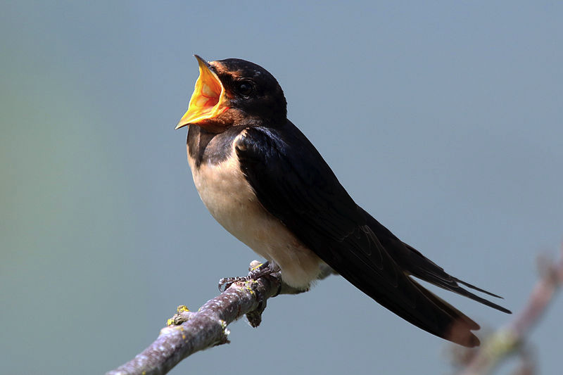
COMMUNICATION IN ANIMALS
Assoc. Prof. Dr. Yasemin Salgirli Demirbas

Slide 2
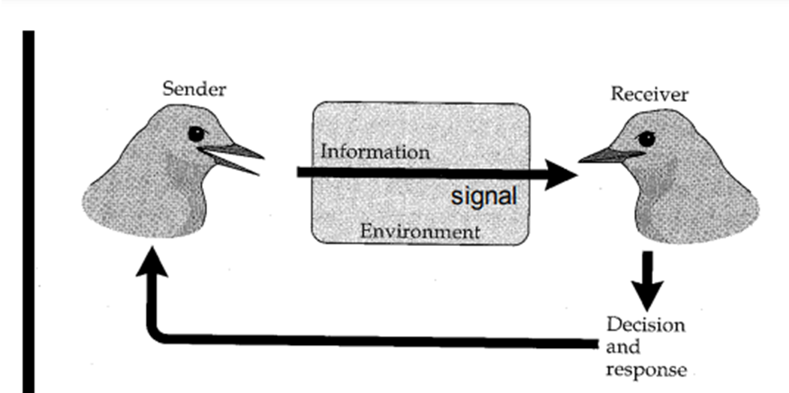
Communication
Wilson (1970): Action on the part of one organism (or cell) that alters the probability pattern of behavior in another organism (or cell) in an adaptive fashion.
Involves a signal produced by a signaler.
The signal is detected and perceived by a receiver.
Transfer of information from a signaler to a receiver

Slide 3
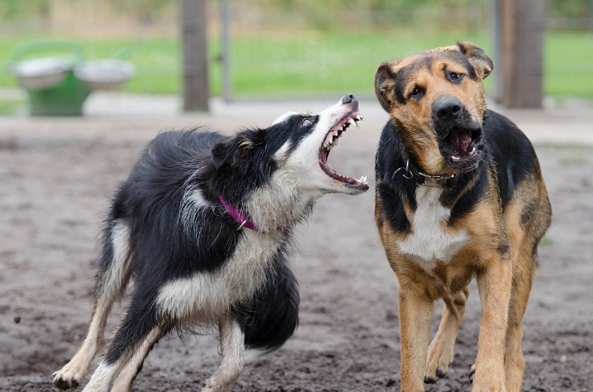
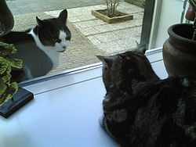
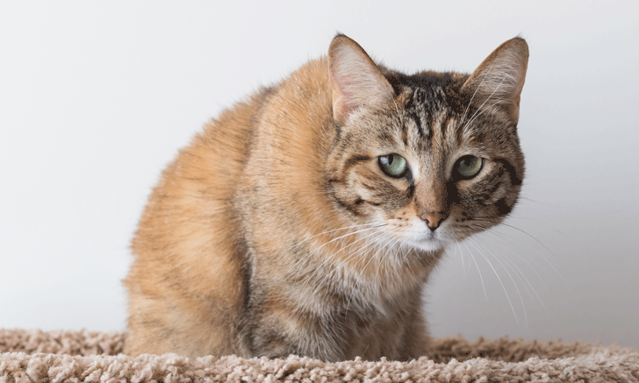
Types of Communication
Body language
A term for communication using body movements or gestures instead of, or in addition to, sounds, verbal language or other communication.
Visual
Sound
Tactile
Chemical

Slide 4
How can we predict an animal’s visual acuity?
Visual acuity:
Depends on the density of photoreceptors and ganglion cells, focal length, and the quality of the optics.
We can compare them with electrophysiological measurements of the cortex/retina and the results from behavioural experiments.

Slide 5
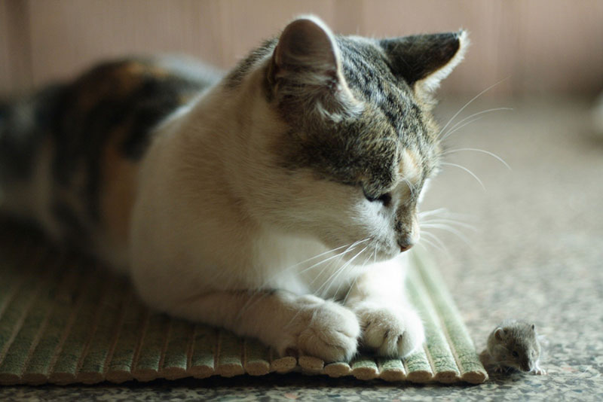
Night vision
Tapetum lucidum: biological reflector system
enables animals to see in dimmer light than would otherwise be possible.
Cats, dogs, horses, cattle have tapetum lucidum.
Mice, rats, hamsters, rabbits don not have tapetum lucidum.

Slide 6
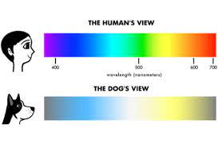
Color Vision
The perception of colour is determined by the presence of cells in the eye called cone photoreceptors.
Most mammals have two kinds of cones, which are sensitive to blue and green light.

Slide 7
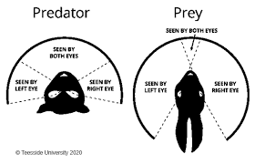
Prey vs predator (Field of vision)

Slide 8
Prey detection and selection by birds can be influenced by prey coloration.
Yellow dummy caterpillars received fewer bird attacks, probably due to aposematism.
Green caterpillars received fewer bird attacks, probably due to reduced detectability.
Birds predominantly attacked caterpillars with dark colours.

