Slide 1
Arthrodesis, Bone Tumors
Dr. Murat ÇALIŞKAN

Slide 2
What is arthrodesis?
Arthrodesis means the surgical fusion of a joint. In other words, the bones forming the joint are permanently joined together so that there is no movement in this part of the limb. Arthrodesis is a salvage procedure that is generally only performed when there are no other options to save the function of the joint.

Slide 3
What joints can be arthrodesed (fused)?
The shoulder, elbow, carpal (wrist), stifle (knee), hock (ankle) and digit (toe) joints can be arthrodesed. The main joint that cannot be fused is the hip joint. This is generally not a problem since the hip joint can be replaced with an artificial one. Elbow and knee replacements are also possible alternatives to arthrodesis of these joints.

Slide 4
indications for arthrodesis are:
osteoarthritis that is causing chronic pain and cannot be managed medically
joint instability that cannot be treated by other means
fractures involving the joint surface that cannot be repaired
infection involving the joint that fails to respond to antibiotics
tumours in or around joints
muscle/tendon rupture that cannot be managed directly

Slide 5
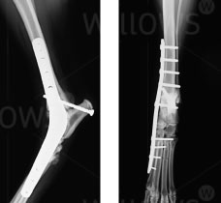

Slide 6
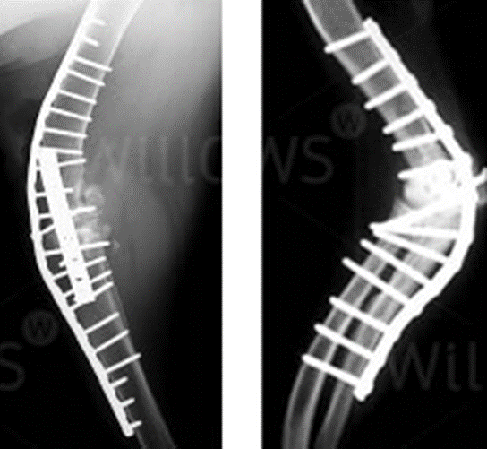
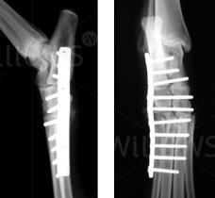

Slide 7
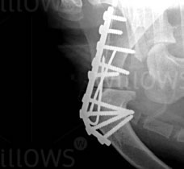
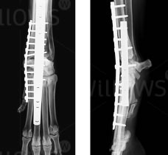

Slide 8
There are a number of important steps when fusing a joint:
the surface of the joint (known as the articular cartilage) must be removed to enable bony fusion.
a bone graft should be placed into the spaces between the bones to promote fusion. This may be an autograft (from the patient), an allograft (from a donor) or a combination of both.

Slide 9
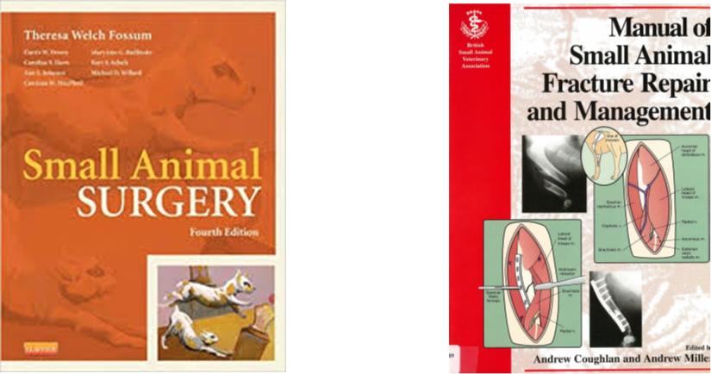
REFERENCES
https://www.willows.uk.net/specialist-services/pet-health-information/orthopaedics/arthrodesis
Ankara Üniversitesi Açık Ders Malzemeleri Ortopedi ve Travmatoloji
Prof. Dr. Hasan Bilgili Ders notu.

