Slide 1
BASIC GENETIC TERMS-V

Slide 2
Genetic information
When the genes are transferred to the next generation, there is information that affects all characteristics of the lineage. it is called GENETIC INFORMATION.

Slide 3
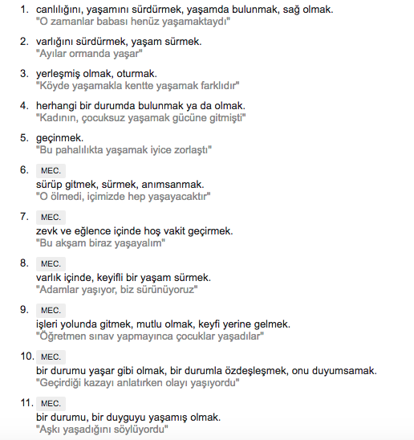
What do we know so far?
Hypothesis and theories on inherition
Knowledge about living.
What is living? ☺

Slide 4
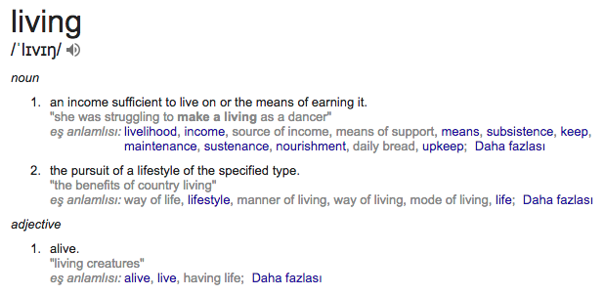

Slide 5
Continuity!
Genetic material has 4 specialities;
1- Replication,
2- Storage of information
3- transcription
4- variations via mutations

Slide 6
Discovery of genetic material
Chromosome structure.
????
Chromatins???

Slide 7
Why proteins?
Chromatins: DNA and protein
Proteins have 20 different amino acids. They are everywhere in cells.
DNA has 4 bases and its found in nukleus.
DNA structure is “simple”
Proteins are more complicated.

Slide 8
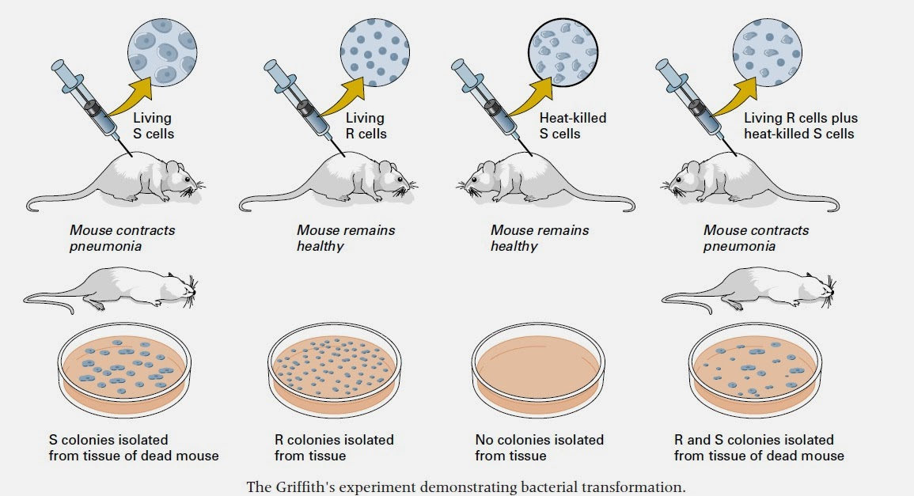
Genetic transformation experiment Griffith

Slide 9
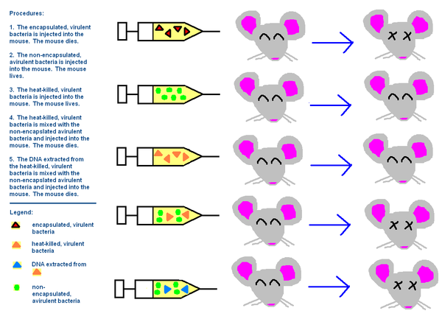
Avery, McLeod and McCarty

Slide 10
Avery, McLeod and McCarty

Slide 11
They weren’t convinced!
The protein or amino acids considered as the inheritance material until the 1940s are thought to be:
There are only 4 nucleotides in DNA, but there are 20 kinds of amino acids and many proteins !!! ’

Slide 12
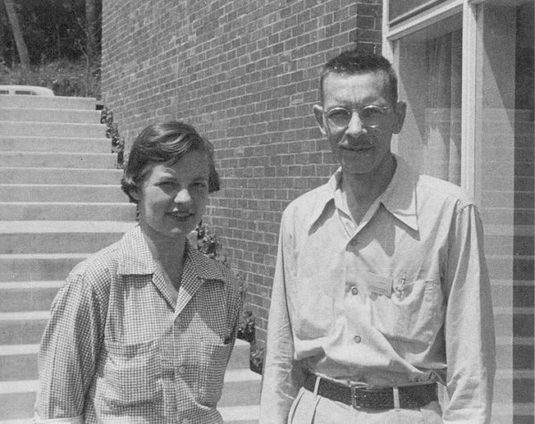
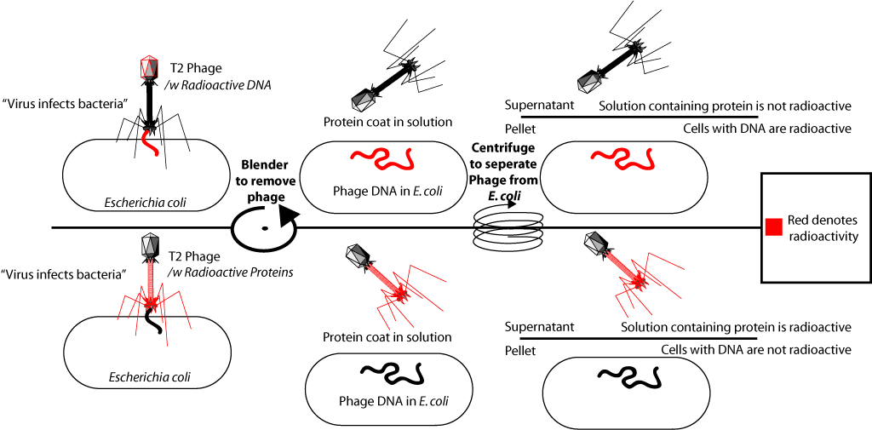
Hershey and Chase
DNA 32P, Protein 35S

Slide 13
What did we learn?
Inheritance material is DNA!
Always??
Questions needs to be asked and answered…
But how can this simple molecule, consisting of four bases, encode different genes that allow the formation of the organism?
How it is transfered?

Slide 14
Structure of DNA
The structural features of DNA were known before the discovery of the inheritance material
DNA is composed of four bases, the structurally similar nucleotide.
Base and sugar: Nucleoside
purine bases Adenine, Guanine
Pyrimidine bases Timine, Cytosine

Slide 15
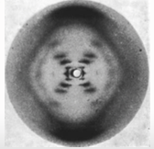
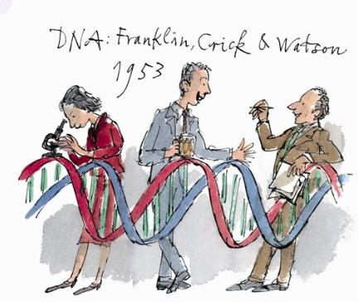
Structure of DNA
X-ray studies - show the helix structure of the DNA molecule.
Chargaff rule - revealed some common characteristics of DNAs
1- Total ratio of purines Equal to the total ratio of pyrimidines
2- Adenine up to Timine, Guanine up to Cytosine

Slide 16
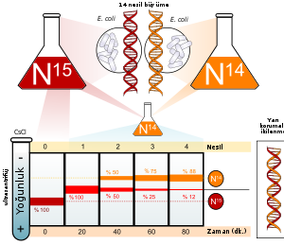
Meselson and Stahl
The DNA is copied during each cell division and is semi-conserved (semi-conserved).

