Slide 1
“Shooting an Elephant” by George Orwell
Ake 107/ing 109/ding 109 textual analysis: Prose and short story
Dr. gamze kati gümüş

Slide 2
About the author
George Orwell is the penname of Eric Arthur Blair. He was born in India, and served as an officer of the Indian Imperial police.

Slide 3
British Raj
The period of British rule in India between 1858-1947.

Slide 4
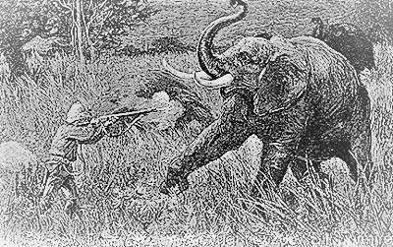
THE Setting
This Photo by Unknown Author is licensed under CC BY-NC-ND

Slide 5
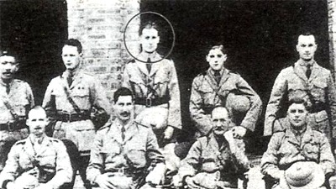
CHARACTERS
Notes:
https://donostiabookclub.blogspot.com/2018/10/turbulent-life-of-george-orwell.html

Slide 6
THE NARRATOR

Slide 7
CONFLICTS

Slide 8
THEMES

Slide 9
SYMBOLS
Mad elephant
Dead coolie
Mud

Slide 10
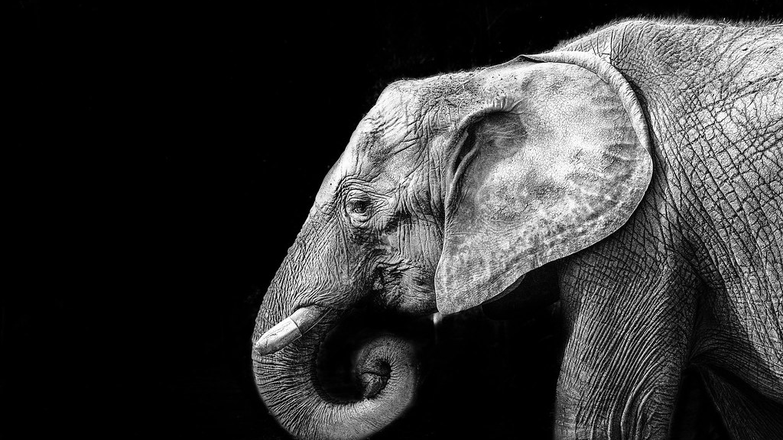
METAPHORS AND SIMILES
This Photo by Unknown Author is licensed under CC BY-NC-ND

Slide 11
IRONY

Slide 12
THE LANGUAGE

