Slide 1
Sampling and Sample Preparation
Assoc Prof. ÖZGE ŞAKIYAN DEMİRKOL
01.03.2021

Slide 2
Terms crucial to learn to understand food analysis:
Food analysis includes the following steps:
Sampling
Sample preparation
Laboratory analysis Error Certainty and reliability
Data processing
Interpretation
VARIANCE

Slide 3
Variance is an estimate of the uncertainty.
The total variance of the whole testing procedure is equal to the sum of the variances associated with each step of the sampling procedure and represents the precision of the process. Precision is a measure of the reproducibility of the data.
In contrast, accuracy is a measure of how close the data are to the true value.

Slide 4
What is a sample, population and sampling?
The small portions taken for analysis are referred to as samples,
The entire lot or the entire production for a certain period of time, in the case of continuous processes, is called a population.
The process of taking samples from a population is called sampling.

Slide 5
Why sampling is important?
In the case of food products, analyzing a whole population would be practically impossible because of the destructive nature of most analytical methods.
So a sampling procedure is required.
The reliability of sampling is dependent more on the sample size than on the population size. The larger the sample size, the more reliable the sampling. However, sample size is limited by time, cost, sampling methods, and the logistics of sample handling, analysis, and data processing.

Slide 6
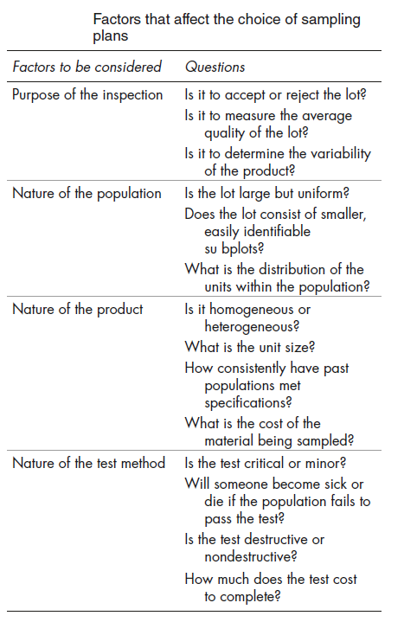
Factors Affecting the Choice of Sampling Plans

Slide 7
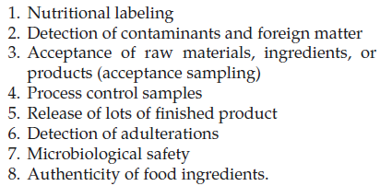
Purpose of Inspection
In general the two primary objectives of sampling are;
to estimate the average value of a characteristic,
to determine if the average value meets the specifications defined in the sampling plan.
The individual possible objectives

Slide 8
Nature of Population and Product
Populations for sampling are often defined in terms of being homogeneous or heterogeneous and being either discrete or continuous.
Nature of product can be described by its homogenity, amount and economy.

Slide 9
Nature of test method
cost,
speed,
accuracy,
precision,
destructive vs. nondestructive.
low-cost,
rapid,
nondestructive tests

Slide 10
Moreover, the importance of the analysis is also effective.
Critical
e.g. Toxicitiy tests
Major
For the properties which are not harmful to health but not true to be detected
Minor
For the propertieswhich can be detected in foods but not appropriate according to economical aspects

Slide 11
Preparation of samples:
Grinding
Size determination
Enzymatic inactivation
Drying
Extraction

Slide 12
The pretreated samples are placed in dishes.
Should be capable of hermetically sealed if required
Should not react with the sample
Should not affect the taste, odor and pH of the sample
Labelling:
The name of the sample
The date when the sample prepared
Analysis date
The name of the analyst

Slide 13
Thanks!!!!
osakiyan@ankara.edu.tr

