Slide 1
Reconstruction, 1865-1877
AKE 117 AMERICAN HISTORY
DR. GAMZE KATI GÜMÜŞ

Slide 2
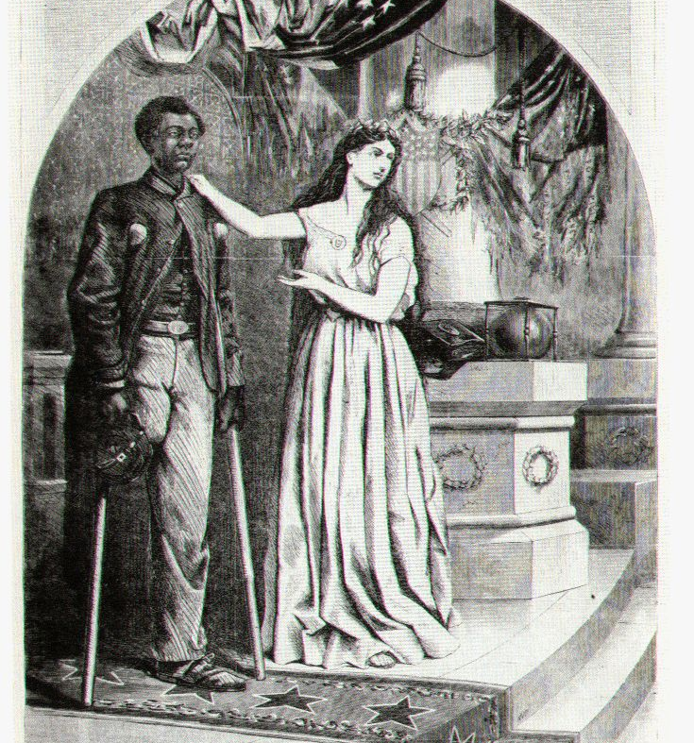
The Condition of the US after the War
South:
The casualty rate was high in the Confederate Army.
Most Southern cities were in ruins, since the war mainly took place in the Southern states.
Two-thirds of the railroads were destroyed.
Union soldiers:
Pensions were paid only to those injured and to the families of those who had been killed.
Freedmen:
3 million emancipated slaves needed urgent necessities of food, clothing, shelter as well as education and work.
This Photo by Unknown Author is licensed under CC BY-SA-NC

Slide 3
Problems addressed by Reconstruction
The civil and political rights of the freedmen
The readmission of the seceded Southern states into the Union
The punishment of the supporters of the secession
A general economic, political and social reconstruction in the Union

Slide 4
Constitutionalism as a Limit to Change
The National government’s authority was limited. Citizens were subjected to the laws of their states rather than the national government’s. Therefore, the national government did not consider taking more responsibility after the war.
As a result, the rebuilding had to be the work of the Southern states and local authorities.

Slide 5
AMENDMENT XIII
Section 1. Neither slavery nor involuntary servitude, except as a punishment for crime whereof the party shall have been duly convicted, shall exist within the United States, or any place subject to their jurisdiction.
Section 2. Congress shall have power to enforce this article by appropriate legislation.
Passed by Congress January 31, 1865. Ratified December 6, 1865.
Notes:
https://www.ourdocuments.gov/doc.php?flash=false&doc=40&page=transcript

Slide 6
13th Amendment now
“Notably, the Amendment does allow a person convicted of a crime to be forced to work. Thus, prison labor practices, from chain gangs to prison laundries, do not run afoul of the Thirteenth Amendment. The Thirteenth Amendment has also been interpreted to permit the government to require certain forms of public service, presumably extending to military service and jury duty.”
from Interactive Constitution
Notes:
https://constitutioncenter.org/interactive-constitution/interpretation/amendment-xiii/interps/137

Slide 7
Amendment XIV
Section 1
All persons born or naturalized in the United States, and subject to the jurisdiction thereof, are citizens of the United States and of the State wherein they reside. No State shall make or enforce any law which shall abridge the privileges or immunities of citizens of the United States; nor shall any State deprive any person of life, liberty, or property, without due process of law; nor deny to any person within its jurisdiction the equal protection of the laws.
Passed by Congress June 13, 1866, and ratified July 9, 1868.
Notes:
https://www.ourdocuments.gov/doc.php?flash=false&doc=43

Slide 8
Amendment XV
Section 1
The right of citizens of the United States to vote shall not be denied or abridged by the United States or by any State on account of race, color, or previous condition of servitude.
Passed by Congress February 26, 1869, and ratified February 3, 1870.
Notes:
https://www.ourdocuments.gov/doc.php?flash=false&doc=44

Slide 9
The Freedmen’s Bureau (1865)
Oliver O. Howard, the head of the bureau, intended to elevate the freedmen.
Urgent needs of clothing, shelter, and food were supplied from surplus army stores.
The agents insisted on the signing of labor contracts to protect the wages of the blacks.
The bureau provided housing for black schools, paid teachers, and helped to establish teachers’ schools and colleges for the training of black teachers.
Lands were allocated to freedmen, since the bureau had the right to lease and sell confiscated lands to emancipated blacks. But this effort was challenged later with the pardons issued to Southerners whose confiscated property was restored.

Slide 10
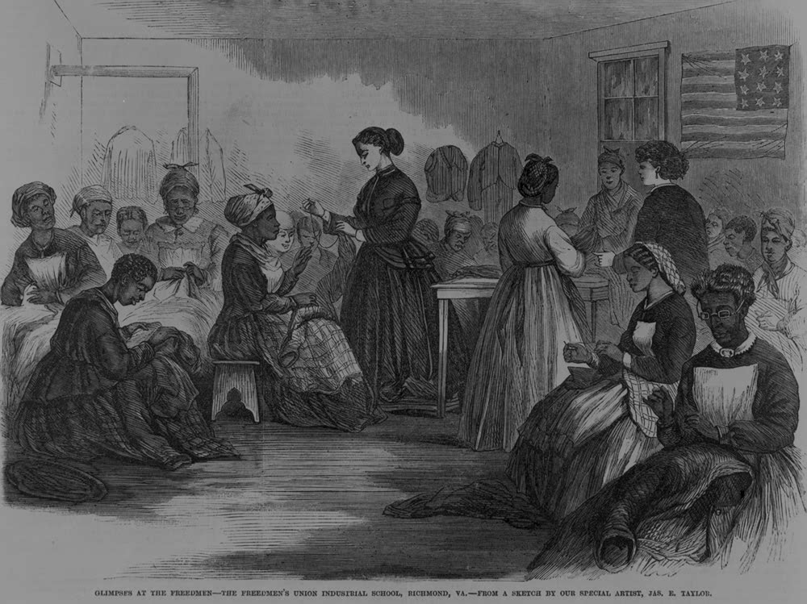
Freedmen
Free blacks were unwilling to sign labor contracts to work on plantations, because they feared the prospect of being treated as slaves again.
The family institution was strengthened as well. Matrimony became a legal institution for the blacks.
The black community was becoming more and more mobile as:
They were heading to towns and cities where the Freedmen’s Bureau was issuing rations
They were in search of family members who were separated from them during their slavery years
They wanted to test their freedom
They were in search of land and labor
This Photo by Unknown Author is licensed under CC BY-SA

Slide 11
BLACK CODES (1865-66)

Slide 12
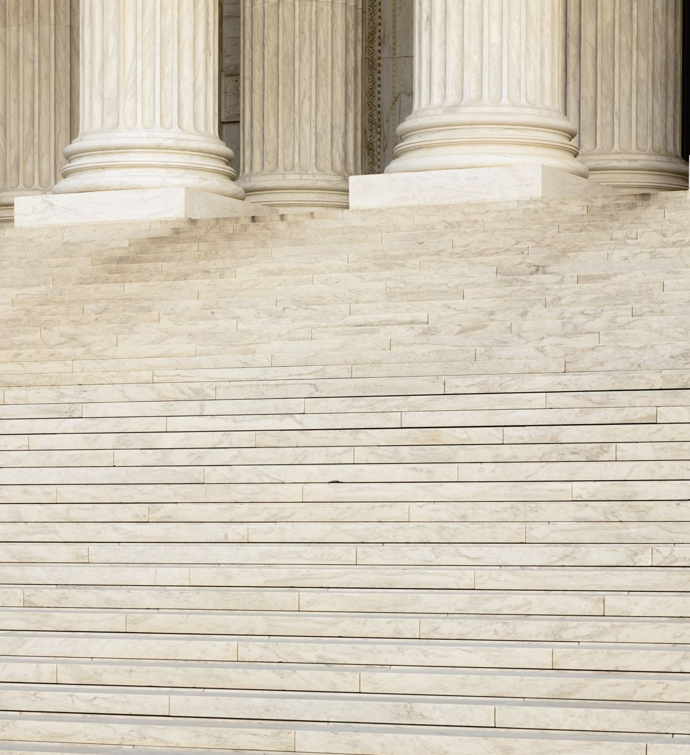
Positive:
These laws recognized the freedmen’s rights
to make civil contracts
To sue and be sued
To acquire and hold most kinds of property

Slide 13
Restrictive:
Blacks might not purchase or carry firearms
They might not assemble after sunset
They might not meet without the supervision of a white person
Idlers or unemployed blacks could be imprisoned or forced to do hard labor
Blacks might not practice artisanship, or become a mechanic or shopkeeper (husbandry and being a servant were exempted)

Slide 14
Jim Crow Laws (1877-1950s)
This Photo by Unknown Author is licensed under CC BY-SA

Slide 15
Jim Crow Laws
“Separate but equal”
Segregationist policy of Southern states where they divided the public sphere between the blacks and whites, creating the color line.
Amalgamation of races (marriage between black and white races) was prohibited.
School integration was not evident; black and white children were taught at separate schools.

Slide 16
Notes:
https://www.britannica.com/event/Jim-Crow-law

Slide 17
Notes:
https://www.alamy.com/stock-photo-entitled-a-cafe-near-the-tobacco-market-durham-north-carolina-segregation-104019603.html

Slide 18
The Black Codes: A Clip from FOURTEEN
https://constitutioncenter.org/interactive-constitution/educational-video/the-black-codes-a-clip-from-fourteen

Slide 19
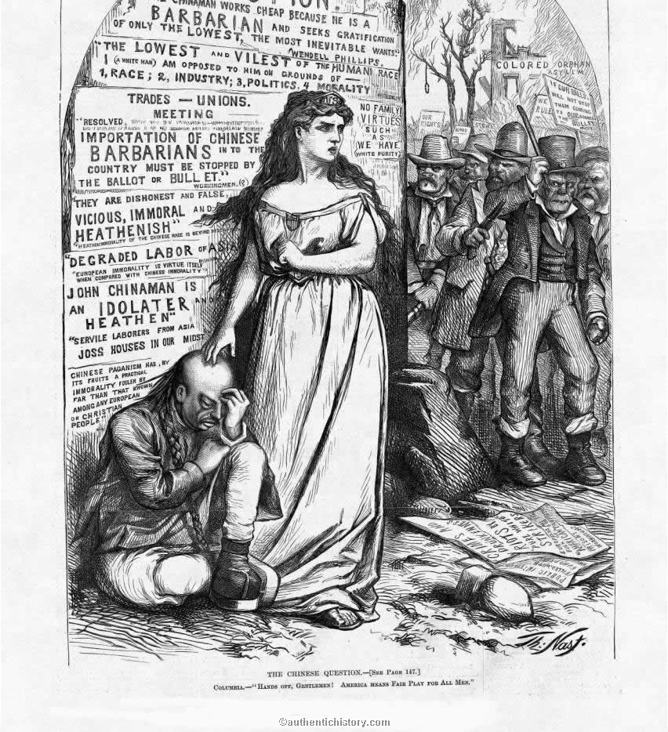
The Chinese Exclusion Act (1882)
Upon the discovery of gold in California, many Chinese immigrated there, where they worked for long hours at low wages.
This new surplus immigrant population jeopardized the white community’s ability to find jobs.
The unfamiliar dress, diet and habits of the “yellow-skinned” Chinese led to further discrimination.
In 1882, Congress passed the Chinese Exclusion Act, which suspended all Chinese immigration for ten years and forbade the naturalization of Chinese already in the country.
This Photo by Unknown Author is licensed under CC BY-SA-NC

Slide 20
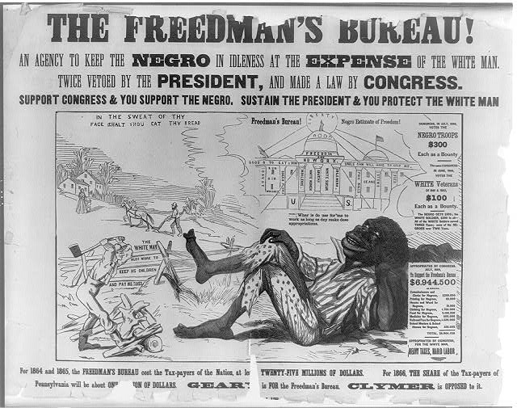
Northern Views of the Black Race
Political cartoons represented a menacing, distinctive and alien black community, and this representation troubled the white imagination.
Influential scientists such as Louis Agassiz and supporters of Charles Darwin, who had just published the Origin of Species in 1859, believed that the civilized white race would outnumber the black race over time, and eventually the black race in the US would perish.
The white community, looking up to these influential white men, followed their lead in their views on racial politics; and black suffrage was rejected in many Northern States, and in some it had the prerequisite of property ownership.

Slide 21
1866
One in a series of racist posters attacking Radical Republicans on the issue of black suffrage, issued during the Pennsylvania gubernatorial election of 1866. The series advocates the election of Hiester Clymer, who ran for governor on a white-supremacy platform, supporting President Andrew Johnson's Reconstruction policies. In this poster a black man lounges idly in the foreground as one white man ploughs his field and another chops wood. Accompanying labels are: "In the sweat of thy face shalt thou eat thy bread," and "The white man must work to keep his children and pay his taxes." The black man wonders, "Whar is de use for me to work as long as dey make dese appropriations." Above in a cloud is an image of the "Freedman's Bureau! Negro Estimate of Freedom!" The bureau is pictured as a large domed building resembling the U.S. Capitol and is inscribed "Freedom and No Work." Its columns and walls are labeled, "Candy," "Rum, Gin, Whiskey," "Sugar Plums," "Indolence," "White Women," "Apathy," "White Sugar," "Idleness," "Fish Balls," "Clams," "Stews," and "Pies." At right is a table giving figures for the funds appropriated by Congress to support the bureau and information on the inequity of the bounties received by black and white veterans of the Civil War.
Notes:
https://www.loc.gov/item/2008661698/

Slide 22
Southern Views of the Black Race
The so-called scientific racial inferiority of the black man was a commonly accepted notion in the South.
In 1867, Congress passed the 1867 Military Reconstruction Act, which excluded prominent whites who partook in the Confederate government; and entitled free blacks the right to vote.

Slide 23
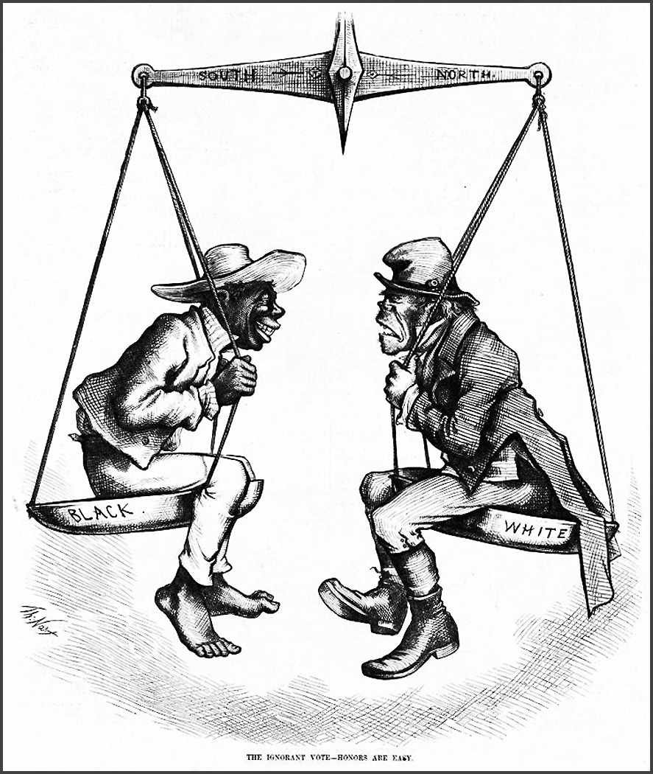
Southern Views of the Black Race
By 1871, all former Confederate States had been readmitted to the Union.
However, this admittance did not prevent Southern Democrats to object the formation of hospitals, jails, orphanages, asylums and schools for blacks.
Notes:
http://www.latinamericanstudies.org/reconstruction-nast.htm
T. Nast 1876

Slide 24
THE KU KLUX KLAN
Notes:
https://www.history.com/topics/reconstruction/ku-klux-klan

Slide 25
THE KU KLUX KLAN
Southern Whites had two aims:
to intimidate or to drive from the South whites who politically cooperated with the Republican regime.
To terrorize and silence blacks, especially those active in politics

Slide 26
Grant and the Klan
1869–1877
President Ulysses S. Grant (18th president); Presidential term:
1870–1871
Grant urged the Congress to pass Enforcement Acts (1870-1871) that enabled him to arrest Klan members, and thus disband the group.

Slide 27
How to Exclude the Black Man from Politics?
The poll tax
The eight box law
The secret (Australian) ballot*
Requirement of literacy and the ability to interpret the Constitution
Literacy test
Notes:
For more info on this and on American voting system, see https://www.abc.net.au/news/2020-10-11/us-election-voting-changed-by-secret-australian-ballot-history/12726686

Slide 28
Notes:
https://chiniquy.wordpress.com/2015/06/09/racial-names-given-to-african-americans-by-caucasians/anti-ku-klux-klan-cartoon/

Slide 29
Notes:
https://www.pbs.org/wgbh/americanexperience/features/reconstruction-thomas-nasts-political-cartoons/

Slide 30
Notes:
https://www.pbs.org/wgbh/americanexperience/features/reconstruction-thomas-nasts-political-cartoons/

Slide 31
Notes:
https://www.pbs.org/wgbh/americanexperience/features/reconstruction-thomas-nasts-political-cartoons/

Slide 32
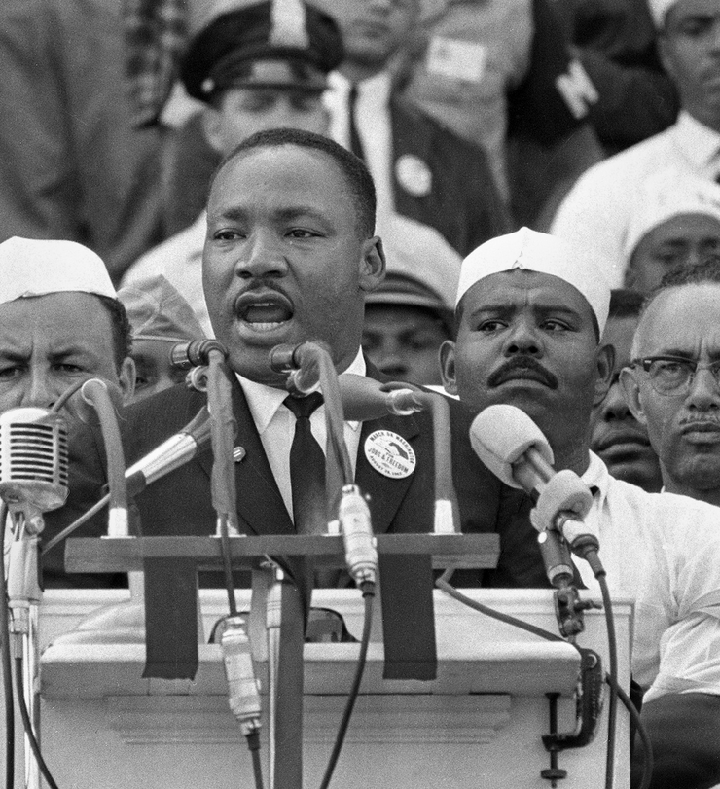
Free At Last!
The Negro Spiritual:
https://www.youtube.com/watch?v=cRdk57gc9Jo
Martin Luther King, Jr. “I Have A Dream Speech” (1963)
https://www.youtube.com/watch?v=I4Wbmp6CQo8
This Photo by Unknown Author is licensed under CC BY-NC-ND

