Slide 1
Elbow Dysplasia
Dr Murat ÇALIŞKAN

Slide 2
Canine elbow dysplasia (ED) is a disease of the elbows of dogs caused by growth disturbances in the elbow joint.
There are a number of theories as to the exact cause of the disease that include defects in cartilage growth, trauma, genetics, exercise, diet and so on.

Slide 3
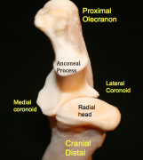
If the radius grows more slowly than the ulna it becomes shorter leading to increased pressure on the medial coronoid process of the ulna. This in turn can cause damage to the cartilage in joint and even fracture of the tip of the coronoid process, which damages the medial compartment (side closest to the body) of the joint.

Slide 4
Elbow dysplasia is most often seen in large to giant breed dogs, particularly Labradors, Golden Retrievers, German Shepherds, and Rottweilers, but can occur in most breeds of dog. Different breeds have predispositions to different forms of the disease, so that ununited anconeal process (UAP) is largely a problem of German Shepherds, medial compartment disease (medial coronoid injury) is seen in many other breeds and sight hounds are free of the disease.

Slide 5
Diagnosis of elbow dysplasia is usually performed with a combination of clinical examination and x-rays. Usually the dog has pain on fully bending or extending the elbow and often your veterinarian will want to watch your dog walk or trot to detect any lameness. X-rays will typically shows signs of arthritis but may also show the presence of small bone fragments in the joint or an ununited anconeal process.

Slide 6
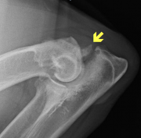
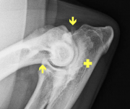
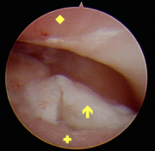
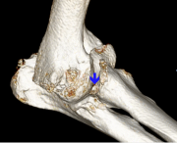

Slide 7
Treatment depends on the severity of the disease in the elbow. Depending on the individual dog’s elbow problem surgery may involve:
Correction of joint step; is usually done by cutting the ulna to re-establish elbow congruence.
Removal of any coronoid fragments and removal of loose cartilage
Surgical alteration of the elbow joint to shift weight away from damaged areas)
Reattachment or removal of an united anconeal process of the medial joint compartment
Joint replacement if the elbow is severely diseased

Slide 8
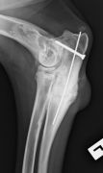
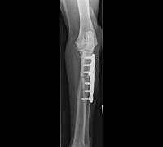

Slide 9
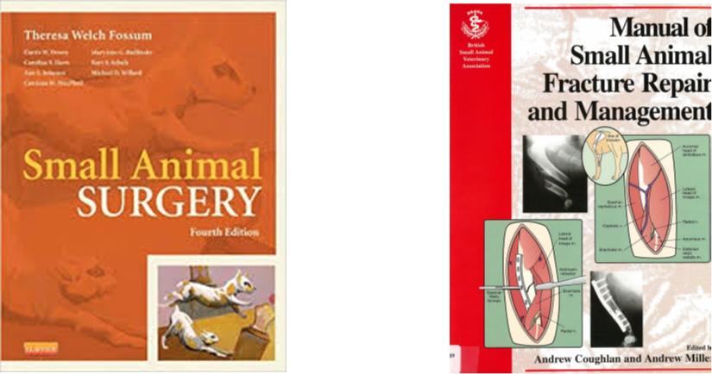
REFERENCES
https://www.acvs.org/small-animal/canine-elbow-dysplasia
Ankara Üniversitesi Açık Ders Malzemeleri Ortopedi ve Travmatoloji
Prof. Dr. Hasan Bilgili Ders notu.

