Slide 1
COM 412
Information Technology and Security Governance

Slide 2
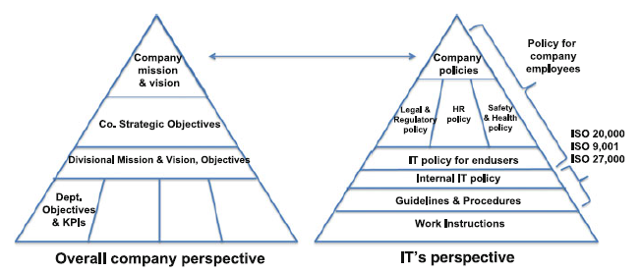
IT & Security Governance
Project Governance
* a component of IT governance
* policies, guidelines, and procedures for IT organizations
should be aligned with mission & vision
very high,
need to be operationalized

Slide 3
IT & Security Governance
Project Governance
* IT policies:
- apply not only to the IT Division’s personnel, but also apply company-wide
- should cover:
• implementing new services
• service delivery management
• incidence and problem management
• security
• service continuity and disaster recovery
• customer relationship management
• supplier management
• configuration management and change management
• release management
• project management

Slide 4
IT & Security Governance
Project Governance
* IT policies for end users
• Email usage policy
• Internet usage policy
• Security policy
• Policy on requests in accessing a service
• Policy on requests for infrastructure
• Policy on requests for new applications
• Policy on requests for major enhancements
• Policy on requests for application modifications and enhancements
• Policy on requests for PCs, laptop, printers, tablets, smartphones, scanners, and other devices
• Service Desk policy

Slide 5
IT & Security Governance
Project Governance
* One level down from IT policies → procedures & guidelines
• Availability management
• Capacity management
• Change and release
• System backup and recovery
• Disaster Recovery Plan
• Service Desk
• Configuration Management
IT backup policy: “all major systems need to be regularly backed-up
Procedures: criteria for backing up, retention period, and how backup media is to be retained
Work instructions: tools that will be used, what type of backup

Slide 6
IT & Security Governance
Project Governance
* Head of the project portfolio defines project policy and governance for all projects
* Project Manager apply these to his/her specific project
* Project policy should cover:
• Project monitoring and control
• Project team roles and responsibilities
• Communication management
• Scope management (including change requests)
• Risk management
• Asset management
• Incidence and issue management
• Release management

Slide 7
IT & Security Governance
Project Governance
* Project policy should cover:
• Infrastructure capacity management
• Request management for projects
• Code development guidelines
• Test guidelines
• Training guidelines
• Backup and recovery policy
• Pre-go live guidelines
• Service Desk usage policy
• Post-implementation support and warranty period policy
• Security guidelines

Slide 8
IT & Security Governance
Project Monitoring and Control
* PMs (vendor and client), Portfolio manager and the
key stakeholders should know:
• scope (quality)
• time
• cost
• resources
at any time.

Slide 9
IT & Security Governance
Project Monitoring and Control
* Three essential tools:
- Project Management tool (brief view and snapshot about progress and status of a project -- MS Project, Primavera, etc.)
-- what tasks have been finished, what not,
-- if there are delays, if it affects the overall timeline,
-- resource utilization,
-- deliverables attained,
-- SPI and CPI.

Slide 10
IT & Security Governance
Project Monitoring and Control
* Three essential tools:
- Project Management tool
-- SPI and CPI:
Schedule Performance Index = (Earned Value) / (Planned Value)
SPI= EV / PV
SPI>1, SPI=1, SPI<1 ???
If SPI > 1 Then You have completed more work than planned, the project is ahead of schedule.
If SPI = 1 Then The completed work is equal to the planned work, the project is on schedule.
If SPI < 1 Then The completed work is less than planned work, the project is behind schedule.

Slide 11
IT & Security Governance
* You have a project to be completed in 12 months.
* The budget is 100,000 USD.
* Six months have passed, and 60,000 USD has been spent.
* Upon closer review, you find that only 40% of the work has been completed so far.
Please find the Schedule Performance Index and deduce whether the project is ahead or behind of schedule.
* Actual Cost (AC) = 60,000 USD
* Planned Value is not given. However, the project duration is 12 months and 6 months have passed. We can assume the budget was distributed evenly for each month. Therefore, in 6 months, 50% of the budget will have been spent.
Planned Value (PV) = 50% of 100,000 USD = 50,000 USD
* Earned Value (EV) = 40% of 100,000 USD = 40,000 USD
* Schedule Performance Index (SPI) = EV / PV = 40,000 / 50,000 = 0.8
You are behind schedule since the Schedule Performance Index is less than one.

Slide 12
IT & Security Governance
Project Monitoring and Control
* Three essential tools:
- Project Management tool
-- SPI and CPI:
Cost Performance Index = (Earned Value) / (Actual Cost)
CPI = EV / AC
CPI>1, CPI=1, CPI<1 ???
If CPI > 1 Then You are earning more than what you have spent, the project is under budget.
If CPI = 1 Then Earning and spending is equal, the project is proceeding as per the planned spending.
If CPI < 1 Then You are earning less than what you have spent, the project is over budget.

Slide 13
IT & Security Governance
* You have a project to be completed in 12 months.
* The budget is 100,000 USD.
* Six months have passed, and 60,000 USD has been spent.
* Upon closer review, you find that only 40% of the work has been completed so far.
Please find the Cost Performance Index and deduce whether we are under budget or over budget.
* Actual Cost (AC) = 60,000 USD
* Planned Value is not given. However, the project duration is 12 months and 6 months have passed. We can assume the budget was distributed evenly for each month. Therefore, in 6 months, 50% of the budget will have been spent.
Planned Value (PV) = 50% of 100,000 USD = 50,000 USD
* Earned Value (EV) = 40% of 100,000 USD = 40,000 USD
* Cost Performance Index (CPI) = EV / AC = 40,000 / 60,000 = 0.67
We are earning 0.67 USD for every 1 USD spent since the Cost Performance Index is less than one. This means we are over budget.

Slide 14
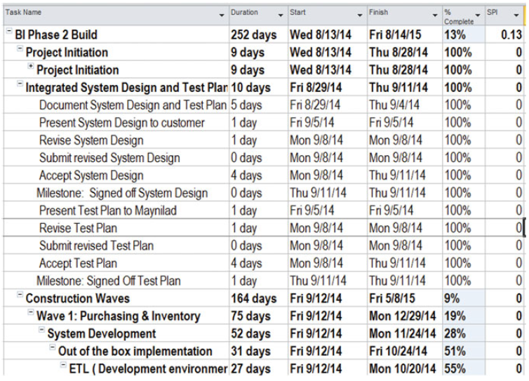
IT & Security Governance
Project Monitoring and Control
Sample Project Plan

Slide 15
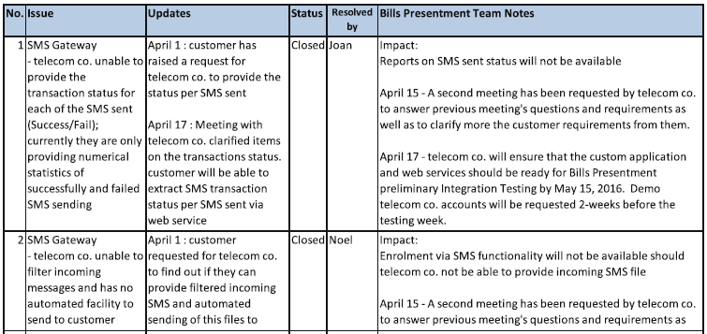
IT & Security Governance
Project Monitoring and Control
* Three essential tools:
- Issue registry (a list of all issues encountered and/or reported for the project –maybe MS Excel sheet)
-- the date identified,
-- the person responsible for seeking resolution of the issue, -- status of the issue,
-- remarks.

Slide 16
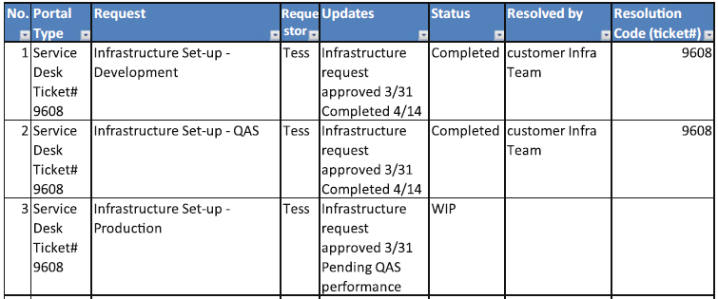
IT & Security Governance
Project Monitoring and Control
* Three essential tools:
- Request registry (a list of any and all requests for the project which affect/modify the original scope of work –maybe MS Excel sheet)
-- Similar to Issue Registry

Slide 17
IT & Security Governance
Project Monitoring and Control
* Additional governance documents:
- Deliverable checklist (a document with the list of all deliverables agreed for the project)
-- the phase of the project in which it is to be generated,
-- who it will be prepared by,
-- status, date submitted,
-- who is to produce the document, description,
-- whether it requires a sign-off, and who shall be the signatories and approvers.
What may be the deliverables?
Deliverables may be anything ranging from
a kick-off meeting, a blueprint, technical design,
actual code, UAT, training, manuals, meeting, etc.
Since every project is different,
the exact deliverables to be produced will be agreed upon at the start of the project by both PMs.

Slide 18
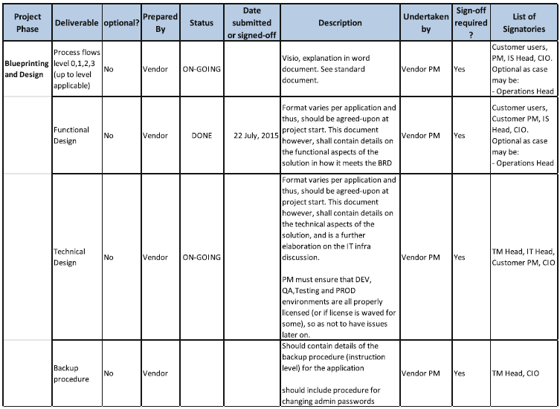
IT & Security Governance
Project Monitoring and Control
Sample Deliverables Checklist

Slide 19
IT & Security Governance
Project Monitoring and Control
* Additional governance documents:
- About deliverables
-- choosing proper deliverables to be able to monitor the real
progress of the project
-- deliverables are milestones which help to understand whether the project has progressed or not to that stage
-- deliverables should be:
• easily identified
• objective (either they are attained or not, there should be no room for ambiguity)
• clear in terms of whether they have been achieved.
• spaced along the life of the project
• usable

Slide 20
IT & Security Governance
Project Team Roles and Responsibilities
* Project team members, stakeholders should have clear roles and responsibilities.
* the PM should be the single point of contact.
* the PM should be singly responsible for the delivery of the whole project.
* the PM is also responsible for:
• Scope mgmt.
• Time mgmt.
• Cost management
• Quality
• Resources
• Risk Management
• Asset Management
• Governance and reporting
• Communication management
• Procurement and contract management

Slide 21
IT & Security Governance
Project Team Roles and Responsibilities
* other project team members (full-or part-time / depend on the type of project, structure and model)
• Business Analyst (V): captures and translates business requirements into functional specifications for the design and configuration of the application
• Programmer (V)
• Technical manager/System Architect (V): determines the necessary infrastructure for the execution of the project
• Technical support personnel (V): (DBA, Network Admin, System Admin) installs, creates, configures, defines permissions and maintaines during the course of the project
• Tester (V): defines the test scripts and runs the tests before UAT
• Documentation writers (V): prepares documentation of the project (process flows, end user requirements, manuals, etc.)

Slide 22
IT & Security Governance
Project Team Roles and Responsibilities
* other project team members (full-or part-time / depend on the type of project, structure and model)
• Process experts (C): end users that are experts in the business or business processes that will be covered by the project
• Technical support personnel (under the TM team) (C): the counterparts of the project technical support personnel
Aside from the project team itself, a steering committee may be needed. The role of the steering committee is to guide, and if necessary decide and approve matters which cannot be decided at the project management level.

Slide 23
IT & Security Governance
Communication Management
* Communication policy: who, how, and when will be informed
project dependent
This policy should describe at least:
• Kick-off: the first formal project meeting with end users, PMs, and other key stakeholders
• Project update meetings: normally weekly
• Steering committee meetings

Slide 24
IT & Security Governance
Scope Management
* Scope should be as clear as possible upon the start of the project
* Should be handled correctly during the whole lifecycle of the project
* Most projects would be turn-key (fixed price)
* the challenge of the PMs:
- keeping the scope within the reasonable bounds of what was tendered (and successively detailed)
- providing that no additional price or resources are needed
* Any specifications that don’t conform to this → change request
* The first and most important tool for identifying possible change requests is the request registry
* Any request is to be registered into this document for further analysis

Slide 25
IT & Security Governance
Scope Management
* Things to do about change requests
- analyze whether the request is actually outside the scope of the work
- if so analyze whether this request is reasonable
• Functionality and usability (necessary or nice to have? individual’s request or functionality?)
• Is it a key requirement?
• Cost
• Timing (necessary before going live or later?
will it affect the overall timeline?)
• Resources

Slide 26
IT & Security Governance
Scope Management
* After passing the initial screening, request goes on to a formal
“change request status”
* Main responsibility for filling-up the details is vendor’s PM
• Identify main person who can estimate the change request tasks and effort
• Identify the resources needed for the change request and check availability
• If not readily available, check other project pools or external sources (subcontract)
• Identify the man-days for each resource needed to complete the change request.
• Cost the change request
• Get internal management approval

Slide 27
IT & Security Governance
Scope Management
* The change request proposal is then with the customer PM
* Customer PM evaluates, negotiates (if needed) and approves or disapproves.
* the change request;
- may need an additional contract,
- may need addendum to the main contract,
- may be accepted as part of the main contract.

Slide 28
IT & Security Governance
Risk Management
* The basic tool risk management registry
* Evaluates both (+) and (–) risks, their probability, impact, and mitigation/enhancement steps
* Done during the weekly project update meetings
* Special risk management sessions may also be called by the PM
(for cut-over, data migration, release of new enhancements, etc.)
e.g. migration from a legacy marketing system to a new marketing system scenario.
- one of the risks: the quality and reliability of the customer data
Actions to be taken (mitigation):
• Verify the accuracy of a sample of the data: It was determined that customer profile, address and contact numbers are dirty
• Correct the dirty data via email and calls
• Use a sample slice of the data for testing and verification

Slide 29
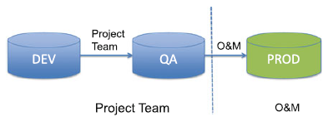
IT & Security Governance
Asset Management
* Servers, environments, switches, laptops and other devices
* All intangibles (installations, configuration items, etc.)
* Assets assigned to a project are the responsibility of the PM until formal turnover to O&M
* Project team in charge of DEV, QA; O&M in charge of PROD setup

Slide 30
IT & Security Governance
Issue Management
* The basic tool issue registry (will be reviewed as part of project monitoring and control)
* It is important to flag and identify the person responsible for addressing the issue
* Resolution, root cause and any work-around applied should be documented as part of the knowledge-base
Release Management
* For projects it is much simpler than for operations (since changes are
not yet in production until the moment of go-live)
* O&M is always responsible
* All releases should also have a rollback procedure

Slide 31
IT & Security Governance
Infrastructure Capacity Management
* Infrastructure needed by the project should be defined during the proposal stage
* Customer should be made aware of the needed infrastructure (Customer may start a purchase if needed infrastructure is not
available)
* Technical specifications and architecture of the infrastructure should be defined and agreed upon shortly after the project kick-off
Request Management for Projects
* The basic tool request registry
* Two types:
• Those affecting project resources only
- handled and resolved by the two PMs
- related to scope management (follow the change request procedure)
• Those affecting O&M (production mainly)
- usually through the service desk

Slide 32
IT & Security Governance
Code Development Guidelines
* May encompass:
• Naming conventions for programs, objects, tables, variables, etc.
• Documentation format and details required
• Network Domain name conventions (should specify the avoidance of using IP addresses, as these change over time)
• Error and exception handling
• Message types and convention
• Tables and objects (description of mandatory fields, necessary descriptions for each)
• Indexing, when and how to create indexes
• Performance standards
• Use of standard interfaces
• Code security

Slide 33
IT & Security Governance
Test Guidelines
* should specify the type of tests to be undertaken and by which party:
• Unit testing: mandatory, conducted by vendor
• Integration testing: mandatory, conducted by vendor
• Regression testing: needed only if change is undertaken on an application currently in production, or if a change is to be performed on an already accepted application (retest), conducted by vendor, O&M, and end users
• User acceptance test: mandatory, only after the above have been undertaken
• Stress testing: optional
• Stress vs. load vs. performance testing?

Slide 34
IT & Security Governance
Test Guidelines
* Load, stress and performance testing are interrelated
* Often we see load testing and stress testing falling under the umbrella term performance testing
* Load testing: comparing the current state of usage to what would happen if we hit specific loads of users, simultaneously made calls or processed transactions
* Stress testing: "extreme load testing". A kind of performance testing that happens when we push our app, API or software to the upper limits of its capacity

Slide 35
IT & Security Governance
Training Guidelines
* Training guidelines should be as explicit and detailed as possible
* Different trainings should be undertaken for different stakeholders
(End users, system admins, operators, app. mngt., developers, trainers)
* Training plan should encompass:
• Type of training
• Recipients of the training
• Estimate on the number of trainees
• Person to conduct the training
• Approach taken for the training
• List of associated material needed for the training
• Time the training will be imparted

Slide 36
IT & Security Governance
Backup and Recovery Guidelines
* Should state when backups are to be conducted, by whom, and the type of backups
* The project team must trigger the request, performed by the O&M
Pre-go-Live Guidelines
• Approved cut-over plan
• Approved data migration plan
• Successful data migration sign-off
• UAT completed and accepted
• List of manuals and other materials to be used by the users and O&M
• Preparation and briefing for the 1st and 2nd level support teams
• FAQ for the Service Desk personnel
• Full backup
• Pre- and post-go-live checklist
• Password change test
• Operations Manual
• Acceptance by O&M of Knowledge Base from project team
• Advisories to users (informing them of the new releases)
• Go/No-go signed decision by the CIO

Slide 37
IT & Security Governance
Post-implementation Support Policy
* Should be agreed-upon by both parties at the start of the project
* all tickets still OPEN at the end of the post-implementation support phase shall still be resolved by the vendor:
e.g. post-implementation support: 3 months
there were still 8 incidence tickets open with the vendor on day 3 months - 1 day
these incidents should be resolved by the vendor
Service Desk Usage Policy
Indicates the manner in which the project team shall be allowed access to the
service desk, and how its requests will be escalated
Security Guidelines
* Security guidelines used by O&M and end users
* May explain the policy needed for granting remote access to systems

