Slide 1
CHE138-1
GENERAL INTRODUCTION TO MATLAB
1

Slide 2
MATLAB
•
•
•
•
•
•
Scientific Computing
Interactive Calculation
Programming
Graphics
Animation
Portability
2

Slide 3
MATLAB
•
•
MATrix LABoratory
Software Package for high-performance numerical computation and visualization
Own high-level programming language
External Interface to run Fortran and C
programs
•
•
3

Slide 4
MATLAB
•
•
Optional Toolboxes
Toolboxes are collections of functions
written for special applications
such
as
–
–
–
–
–
Symbolic Computation
Image Processing
Statistics
Control System Design
Neural Networks
4

Slide 5
MATLAB
•
•
•
Matrix is the basic building block
Fundamental data-type is the array
Vectors, scalars, real and complex matrices are special cases of basic data type
Built-in functions are optimized for vector operations
Hence vectorized commands or codes run much faster
•
•
5

Slide 6
MATLAB ENVIRONMENT
•
MATLAB windows
–
–
–
Command window
Graphics window
Edit
window
6

Slide 7
Command Window
7

Slide 8
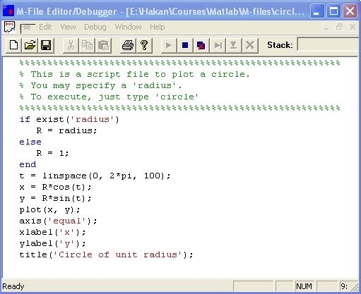
EDIT WINDOW
8

Slide 9
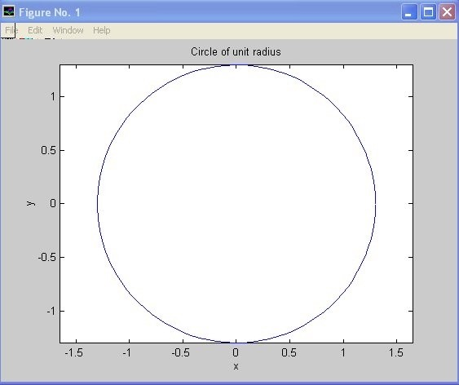
GRAPHICS (FIGURE) WINDOW
9

Slide 10
On-line HELP
•
Demo
– Type demo at MATLAB
On-line documentation
prompt
•
–
–
–
–
lookfor
help
helpwin
helpdesk
10

Slide 11
Dimensioning
•
•
Dimensioning is automatic.
No dimension statements are required for vectors or arrays
•
Use
find
‘size’ and ‘length’ (vectors only)
to
dimension
of an existing
matrix
11

Slide 12
Case sensitivity
•
MATLAB differentiates between
lowercase and uppercase letters.
the
•
A
and
a
are
different
variables.
12

Slide 13
Output format
•
•
•
•
•
•
•
•
•
•
format
format
format
format
format
format
format
format
format
...
short
short long
31.4159
3.1416e+01
31.41592653589793
3.141592653589793e+01
31.416
31.4159265358979
403f6a7a2955385e
3550/113
31.42
e
long e
short g
long
hex rat bank
g
13

Slide 14
Command History
•
MATLAB saves previously typed
commands in a buffer.
Commands can be recalled with the up- arrow key.
Also type first few characters and then press up-arrow key to recall commands.
•
•
14

Slide 15
Directories
•
For your programs to be automatically
accessible to MATLAB save in a place in the “path”.
•
“path” command specifies and adds the
paths.
“cd” command changes the working directory.
file
•
15

Slide 16
Printing
•
Select “Print” from the “File” menu and
click “Print” in the dialog
box.
•
You can
prompt.
also
type
“print”
at
the
MATLAB
16

Slide 17
Long commands
•
If your command does not fit on one line you can
continue the command on the next line if you type
three consecutive periods at the
end
of
the
line.
•
»
2
Length
2 + ...
limit
is
4096
characters
ans =
4
»
17

Slide 18
Variable Naming
•
•
Names must begin with a letter
After the first letter, any number of underscores may be used
digits or
•
But MATLAB
characters
remembers
only
the
first
19
18

Slide 19
Remarks
•
Comments: MATLAB takes anything
following a % as a comment and ignores it.
(;) A semicolon at the end of a command
•
suppresses the screen output,
result is saved in the variable
Use the command “more on”
screen display (one screenful
display at a time).
although the
ans.
for paged- of output
•
19

Slide 20
DOS Commands
•
Dos command can be
executed
by
typing
!
before
the
command.
>>
!dir
20

