Slide 1
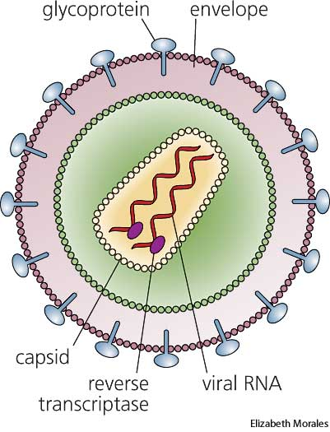
RETROVIRIDAE

Slide 2
the genera include these veterinary viruses:
1) Mammalian Type C retrovirus:
Feline leukaemia virus (FeLV)
Feline sarcoma virus
Porcine type C oncovirus
2) Mammalian Type D retrovirus:
Sheep pulmonary adenomatosis /Jaagsiekte
3) Avian type C retroviruses - Avian leukosis virus (ALV)
5) BLV-HTLV retroviruses - Bovine leukosis virus (BLV)
6) Lentivirus:
Feline immunodeficiency virus
Bovine immunodeficiency virus
Visna‑Maedi (Maedi-Visna) virus (of sheep) (V‑MV)
Caprine‑arthritis‑encephalitis virus
Equine infectious anaemia virus (swamp fever) (EIA)
Human immunodeficiency virus

Slide 3
Structure
The particles are roughly spherical, and about 100nm diameter. They have several hundred knobbed spikes.
The nucleocapsid protein is helical and not noticeable by em.
An obvious outer layer of capsid protein is icosahedral or cone-shaped, depending on genus.
The RNA genome has 3 genes, gag, pol and env.
Gag (group‑specific antigen coding gene) encodes the capsid proteins and the proteases which cleave them and the envelope spikes;
pol encodes the reverse transcriptase enzyme; and the integrase (see later)
env encodes the envelope spikes whose knob is termed gp 69 or 70.

Slide 4
The virus only survives for a few hours outside the host.
Replication: Retrovirus replication is most unusual.
Single stranded nucleic +veRNA is transcribed to -veDNA by the reverse transcriptase protein which is released during uncoating.
-veDNA becomes circular double stranded ±DNA which is integrated into host cell chromosomes by a second viral enzyme, a DNA integrase.
Chromosomal proviral DNA then codes for viral proteins and viral RNA using cellular enzymes and organelles.
The rate of virus production from the cell is slow and cells continue to divide.

Slide 5
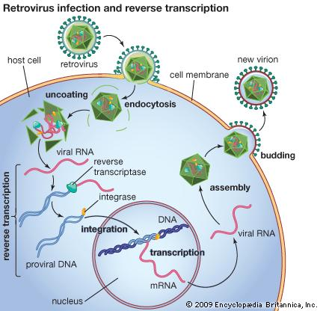

Slide 6
Equine Infectious Anemia
Swamp Fever, Mountain Fever, Slow Fever, Equine Malarial Fever, Coggins Disease

Slide 7
Equine infectious anemia (EIA) is a retroviral disease of equids that may be characterized by acute and/or chronic recurring clinical signs including fever, anemia, edema and cachexia in some animals. Many horses have very mild or inapparent signs on first exposure, and carry this virus subclinically.
EIA is an exotic, type III immune-complex haemolytic disease of horses
All infected horses, including those that are asymptomatic, become carriers and are infectious for life.
Infected animals must either be destroyed or remain permanently isolated from other equids to prevent transmission.
Notifable Disease

Slide 8
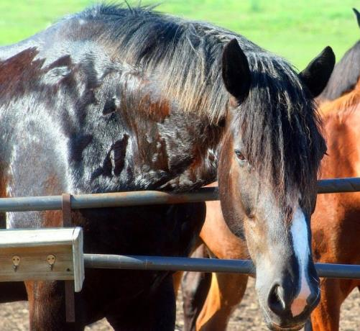
Ethiology
Retroviridae Lentivirus Equine Infectious Anemia Virus EIAV
Enveloped (radial protruding), HA
Sensitive to Ether and Chloroform
In close antigenic relationship with HIV (AIDS)
Virus replicates only the bone marrow and leukocyte cell culture with CPE (lytic).

Slide 10
Equine infectious anemia virus is reported to infect all members of the Equidae.
Clinical cases occur in horses and ponies (Equus caballus), and have also been reported in mules.
Equine infectious anemia has been found nearly worldwide.
According to Ataseven et al (2005), there is no prevalence of EIA in mules and donkeys as in horses kept by people. It is concluded that EIA is not prevalent in these geographic regions of Turkey and that EIA offers no potential risks for the horse-breeding and -racing industry in Turkey

Slide 11
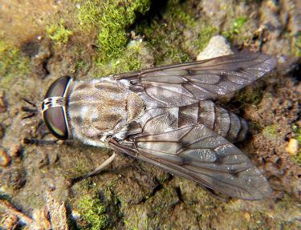
Transmission
Equine infectious anemia virus is transmitted mechanically on the mouthparts of biting insects.
In horses, this virus persists in blood leukocytes for life, and also occurs in plasma during febrile episodes.
Symptomatic horses are more likely to transmit the disease than animals with inapparent infections; after visiting an asymptomatic carrier, only one out of every 6 million flies is likely to become a vector.
Although other insects including stable flies (Stomoxys calcitrans) can transmit EIAV, the most effective vectors are biting flies in the family Tabanidae, especially horse flies (Tabanus spp. and Hybomitra spp.) and deer flies (Chrysops spp.).

Slide 12
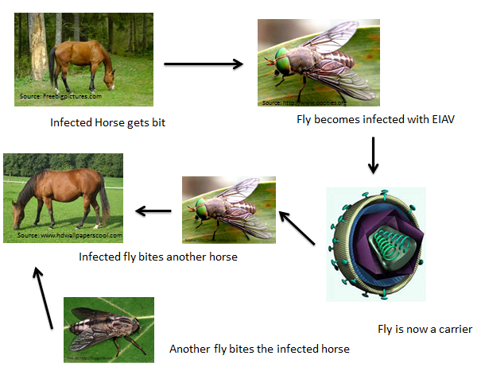
https://cellularphysiology.wikispaces.com/Equine+Infectious+Anemia

Slide 13
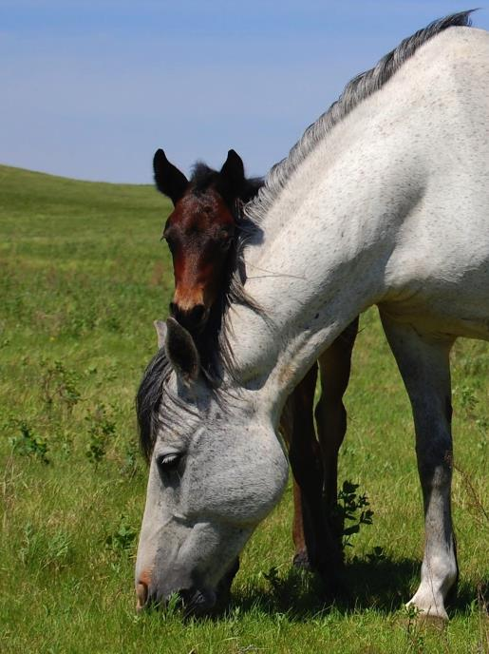
The bites of these flies are painful, and the animal’s reaction interrupts feding.
This virus can also be transmitted
in blood transfusions or
on contaminated needles,
surgical instruments and
teeth floats.
EIAV may also be passed from a mare to her foal in utero.
EIAV does not appear to be shed in saliva or urine.
However, it can be found in milk and semen, and horses can be
infected by inoculating these secretions subcutaneously.
Possible transmission through milk has been reported in
some nursing foals.

Slide 14
Pathogenesis and Pathology
The virus multiplies in monocytes / macrophages.
Bone marrow suppression and autoimmune destruction in erythrocytes cause anemia
The high levels of virus coats the rbc’s which are then lysed by complement to cause jaundice, oedema, hemorrhagic diarrhoea, petechial hemorrhages and a high chance of mortality.
Glomerulonephritis due to immunocomplexes
Infected horses have lifelong infection of their leucocytes until stressed (eg by pregnancy, corticosteroids, surgical operation, disease) or new virus variants arise.
Viraemia then increases by 100-fold.
Bouts of fever and jaundice can occur and worsen, from the increased immune response, every few months.

Slide 15
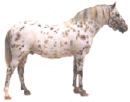
Pathogenesis (chronical infection)
anemia
Virus replication
trombositopeni
Antigenic change
Glomerulonephritis
İnfectious phase
Fever and
viremia

Slide 16
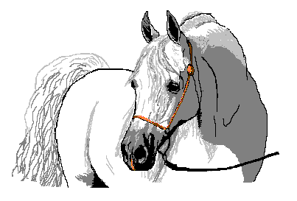
Asemptomatic carriers
infectios
phase
stress
or
steroid
viremia

Slide 17
The spleen, liver and abdominal lymph nodes may be enlarged, and the mucous membranes can be pale.
Cross sections of the liver, the view like «COCONUT».
The yellow zone in the bone marrow has been lost and turned to the red zone.
In chronic cases, emaciation may also be noted. Edema is often found in the limbs and along the ventral abdominal wall. Petechiae may be observed on internal organs, including the spleen and kidney.
Chronically infected horses that die between clinical episodes usually have no gross lesions, but some animals may have proliferative glomerulonephritis or ocular lesions.

Slide 18
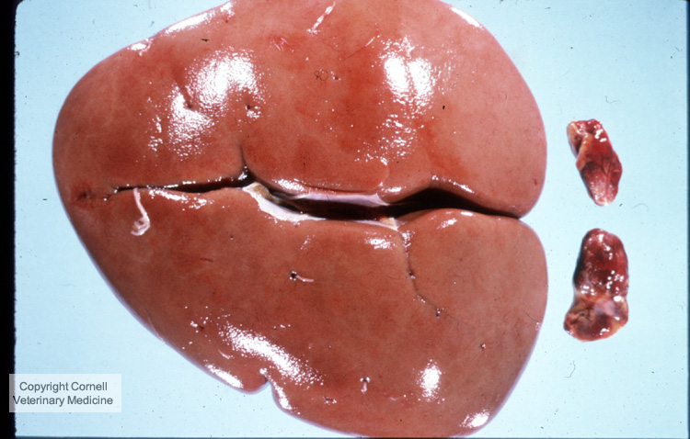
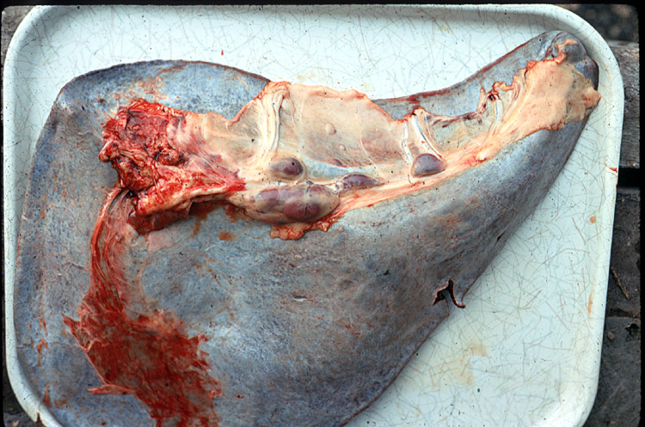
Glomerulonefritis
Splenomegali

Slide 19
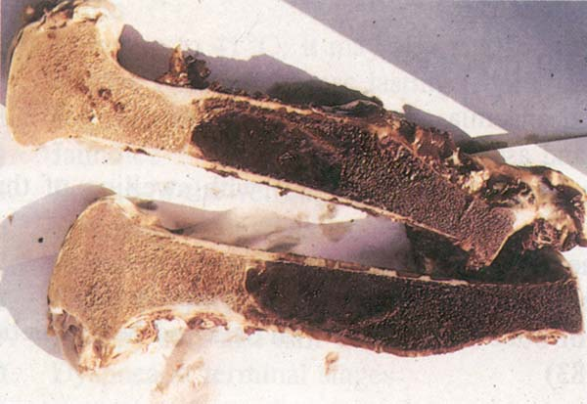
http://www.fao.org/docrep/003/t0756e/T0756E07.htm
Equine infectious anaemia. Replacement of bone marrow fat with dark red hemopoietic tissue (erythroid hyperplasia).

Slide 20
Clinical Signs
The incubation period is a week to 45 days or longer. Some horses remain asymptomatic until they are stressed.
The clinical signs of acute EIA are often nonspecific.
1-Acute Form:
There are fever, weakness, fatigue, anemia, and increased respiration in animals.
Abdominal and pleural edema, sometimes blood in feces.
Petechial hemorrhages in mucous membranes
80% death

Slide 21
2- Chronic Form:
Anemia
Weakness
weight loss,
Abdominal, leg and chest edema
Jaundice
petechial hemorrhage

Slide 22
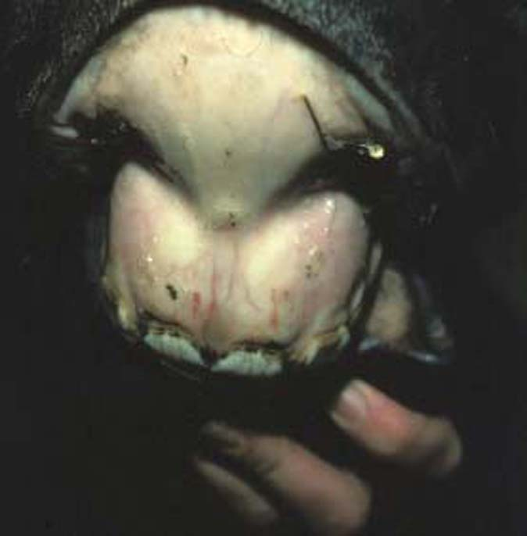
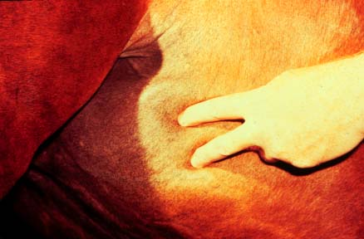
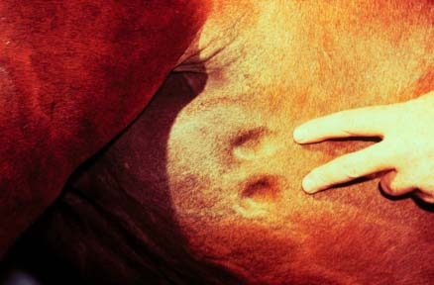
Secondary effects of thrombocytopenia
petechial hemorrhage
oedema

Slide 23
Diagnosis and Differantial Diagnosis
Clinical Equine infectious anemia should be among the differentials in individual horses with weight loss, edema and intermittent fever.
Laboratory tests Equine infectious anemia is often confirmed by serology.
Once an animal is infected, it becomes a carrier for life.
The two most commonly used serological tests are the agar gel immunodiffusion (AGID or Coggins) test and enzyme-linked immunosorbent assays (ELISAs).
RTPCR assays can also be used to detect infected horses.

Slide 24
The differential diagnosis includes other febrile illnesses including
AHS
equine viral arteritis,
Ruam
purpura hemorrhagica,
leptospirosis,
babesiosis,
severe strongyliasis or fascioliasis,
phenothiazine toxicity,
autoimmune hemolytic anemia and
other diseases that cause fever, edema and/or anemia.

Slide 25
Immunity
Animals can be virus-carriers for several years despite having antibody.
Precipitant, the complement binding and neutralizing antibodies are formed.
Immunity is not sufficient due to antigenic variation.

Slide 26
Prevention and Control
the fight against flies is important.
Horses should be serologically tested at intervals of 4-6 months.
Infected animals are euthanized by rules.
Many countries have control programs requiring equids to be tested for equine infectious anemia.
No vaccine is available.
Infected equids become lifelong carriers, and must be permanently isolated from other susceptible animals or euthanized.

Slide 27
References
Ataseven, V. S., & Arslan, H. H. (2005). Equine infectious anemia in mules, donkeys, and horses: epidemiologic studies in the different geographic regions of Turkey. Journal of equine veterinary science, 25(10), 439-441.
http://www.cfsph.iastate.edu/Factsheets/pdfs/equine_infectious_anemia.pdf

Slide 28
Visna-Maedi

Slide 29
Maedi-visna and caprine arthritis and encephalitis are economically important viral diseases that affect sheep and goats.
Isolates are neurotropic or pneumotropic and cause chronic wasting disease in sheep. Variants which escape neutralisation arise during the infection (as with HIV and Equine Anaemia Virus).
The major syndromes in sheep are dyspnea (maedi) or neurological signs (visna), which are both eventually fatal.
Adult goats generally develop chronic progressive arthritis, while encephalomyelitis is seen in kids.
VİSNA: A very contagious, progressive infection characterized by very severe demyelination. CNS symptoms and paralysis occurs.
MAEDI: It is a chronic disorder, a disease that causes interstitial pneumonia characterized by dry coughing and dyspnea.

Slide 30
Ethiology
Retroviridae Lentivirus
RNA
It contains the enzyme called Reverse Transcriptase (RNA depended DNA Polymerase).
Enveloped
Sentive to Ether and Chloroform.
Virus inoculated in Choroid Plexus cell cultures of sheep.
While Visna is neutralized with Maedi antiserum, Maedi is partially neutralized with Visna antiserum.
SLOW VIRUS INFECTION

Slide 31
Transmission
MVV can be transmitted to lambs, kids or other susceptible species in milk or colostrum. Lactogenic transmission was once thought to be the major route by which SRLVs spread, based on the ability to prevent most infections by removing lambs or kids from their dams at birth.
In addition to milk, SRLVs have been found in respiratory secretions and feces, and infections have been demonstrated by intranasal or intraconjunctival inoculation, and via fecally-contaminated water.
Feed and water troughs, or the aerosolization of infectious milk in dairies, might be additional sources of virus.
Iatrogenic spread through the reuse of needles or other objects that contact blood and tissues (e.g., tail docking equipment) also seems possible
Transmission is via aerosol,
milk, or colostrum.

Slide 32
SRLVs can be found in semen and the female reproductive tract (e.g., uterus) of both sheep and goats, but they do not appear to directly infect oocytes or sperm.
Once an animal becomes infected, SRLVs are integrated into leukocyte DNA, and the animal carries the virus for life.
Viral burdens vary between individual animals; however, both asymptomatic and symptomatic animals can transmit SRLVs.

Slide 33
Pathogenesis and Pathology
MVV undergoes a primary replication in lung macrophages, which carry virus to the target organs, the brain, lung tissue, udder and/or joints according to the isolate.
Target organs become chronically inflamed after 2‑6 years of T cell responses to bouts of replication and the sheep rapidly lost condition and fall behind during flock movements.
In Visna inflammation results in demyelination with subacute meningitis around the ventricles and choroid plexus. Posterior paresis progresses for up to one year when the sheep can no longer stand.

Slide 34
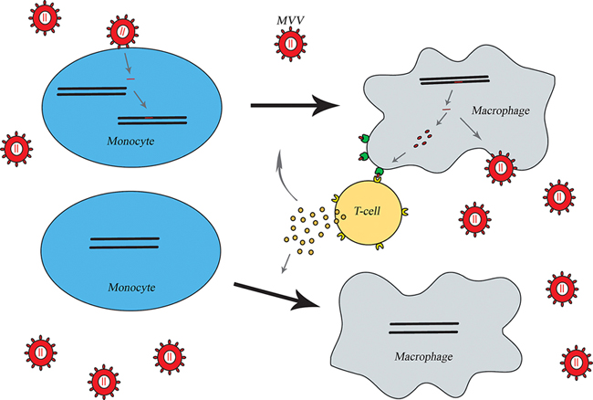
Immune activation in maedi-visna mediated lesions. Differentiated macrophages enable continuous presentation of viral antigens to T-lymphocytes. In return the activated T-lymphocytes produce more cytokines that induce differentiation of monocytes to macrophages.

Slide 35
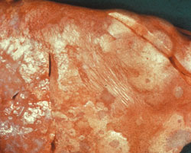
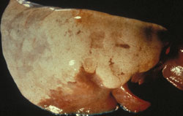
In Maedi the alveolar septa become infiltrated by lymphocytes and macrophages and the smooth muscle becomes hypertrophic (compensatory hypertrophy).
Sheep become increasingly dyspnoeic and deaths occur after 6 months.
At post-mortem the lungs are enlarged, abnormally firm and heavy, and fail to collapse when the thoracic cavity is opened. They are typically emphysematous and mottled or uniformly discolored, with pale gray or pale brown areas of consolidation.
Sheep, lung. Lung fails to deflate and contains coalescing multifocal gray-white nodules/plaques (proliferative lymphocytes and pneumocytes) with adjacent atelectatic depressed parenchyma (red-pink).
Sheep, lung. Lung fails to deflate with pale gray coalescing proliferative areas and cranioventral atelectasis (reddish area)

Slide 36
Clinical Signs
The incubation period for SRLV-associated diseases is highly variable, and usually lasts for months to years.
Sheep typically develop the clinical signs of maedi when they are at least 3-4 years of age.
Visna seems to appear somewhat sooner, with clinical signs in some sheep as young as 2 years.

Slide 37
Maedi is the most common form of disease in sheep infected with MVV, and usually occurs in adults.
It is characterized by
wasting
progressive dyspnea.
Arthritis
Mastitis
Abort and normal childbirths
Fever, bronchial exudates depression are not usually seen.
Maedi is eventually fatal; death results from anoxia or secondary bacterial pneumonia

Slide 38
Visna usually begins insidiously, with subtle neurological signs such as
hindlimb weakness,
trembling of the lips or a head tilt,
loss of condition.
ataxia,
incoordination,
muscle tremors,
paresis
paraplegia, usually more prominent in the hindlegs.
Other neurological signs, including rare instance of blindness, may also be seen.

Slide 40
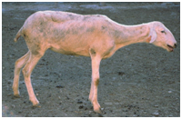
Limb paralysis due to infection with maedi-visna virus (MVV). Early in the disease course animals often show unilateral hindlimb paresis (a). The disease then progresses to ataxia, hindlimb paralysis (b), recumbency and death. Animals affected with visna are usually a small subsection of those infected with MVV in a flock (Picture b: Valentín Pérez and Julio Benavides)
http://drsait.com/Maedi-Visna-virus.php
Crilly, J. P., Rzechorzek, N., & Scott, P. (2015). Diagnosing limb paresis and paralysis in sheep. In practice, 37(10), 490-507.

Slide 41
Diagnostic and Differential Diagnostic
Clinical symptoms.
Using either serum samples or milk AGID for antibody or ELISA.
PCR assays or virus isolation can also be used for diagnosis.
Visna; Scrapie, Borna, Rabies, Loping ill
Maedi; Lung Adenomatosis

Slide 42
Caprine Arthritis and Encephalitis (CAEV)
Caprine Arthritis-Encephalitis, Small Ruminant Lentivius Infection

Slide 43
CAEV is a viral infection characterized by chronic arthritis of carpal joints, hardening and growth of the mammals, acute encephalitis and chronic pneumonia.
It causes an encephalitis of kids or an insidious polyarthritis of adults.

Slide 44
Ethiology
This is caused by a distinct virus which is serologically related to MVV but has antigenic and genetic differences in its envelope.,
Retroviridae Lentivirus
RNA
It contains the enzyme called Reverse Transcriptase (RNA depended DNA Polymerase).
Enveloped
Sentive to Ether and Chloroform.
Virus forms by weak CPE in the synovial membrane cell culture and in the Lamb Kidney and Testis Cell Culture.

Slide 45
Transmission
CAEV can be transmitted to lambs, kids or other susceptible species in milk or colostrum.
Lactogenic transmission was once thought to be the major route by which SRLVs spread, based on the ability to prevent most infections by removing lambs or kids from their dams at birth.
In addition to milk, SRLVs have been found in respiratory secretions and feces, and infections have been demonstrated by intranasal or intraconjunctival inoculation, and via fecally-contaminated water.
Feed and water troughs, or the aerosolization of infectious milk in dairies, might be additional sources of virus.
Iatrogenic spread through the reuse of needles or other objects that contact blood and tissues (e.g., tail docking equipment) also seems possible

Slide 46
SRLVs can be found in semen and the female reproductive tract (e.g., uterus) of both sheep and goats, but they do not appear to directly infect oocytes or sperm.
Once an animal becomes infected, SRLVs are integrated into leukocyte DNA, and the animal carries the virus for life.
Viral burdens vary between individual animals; however, both asymptomatic and symptomatic animals can transmit SRLVs.

Slide 47
Pathology
In goats with polyarthritis, there is
thickening of the joint capsule, with proliferation of the synovial villi.
The joint capsules, tendon sheaths and bursae may be calcified.
Goats with caprine arthritis and encephalitis may also have interstitial pneumonitis.
In animals with indurative mastitis, the udder is diffusely indurated and the associated lymph nodes may be enlarged.

Slide 48
Microscopically, CAE is characterized by inflammation that consists of an interstitial, mononuclear cell reaction.
Large aggregates of lymphoid cells and follicle formation may sometimes be seen.
The histopathologic lesions found in joints include synovial cell hyperplasia, synovial edema and necrosis, villous hypertrophy and subsynovial mononuclear cell infiltration.
In kids with encephalomyelitis, the lesions are characterized by multifocal, mononuclear cell inflammatory infiltrates and varying degrees of demyelination.
Chronic interstitial pneumonia may be seen in the lungs, with mononuclear cell infiltrates in the alveolar septae and the perivascular and peribronchial regions.
Indurative mastitis is characterized by mononuclear infiltration of the periductular stroma; these cells obliterate the normal mammary tissue.

Slide 49
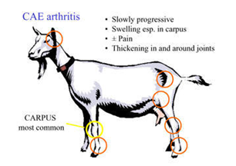
Clinical Signs
Encephalomyelitis (progressive paresis) occurs primarily in 2-6 month-old kids, but has also been reported in a one-month-old kid and older animals including adults.
The initial symptoms in kids may include lameness, ataxia, hindlimb placing deficits, hypertonia and hyperreflexia.
Initially, many kids are bright and alert, and continue to eat and drink normally.
The neurologic signs gradually worsen to paralysis.
Some affected kids may also appear depressed or exhibit head tilt, circling, blindness, nystagmus, opisthotonos, torticollis, facial nerve deficits, paddling or dysphagia.

Slide 50
Neurological signs are uncommon in adult goats infected with CAEV.
These cases are usually characterized initially by minor gait aberrations, lameness and knuckling, which progress to paralysis over weeks to months.
The reflexes remain intact. Other signs (e.g., coarse tremors, nystagmus, trismus, salivation, blindness) are occasionally reported.
Chronic, painful polyarthritis, accompanied by synovitis and bursitis, is the main syndrome in adult goats infected with CAEV. This syndrome can occasionally occur in goats as young as 6 months.
Early symptoms include distention of the joint capsule and a variable degree of lameness.
Although the course of disease is slow, it is always progressive. In late stages, goats may walk with their front legs flexed or become recumbent.

Slide 51
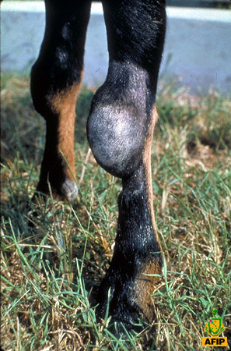
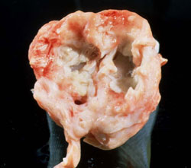
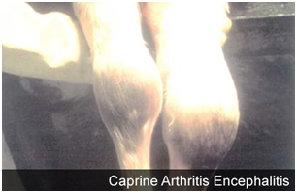
Indurative mastitis can occur in does.
These goats have a swollen, firm mammary gland and produce decreased amounts of normal-appearing milk.
In some goats, the mammary gland may soften and milk production may approach normal; milk yield remains low in others.
http://www.cldavis.org/woodard_bone/windows/figureIIc-10.htm

Slide 52
Diagnosis
Caprine arthritis and encephalitis should be suspected in adults with polyarthritis and/ or indurative mastitis, and kids with progressive paresis, particularly when more than one syndrome occurs in a herd.
Serum should be collected for serology.
Milk can also be tested for antibodies.
Virus isolation can be conducted on peripheral blood or milk from live animals, and possibly joint fluid aspirates.
AGID and ELISAs are the most commonly used serological tests.
PCR

Slide 53
Control and Prevention
MVV and CAEV are often introduced into a herd in live animals. Additions to uninfected herds should come from SRLV-negative herds. Other animals should be quarantined and tested before adding them to the herd.
Uninfected herds should also be kept from contact with untested or seropositive herds.
Mixing sheep and goats, or feeding milk or colostrum from one species to another, can lead to the transfer of viruses between species.
There are currently no vaccines for SRLVs.

Slide 54
One approach is to completely depopulate the herd and replace it with uninfected animals.
Another is to separate lambs or kids permanently from seropositive dams immediately at birth, and raise these animals on uninfected colostrum and pasteurized milk, milk replacer or milk from uninfected animals.
The herd should be tested frequently for SRLVs, and seronegative and seropositive animals should be maintained separately

Slide 55
References
http://www.cfsph.iastate.edu/Factsheets/pdfs/maedi_visna_and_caprine_arthritis_encephalitis.pdf
PETER H. RUSSELL, BVSc, PhD, FRCPath, MRCVS Department of Pathology and Infectious Diseases, The Royal Veterinary College. Lentiviruses.

