Slide 1
Sexual cycle and artificial insemination in Mare
Doç. Dr. Kemal Tuna OLĞAÇ

Slide 2
Mare Sexual Cycle
Puberty occurs in 12-24 months of age.
250-300 kg (50-60% of adult Live Weight)
Seasonal polyestricity depends on day light duration (PHOTOPERIOD)
Annual reproductive activities in horses
Vernal Transition Period
Breeding Season
Autumn Transition Period
Anestrus
Decreasing level of melatonin that secretes from pineal gland induces reproductive activity.
Long days → Sexual activity (April - September)

Slide 3
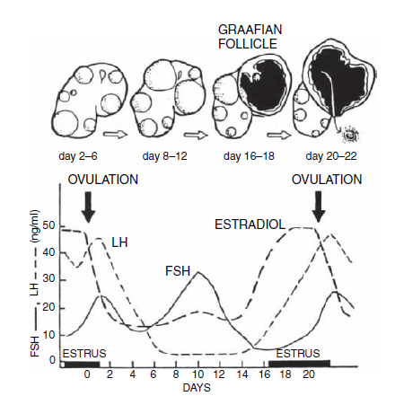
Mare Sexual Cycle
3,5 – 4,5 cm
Lasts approximately 22 days;
Proestrus (2 days)
Estrus (5-7 days)
Metaestrus (2-3 days)
Diestrus (13-15 days)
Anestrus (seasonal)

Slide 4
Mare Sexual Cycle
Proestrus
Lasts 2-3 days
No clinical signs
No external or internal differentiations

Slide 5
Mare Sexual Cycle
Estrus
Lasts 5-7 days
Ovulations occur 24-48 h before end of the estrus (mostly 1 follicle)
Moist and wet vaginal mucosa covered with thin and juicy mucus, hyperemic and shiny.
Foal heat**

Slide 6
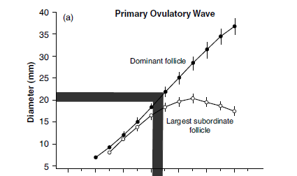
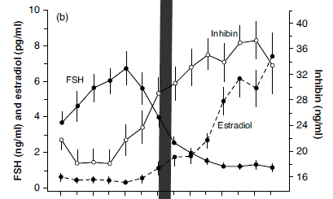
Mare Sexual Cycle

Slide 7
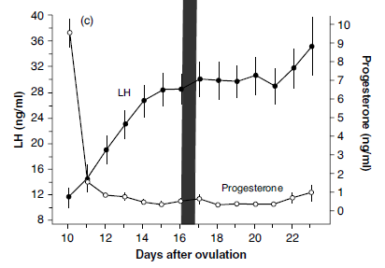
Mare Sexual Cycle

Slide 8
Mare Sexual Cycle
Teasing stallion
Vocalization
Relaxed facial muscles, ears turned to the side
Lowered head is held in its normal position
Trying to stand around the stallion
Deviates the tail and exposition of the perineal region
Rhythmic eversion of the vulvar labias and showing clitoris (Clitoral winking)
Turn her hindquarters to the stallion and show a characteristic posture with lowered pelvis and straddled hind limbs (Squating)
Frequently voidance of small quantities of urine in front of the stallion

Slide 9
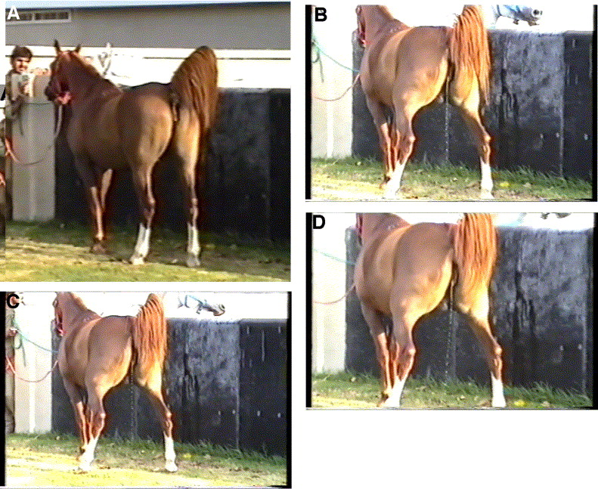
Mare Sexual Cycle

Slide 10
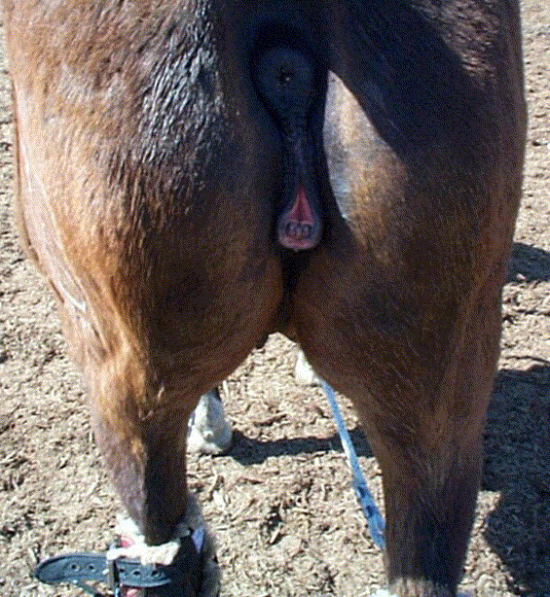
Mare Sexual Cycle

Slide 11
Mare Sexual Cycle
Metaestrus
Lasts approximately 2-3 days
Luetal cells originated from granulosa cells, but not thecal cells
Progesteron secretion begins and rises

Slide 12
Mare Sexual Cycle
Diestrus
Longest period of the cycle, takes 13-15 days
There is a compact Corpus Luteum that secretes
Progesteron
Corpus Luteum begins to regress after 15-17. days of
the cycle

Slide 13
Mare Sexual Cycle
Anöstrus
Occurs in late autumn and winter period of the year
Hypothalamus and pituitary are not functional
LH secretion does not exist, while FSH can be observed in very low-level

