Slide 1
ChemIcal equIlIbrIum

Slide 2
In a chemical event, the reactants are not always fully converted to products, but when the equilibrium constant of the reaction is too large, it is assumed that completely reactants are converted to products. In some reactions, no matter how long the reaction time is kept, a large part of the starting material and products can be present at the same time in the reaction medium. Such reactions are called equilibrium reactions.

Slide 3
If all substances in the reaction medium are in the same phase, this equilibrium is called homogeneous equilibrium.
If all substances in the reaction medium are in the two or more phases, this equilibrium is called heterogeneous equilibrium.
Reactions with a very large equilibrium constant are called forward one-way reactions
Reactions with a small equilibrium constant are called backward one-way reactions.

Slide 4
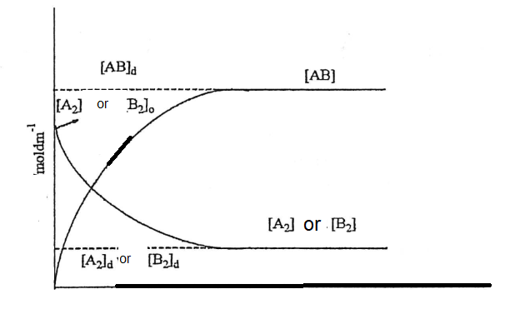

Slide 5
If the reaction between A2 and B2 is examined, since the A2 and B2 are spent over time, the rate of the forward reaction decreases during the reaction. If there is no AB in the environment at the time of initiation, no back reaction is observed at this time. However, the AB breaks down into reaction and becomes substances A2 and B2. While the backward reaction rate of the AB substance with a low initial concentration is small, this rate begins to increase with increasing AB concentration over time, and after a while the rate of dissipation of A2 and B2 equals the rate of backward decomposition of AB; this is called dynamic equilibrium. The dynamic equilibrium established at this moment is called the equilibrium position.

Slide 6
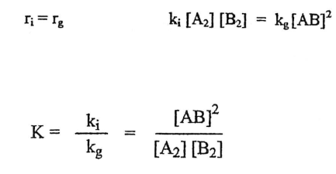

Slide 7
Le Chatelier Rule
If any effect is made on an equilibrium system from the outside and one of the factors in the equilibrium expression is changed, the system automatically shifts in a direction to reduce this effect. This effect means changing one or more parameters (concentration, pressure and temperature). While changing the concentration and pressure only changes the equilibrium composition, changing the temperature causes the equilibrium constant to change; changing the concentration and pressure does not change the equilibrium constant.

Slide 8
The temperature changes the equilibrium constant (K) of the equilibrium reaction, but it is necessary to know whether the chemical reaction is exothermic or endothermic in order to know in which direction the reaction direction will shift.

Slide 9
Experiment:
1. Number 1 to 5 of the 6 test tubes, one of which is a comparison tube. Place 5 mL of 0.002 M NaSCN solution in all tubes.
2. Prepare the comparison solution by adding 5 mL of 0.2 M Fe (NO 3) 3 solution to the comparison tube.
3. Add 10 mL of 0.2 M Fe (NO 3) 3 solution to a 25 mL gradient, then make up to 25 mL (0.08 M Fe + 3) with distilled water and stir the solution well. Add 5 mL of this solution to tube 1 and shake the tube.
4. Take up the excess pipette and place in an empty tube until 10 mL of 0.08 M Fe (NO 3) 3 solution remains in the tape measure. Dilute the remaining solution to 25 mL with distilled water (0.032 M Fe + 3) and stir the solution well. Add 5 mL of this solution to tube 2 and shake the tube.

Slide 10
5. Repeat the procedures described in procedure 4 in succession to obtain more dilute solutions each time and add 5 mL of these diluted Fe (NO 3) 3 solutions to test tubes 3, 4 and 5 respectively and shake the tubes.
6. Compare the color darkness of the comparison tubes with each of the other tubes. To do this, take the two tubes to be compared and hold them side by side and wrap them separately, but with the same kind of white paper. Look at both tubes from top to bottom on a white background with the light in the same direction. If the color darkness of the solutions in the tubes is the same, measure the height of both solutions with a ruler. If the color is not the same, transfer some of the comparison solution to a clean, dry beaker (this may be necessary for reuse). Continue the process only by changing the height of the comparison solution until the color darkness is the same. Measure the height of the solutions with the same color and repeat the color measurement for all tubes.

