Slide 1
Enzymes
Dr. Açelya Yılmazer

Slide 2
What are Enzymes?
Enzymes are catalytically active biological macromolecules
Most enzymes are globular proteins,
however some RNA (ribozymes, and ribosomal RNA) also catalyze reactions
Study of enzymatic processes is the oldest field of biochemistry, dating back to late 1700s
Study of enzymes has dominated biochemistry in the past and continues to do so

Slide 3
Why Biocatalysis?
Higher reaction rates
Greater reaction specificity
Milder reaction conditions
Capacity for regulation
Metabolites have many potential pathways of decomposition
Enzymes make the desired one most favorable

Slide 4
Enzymatic Substrate Selectivity
No binding
Binding but no reaction
Example: Phenylalanine hydroxylase

Slide 5
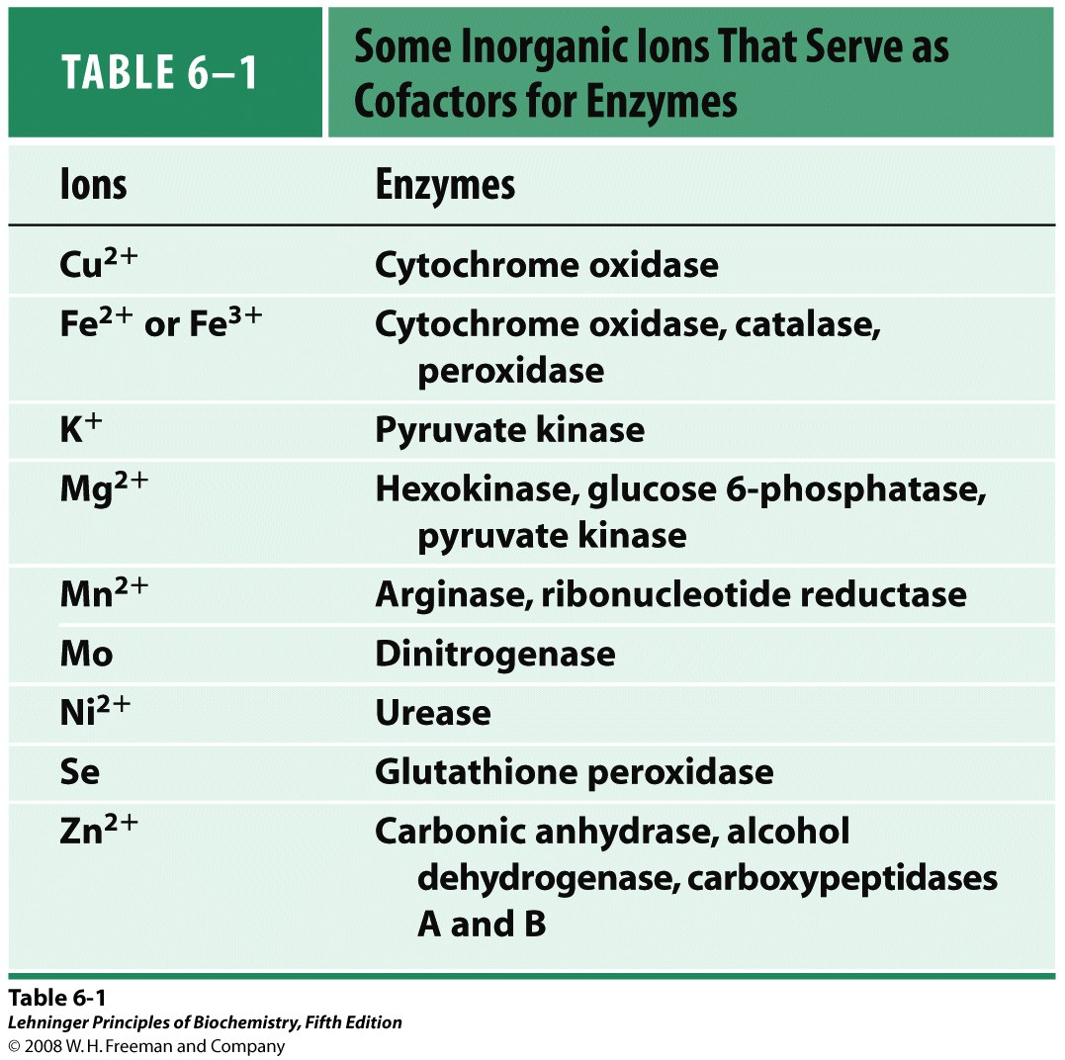
Cofactors: Some enzymes need inorganic ions to get activated

Slide 6
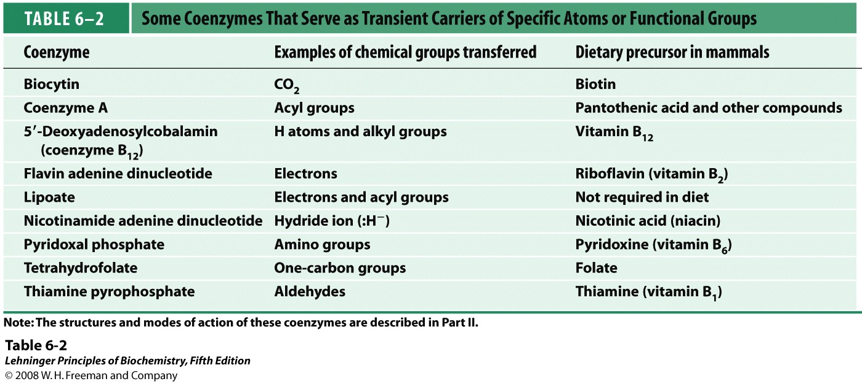
Coenzyme: Organic cofactors
Holoenyzme: catalytically active enzyme and linked coenzyme or cofactor katalitik olarak aktif enzim ve bağlı koenzim/kofaktör.
Apoenzyme(apoprotein): protein part of the holoenzim

Slide 7
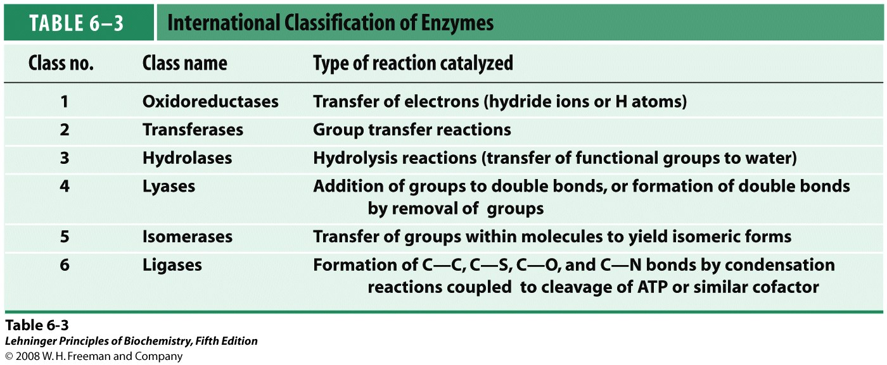
‘-ase’
DNA polimerase; ürease
Latin names: pepsin

Slide 8
Enzyme-Substrate Complex
Enzymes act by binding substrates
the non-covalent enzyme substrate complex is known as the Michaelis complex
allows thinking in terms of chemical interactions
allows development of kinetic equations

Slide 9
Transition State Theory
Slow reactions face significant activation barriers that must be surmounted during the reaction
transition state theory is applicable for catalysis
rate constants and free energies can be related

Slide 10
Rate Acceleration
The enzyme lowers the activation barrier compared to the uncatalyzed aqueous reaction
In theory, the enzyme may also facilitate the tunneling through the barrier. This may be important for electrons.

Slide 11
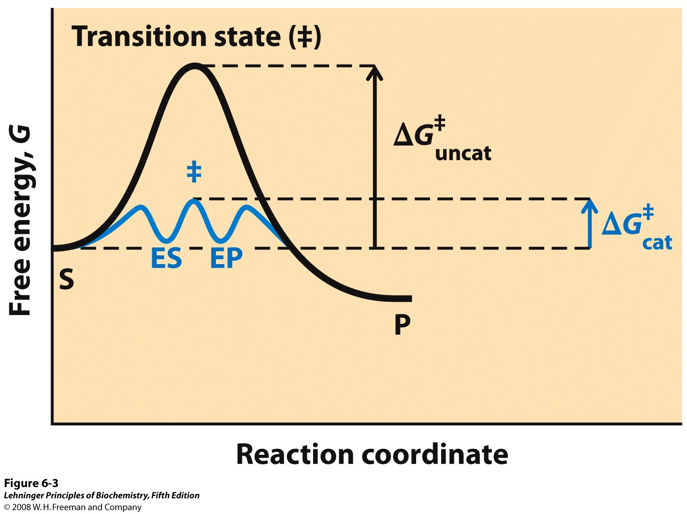
Notes:
FIGURE 6-3 Reaction coordinate diagram comparing enzyme-catalyzed and uncatalyzed reactions. In the reaction S → P, the ES and EP intermediates occupy minima in the energy progress curve of the enzyme-catalyzed reaction. The terms ΔG‡_{uncat} and ΔG‡_{cat} correspond to the activation energy for the uncatalyzed reaction and the overall activation energy for the catalyzed reaction, respectively. The activation energy is lower when the enzyme catalyzes the reaction.

Slide 12
How to Lower ΔG≠?
Enzymes organizes reactive groups into proximity
Uncatalyzed bimolecular reactions:
two free reactants → single restricted transition state
conversion is entropically unfavorable
Uncatalyzed unimolecular reactions:
flexible reactant → rigid transition state conversion is
entropically unfavorable for flexible reactants
Catalyzed reactions:
Enzyme uses the binding energy of substrates to organize
the reactants to a fairly rigid ES complex
Entropy cost is paid during binding
Rigid reactant complex → transition state conversion is entropically OK

Slide 13
How to Lower ΔG≠?
Enzymes bind transition states best
The idea was proposed by Linus Pauling in 1946:
enzyme active sites are complimentary to the transition state of the reaction
enzymes bind transition states better than substrates
stronger interactions with the transition state as compared to the ground state lower the activation barrier
Largely ΔH‡ effect

Slide 14
Illustration of TS Stabilization Idea: Imaginary Stickase

Slide 15
How is TS Stabilization Achieved?
acid-base catalysis: give and take protons
covalent catalysis: change reaction paths
metal ion catalysis: use redox cofactors, pK_{a} shifters
electrostatic catalysis: preferential interactions with TS

Slide 16
What is Enzyme Kinetics?
Kinetics is the study of the rate at which compounds react
Rate of enzymatic reaction is affected by
Enzyme
Substrate
Effectors
Temperature

Slide 17
Why Study Enzyme Kinetics?
Quantitative description of biocatalysis
Determine the order of binding of substrates
Elucidate acid-base catalysis
Understand catalytic mechanism
Find effective inhibitors
Understand regulation of activity

Slide 18
Two-substrate Reactions
heksokinaz
ATP + glukoz ADP + glukoz 6-fosfat
Kinetic mechanism: the order of binding of substrates and release of products
When two or more reactants are involved, enzyme kinetics allows to distinguish between different kinetic mechanisms
Sequential mechanism
Ping-Pong mechanism

Slide 19
Sequential Kinetic Mechanism
We cannot easily distinguish random from ordered
Random mechanisms in equilibrium will give
intersection point at y-axis
Lines intersect

Slide 20
Enzyme Inhibition
Inhibitors are compounds that decrease enzyme’s activity
Irreversible inhibitors (inactivators) react with the enzyme
one inhibitor molecule can permanently shut off one enzyme molecule
they are often powerful toxins but also may be used as drugs
Reversible inhibitors bind to, and can dissociate from the enzyme
- they are often structural analogs of substrates or products
- they are often used as drugs to slow down a specific enzyme
Reversible inhibitor can bind:
To the free enzyme and prevent the binding of the substrate
To the enzyme-substrate complex and prevent the reaction

Slide 21
Classification of Reversible Inhibitors
Reversible inhibitor can bind:
To the free enzyme and prevent the binding of the substrate
To the enzyme-substrate complex and prevent the reaction

Slide 22
Regulatory Enzymes
Cellular metabolism have seqeuntial pathyways and enzymes that work together. Such enzymatic systems should be regulated..
Regulatory enzymes regulate activity through
Reversible modification allosteric enzymes
Covalent modification
Notes:
Örn: glukozun laktata yıkılması ya da aa sentez yolakları

