Slide 1
Sub-Departamento de Língua Portuguesa | Faculdade de Línguas, História e Geografia |
UNIVERSIDADE DE ANKARA
ISP 420 – Portekiz Kültürü | Cultura Portuguesa

Slide 2
Summary
As reformas de Marquês de Pombal.
Os inícios da Modernidade Portuguesa (XIX to XX);
Século XX: Fim da Monarquia | I República | Ditadura.
Cultural Features
The 2 main ‘world visions’ and traits of Portuguese culture: An historical conflict until 1980s
Portuguese Culture through its Literature
The features of Portuguese Literature: Between the founder of Modern Literature Almeida Garret to Romanticism and Realism
The Europeism/ Cosmopolitism and Social Critique of Eça de Queiroz
Orpheu and Pessoa: Modernism

Slide 3
A brief historical summary (XVIII-XIX)
Marquês de Pombal – a modernist reformer or absolutist ruler?
Sebastião José Carvalho e Melo (1699-1782)
In 1750, King José I, having noted the great talent of the ambassador, appointed him Secretary of State (Minister) for foreign affairs. When a devastating earthquake struck Lisbon on November 1, 1755, Pombal organized the aid forces and planned their reconstruction.
In that same year, he was appointed prime minister and, from then on, his powers were almost absolute, developing a political program in accordance with the principles of the Enlightenment.

Slide 4
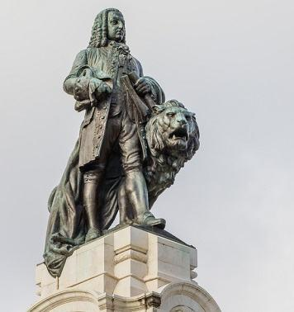
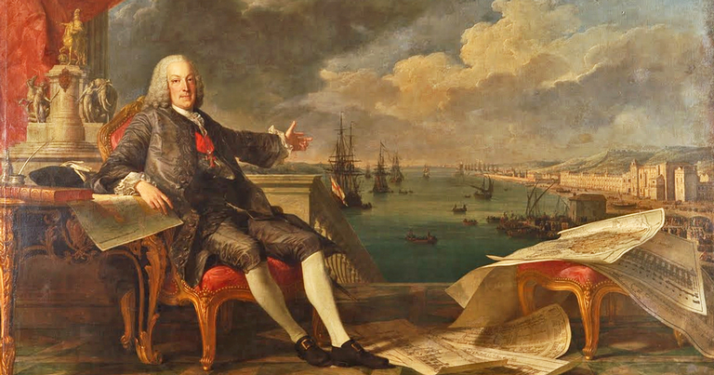
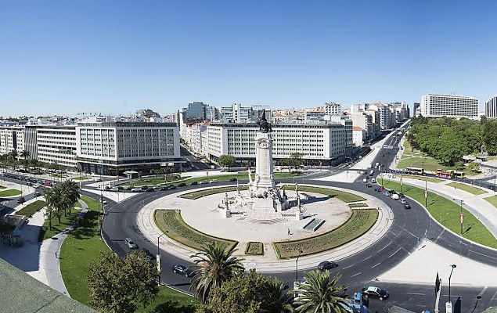
O Marquês de Pombal por Claude Joseph Vernet

Slide 5
A brief historical summary (XVIII-XIX)
Marquês de Pombal – reformas Pombalinas
Rebuilt Lisbon after the 1755 earthquake;
Diversification of the Brazilian agriculture production and founder of Portuguese bureaucratic machine to deal with the taxes and the management of the colonies;
Keep the tight diplomatic balance between Portugal and the trio France/Spain – England;
Expulsion of the Jesuítas from Portugal and the Colonies in 1759.
Creation of many commercial companies, including the famous “Companhia das Vinhas do Alto Douro” (1756) – the first in the world

Slide 6
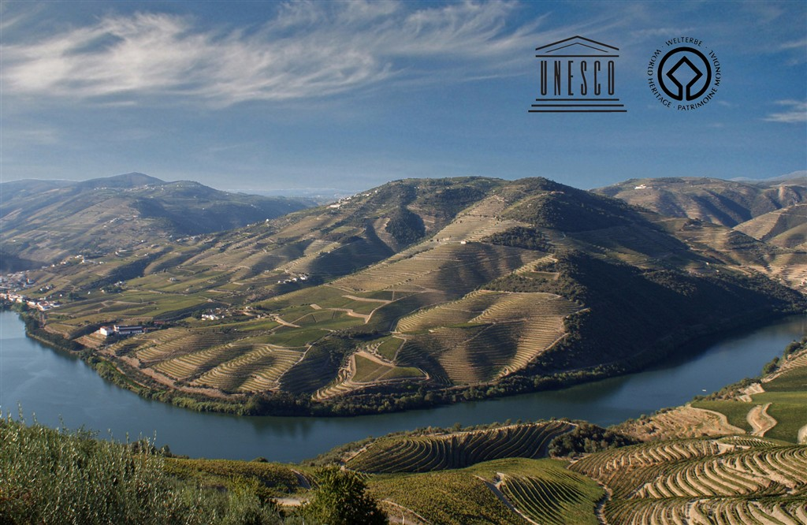
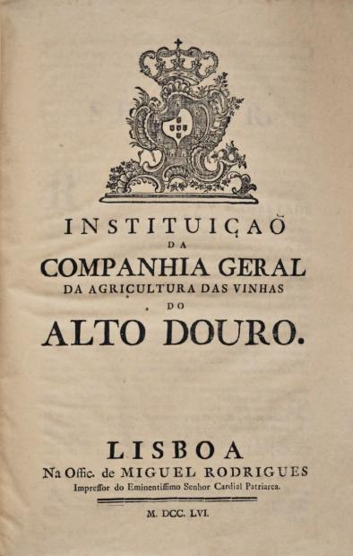
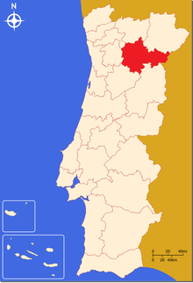
“Companhia das Vinhas do Alto Douro”
A product of excellence – one of the main export products of Portugal and a source of considerable great trade with England (the main buyers).

Slide 7
O Vale do Douro – UNESCO World Heritage in 2001

Slide 8
Douro and the Wine Culture
https://www.youtube.com/watch?v=biz4oAWAMDk
“The chief product of the 18th century was undoubtedly wine,
Mostly Port wine, which brought prosperity to a part of the country but also bound Portugal to England, her largest wine buyer. The wine was largely in the hands of English merchants and firms”
Oliveira Marques, p.124
https://www.youtube.com/watch?v=NzJdN4-NkaQ
(…) Socalcos que são passados de homens titânicos a subir as encostas, volumes, cores e modulações que nenhum escultor pintou ou músico podem traduzir, horizontes dilatados para além dos limiares plausíveis de visão. (…)
Um poema geológico. A beleza absoluta (…)
Miguel Torga

Slide 9
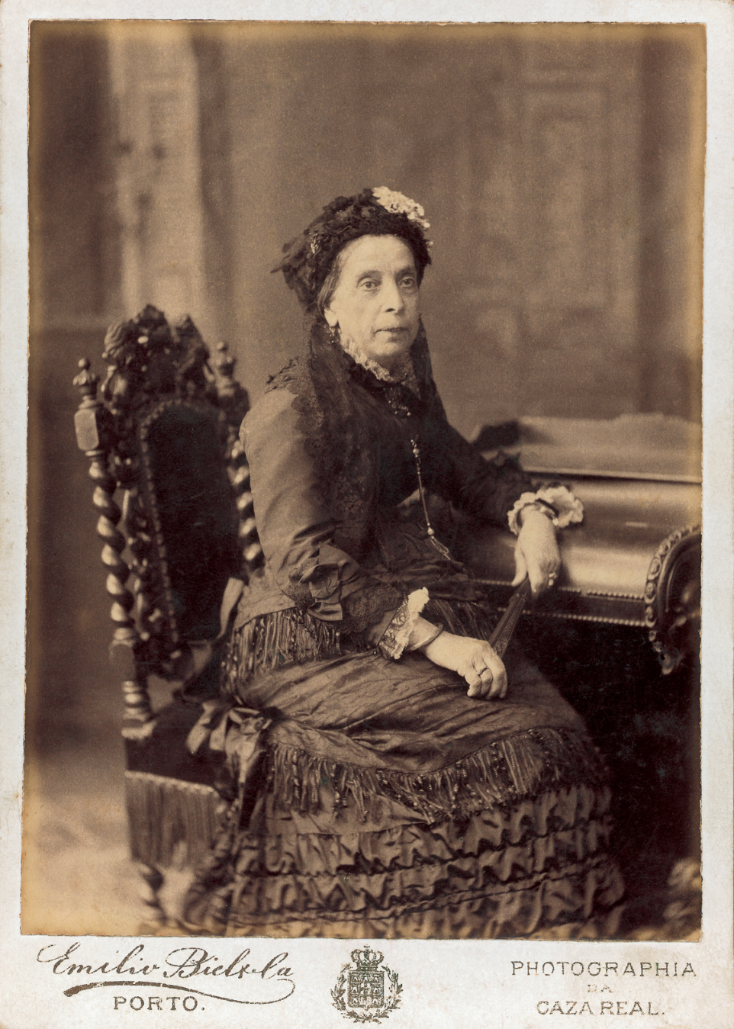
Douro and the Wine Culture
“A Ferreirinha” (1811-1896)
‘Cada um na sua terra deverá fazer tudo o que seja para o bem da humanidade’

Slide 10
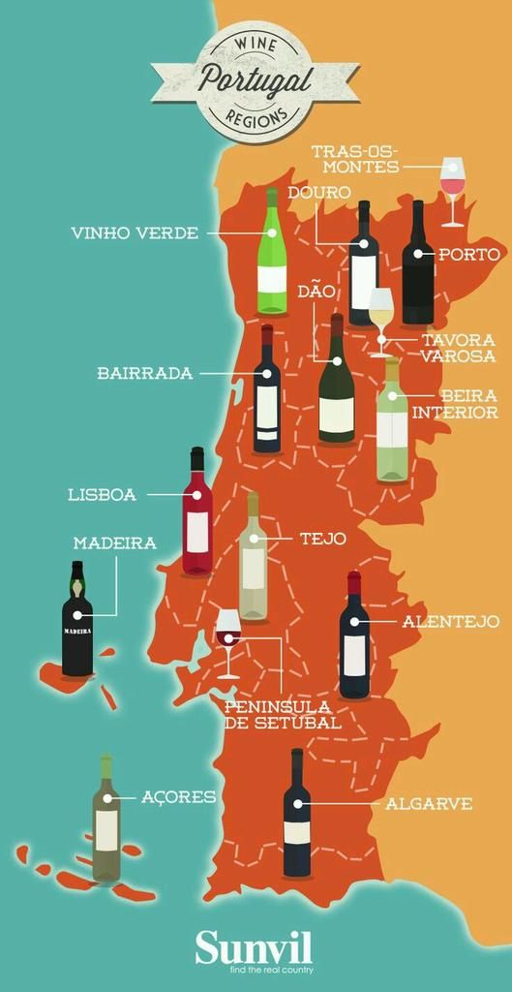
Wine country

Slide 11
A brief historical summary (XVIII-XIX)
The Napoleon continental blockade in 1806;
Spanish and French Ultimatum of 1807 and move of the Royal Family, under King João VI, to Brazil and arrival to Brazil in early 1808;
New capital of the Kingdom was established in Rio and for 14 years (untill 1822) Portugal was nothing more than a colony.
French invasion by General Junot; popular resistance; guerrilla war against invaders; rebellions in Porto and revolution spread everywhere. Help from the English led Junot to ask for truce. General Beresford pratically governed the country until 1820.

Slide 12
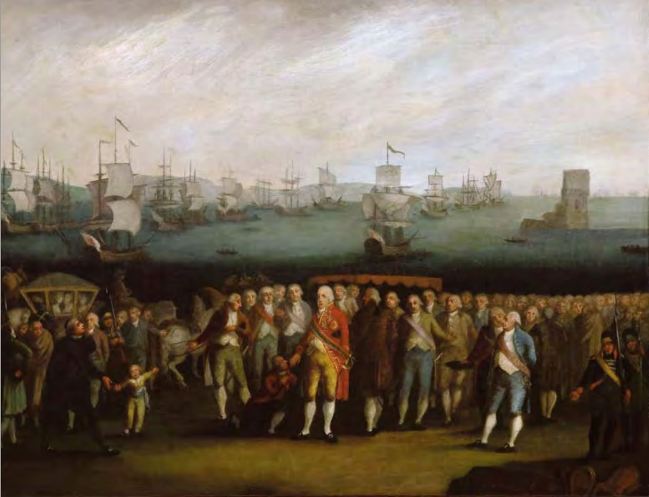
A brief historical summary (XVIII-XIX)
1808 – Escape to Brazil –
How João VI tricked Napoleon.
In Napoleon’s memoirs,
he wrote that João was
“the only one who tricked me.”

Slide 13
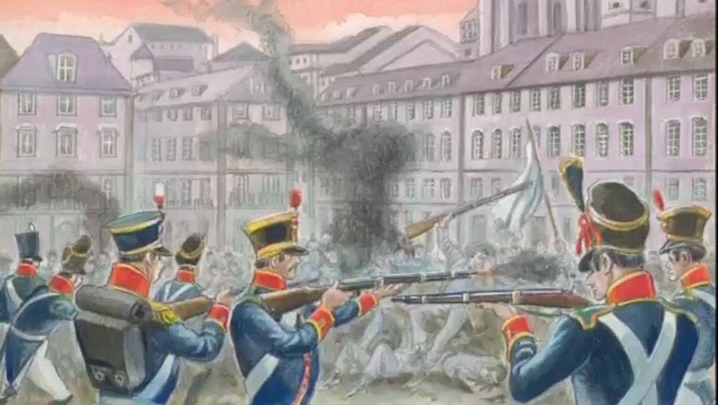
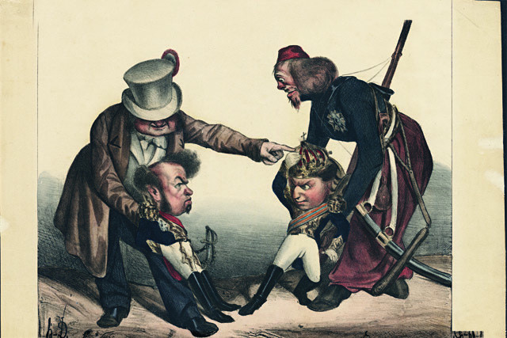
Transition XIX to XX
Liberal vs Absolutist – The Portuguese Civil war “A Guerra entre Irmãos”

Slide 14
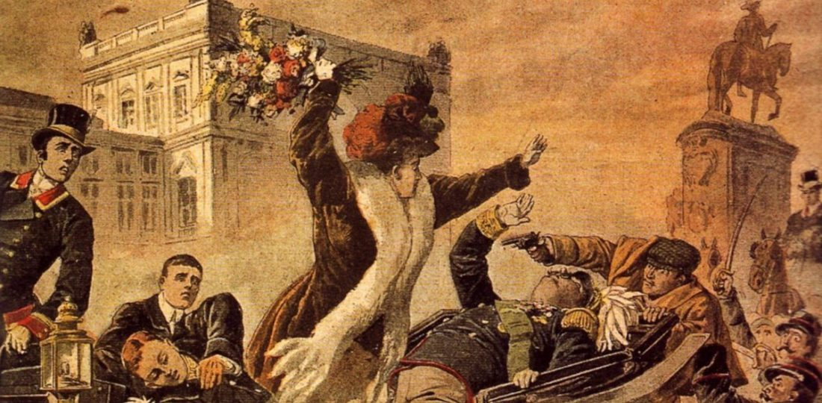
Regicídio 1908 – End of Monarchy and implementation of I Republic 5th October 1910

