Slide 1
5. subject
Handicrafts made by using stones
as raw materials

Slide 2
Handicrafts made by using worthless stones
as raw materials
Decoration stuff processing
Marble processing

Slide 3
Handicrafts made by using worthless stones
as raw materials
Making architectural element
column headers
edges of door and windows
fountains
tombstones
Making agricultural tools
millstone

Slide 4
Decoration stuff processing
Making jewelry
necklace, bracelet, earrings, ring, brooch
Making using stuff and accessories
Prayer beads
Pipe
Stalk of cane, umbrella, knife
cufflink
Marble processing

Slide 5
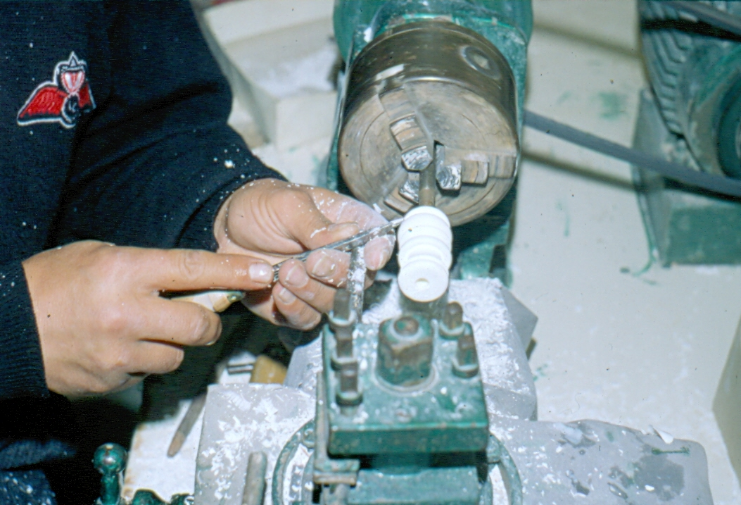
Meerschaum and it’s processing, Eskişehir, 1990

Slide 6
Pipes made from meerschaum, Eskişehir, 1990

Slide 7
Chess made from meerschaum, 1990, Eskişehir

Slide 8
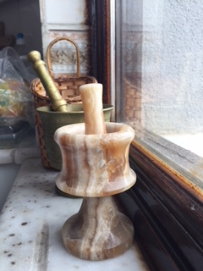
Vase made from Onyx stone and muller made from marble, Ankara, 2018

