Slide 1
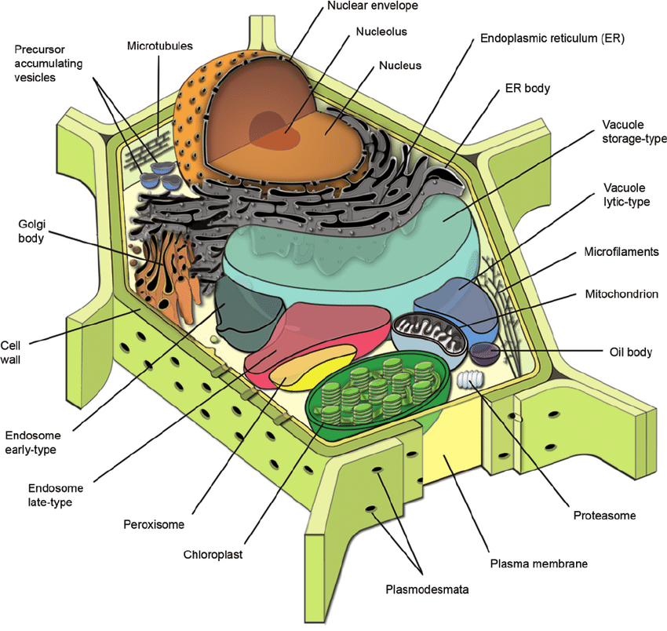
PART 1- COMPARTMENTS Membrane Structure and Membranous Organelles
Cells are basic units of life and require membranes for their existence. Plasma membrane defines each cells boundary and helps create and maintain electrochemically distinct environment within and outside the cell.

Slide 2
Other membranes enclose eukaryotic organelles are nucleus, chloroplast and mitochondrium.
Membranes also form internal compartments, such as Endoplasmic Reticulum (ER) in the cytoplasm and thylakoids in the chloroplast.
The principal function of membranes is to serve as a barrier to the diffusion of most water-soluble molecules.
These barriers limit compartments wherein the chemical composition can differ from the surroundings can be optimised for a particular activity. Membranes also serve as scaffolding for certain proteins.

Slide 3
1.1. Plasma membrane
Plasma membrane forms the outermost boundary of the living cell and functions as an active interface between the cell and its environment. In this capacity plasma membrane controls the transport of molecules into and out of the cell, transmits signals from the environment to the cell interior, participates in the synthesis and assembly of cell molecules and provides physical links between elements of the cytoskeleton and extracellular matrix.

Slide 4
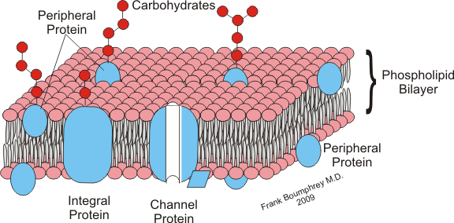
1.2. Common properties and inheritance of cell membranes
All cell membranes consist of a bilayer of polar lipid molecules and associated proteins. In an aqueous environment membrane lipids self-assemble with their hydrocarbon tails clustered together, protected from contact with water. Besides mediating the formation of bilayers, the property causes membranes to form closed compartments. As a result, every membrane is an asymmetrical structure, with one side exposed to the contents inside the compartment and the other side in contact with the external solution.

Slide 5
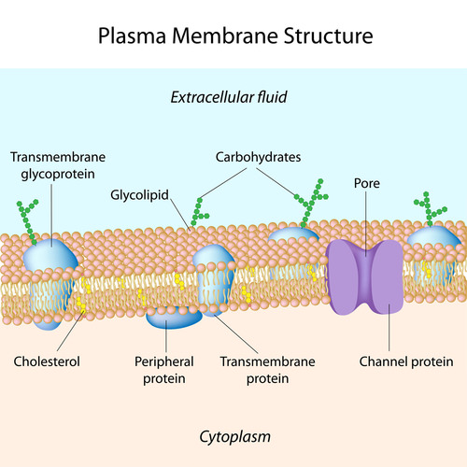
The lipid bilayer serves as a general permeability barrier because most water-soluble (polar) molecules cannot readily traverse its nonpolar interior. Proteins perform most of the other membrane functions and thereby define the specificity of each membrane system. Virtually all membrane molecules are able to diffuse freely within the plane of the membrane, permitting membranes to change shape and membrane molecules to rearrange rapidly.
Cells must maintain the integrity of all their membrane-bounded compartments to survive, so all membrane systems must be passed from one generation of cells to the next in a functionally active form

Slide 6
1.3. The fluid-mosaic membrane model
The fluid-mosaic membrane model describes the molecular organisation of lipids and proteins in cellular membranes. In most cell membranes, lipids and proteins (glycoproteins) make roughly equal contributions to the membrane mass.

Slide 7
The lipids belong to several classes, including phospholipids (the most common type of membrane lipids), galactosylglycerides, glucocerebroides and sterols (cholesterol, camposterol, sitosterol, stigmasterol).
Lipids share an important physicochemical property: They are amphipathic, containing both hydrophilic (water-loving) and hydrophobic (water-hating) domains.
Provides mechanical links between cytosolic and cell wall compounds.

Slide 8
The original fluid-mosaic membrane model included two basic types of membrane proteins: peripheral proteins (water-soluble) and integral proteins (water-insoluble).
As membrane components, proteins perform a wide array of functions:
Transporting molecules and transmitting signals across the membrane.
2. Processing lipids enzymatically.
3. Assembling glycoproteins and polysaccharides.

Slide 9
Plasmodesmata:
In conjunction with specialized domains of the ER, the plasma membrane produces plasmodesmata, membrane tubes that cross cell walls and provide direct channels of communication between adjacent cells.
As a result of these plasmodesmal connections, all the living plant cells of the individual plant share a physically continuous plasma membrane. On the contrast, in animals, every cell has a separate plasma membrane.

Slide 10
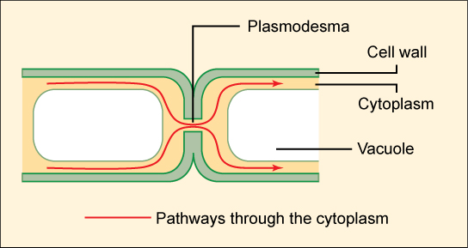
Plant and algae cells communicate with each other via plasmodesmata. They are cytoplasmic channels that pass through the cell wall and bind the cytoplasm of neighboring cells together. Nearly all of the plant cells are bound to neighboring cells with plasmodesmata.

Slide 11
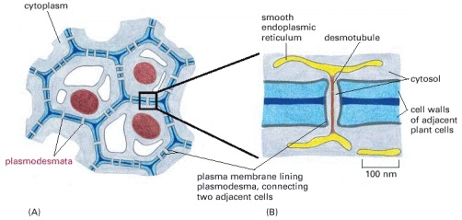
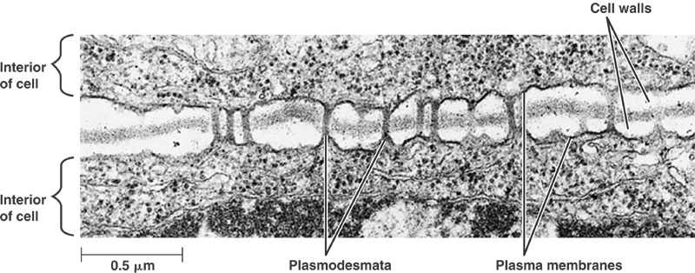

Slide 12
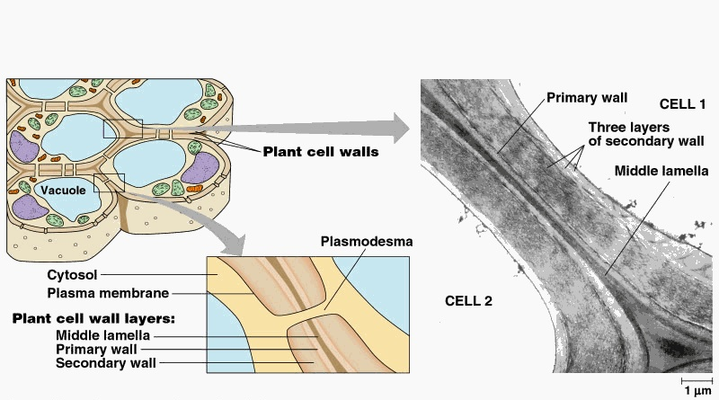
Plasmodesmata are not just open channels. The inner parts of these channels are covered with cell membrane along the cell wall and a central band is found at the middle that derive from endoplasmic reticulum. Some proteins are found in the space between the cells. Ions and big molecules like nucleic acids are determined to pass to the neighboring cell via plasmodesmata.

Slide 13
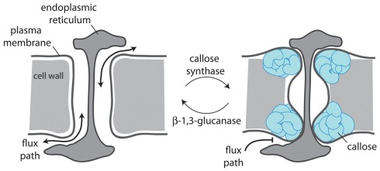
Therefore, these channels are important for the development of the plant tissues. When the plants are wounded, plasmodesmata in that region are occluded with a polysaccharide type filling material called callose, cytoplasm leakage from neighboring cells and the entrance of pathogenic microorganisms are prevented.
Callose also provides a scaffold for repairing the damaged cell membrane and wall, or reinforcing the wall itself.

Slide 14
Another important difference between plants and animals is the fact that plant cells are normally under turgor pressure, which forces the plasma membrane tightly against the cell wall.

Slide 15
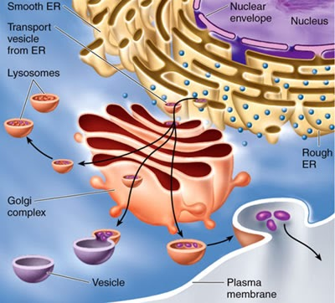
All eukaryote cells (plants, fungi and protista) have an endomembrane system. This system consists of endoplasmic reticulum and golgi apparatus. They have different specialized functions, however they work in coordination.
***Procaryote cells dont have endomembrane system.

Slide 16
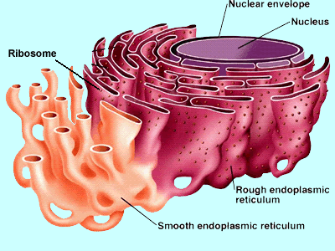
1.4. Endoplasmic reticulum
Endoplasmic reticulum (ER) is the most extensive, versatile and adaptable organelle in eukaryotic cells. It consist of a three-dimensional network of continuous tubules and flattened sacs that underlie the plasma membrane, course through the cytoplasm and connect to the nuclear envelope but remain distinct from the plasma membrane.

Slide 17
Endoplasmic means «within the cytoplasm» and reticulum means «net».
In plants, the principal functions of ER include synthesizing, processing and sorting protein targeted to membranes, vacuoles or the secretory pathway as well as adding N-linked glycans to many of these proteins and synthesizing a diverse array of lipid molecules.
ER also provides anchoring sites for the actin filament bundles that drive cytoplasmic streaming and plays a critical role in regulating the cytosolic concentrations of calcium, which influence many other cellular activities.

Slide 18
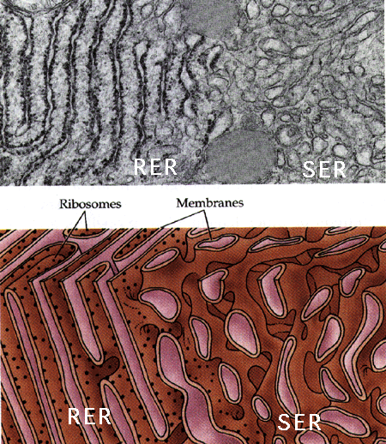
Eukaryotic cells have 2 types of ER: rough ER and smooth ER. These 2 types of ER are physically bound to each other at some special points, however they both have different functions.

Slide 19
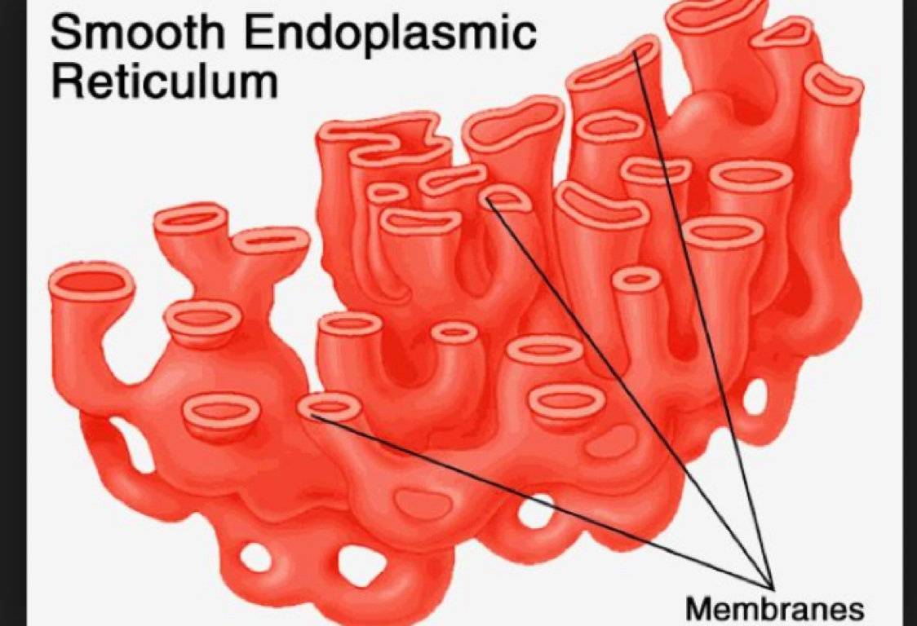
In smooth ER, fatty acids and phospholipids are used in the making of membranes. In addition, SER is the place for biodegradation of toxins and conversion of them into less harmful molecules. These molecules can be expelled from the cell.

Slide 20
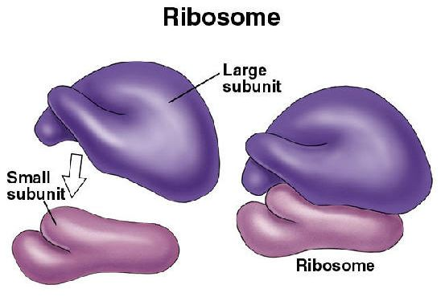
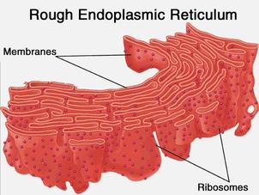
The surface of rough endoplasmic reticulum (RER) is covered with ribosomes. Ribosomes are small spherical structures consisting of proteins and RNA molecules.

Slide 21
Ribosomes are found on RER or as free in eukaryotic cells. Their function is to bind free amino acids to each other and form proteins. The proteins that will be sent outside the cell are produced by the ribosomes found on the surface of RER. These proteins have a special amino acid sequence at the end. This small sequence is the signal demonstrating that the synthesis starts at the free ribosomes. If this special sequence appears when protein synthesis starts, then the ribosome is attached to the RER and protein synthesis continues into the ER tubes through the protein channels found in the RER.

Slide 22
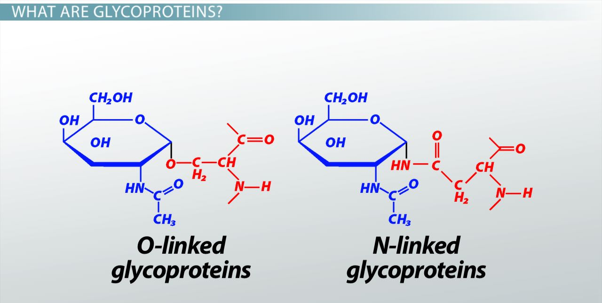
When proteins enter into RER, sugars (oligosaccharides) may also be attached to them; thus proteins become glycoproteins. Then glycoproteins are directed to the vicinity of Golgi apparatus by RER for other chemical processes to take place. Glycoproteins leave the RER in small, spherical vesicles.

Slide 23
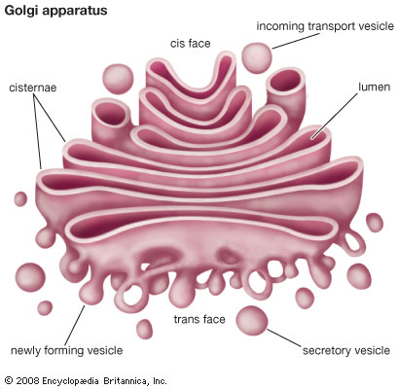
1.5. Golgi apparatus
The term Golgi apparatus refers to the complement of Golgi stacks and associated trans-Golgi networks (TGNs) within a given cell. Each membranous sack is called cistern. Golgi apparatus occupies a central position in the secretory pathway, receiving newly synthesized proteins and lipids from the ER and directing them to either the cell surface or vacuoles.

Slide 24
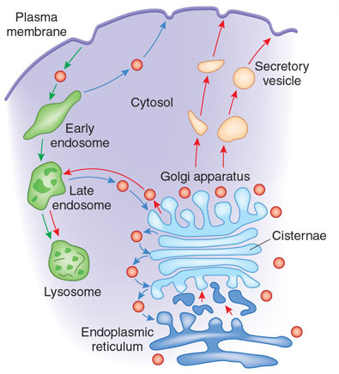
Golgi apparatus is involved in many other cell functions, as well. The function of Golgi is to produce new cell materials, make modifications in the products and send the products out of the cell or distribute them within the cell.

Slide 25
Typically , the middle part of the cisterns are thin, and the ends are swollen. The inner side of the cisterna sac at the edge towards the inner side is called the «cis face (binding side)». Proteins that recognize the vesicles coming from the ER and bind to them are present at the cis side. Spherical small vesicles fuse with the cis side with the help of these proteins. By this way, glycoproteins that have been synthesized in ER reach the Golgi.

Slide 26
The outer side of the cistern that is found at the side facing the cell membrane is known as the «trans face (secretory face)». The distribution of materials produced in Golgi apparatus is performed with the help of vesicles detaching from the trans face.

Slide 27
Different enzyme groups are found in each cistern. Materials transported in the Golgi move towards one direction through the cistern sacs during this process and go through different chemical changed in each vesicle in an orderly way.
Golgi enzymes shorten the oligosaccharides that are attached to protein in ER or reorganize them. These changes modify the related proteins to perform their specialized functions within the cell.
In addition to these functions, Golgi also produces non-cellulosic cell wall polysaccharides like pectin and hemicellulose.

Slide 28
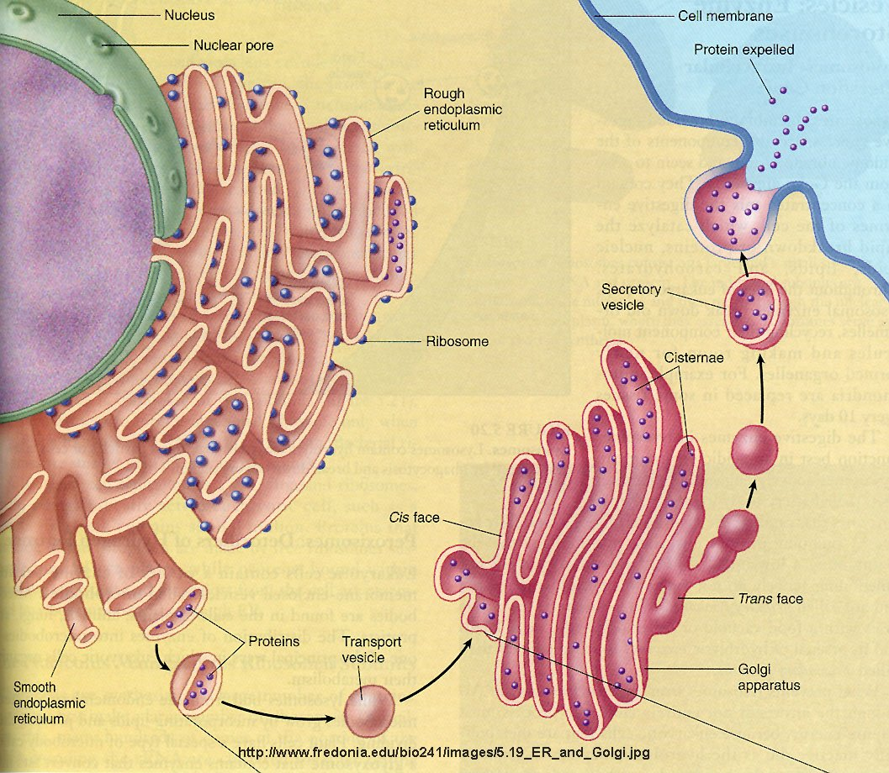

Slide 29
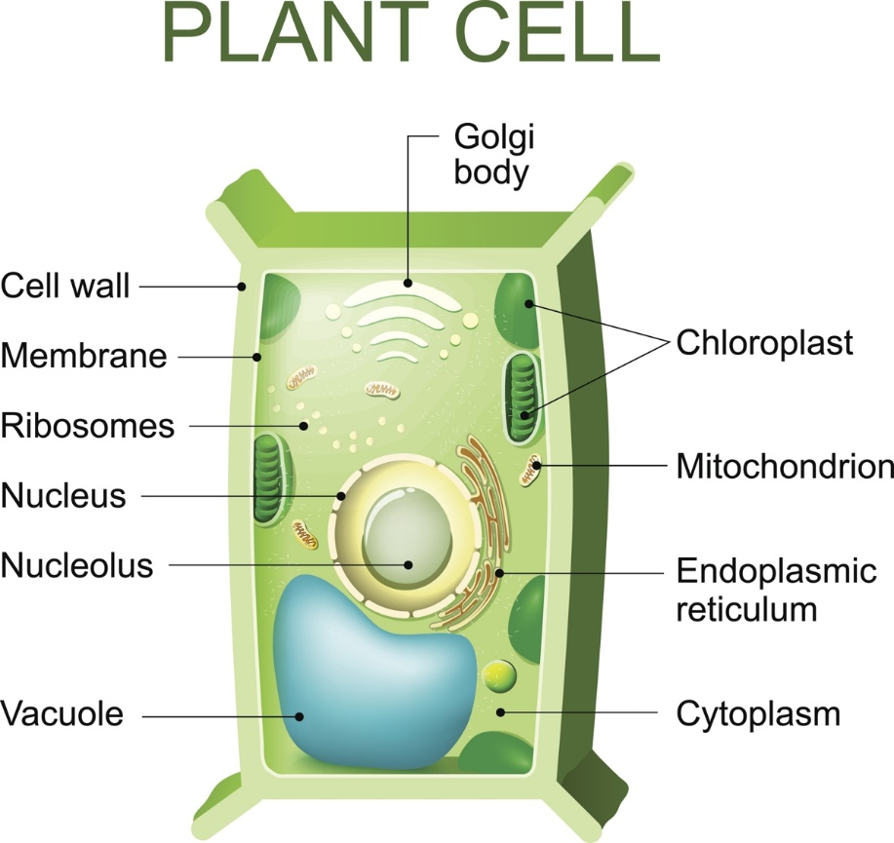
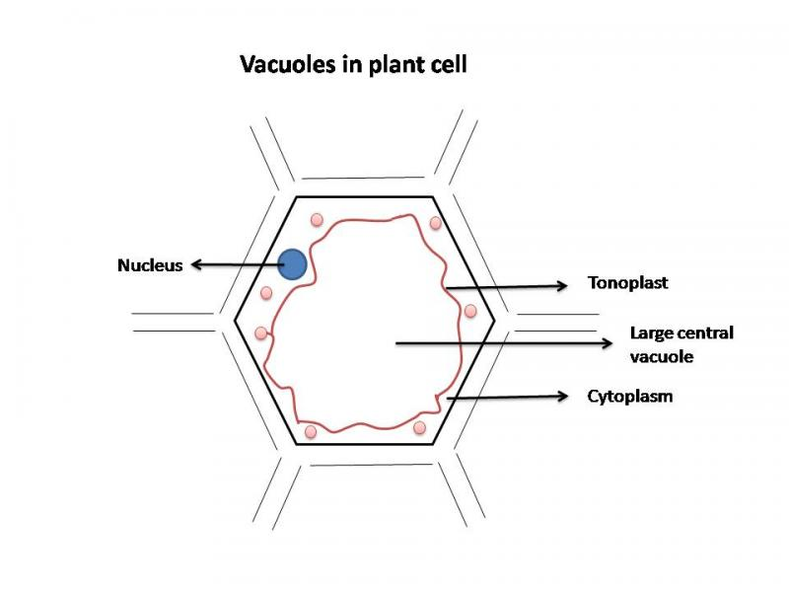
1.6. Vacuoles
Vacuoles, fluid-filled compartments (the liquid part of the vacuole is called tonoplasm) encompassed by a membrane called tonoplast (=vacuolar membrane), are conspicuous organelles of most plant cells. They usually occupy more than 30% of the cell volume. In large, mature cells, the space occupied by the vacuole compartments can approach 90% of the cell volume.

Slide 30
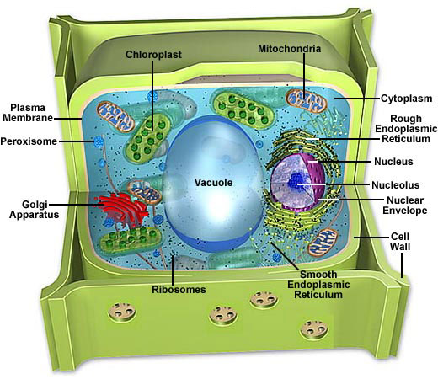
It is an organelle full of fluid and is the place where substances found within the cell fluid are gathered (crystals, tannins, tartaric acid, malic acid, minerals, pigments, proteins, lipidic substances).
Vacuole also regulates the water equilibrium of the cell. Vacuole takes water from the outside or release water to the outside according to osmotic pressure.

Slide 31
Some of the important functions of vacuoles:
Isolating materials that might be harmful or a threat to the cell
Containing waste products
Containing water in plant cells
Maintaining internal hydrostatic pressure or turgor within the cell
Maintaining an acidic internal pH
Exporting unwanted substances from the cell
Allows plants to support structures such as leaves and flowers due to the pressure of the central vacuole

Slide 32
