Slide 1
COM 412
Information Technology and Security Governance
Week 9
Organizational Security

Slide 2
Security in Organizational Structures
* CEO: Chief Executing Officer – Big Boss
* Beneath CEO
- C-level executives of business functions
- Such as finance, IT, strategy, operations, sales, and marketing
- These executive appointments come with titles: CFO (chief financial officer), CIO (chief information
officer), COO (chief operating officer)
- These executives has a subset of responsibilities:
-- CIO: responsible for the business’s information and technology strategy
Notes:
Let’s look at the organizational structures first.
At the top CEO is there.
CEO: yönetim kurulu başkanı
CFO: finans direktörü
CIO: bilişim kurulu/dairesi başkanı
COO: operasyon direktörü

Slide 3
Security in Organizational Structures
* information security manager (ISM) must work closely with CIO
* chief information security officer (CISO)
* chief security officer (CSO)
* an ISM must have:
- solid understanding of information risk management
- great communication skills
- patience
Notes:
In some organizations, where the level of security understanding is high,
the information security manager’s job is elevated to a board-level position,
such as chief information security officer (CISO) or chief security officer (CSO)
being an information security manager requires you to have
a solid understanding of information risk management,
great communication skills and
patience to explain complicated and abstract concepts to non-technical executives and board members

Slide 4
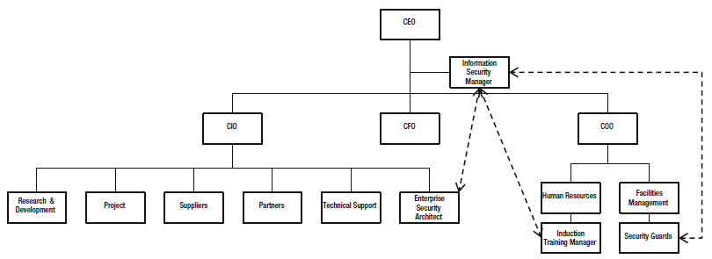
Security in Organizational Structures
Notes:
you’ll see that the information security manager sits at the top of the organization, reporting directly to the CEO.
there are dotted lines into security guards, enterprise security architects, and the induction (giriş, başlama) training manager.
While each of staff members is controlled within the context of their own teams, they all have corporate responsibilities.
the information security manager can discharge the responsibility (sorumluluğu yerine getirmek) for security induction
and security awareness training, by providing an assurance function across the content and examinations

Slide 5
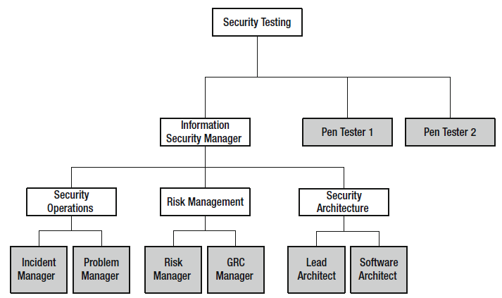
Security in Organizational Structures
Notes:
most of the key functions that the information security manager needs to consider in day to day activities are:
security operations, architecture, risk management, and security testing.
And this is a sample functional structure for the security team. ISM manages this team.

Slide 6
Security in Organizational Structures
* Security Operations Team
- manages the security of devices
- monitors the external threat environment
- reacts to early warnings of new threats
- reacts to system and security alarms
- resolves ongoing issues
- watches consoles and ensures that all of the critical assurance systems are running
Notes:
The core function of the security operations team is:
- to manage the security of devices within the environment,
to monitor the external threat environment
react to early warnings of new threats to prepare the business to deal with these
react to system and security alarms and get involved in managing security incidents
Problem managers resolve ongoing issues that recur within the environment.
A team of analysts employed in the security operations team
and they watch consoles and ensure that all of the critical systems used by the business are running and free of alarms.

Slide 7
Security in Organizational Structures
* Risk Management Team
- conducts technical and business-level risk assessments
- presents a risk management
Notes:
The risk management team will
- conduct both technical and business-level risk assessments,
- present a risk management plan back to the information security manager with recommendations of which risks can be mitigated, monitored,
or insured against (sigortalamak).

Slide 8
Security in Organizational Structures
* Security Architecture Team
- ensures that the business’s security objectives are met as technology and processes change
- contains security architecture specialists
Notes:
The security architecture team works closely with the businesses change program and other project design teams
to ensure that the business’s security objectives are met as technology and processes change.
You will find that the team often contains security architecture specialists,
such as software architects, infrastructure architects and even database security architects,
as these are all extremely specialized and complicated areas.

Slide 9
Security in Organizational Structures
* Security Testing Team
- write test plans when new systems are transitioning into production
- conduct vulnerability tests, pentests
Notes:
the security testing team may be a component team within a larger testing organization,
or may be dedicated as a smaller, more targeted team to the information security manager.
This team will write test plans for the security architecture group, when new systems are transitioning into production
When this testing team is not scoping test plans for projects, they conduct vulnerability tests on infrastructure, software, and websites
they may also perform penetration testing of your systems.

Slide 10
Hackers
Notes:
Just to recap, mainly three types of hackers are there: White-hat hackers, black-hat hackers, gray-hat hackers
White-hat hacking is pentesting or penetration testing.

Slide 11
Hacking Steps
* Reconnaissance (PreAttack): The process of information gathering
* Scanning (PreAttack): Taking the information discovered during reconnaissance and using it to examine the network
* Gaining access (Attack): The phase where the real hacking takes place
* Maintaining access (Attack): Keeping the access for future exploitation and attacks
* Clearing tracks (PostAttack): Covering tracks to avoid detection
Notes:
This is CEH methodology of offensive security or hacking

Slide 12
Pentest Methods
Notes:
A blind test is one in which only publicly available information is used.
A double-blind test is one in which only publicly available information is used and the security staff is not notified of the event.
A double-blind test allows the organization to observe the reactions of the security staff.

Slide 13
Pentest Methods
White box
* Pros
- Deep and thorough testing
- Maximizes testing time
- Extends the testing area where black box testing can not reach (such as quality of code, application design, etc.)
* Cons
- Non realistic attack, as the penetration tester is not in the same position as a non-informed potential attacker

Slide 14
Pentest Methods
Black box
* Pros
- It simulates a very realistic scenario
* Cons
- Testing time can not be maximised in certain scenarios
- Some areas of the infrastructure might remain untested

Slide 15
Working with Standards and Regulations
* Statutory requirements
* Regulatory requirements
* Advisory requirements
- NIST
- CESG
- ASG
- …
Notes:
statutory requirements (kanuni gereksinimler): they flow down from the government, law enforcement, or legal system that you are bound by.
For example; privacy legislation may force you to notify a government agency and your customers if a data breach occurs,
so, this is a legal requirement that you need to be aware of and ensure that your systems are compliant,
but also making sure that your staff are compliant.
--------------------------------------------------------------------------------------------------------------------------------------------------
Regulatory requirements (düzenleyici gereksinimler) are imposed upon your business by external organizations.
Unlike statutory requirements, regulatory requirements are imposed by trade bodies rather than legislative bodies.
For example the global finance industry has extremely strict controls that are imposed on banks and finance organizations.
Any organization directly handling credit card information must maintain an active PCI-DSS (Payment Card Industry Data Security Standard) compliance certificate.
--------------------------------------------------------------------------------------------------------------------------------------------------
Advisory requirements (tavsiye niteliğinde gereksinimler) are not mandated, instead existing to help organizations.
Most governments have their own cybersecurity advisory units.
The following organizations publish cybersecurity advisories in each of their respective countries:
The National Institute of Standards and Technology (NIST): This is a US government agency that publishes standards and guidelines related to
cybersecurity matters
CESG : Communications Electronic Security Group is the United Kingdom’s national technical authority for all aspects of cybersecurity.
Australian Signals Directorate (ASD): is the Australian Defense Force branch of government that manages all aspects of communication security.

Slide 16
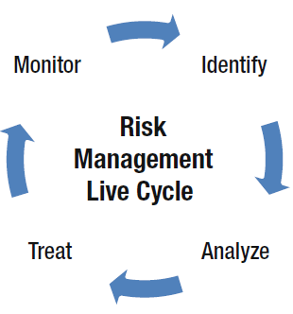
Working with Risk Management
* Risk management sits at the heart of everything the information security team does
* Information risk management must be embedded into every process
* Risk register
Notes:
Risk management sits at the heart of everything the information security team does.
Information security manager should encourage the business to embed information risk management into
every process it uses to deliver its products and services.
Every member of staff should be encouraged and educated to raise (söylemek) threats, vulnerabilities, and risks
with the information security team when they are discovered or observed.
Threats, vulnerabilities, and risks are recorded in a central register, known as a risk register.
You see the risk management life cycle on the slide.
Risk management is an iterative process, comprising of the four key stages of identify, analyze, treat, and monitor.

Slide 17
Working with Risk Management
- Vulnerability
- Threat
- Risk
Notes:
Just to recap;
A vulnerability is,
- Weakness of a system (e.g. transferring data clear text)
- When exploited loss and damage may ocur
- Exploiting a vulnerability intentionally is called ‘attack’
A threat is,
- Situation that is resolved when we prevent the weakness
- It may be an attack or innocent fault of a person
A risk is is potential for loss, damage, or destruction of an asset as a result of a threat exploiting a vulnerability.

Slide 18
Working with Risk Management
Notes:
A risk is referred to multiplication of threat and vulnerability.
For example; In a system that allows weak passwords;
password is vulnerable for dictionary or exhaustive key attacks; this is Vulnerability
An intruder can exploit the password weakness to break into the system; this is Threat.
the resources within the system are prone for illegal access/modify/damage by the intruder; this is Risk.

Slide 19
Risk Identification
* The first stage of risk management
* You’ll need to collate all threats, vulnerabilities, and risks
* You’ll need to record each item in a format that can be analyzed -- Risk register
* Ways to collate:
- Pentesting
- Mailbox
- Workshops
- BIA
- ISO/IEC 27002: A standard of “International Organization for Standardization” & “International Electrotechnical Commission”
Title: “Information technology – Security techniques – Code of practice for information security controls” standard
Notes:
The first stage of risk management is risk identification.
You’ll need to collate all threats, vulnerabilities, and risks that may be affecting the business.
This information will need to be passed to the next stage of the risk management process for analysis,
so you’ll need to record each item in a format that can be analyzed.
This record of risks is called the risk register .
There are a variety of ways to collate this information. For example:
Pentesting
Risk notification mailbox: You can set up an email address that is open to the entire business that allows anyone to raise a concern.
Threat workshops: workshops with teams within your organization who will best understand how they would exploit the systems they are responsible for.
Business impact analysis (BIA): a formal process to identify the impact of losing an information artifact based on certain threats.
For example; you can identify high-level threats, such as the lack of availability of a critical database. NIST provides a useful BIA template.
ISO/IEC 27002: contains a long list of security controls coupled with implementation guidance

Slide 20
Risk Analysis
* The second stage of risk management
* Establish whether or not they pose a real risk
* Two primary methods:
- Qualitative: subjective
-- We can develop probability scales:
• Negligible, rare, unlikely, possible, probable
• Rare, unlikely, possible, likely, almost certain
• Low, medium, high
Notes:
The analysis stage comes next.
This is where you take all of the threats and vulnerabilities and establish (belirlemek) whether or not they pose a real risk.
There are two primary methods for analysis: Qualitative (nitel) and Quantative.
Qualitative assessments are largely subjective.
You can develop probability scales that may have ratings such as:
• Negligible (ihmal edilebilir), rare (nadir), unlikely (olasılık dışı), possible (mümkün), probable (olası)
• Rare, unlikely, possible, likely, almost certain
• Low, medium, high
- And assess the risks according to these scales

Slide 21
Risk Analysis
* Two primary methods:
- Qualitative
- Quantitative:
-- Scientific
-- It relies on having enough empirical data
Notes:
Quantitative analysis is the “scientific” method.
It relies on having enough empirical data to determine a statistical probability.
You see a threat matrix that consists of impact ratings and likelihood ratings ranging from low to high.
This is a typical threat matrix especially for a qualitative methodology based risk management.

Slide 22
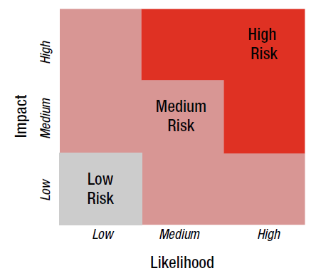
Risk Analysis
Notes:
You see a threat matrix that consists of impact ratings and likelihood ratings ranging from low to high.
This is a typical threat matrix especially for a qualitative methodology based risk management.
And a few examples of threats, vulnerabilities, impacts & likelihoods and final risk levels according to the threat matrix.
You can use as many levels as needed to define impact and likelihood
For example; some organizations have three levels of impact and six levels of likelihood.

Slide 23
Risk Treatment
* Risks can be treated in one of four ways:
- Avoid the risk
- Accept the risk
- Reduce the risk
- Transfer the risk
Notes:
After establishing how much risk the organization is exposed to, you need to decide which risks require treatment.
Risks can be treated in one of four ways:
- Avoid the risk, sometimes referred to as eliminate or terminate.
- Accept the risk, sometimes referred to as tolerate.
- Reduce the risk, sometimes referred to as minimize or lessen.
- Transfer the risk, also referred to as risk sharing.

Slide 24
Risk Treatment
* Security controls that can be used in treatment:
- Physical controls: e.g. physical access control systems
- Procedural controls: e.g. employee clearance checks
- Technical controls: e.g. firewalls, anti-malware product
Notes:
Here is the classification of security controls you can use in treatment. These are all industry-accepted terms.
• Physical controls are real-world mitigations that reduce the risks to information.
Examples of physical controls could be to introduce physical access control systems, such as secure cabinets and security guards
• Procedural security controls usually take the form of policies and procedures that define how staff behaves.
An example might be an employee clearance checks.
• Technical security controls are the traditional information security controls such as firewalls, anti-malware
products, SIEM (security information and event management) solutions, and vulnerability scanning systems.

Slide 25
Risk Treatment
* Controls’ mode of assisting in risk reduction:
- Preventative controls: directly protect information
e.g. a F/W blocks unauthorized ports or protocols
- Directive controls: tell your workforce what action needs to be taken to protect information
e.g. a procedure for locking the filing cabinet at the end of the working day
- Detective controls: detect and report unauthorized or undesired events
e.g. monitoring of audit logs
- Corrective controls: respond to and fix security incidents
e.g. antivirus products can be configured to quarantine and clean a system after it’s been infected by a virus
Notes:
Security controls usually provide risk reduction in one or more of four ways. These are the controls’ mode of assisting in risk reduction:
• Preventative controls directly protect information by blocking the threat or removing the vulnerability.
An example might be where a firewall blocks unauthorized ports or protocols from traversing your business’s Internet connection.
• Directive controls are procedural controls.
They tell your workforce what action needs to be taken to protect information,
such as a procedure for locking the filing cabinet (dosya dolabı) at the end of the working day.
• Detective controls detect and report unauthorized or undesired events.
Detective security controls are often invoked after an undesirable event has occurred.
An example might be the monitoring of audit logs.
• Corrective security controls are used to respond to and fix security incidents.
Corrective controls limit or reduce further damage from an attack.
For example, antivirus products can be configured to quarantine and clean a system after it’s been infected by a virus.

Slide 26
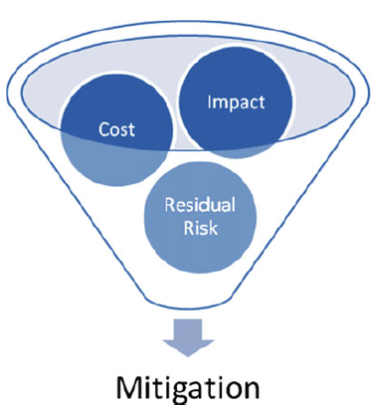
Risk Treatment
Notes:
The choices made in risk treatment planning need to consider the cost of the planned mitigation,
the business impact of installing or enacting the mitigation and the residual risk left over once the mitigation is in place.

Slide 27
Risk Monitoring
* Last stage
* You watch here existing risks to make sure that they are not worsening
Notes:
Lastly, once you have put your mitigations in place, you enter the risk monitoring stage.
This is where you watch existing risks to make sure that they are not worsening.
For example, the impact and likelihood of a risk can easily vary with time, such as your system’s being infected by a virus.
When building your risk management capability, you need to consider business continuity management and disaster planning.

Slide 28
Working with Enterprise Architecture
* Security architecture is a core consideration within any business’s enterprise architecture
* Def. of architecture
* Def. of architect
* Enterprise architect’s work includes the entire business, the workforce, business’s processes and, the information and IT
* Frameworks: TOGAF & SABSA
Notes:
And final words about this topic. It is about architecture.
- Security architecture has become a core consideration within any business’s enterprise architecture.
- A general definition of architecture is that it typically represents how the components of a product, system, or
service are organized and integrated together.
An architect is the professional person who has the depth of knowledge and expertise
to define how these products, systems and services are constructed.
the scope of the enterprise architect’s work includes the entire business, the workforce,
all of the business’s processes and, the information and information technology.
a variety of frameworks and methodologies have been developed that assist architects: TOGAF, SABSA.
These are all about architecture. If you want to learn more you can make a research about TOGAF and SABSA.

