Slide 1
Fat analysis
Assoc Prof. ÖZGE ŞAKIYAN DEMİRKOL
29.03.2021

Slide 2
Lipids, proteins, and carbohydrates constitute the principal structural components of foods.
Lipids are a group of substances that, in general, are soluble in ether, chloroform, or other organic solvents but are sparingly soluble in water. However, there exists no clear scientific definition of a lipid.
The terms lipids, fats, and oils are often used interchangeably.
The term “lipid” commonly refers to the broad, total collection of food molecules that meet the definition previously stated. Fats generally refer to those lipids that are solid at room temperature, and oils generally refer to those lipids that are liquid at room temperature.

Slide 3
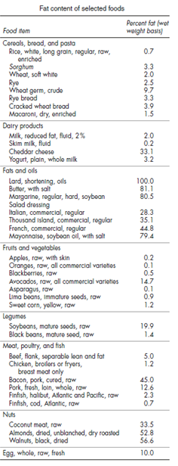
General classification
Simple lipids: ester of fatty acids with alcohol (i.e., fats, waxes)
2. Compound lipids: compounds containing groups in addition to an ester of a fatty acid with an alcohol (i.e., phospholipids, cerebrosides, and sphingolipids)
3. Derived lipids: substances derived from neutral lipids or compound lipids (e.g., fatty acids, long-chain alcohols, sterols, fat-soluble vitamins, and hydrocarbons)

Slide 4
The importance of analysis
An accurate and precise quantitative and qualitative analysis of lipids in foods is important;
for accurate nutritional labeling,
to determine whether the food meets the standard of identity,
to ensure that the product meets manufacturing specifications.

Slide 5
Fat analysis methods
Solvent extraction methods
Nonsolvent wet extraction methods
Instrumental methods

Slide 6
The principle of extraction method
The separation of components (such as fats) from solid or liquid phase food materials by using convenient solvent depending on solubility difference

Slide 7
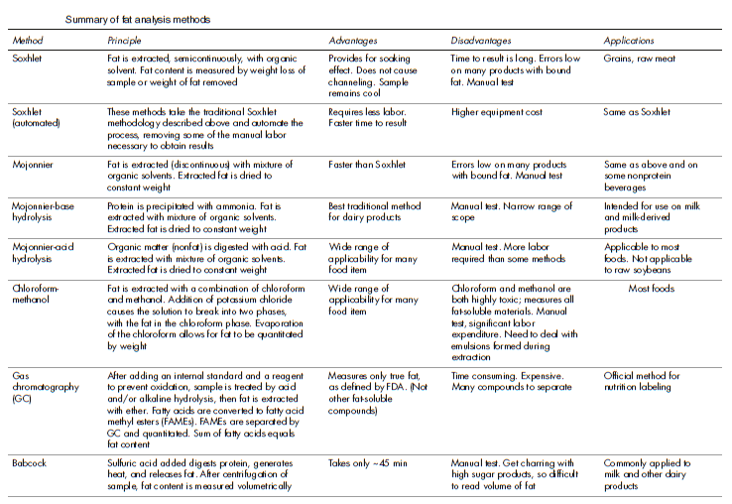

Slide 8
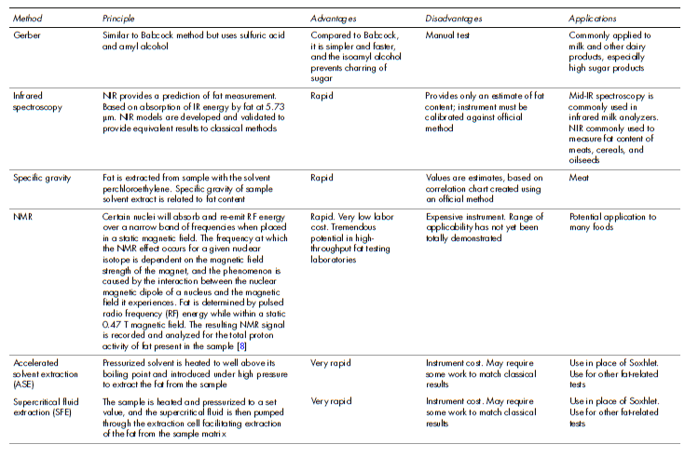

Slide 9
The factors affecting analysis duration:
The food materials properties
Particle size
Mass transfer area
The solvents properties
The circulation velocity
Solid to solvent ratio

Slide 10
Thanks!!!!
osakiyan@ankara.edu.tr

