Slide 1
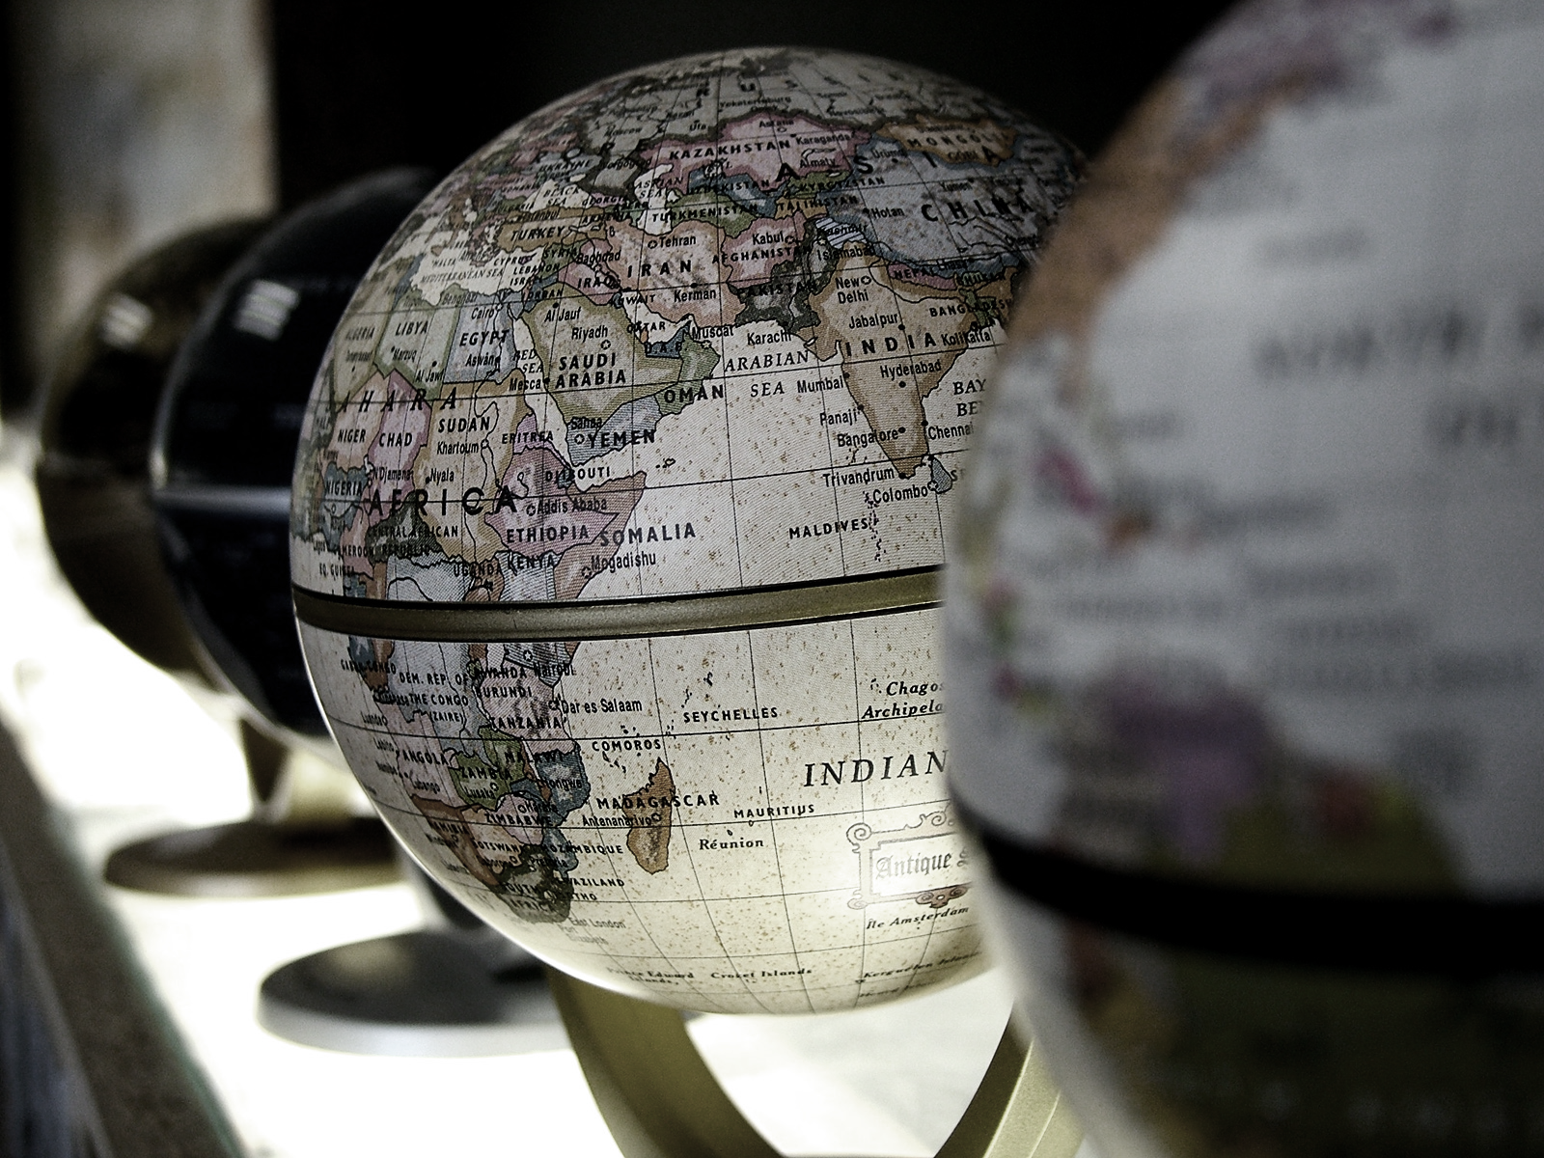
Political Geography
Asst. Prof. Merve ALTUNDAL ÖNCÜ

Slide 2
RESOURCE AND POWER
It is impossible to consider the population of a state, its efficiency and effectiveness, without, at the same time, discussing the resources, which are available for its use.
People must have land on which to live and to grow their food.
Almost all food is derived directly from the soil, and its volume and quality depend directly on the extent and nature of the soil.

Slide 3
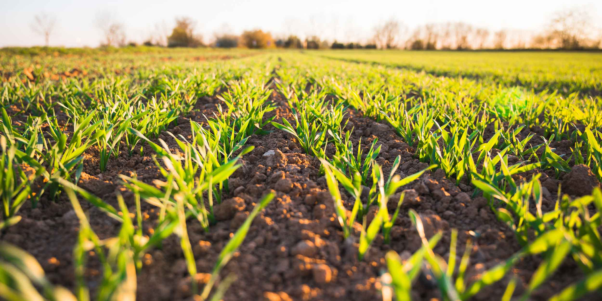
For successful agriculture good soils and for industries reserves of minerals are needed.
The cultivable soil must, then, be regarded as a primary resource in the estimate of national power.
The raw materials from which the metals are derived have a place of special importance in any discussion of national power, because modern industry cannot be carried on without them.
A state which lacks the more important minerals or which has only small reserves may feel especially vulnerable.

Slide 4
Few natural resources can be used in the forms in which nature has given to mankind. They need to be smelted, refined, and fabricated.
Potential resources, which need years to develop, may not greatly help. If the decision-making authority initiates a policy now, it needs the support of resource at once, not at some hypothetical date in the future.
On several occasions in the past century the responsible powers in a State have been forced to admit, “we shall be in a position to risk war only if certain resources are available” and to delay political action until a safety margin in resources has been achieved.

Slide 5
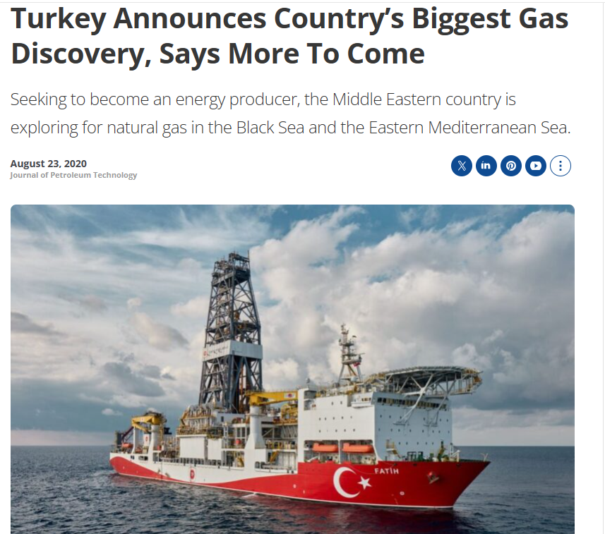

Slide 7
https://www.mfa.gov.tr/turkeys-energy-strategy.en.mfa

Slide 8
So in order to be considered in the power potential of the state, the resources must be developed and available, or available after a very short delay.
This pre-supposes the construction of transportation net to bring the raw resources to the factories for processing and the finished goods to those locations where their use is the most effective.

