Slide 1
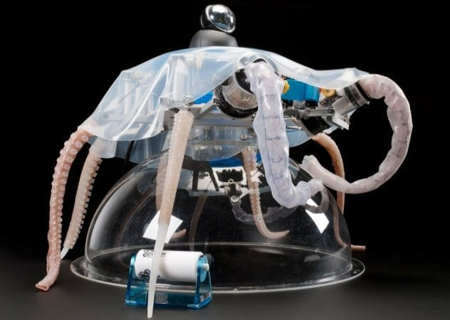
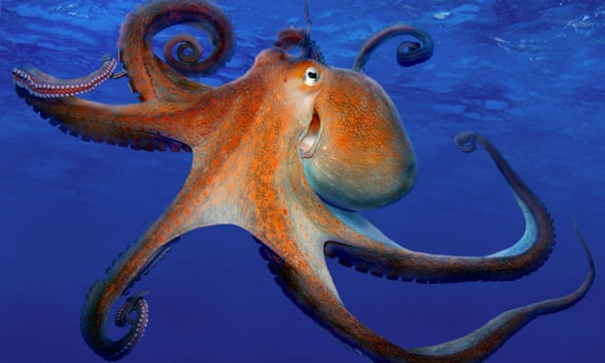
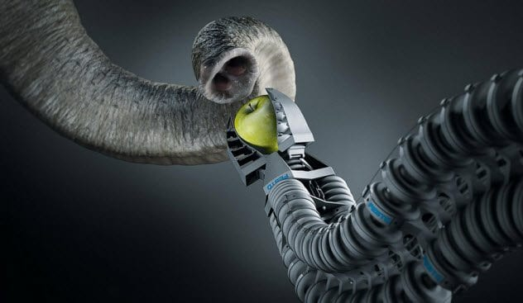
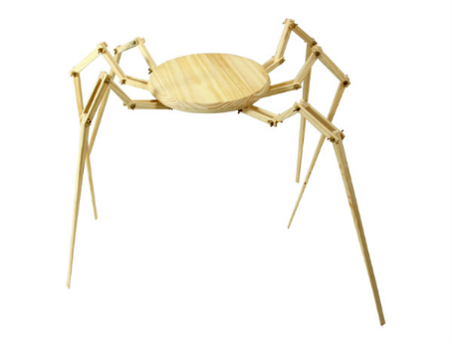
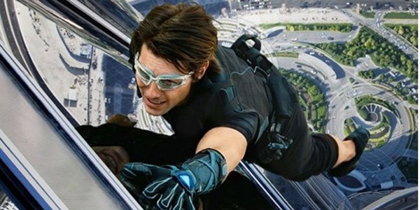
Inspiration from other Animals
Dr. Arzu GÜRSOY ERGEN
Science Faculty
Biology Department

Slide 2
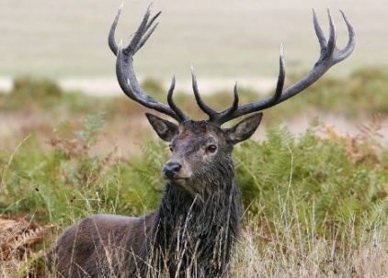
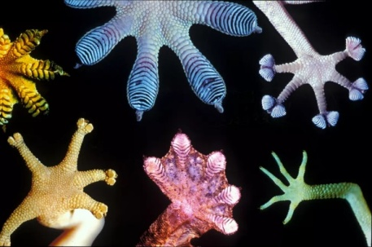
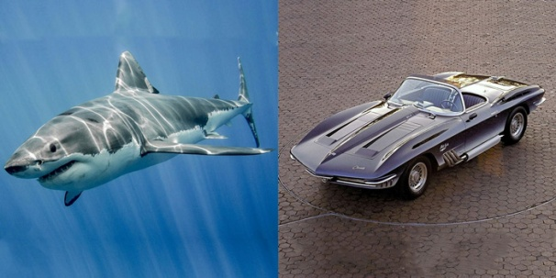
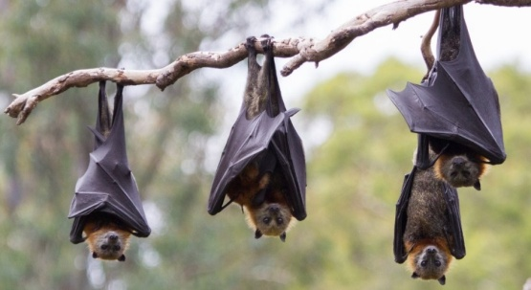
Gecko & its amazing climbing properties
A Robotic Arm Like an Elephant Trunk
Bats, echo waves & a walking cane for the blind
Sharks & swimsuits
Material based on sharkskin stops bacterial breakouts
Mercedes-Benz, the boxfish & the car
Dolphin inspired Tsunami warning system
Radar/Sonar System-Dolphins-Bats
Wale fin & green energy solution
The Road Shark = Corvett
Snowshoe = Hare
Mussels: Adhesives
Squishy Robots Octopus
Spiders webs
Cat eye = Car lights = Reflector

Slide 3
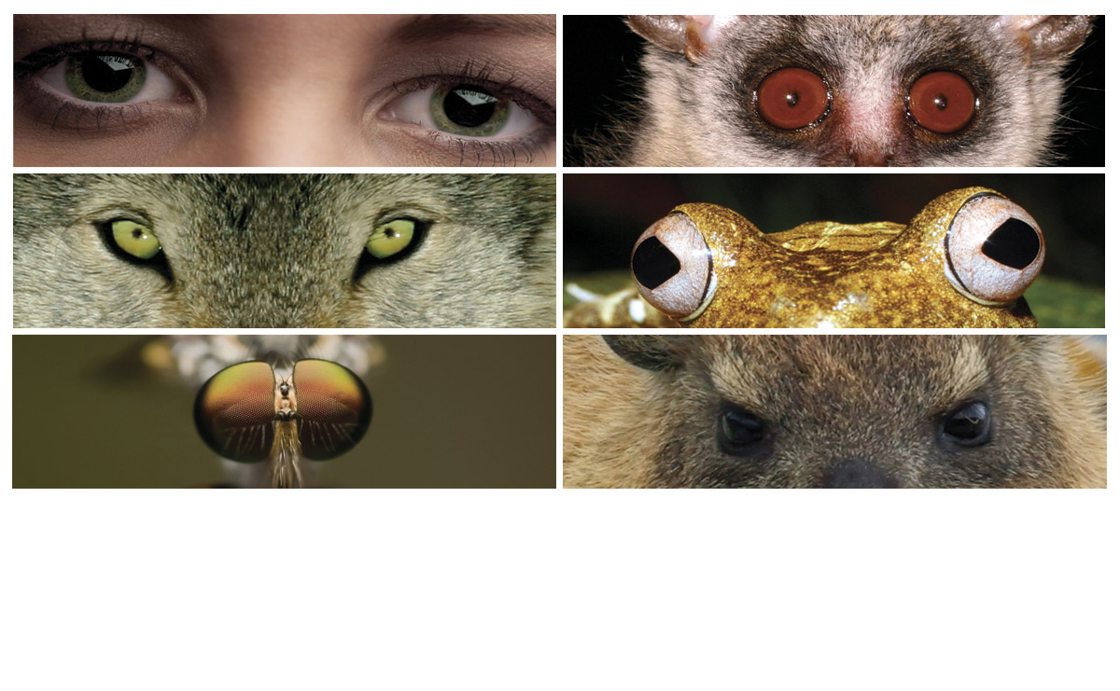
we are nature!!!
Notes:
We are Nature.
We can protect the environment more effectively when we look to our natural world for solutions to our environmental impacts.
The science of Biomimicry can help us do that.
.
1: human
2: wolf
3: fly
4: bush baby
5: map tree frog
6: rock hyrax

Slide 4
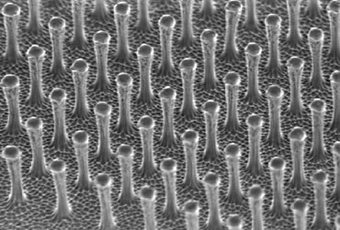
1) Gecko & its amazing climbing properties
A gecko has skin which enables it to define gravity & climb up steep walls. This is due to the grips on their paws through their tiny hairs. Scientists have used this to develop products such as climbing shoes for grip.
Even Tom Cruise used this technology to climb the Burj Khalifa, Dubai in Mission Impossible.

Slide 5
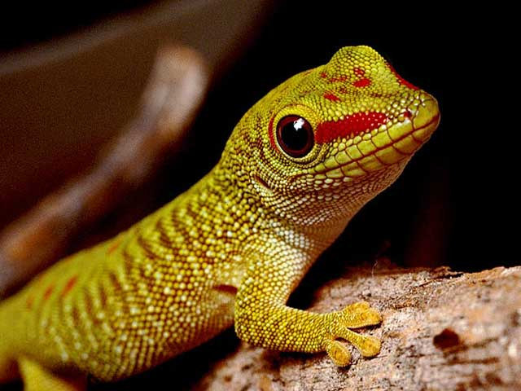
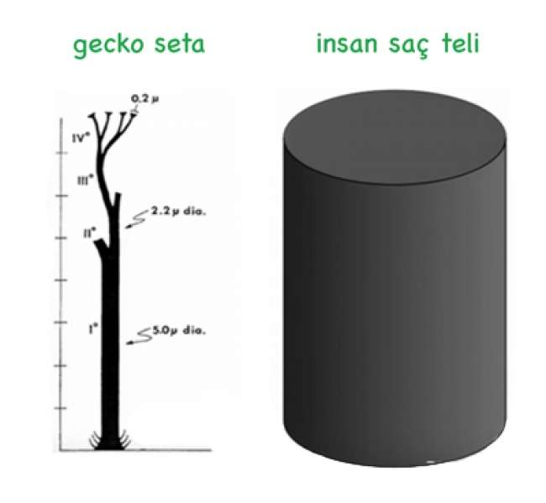
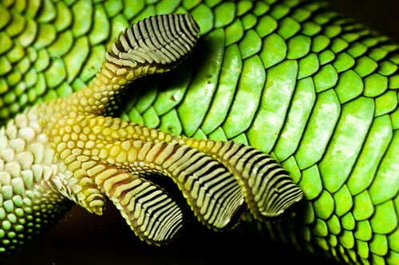
A gecko's grip
Geckos can climb, walk along walls and ceilings even the most slippery surface with ease and hang from glass using a single toe.
The secret behind this extraordinary climbing skill lies with millions of tiny keratin hairs – called setae – on the surface of each foot.
An intermolecular phenomenon known as van der Waals force is exerted by each of these hairs.
Although the force is individually miniscule, the millions of hairs collectively produce a powerful adhesive effect.
A new material covered with nanoscopic hairs that mimic those found on geckos' feet could allow people to walk up to sheer surfaces and across ceilings.
The tape could be detached from the surface by simply peeling it slowly away from one side.
Made of millions of plastic fibers, the adhesive can support almost a pound of weight, and the material gets even stronger with use.
Possible applications include climbing equipment and medical devices.
Notes:
Climbing like geckos
Geckos can climb even the most slippery surface with ease and hang from glass using a single toe. The secret behind this extraordinary climbing skill lies with millions of tiny keratin hairs – called setae – on the surface of each foot. An intermolecular phenomenon known as van der Waals force is exerted by each of these hairs. Although the force is individually miniscule, the millions of hairs collectively produce a powerful adhesive effect.
A new material covered with nanoscopic hairs that mimic those found on geckos' feet could allow people to walk up to sheer surfaces and across ceilings. The tape could be detached from the surface by simply peeling it slowly away from one side.
For Information, visit: http://www.newscientist.com/article/dn3785-gecko-tape-will-stick-you-to-ceiling.html.

Slide 6
Biomimicry
Designer:
What is the product made from?
How has the product been ‘inspired by nature’?
Level 1
Level 2
Level 3
How is the product designed for the whole cycle (product in a system)?
Image/s

