Slide 1
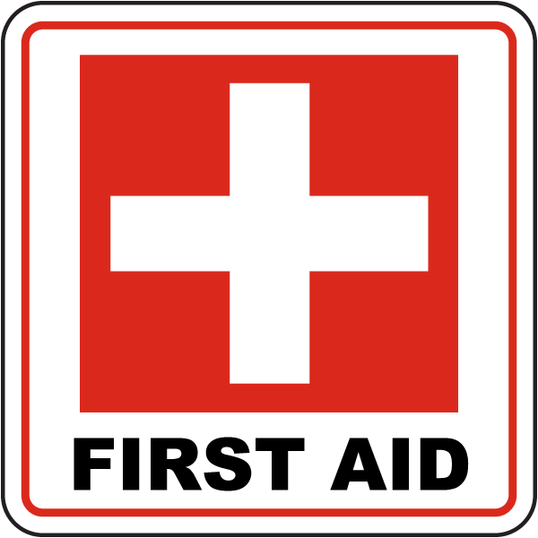
Exposure: Hyperthermia
AOB

Slide 2
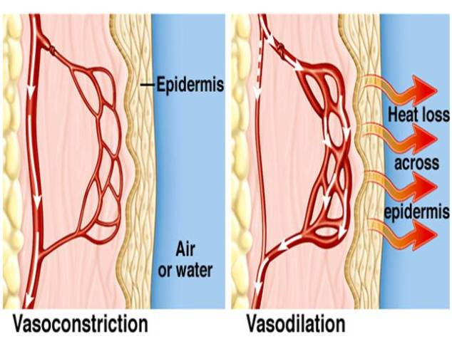
Human body keeps internal temperature at around 37°C (98.6°F), the temperature at which the organs work their best
Circulatory system and skin work as heat conductors, carrying away/ conserving the heat your body produces
When the core temperature is too hot, blood vessels close to the skin dilate, so more heat is released through the skin’s surface
https://pmgbiology.com/tag/vasodilation/

Slide 3
After prolonged exposure to a heat, the body adapts to higher heat in the following ways:
sweat more
sweat starts containing a lesser concentration of salt so Na⁺ doesn’t become depleted
heart beats more efficiently, circulating more blood per beat to cool at skin surface
cells become more efficient, making less heat per unit of energy produced

Slide 4
FACTORS THAT INCREASE THE RISK OF OVERHEATING
• external air temperature > 32°C
• high humidity
• prolonged strenuous physical activity
• AGE—the elderly and children age < 4 are particularly susceptible
• chronic illness

Slide 5
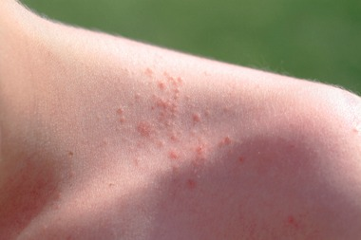
https://www.cdc.gov/niosh/mining/UserFiles/works/pdfs/2017-128.pdf
Red cluster of pimples/small blisters, usually on neck, upper chest, groin, under breasts, and in elbow creases
• Extensive areas of skin that do not sweat on heat exposure, but present gooseflesh appearance
• A cooler, less humid work environment is the best treatment
• Keep rash area dry
• Do not use ointments or creams, as they may impair cooling—warm, moist skin can make the rash worse
Less severe: Heat Rash/Prickly Heat

Slide 6
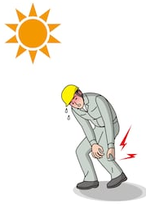
Muscle cramps, pain, or spasms in the abdomen, arms, or legs
•Drink fluids every 15 to 20 minutes and eat a snack or sports drink
•Avoid salt tablets
•Get medical help if the person has heart problems, is on a low sodium diet, or if cramps do not subside within 1 hour
Heat Cramps

Slide 7
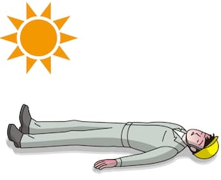
Severe: Heat Syncope
Fainting, dizziness, or lightheadedness after standing or suddenly rising from a sitting/ lying position
• Sit or lie down in a cool place when beginning to feel faint or dizzy
• Slowly drink water or clear juice

Slide 8
SEVERE ⇒ ⇒ OFTEN FATAL:
Heat Exhaustion
Call for medical help
Stay with person until help arrives
Remove person from hot area and give liquids to drink
Remove unnecessary clothing, including shoes and socks
Cool worker with water, cold compresses, an ice bath, or fans
Encourage frequent sips of cool water
Headache
Nausea
Dizziness, weakness
Irritability
Thirst, heavy sweating
Elevated body temperature
Decreased urine output

Slide 9
OFTEN FATAL:
Heat Stroke
Confusion, altered mental state, slurred speech, loss of consciousness
Hot, dry skin or profuse sweating
Seizures
Very high body temperatures (>39°C)
Fast, strong pulse
Fatal if treatment delayed

Slide 10
OFTEN FATAL: Heat Stroke
This is an emergency!
Call for emergency care immediately!
Move person to a cool area and remove outer clothing
Cool person with water, cold compresses, an ice bath, or fans
Circulate air around person to speed cooling Place cold, wet cloths or ice on head, neck, armpits, and groin
Stay with person until emergency medical services arrive

Slide 11
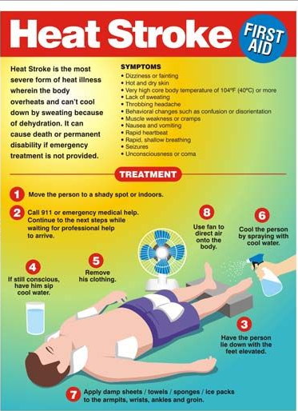
https://www.firstaidforfree.com/first-aid-for-temperature-related-emergencies/heatstroke/

