Slide 1
Evrim, Kurumlar ve İktisat Kuramı: Patikaya Bağımlılık Kuramı 1
Altug Yalcintas
Ankara University
altug.yalcintas@politics.ankara.edu.tr

Slide 3
Patikaya Bağımlılık Kuramı
Mekanik QWERTY’ler (ya da Q-tip klavyeler)

Slide 4
Patikaya Bağımlılık Kuramı
Mekanik F-tip klavyeler

Slide 5
Patikaya Bağımlılık Kuramı

Slide 6
Patikaya Bağımlılık Kuramı
IBM Selectric II dual, 1961

Slide 7
Patikaya Bağımlılık Kuramı

Slide 8
Patikaya Bağımlılık Kuramı

Slide 9
Patikaya Bağımlılık Kuramı

Slide 10
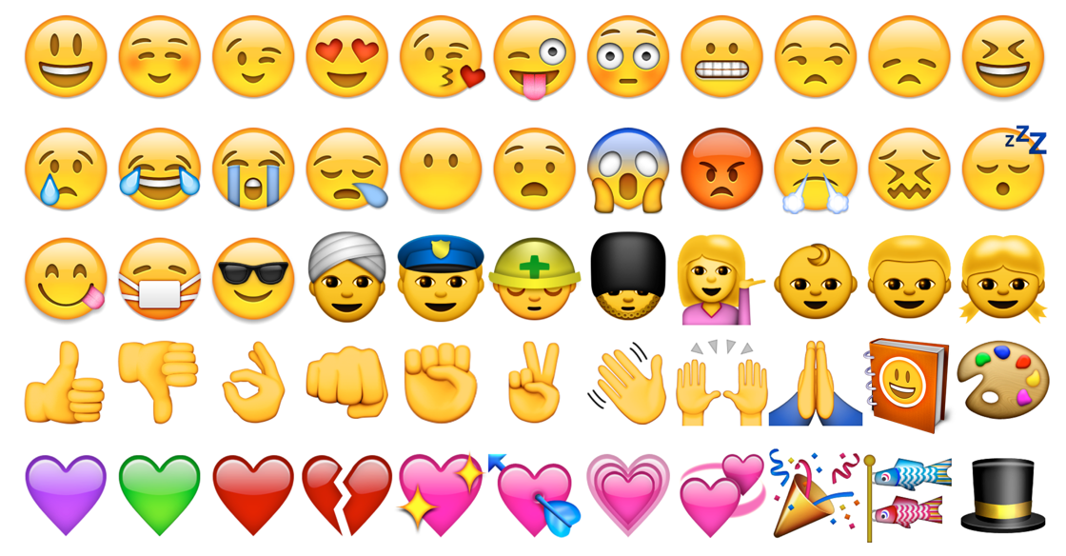

Slide 11
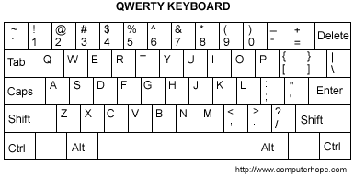
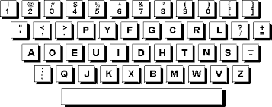
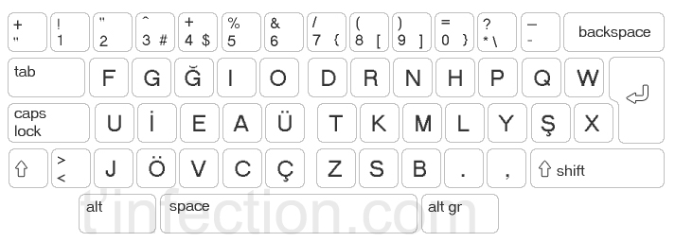
QWERTY, Dvorak, and F type keyboards
DSK Keyboard
A number of “F Klavye” type writers are shown in the «Sütunlu Salon»
Just check out your laptops and smartphones!

Slide 12
QWERTY, Dvorak, and F type keyboards
The first “type writer” was patented by Christopher L. Sholes in 1867 although its prototypes date back to the 1700s.
In 1873, QWERTY was adapted*
(*) QWERTYs were patented by Sholes and his colleagues in 1909 (US), 1924 (UK). Dvorak Simplified Keyboards were patented by August Dvorak and W. L. Deadley in 1932.

Slide 13
QWERTY, Dvorak, and F type keyboards
Why do we use QWERTY’s?
A problem with the original type writer layouts:
jamming and clashing of mechanical parts
A solution was QWERTY:
speed down the typist → lower the number of jammings → increase the number of letters, words, and sentences typed

Slide 14
QWERTY, Dvorak, and F type keyboards
Why do we use QWERTY’s?
After the solution (QWERTY)
Mechanical QWERTY speeds down the typist but
Mechanical QWERTY helps you type more letters and words
(at least, this was the original argument: P. David. 1985. “Clio and the Economics of QWERTY” American Econ Rev 75 (2): 332-337.)

Slide 15
QWERTY, Dvorak, and F type keyboards
Why do we use QWERTY’s?
After digital keyboards, the problem disappeared!
No jamming and clashing of mechanical parts
In other words, we have a SOLUTION without a PROBLEM
We still use QWERTY’s in our PCs, laptops, and tablets even when we type in Turkish!!!

Slide 16
QWERTY, Dvorak, and F type keyboards
Why do we use QWERTY’s?
Are QWERTY’s «the best» keyboard systems?
As we mostly type Turkish texts, why do we still use QWERTYs which are supposed to be the best keyboard system in English?
Or, why do we not use F keyboards?

Slide 17
QWERTY, Dvorak, and F type keyboards
Why do we use QWERTY’s?
Sunk costs
Habits of conduct
Contingencies (or “small events”)
History and institutions matter!
The Theory of Path Dependence

Slide 18
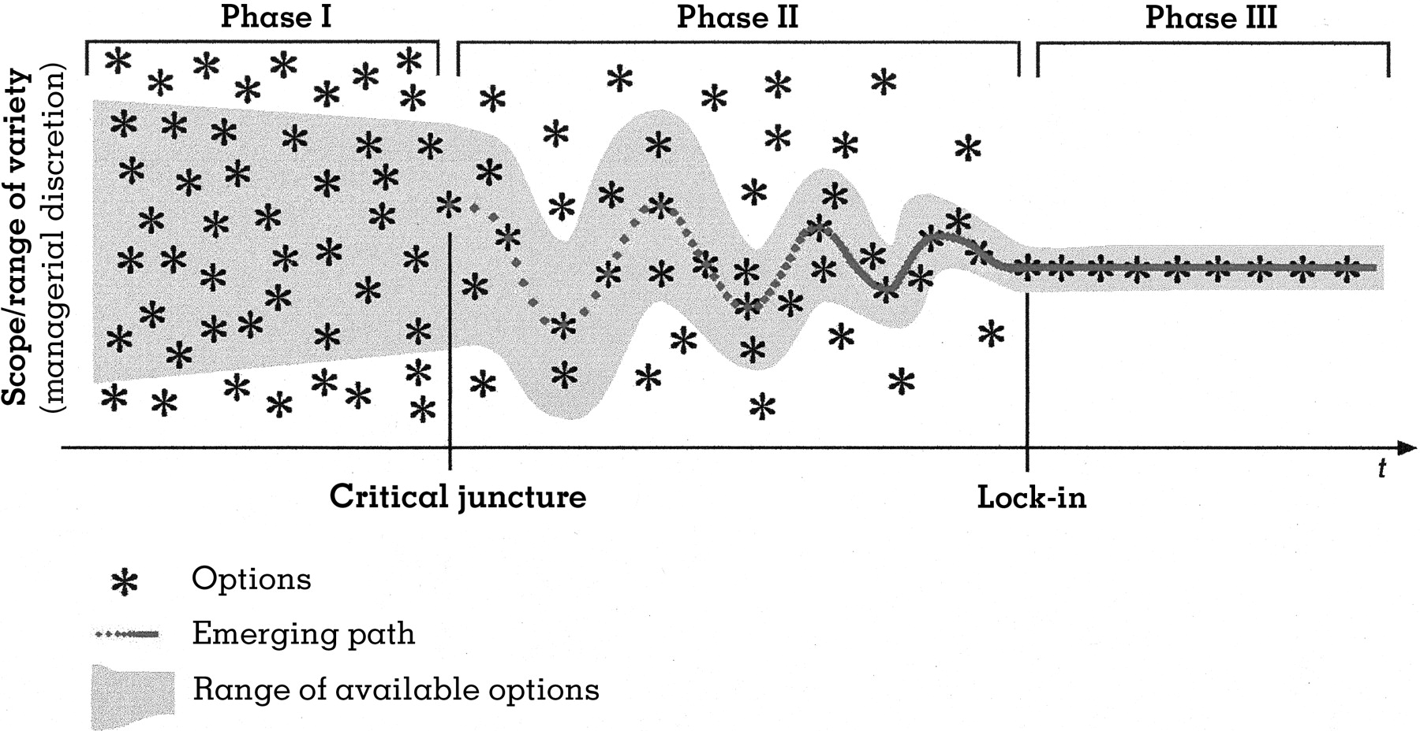
QWERTY, Dvorak, and F type keyboards
What is a pathway anyway?
Source: Source: Georg Schreyögg and Jörg Sydow 2011 “Organizational Path Dependence: A Process View” Organization Studies 32 (3): 321-335.

