Slide 1
Principles of Plant Taxonomy and Systematics

Slide 2
What is plant?

Slide 3
Three major groups of life!

Slide 4
Why study plants? Why important?

Slide 5
Taxonomy and Systematics?

Slide 6
Primary goals of plant systematics:

Slide 7
Taxonomy: D.I.N.C.

Slide 8
How to differentiate these two plants?

Slide 9
Characters used in plant systematics.

Slide 10
Characters used in plant systematics.

Slide 11
Description

Slide 12
Identification

Slide 13
Key (dichotomous/indented):

Slide 14
Key (dichotomous/indented):

Slide 15
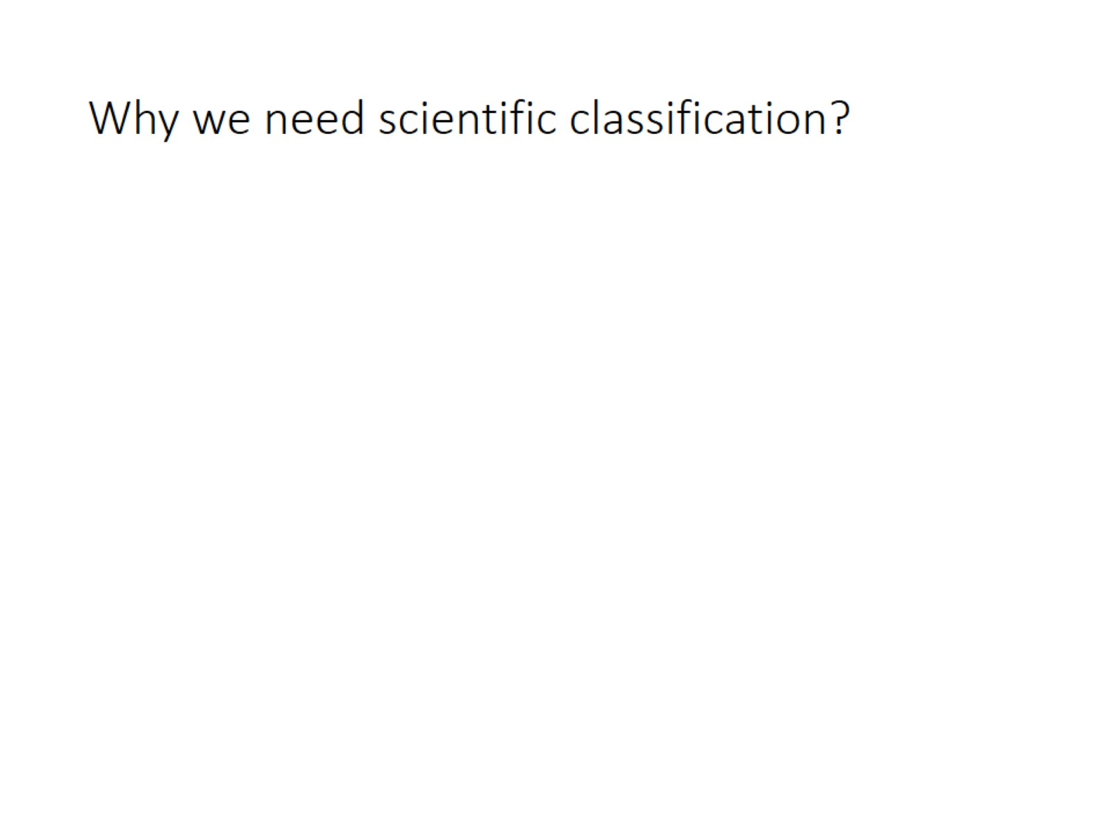
Why we need scientific classification?

Slide 16
What are they?

Slide 17
Scientific names are universally accepted

Slide 18
Scientific names illustrate differences between plants.

Slide 19
Nomenclature

Slide 20
Classification

Slide 21
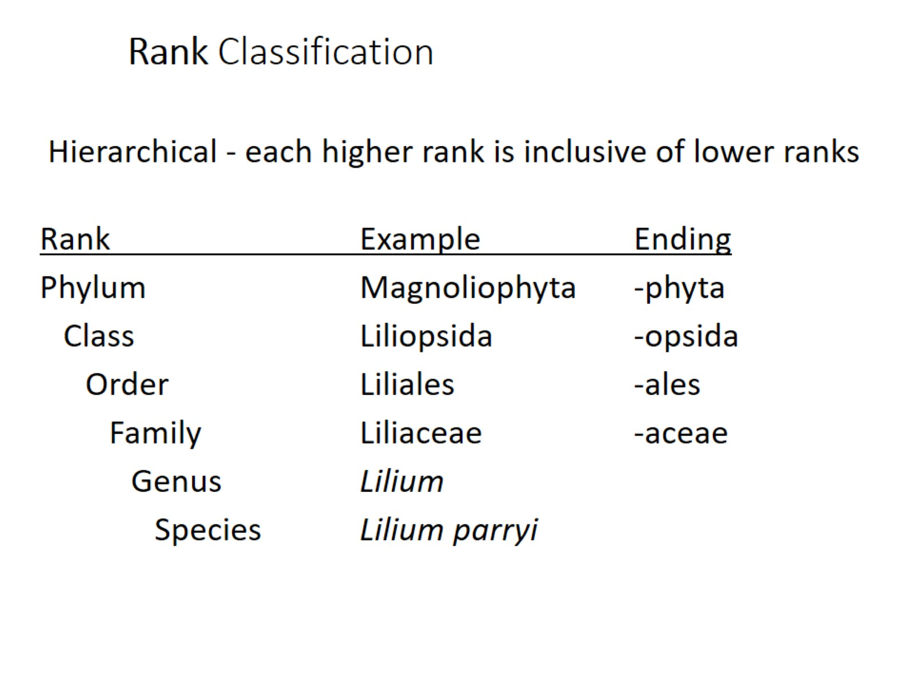
Rank Classification

Slide 22
How to classify life

Slide 23
Problem with phenetic classification:

Slide 24
Phylogenetic classification

Slide 25
All of life is interconnected by descent.

Slide 26
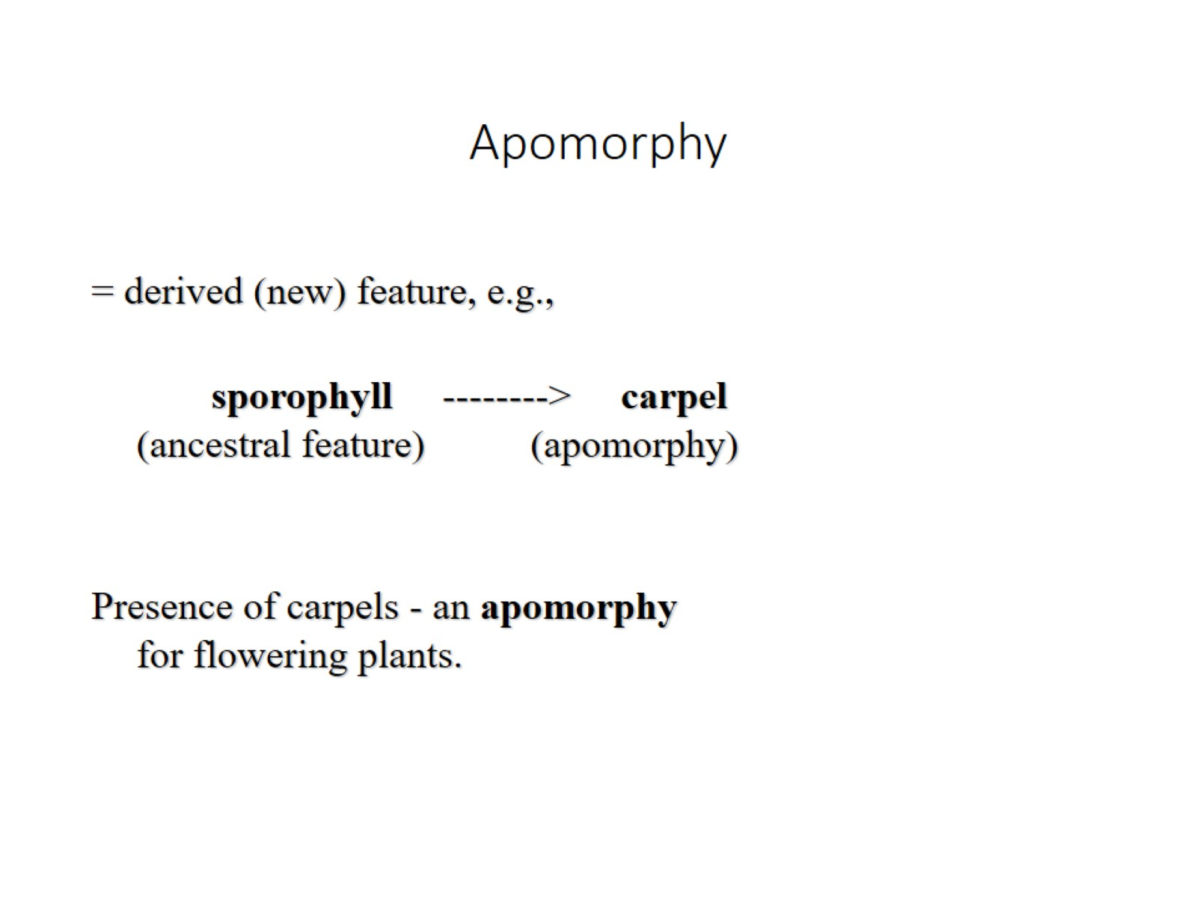
Apomorphy

Slide 27
Taxa are grouped by apomorphies

Slide 28
Split of one lineage into two?

Slide 29
What is a monophyletic group?

Slide 30
Relationship

Slide 31
Example:

Slide 32
Major goal in systematics today: Recognize only monophyletic groups

Slide 33
Polyphyletic group

Slide 34
Paraphyletic group

Slide 35
Features that defined traditional “Dicots” (two cotyledons in embryo seed) are primitive (not apomorphies)

Slide 36
Major goal in systematics today: Recognize only monophyletic groups

Slide 37
Why study systematics?

