Slide 1
COM101B Lecture 10: recursıve functıons
ASST. Prof. Dr. Hacer Yalım Keleş

Slide 2
recursıon
Recursion is the process that a construct operates on itself.
In C, functions can be defined recursively;
a function may call itself directly,
a function calls another function, then that function calls this function back, i.e. indirect recursion.

Slide 3
Example: Factorial function
int factorial(int N)
{
if (N==0)
return 1; // base case: termination condition
else
return N * factorial(N-1); // recurse
}

Slide 4
Recursive evaluation of factorial(3)

Slide 5
Example: Fibonacci numbers
Sequence of numbers: {1,1,2,3,5,8,13,...}
fib(0) = fib(1) = 1
fib(n) = fib(n-1) + fib(n-2), n>1
int fib(int n)
{ return n==0 || n==1 ? 1 : fib(n-1) + fib(n-2); }

Slide 6
Recursive evaluation of fib(3)

Slide 7
ıteratıve versıon of fıbonaccı

Slide 8
propertıes of recurıve functıons
The recursive versions of most of the function (when appropriate) have more concise and understandable form than their iterative versions.
However, compared to their iterative versions, recursive versions are more inefficient
Function call stack is enlarging very fast
passing arguments to each recursion branch makes it inefficient

Slide 9
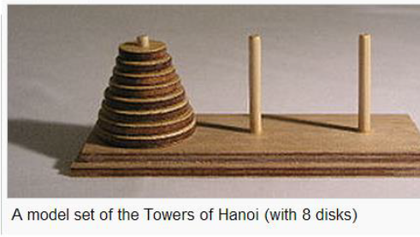
ımplementatıon challenge - recursıon
Tower of Hanoi Puzzle:
The objective: to move the entire stack
to the other rod, obeying the following rules:
1-Only one disk can be moved at a time
2-You can only move the upper disk at a time,
and can be placed at the top of the other stack
3-No disk can be placed on top of a smaller disk.

Slide 10
Readıng assıgnment
Read and implement Section 5.9.2 (Tower of Hanoi Puzzle)

