Slide 1
REPRODUCTIVE HERD HEALTH
Prof.Dr. Şükrü Küplülü

Slide 2
MANAGEMENT OF POSTPARTUM PERIOD

Slide 3
Postpartum Disorders
Diseases of the uterus
Udder Inf.
Metabolic and
functional problems
lameness
(Peter ve ark., 2017)

Slide 4
Postpartum Disorders
(Sundrum, 2015; Leblanc, 2014; Van saun, Sniffen, 2014)

Slide 5
Postpartum Disorders/ Energy Balance
FAT
NEFA
LIVER
BHBA
AcAc
Aseton
(Cockcroft, 2015; Anonim, 2017)

Slide 6
Postpartum Disorders
Healthy
SICK
Gebelik (32. gün) %
(Overton, 2013; Henderson ve ark., 2016; Riberio ve ark., 2016)

Slide 7
Postpartum Disorders
Disorders | AVERAGE INCIDENCE(%) | DAYS SEEN (Postpartum) | Aim
Dystocia | 2,7-11,6 |  | <%2
Clinical Hypocalcemia | 6,5 | First 3 d | %1
Prolapsus uteri | 0,66-2,9 | İlk 2 gün
Ret sec | 8,6 | İlk 3 gün | <%4
Udder edema | %97 | Prepartum 1 postpartum 3 weeks
Metritis | 10,1 | First 15 days
Mastitis | 14,2 | First 15 days | <%5
Ketosis | 4,8 | First 3 weeks | <%1
Disp. Abm | 5 | First 15 days | <%1
Laminitis | 7 | First 30 days | <%2
Ovarian Cysts | 23,3 | First 9 weeks

Slide 8
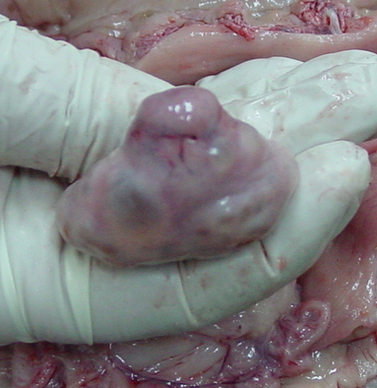
Postpartum Management
Birth in a hygienic environment
Pp. first ovulation (Rectal p. + USG) * Initial examination 21-28. g
(CL + PGF2a, preferably pp, GnRH injection on day 14) * The second inspection is done after 20 days
(CL +, uterus appropriate, PGF2a and seeding or ovosynch. Protocol)

Slide 9
Postpartum Uterus Involution Curve
(Nokes, 2009; Anonim 26, 2017)

Slide 10
Pp. uterine involution and control of uterine infections
Early puerperal infections
Parenteral antibiotics
Fluid therapy
Anti-histaminics
Supportive treatments (NSAI, etc.)
Stimulation of uterine involution (PGF2a)

Slide 11
Pp. uterine involution and control of uterine infections
Postpartum after 30 days
Intrauterine antiseptics:
A- Lugol
B- Lotagen
Intrauterine antibiotics:
* Effective in anaerobic environment, broad spectrum
* DMSO + Antibiotic combination (Rifamycin)
Other Methods:
* Endometrial curettage
* PGF2-alpha x PGF2-alpha
* Eosinophilic culture

Slide 12
Case Based Approaches
anoestrus
Note: Sub oestrus must be distinguished from persistent CL cases, oestrus observation cannot be performed correctly
Post partum prolongs the process
Palpation (10 days apart): Ovarium surfaces smooth, no structure
Serum P4 (twice a week) <1 ng / ml

Slide 13
ANOSTRUS TREATMENT
Correct the feeding (LH)
Eliminate calf effect
The presence of bulls in the environment (pheromone)
Hormonal interference (GnRH, Progestagen + GnRH combi)

Slide 14
Subostrus
No oestrus symptoms
Palpation has Luteal Structure
USG has “luteal structure” and “Dominant follicle”
Hormonal interference
(Synchronization of ovulation: GnRH + PGF2a + Progestagen combination)

Slide 15
Genuine Anoestrus
Ovarian activated due to failure of luteolitic mechanism
Treatment: Operation of luteolitic mechanism
Intrauterine antibiotic, antiseptic administration
Hormonal interference
(Single PGF2a or Ovulation synchronization)

Slide 16
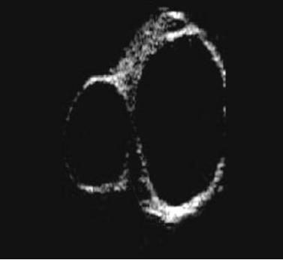
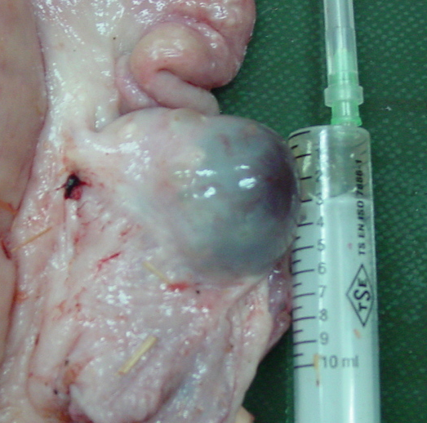
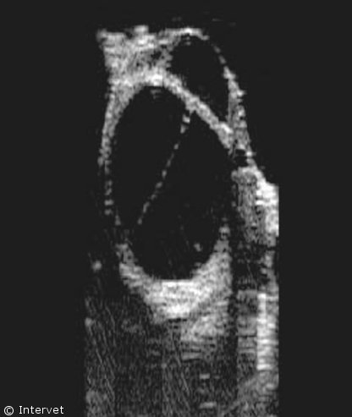
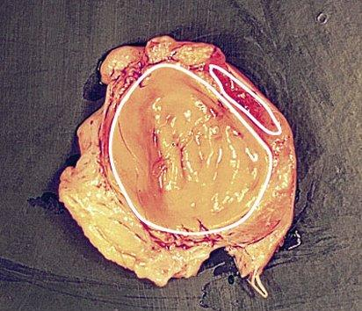
Ovarian Cysts (pp first 35 d)
Follicular or Luteal
GnRH
GnRH + PGF 2?
GnRH + PGF 2 + P
hCG
Spontaneous?
etiology
Küplülü ve ark. ; 2007

Slide 17
Postpartum Ovarian Activity
(Sheldon Ve Ark., 2011)

