Slide 1
Protein analysis
Assoc Prof. ÖZGE ŞAKIYAN DEMİRKOL
26.04.2021

Slide 2
Introduction
Proteins are polymers of amino acids. Twenty different types of amino acids occur naturally in proteins. Proteins differ from each other according to the type, number and sequence of amino acids that make up the polypeptide backbone. As a result they have different molecular structures, nutritional attributes and physicochemical properties.

Slide 3
Structure of proteins
To be able to perform their biological function, proteins fold into one or more specific spatial conformations driven by a number of non-covalent interactions such as hydrogen bonding, ionic interactions, Van der Waals forces, and hydrophobic packing.

Slide 4
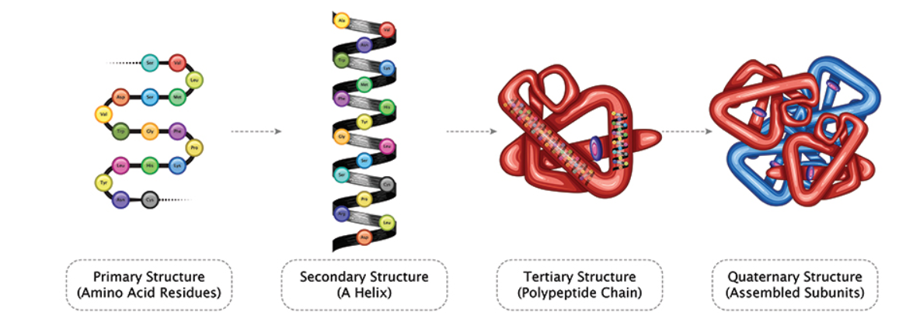
Most proteins fold into unique three-dimensional structures. The shape that a protein folds into naturally is known as its native conformation. There are four distinct aspects of a protein’s structure:

Slide 5
Why proteins are important?
Proteins are important constituents of foods for a number of different reasons.
They are a major source of energy, as well as containing essential amino-acids, such as lysine, tryptophan, methionine, leucine, isoleucine and valine, which are essential to human health, but which the body cannot synthesize.
Proteins are also the major structural components of many natural foods, often determining their overall texture, e.g., tenderness of meat or fish products.

Slide 6
Isolated proteins are often used in foods as ingredients because of their unique functional properties, i.e., their ability to provide desirable appearance, texture or stability. Typically, proteins are used as gelling agents, emulsifiers, foaming agents and thickeners.
Many food proteins are enzymes which are capable of enhancing the rate of certain biochemical reactions. These reactions can have either a favorable or detrimental effect on the overall properties of foods.
Food analysts are interested in knowing the total concentration, type, molecular structure and functional properties of the proteins in foods.

Slide 7
Nitrogen based methods
Kjeldahl method:
The Kjeldahl method was developed in 1883 by a brewer called Johann Kjeldahl. A food is digested with a strong acid so that it releases nitrogen which can be determined by a suitable titration technique. The amount of protein present is then calculated from the nitrogen concentration of the food.

Slide 8
Advantages. The Kjeldahl method is widely used internationally and is still the standard method for comparison against all other methods. Its universality, high precision and good reproducibility have made it the major method for the estimation of protein in foods.
Disadvantages. It does not give a measure of the true protein, since all nitrogen in foods is not in the form of protein. Different proteins need different correction factors because they have different amino acid sequences. The use of concentrated sulfuric acid at high temperatures poses a considerable hazard, as does the use of some of the possible catalysts The technique is time consuming to carry-out.

Slide 9
Dumas (Nitrogen Combustion) Method
A sample of known mass is combusted in a high temperature (about 900 ºC) chamber in the presence of oxygen. This leads to the release of CO₂, H₂O and N₂. The CO₂ and H₂O are removed by passing the gasses over special columns that absorb them. The nitrogen content is then measured by passing the remaining gasses through a column that has a thermal conductivity detector at the end. The column helps separate the nitrogen from any residual CO₂ and H₂O that may have remained in the gas stream. The instrument is calibrated by analyzing a material that is pure and has a known nitrogen concentration, such as EDTA (= 9.59%N). Thus the signal from the thermal conductivity detector can be converted into a nitrogen content.

Slide 10
Advantages: It is much faster than the Kjeldahl method (under 4 minutes per measurement, compared to 1-2 hours for Kjeldahl). It doesn't need toxic chemicals or catalysts. Many samples can be measured automatically. It is easy to use.
Disadvantages: High initial cost. It does not give a measure of the true protein, since all nitrogen in foods is not in the form of protein. Different proteins need different correction factors because they have different amino acid sequences. The small sample size makes it difficult to obtain a representative sample.

Slide 11
UV visible spectroscopy
These methods use either the natural ability of proteins to absorb (or scatter) light in the UV-visible region of the electromagnetic spectrum, or they chemically or physically modify proteins to make them absorb (or scatter) light in this region.
Biuret Method
Lowry Method
Dye binding methods
Turbimetric method

Slide 12
Advantages: UV-visible techniques are fairly rapid and simple to carry out, and are sensitive to low concentrations of proteins.
Disadvantages: For most UV-visible techniques it is necessary to use dilute and transparent solutions, which contain no contaminating substances which absorb or scatter light at the same wavelength as the protein being analyzed. The need for transparent solutions means that most foods must undergo significant amounts of sample preparation before they can be analyzed, e.g., homogenization, solvent extraction, centrifugation, filtration, which can be time consuming and laborious. In addition, it is sometimes difficult to quantitatively extract proteins from certain types of foods, especially after they have been processed so that the proteins become aggregated or covalently bound with other substances. In addition the absorbance depends on the type of protein analyzed (different proteins have different amino acid sequences).

Slide 13
Other instrumental techniques
Measurement of Bulk Physical Properties
Measurement of Adsorption of Radiation
Measurement of Scattering of Radiation

Slide 14
Thanks!!!!
osakiyan@ankara.edu.tr

