Slide 1
GOLD NANOPARTICLES IN DIAGNOSTICS AND THERAPEUTICS FOR HUMAN CANCER
By
Aylin Mustafa Işıl Yazgan Kübranur Öner

Slide 2
What is Cancer?
Cancer is a disease state caused by abnormal cell growth and is the third leading cause of mortality.
Current cancer treatment is based on chemotherapeutic drugs (involve radiation theraphy)
Side effects of this treatment:
Damage healthy tissues
Delays in diagnosis
Lower survival rates

Slide 3
GOLD NANOPARTICLES
Because of the side effect of current treatment, researches start to search for new therapy methods in cancer diseases.
How Gold NPs can be produced?
Physically → Microwave and UV irradiation, Laser ablation
Chemically → By using chemicals, solvents and extreme conditions (pH and temperature)
Biologically → With some plants and microorganisms

Slide 4
Purpose of the Study
Application of gold nanoparticles in the treatment of cancer :
By tumor detection
Drug delivery
Imaging
Photothermal
Photodynamic therapy

Slide 5
Gold Nanoparticles are Prefered in Cancer Treatment due to the their:
Surface Functionalization Property
Fluorescence Property
Tunable Property
Biocompatibility

Slide 6
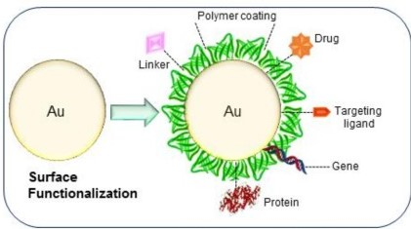
1. Surface Functionalization Property
Due to their biologically active moieties they conjugate amine and thiol groups.
So they are used in:
Diagnostics
Targeting speciﬁc delivery of drugs/genes,
Imaging

Slide 7
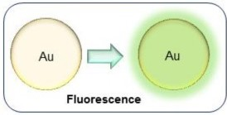
2. Fluorescence Property
Makes the tumor more visible

Slide 8
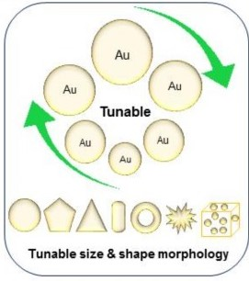
Allow for the synthesis of nanoparticles of speciﬁc size and desired shape.
3. Tunable Property

Slide 9
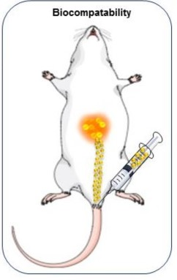
4. Biocompatibility
The inert nature of gold nanoparticles makes them relatively biocompatible and excellent candidate for use as drug carriers.

Slide 10
Usage Areas of Gold Nanoparticles
Site-Specific Delivery
Photo-Imaging
Photothermal Therapy (PTT)
Photodynamic Therapy (PDT)

Slide 11
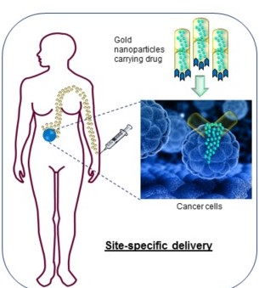
1. Site-Specific Delivery
Due to their small size they easily pass through the tumor vessels compared to chemotherapeutic drugs.
They can be used with chemotherapeutic drugs to target tumor site.

Slide 12
Examples of Gold Nanoparticles in Drug Delivery
MTX-AuNP:
Has higher cytotoxicity towards numerous cell lines as compared to free MTX.
2. DOX-Hyd@AuNP:
Enhanced toxicity against multi drug resistant cancer cells.
3. CPP-DOX-AuNP:
Higher cell death as compared to previously tested 41 nm AuNP.

Slide 13
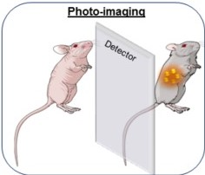
2. Photo-Imaging
Gold NPs speciﬁcally bind to the cancer cells and scatter (shine), making it easier for the surgeons to identify the tumor and healthy cells.
Magnetic Resonance Imaging (MRIs) and Computed Tomography (CT) scans are limited and can only detect tumors above a size of several millimeters so usage of Gold NPs are better.

Slide 14
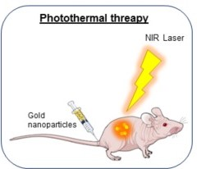
3. Photothermal Therapy (PTT)
PTT melts the tumor in molten gold.
Near infra-red (NIR) light is chosen for PTT due to minimal absorption by the tissues at 650–900 nm wavelenghts to induce cytotoxic damage.

Slide 15
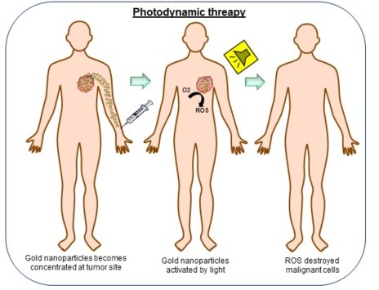
4. Photodynamic Therapy (PDT)
Utilizes light, photosensitizers and oxygen from the tissues.
Photosensitizing agent is injected into the tissues and excited by speciﬁc wavelengths, leading to the energy transfer that generates reactive oxygen species (ROS) and causes cell death by apoptosis.

Slide 16
Gold Nanoparticles in Clinical Trials
!! Very few clinical trials are being actively carried out because the cytotoxicity of gold nanoparticles is highly dependent on the size and morphology of the particles, environmental scenario and the method of production.
Example of Trials
AuroLase®: Made by Silica-gold nanoshells coated with PEG. Used for head/neck cancer, primary and/or metastatic lung tumors.
Gold Nanoparticles : Used for detection of gastric lesions

Slide 17
Limitations for Gold NPs
Toxicity:
Properties of gold nanoparticles such as shape, size, surface chemistry, targeting ligand, elasticity, and composition largely inﬂuence their toxicity.
Some tests showed that positively charged gold NPs have toxic effect compared to negatively charged and vice versa so that there is no standard assay to test the toxicity effect of all nanoparticles.

Slide 18
2. Size and Biodistribution:
According to different studies, it is identified that there is no distinct connection between size of NPs and toxicity. In some tumor types and their locations large nanoparticles has more increased cytotoxicity than small ones and vice versa.
Gold nanoparticles of all sizes mainly accumulated in organs like liver, lung, and spleen. The 15 nm particles accumulated in tissues including blood, liver, lung, spleen, kidney, brain, heart, and stomach whereas much larger particles (200 nm) showed a very minute presence in organs including blood, brain, stomach, and pancreas .

Slide 19
Discussion
Gold NPs have some special properties such as surface functionalization property, fluorescence property, tunable property and biocompatibility that are used for cancer treatment.
Usage areas of Gold NPs are site-specific delivery, photo-imaging, PTT and PDT.
There are some limitations which are toxicity, size and biodistribution to use Gold NPs in the current therapies and, there is an inherent need for the development of universally applicable methods to evaluate the biocompatibility of gold nanoparticles.

Slide 20
AS A CONCLUSION
A great deal of research will be required to focus on internalization of the nanoparticles, to create a universal assay, relevant immunological response and their excretion from the human body.

Slide 21
THANK YOU FOR LISTENING!
☺

