Slide 1
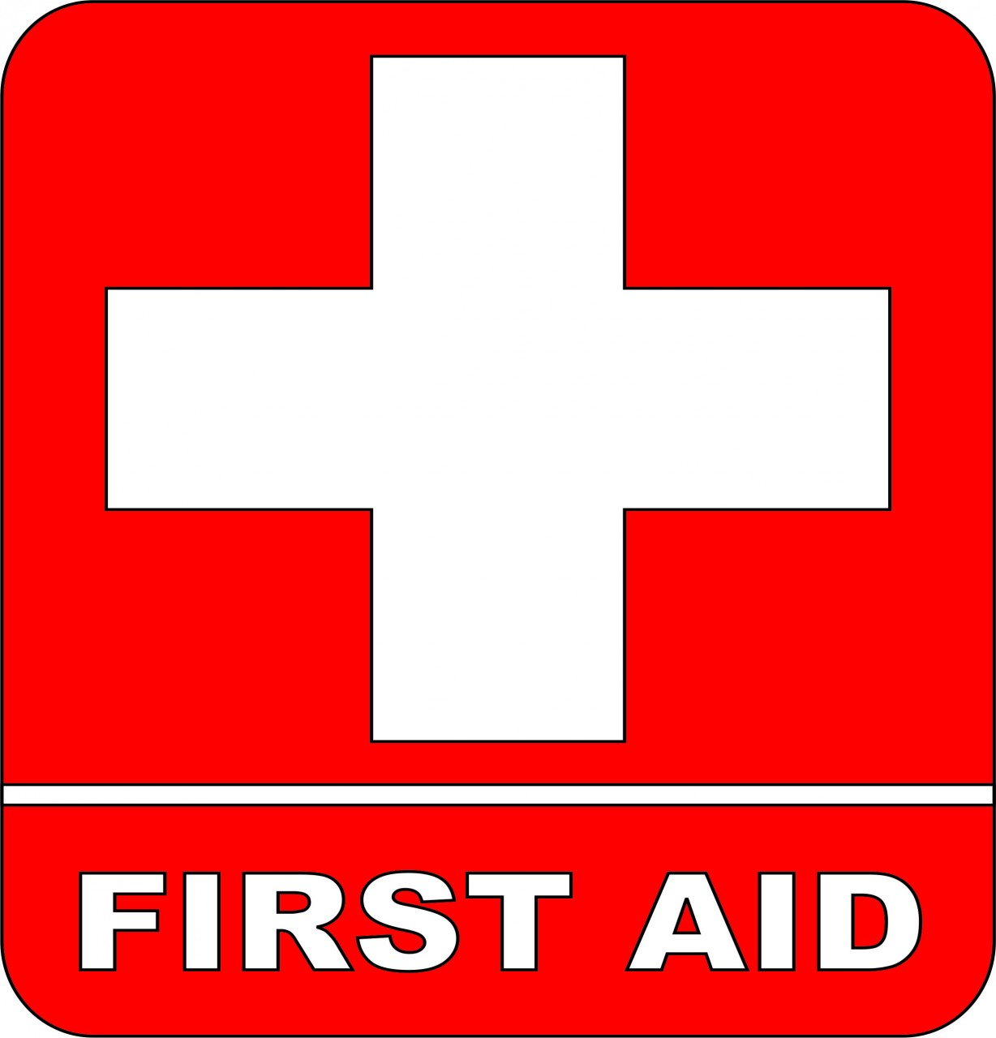

Slide 2
First Aid Basics
First Aid for Cardiac Emergencies
First Aid for Respiratory Emergencies
First Aid for Medical Conditions
Wounds and Circulation
Bone, Joint and Muscle Injuries
Effects of Heat and Cold
Foreign Objects, Poisoning, Bites and Stings

Slide 3
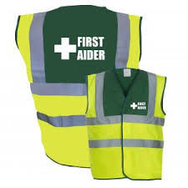
First aid
is the initial assistance or treatment given to a person who is injured or suddenly becomes ill. The person who provides this help may be a first aider, a first responder, a policeman or fireman, or a paramedic or emergency medical technician.
First aider
is a person who takes action while taking care to keep everyone involved safe and to cause no further harm while doing so.

Slide 4
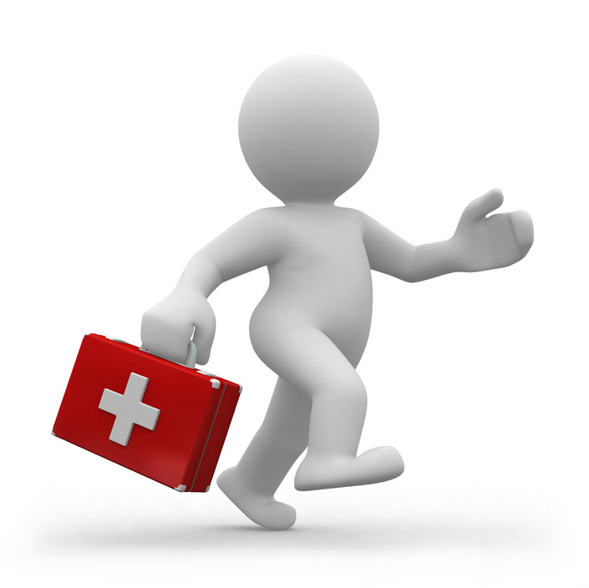
to recognize emergency medical events,
to possess the basic knowledge and skills
to provide basic care until help arrives

Slide 5
Preserve the life of the victim
Prevent worsening of the situation
Promote recovery from the injury or illness

Slide 6
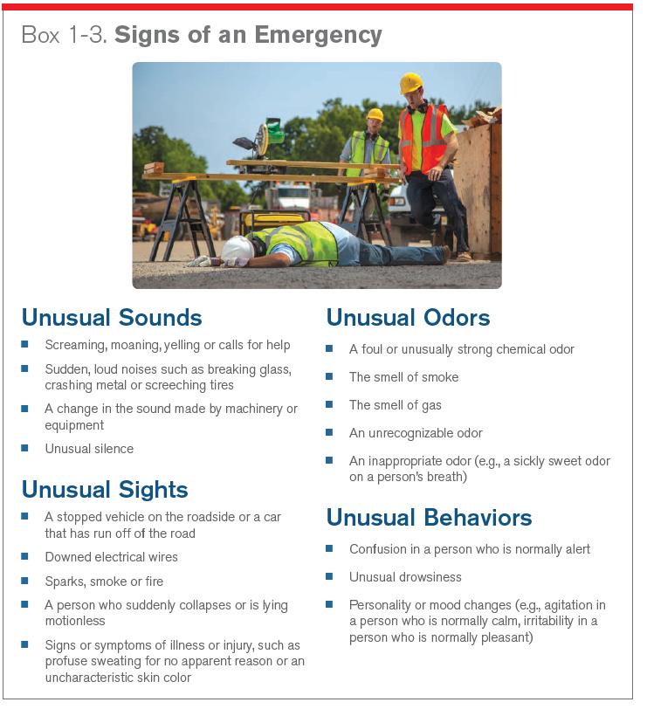

Slide 7
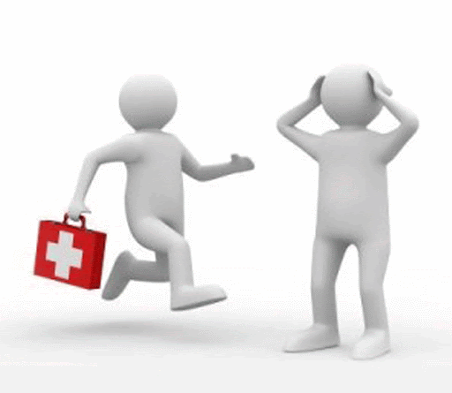
FIRST AID PRIORITIES
■ Assess a situation quickly and calmly.
■ Protect yourself and any casualties from danger
■ Prevent cross-contamination between yourself and the casualty
■ Comfort and reassure casualties.
■ Assess the casualty
■ Give early treatment
■ Arrange for appropriate help: call 112 for emergency help

Slide 8
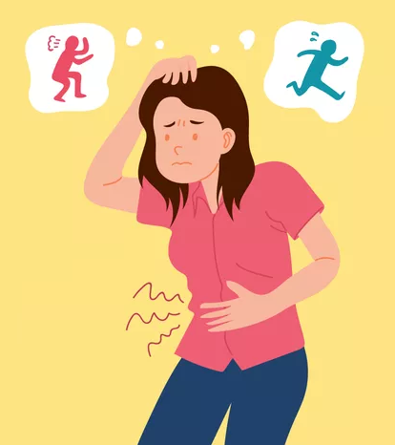
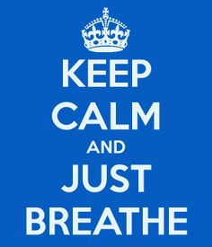
FIRST AID PRIORITIES
■ Assess a situation quickly and calmly.
■ Protect yourself and any casualties from danger
■ Prevent cross-contamination between yourself and the casualty
■ Comfort and reassure casualties.
■ Assess the casualty
■ Give early treatment
■ Arrange for appropriate help: call 112 for emergency help

Slide 9
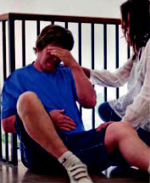
Assessing an incident
When you come across an incident stay calm and support the casualty. Ask him what has happened. Try not to move the casualty; if possible, treat him in the position you find him.

Slide 10
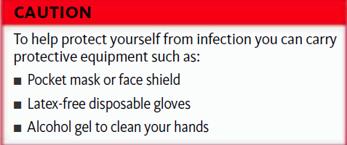
FIRST AID PRIORITIES
■ Assess a situation quickly and calmly.
■ Protect yourself and any casualties from danger—never put yourself at risk
■ Prevent cross-contamination between yourself and the casualty
■ Comfort and reassure casualties.
■ Assess the casualty: identify the injury or nature of illness affecting a casualty
■ Give early treatment, and treat the casualties with the most serious conditions first.
■ Arrange for appropriate help: call 112 for emergency help if you suspect serious
injury or illness

Slide 11
FIRST AID PRIORITIES
■ Assess a situation quickly and calmly.
■ Protect yourself and any casualties from danger
■ Prevent cross-contamination between yourself and the casualty
■ Comfort and reassure casualties.
■ Assess the casualty: identify the injury or nature of illness affecting a casualty
■ Give early treatment, and treat the casualties with the most serious conditions first.
■ Arrange for appropriate help: call 112 for emergency help

Slide 12
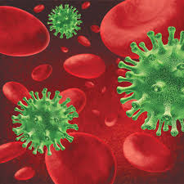
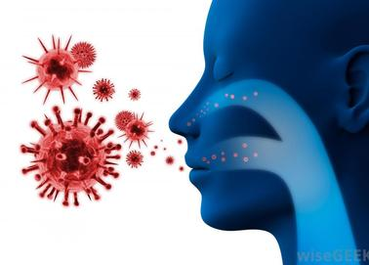
Risk for Infection
Bloodborne pathogens are spread when blood from an infected person enters the bloodstream of a person who is not infected. For infection to occur, an infected person’s blood must enter your bloodstream. This could happen through direct or indirect contact with an infected person’s blood if it comes in contact with your eyes, the mucous membranes that line your mouth and nose, or an area of broken skin on your body. You could also become infected if you stick yourself with a contaminated needle (a “needlestick injury”) or cut yourself with broken glass that has been contaminated with blood.
Bloodborne illnesses that are of particular concern include human immunodeficiency virus (HIV) infection and hepatitis B, C and D.
Airborne pathogens are pathogens that are expelled into the air when an infected person breathes, coughs or sneezes. Infection spreads when a person who is not infected inhales respiratory droplets containing the pathogens.
Examples of airborne illnesses include tuberculosis and influenza.

Slide 13
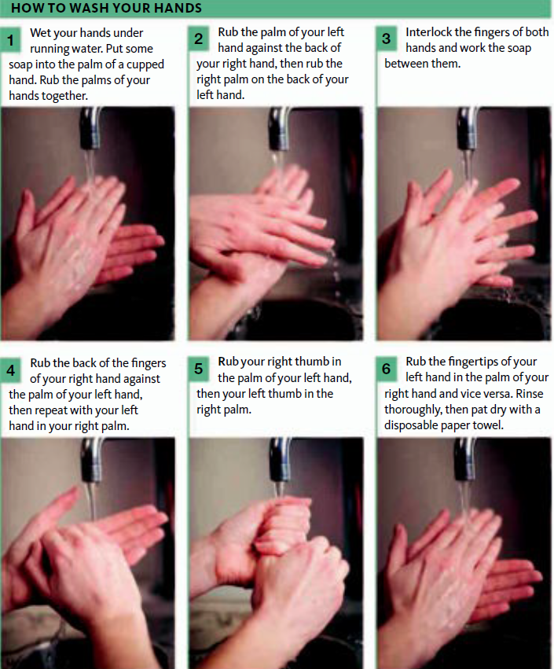
MINIMIZING THE RISK OF CROSS-CONTAMINATION
■ Do wash your hands and wear latex-free disposable gloves. If gloves are not available, dress the casualty’s wound, or enclose your hands in clean plastic bags.

Slide 14
MINIMIZING THE RISK OF CROSS-CONTAMINATION
■ Do wash your hands and wear latex-free disposable gloves. If gloves are not available, dress the casualty’s wound, or enclose your hands in clean plastic bags.

Slide 15
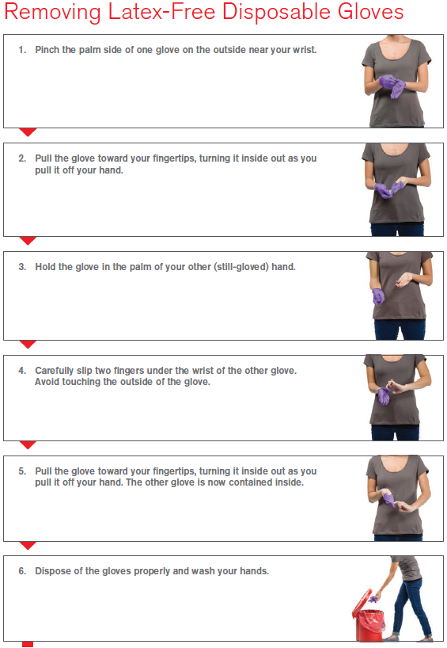

Slide 16
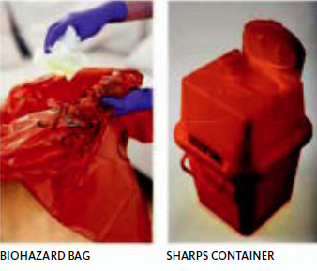
MINIMIZING THE RISK OF CROSS-CONTAMINATION
■ Do wash your hands and wear latex-free disposable gloves. If gloves are not available, dress the casualty’s wound, or enclose your hands in clean plastic bags.
■ Do cover cuts and scrapes on your hands with waterproof dressings.
■ Do wear a plastic apron if dealing with large quantities of body fluids, and wear glasses or goggles to protect your eyes.
■ Do dispose of all waste safely to prevent the spread of infection.

Slide 17
MINIMIZING THE RISK OF CROSSCONTAMINATION
■ Do wash your hands and wear latex-free disposable gloves. If gloves are not available, dress the casualty’s wound, or enclose your hands in clean plastic bags.
■ Do cover cuts and scrapes on your hands with waterproof dressings.
■ Do wear a plastic apron if dealing with large quantities of body fluids, and wear glasses or goggles to protect your eyes.
■ Do dispose of all waste safely to prevent the spread of infection.
■ Do not touch a wound or any part of a dressing that will come into contact
with a wound with your bare hands.
■ Do not breathe, cough, or sneeze over a wound while you are treating a casualty.

Slide 18
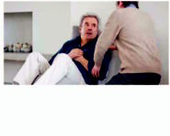
FIRST AID PRIORITIES
■ Assess a situation quickly and calmly.
■ Protect yourself and any casualties from danger
■ Prevent cross-contamination between yourself and the casualty
■ Comfort and reassure casualties.
■ Assess the casualty: identify the injury or nature of illness affecting a casualty
■ Give early treatment, and treat the casualties with the most serious conditions first.
■ Arrange for appropriate help: call 112 for emergency help

Slide 19
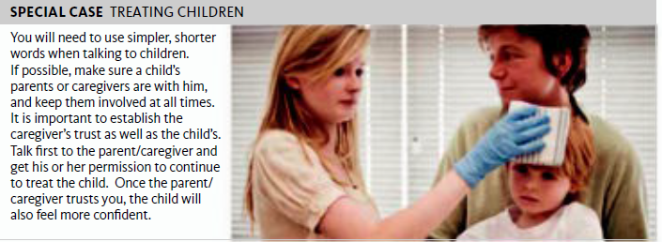

Slide 20
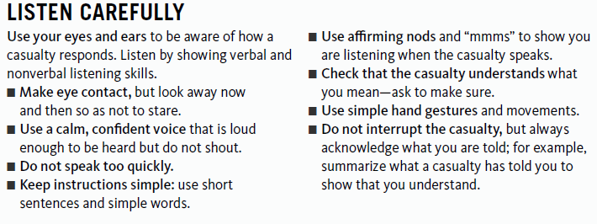
FIRST AID PRIORITIES
■ Assess a situation quickly and calmly.
■ Protect yourself and any casualties from danger
■ Prevent cross-contamination between yourself and the casualty
■ Comfort and reassure casualties.
■ Assess the casualty: identify the injury or nature of illness affecting a casualty
■ Give early treatment, and treat the casualties with the most serious conditions first.
■ Arrange for appropriate help: call 112 for emergency help

Slide 21
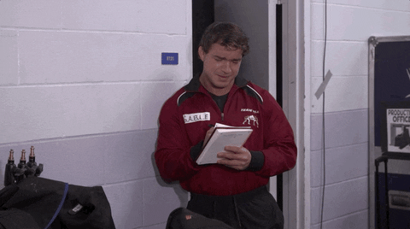
KEEPING NOTES
A written record of the timing of events is particularly valuable to medical personnel.
Hand your notes to the emergency services when they arrive. Useful information to provide includes:
■ Casualty’s details, including his name, age and contact details
■ History of the incident or illness (e.g. the length of unconsciousness, the duration of a seizure)
■ Brief description of any injuries
■ Unusual behavior, or a change in behavior
■ Treatment—where given and when
■ Vital signs—level of response, breathing rate, and pulse
■ Medical history
■ Medication the casualty has taken, with details of the amounts taken and when
■ Next-of-kin contact details
■ Your contact details as well as the time, and place of your involvement

Slide 22
FIRST AID PRIORITIES
■ Assess a situation quickly and calmly.
■ Protect yourself and any casualties from danger
■ Prevent cross-contamination between yourself and the casualty as best as possible
■ Comfort and reassure casualties.
■ Assess the casualty: identify, as best as you can, the injury or nature of illness affecting a casualty
■ Give early treatment, and treat the casualties with the most serious (life-threatening)
conditions first.
■ Arrange for appropriate help: call 112 for emergency help

Slide 23
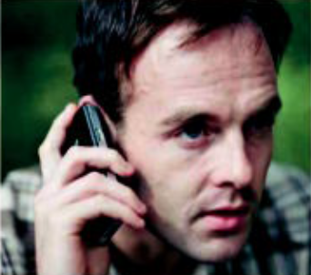
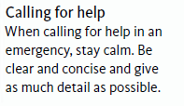
FIRST AID PRIORITIES
■ Assess a situation quickly and calmly.
■ Protect yourself and any casualties from danger—never put yourself at risk
■ Prevent cross-contamination between yourself and the casualty as best as possible
■ Comfort and reassure casualties.
■ Assess the casualty: identify, as best as you can, the injury or nature of illness affecting a casualty
■ Give early treatment, and treat the casualties with the most serious (life-threatening)
conditions first.
■ Arrange for appropriate help: call 112 for emergency help if you suspect serious
injury or illness; take or send the casualty to the hospital; transfer him into the care of a health care professional, or to a higher level of medical care. Stay with a casualty until care is available.

Slide 24
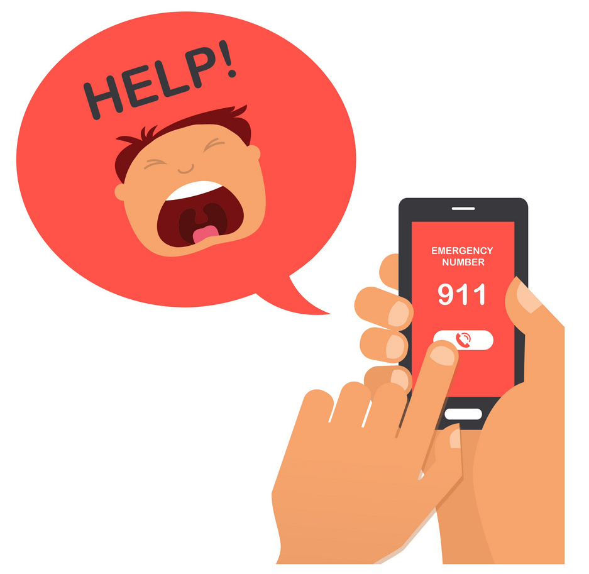
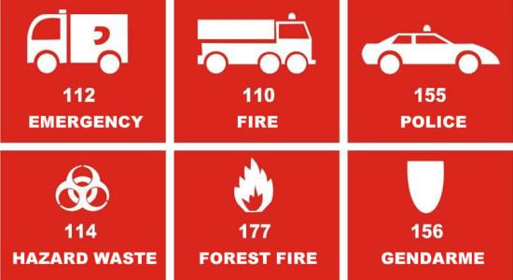

Slide 25
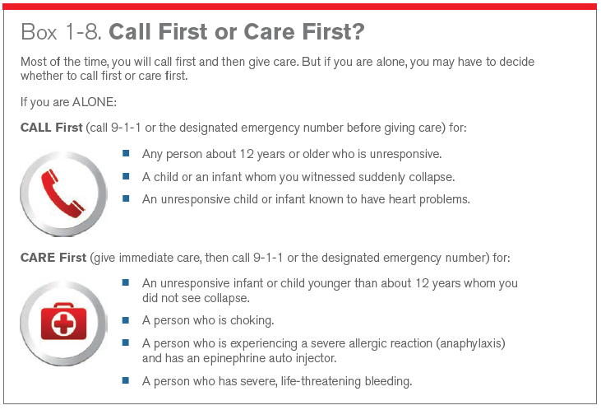

Slide 26
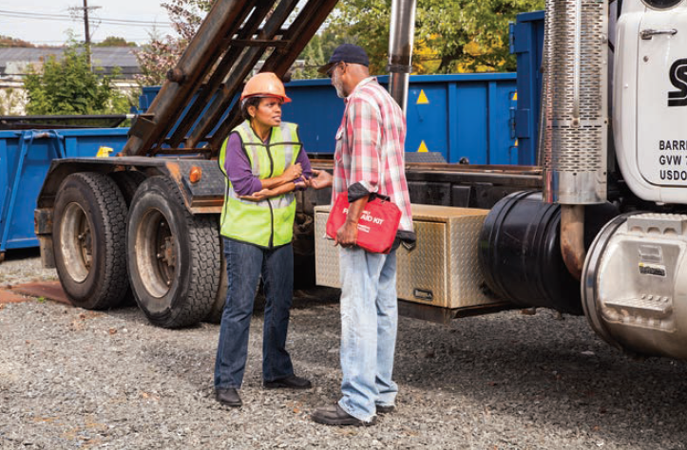
Assisting at the scene
Once the emergency services arrive, tell them everything you know. While they assess and treat the casualty, you may be asked to look after or reassure friends.

Slide 27
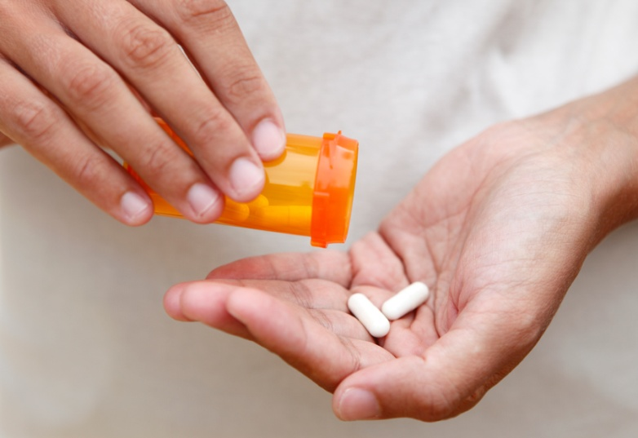
THE USE OF MEDICATION
You must not buy or borrow medication to administer to a casualty, or give your own. He may be put at risk and you could face legal action as a consequence.
Whenever a casualty takes medication, it is essential to make sure that:
■ It is for the condition
■ It is not out of date
■ It is taken as advised
■ Any precautions are strictly followed
■ The recommended dose is not exceeded
■ You keep a record of the name and dose of the medication as well as the time and
method of administration

Slide 28
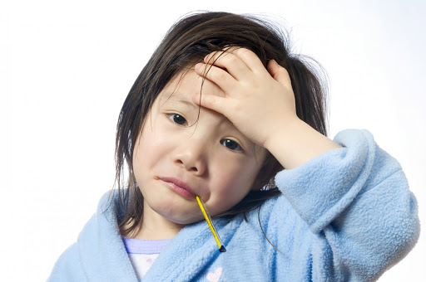
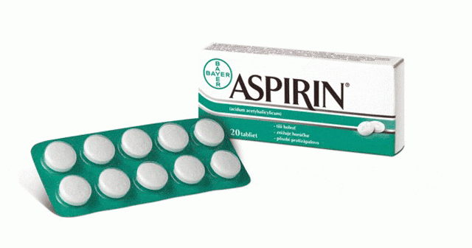
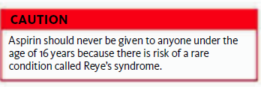
X

Slide 29
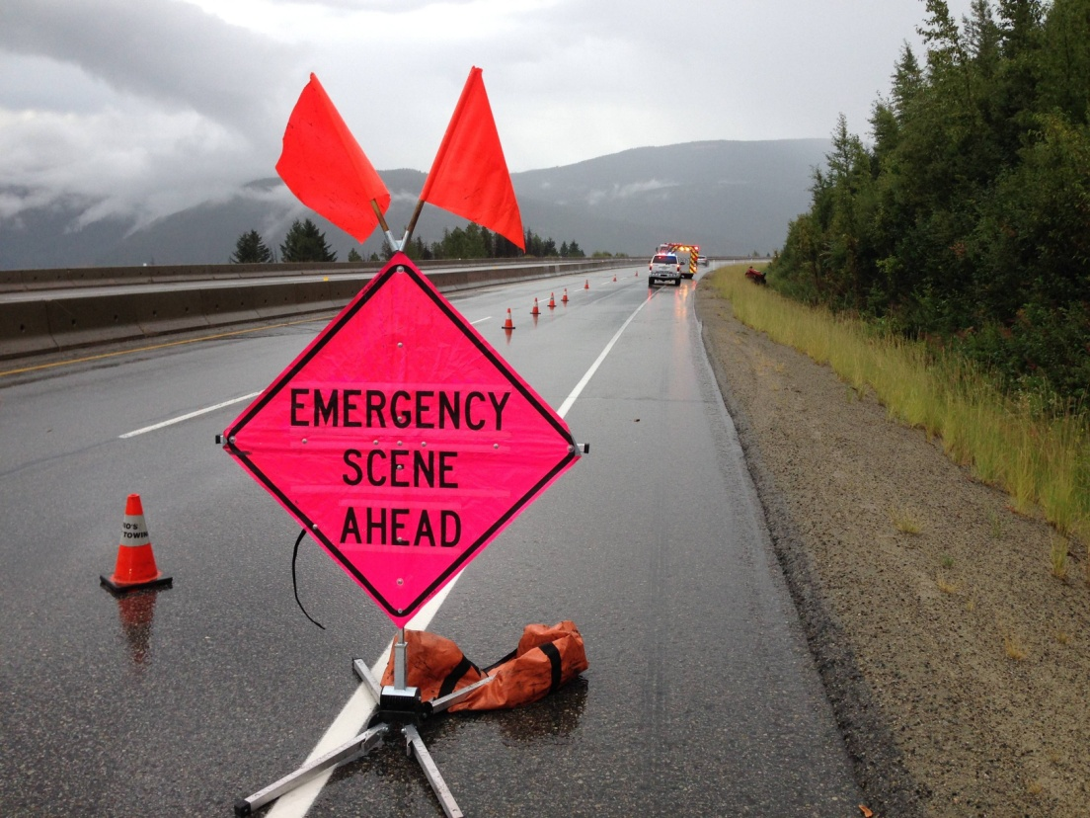
ACTION AT AN EMERGENCY
to assess the situation,
to make the area safe
to give first aid

Slide 30
ACTION AT AN EMERGENCY
to assess the situation,
to make the area safe
to give first aid
■ Safety What are the dangers and do they still
exist? Are you wearing protective equipment?
Is it safe for you to approach?
■ Scene What factors are involved at the
incident? What are the mechanisms of the
injuries? How many casualties are
there? What are the potential injuries?
■ Situation What happened? How many people
are involved and what ages are they? Are any
of them children or elderly?

Slide 31
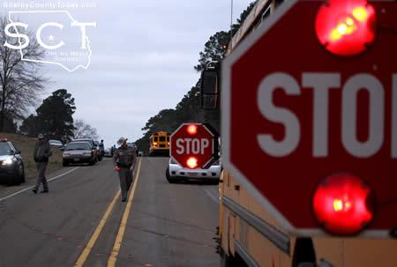
ACTION AT AN EMERGENCY
to assess the situation,
to make the area safe
to give first aid
to remove an appliance plug from the power supply point,
to ensure oncoming traffic is warned,
to wear gloves…

Slide 32
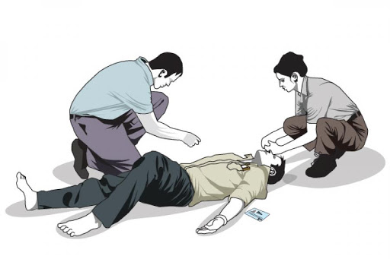
ACTION AT AN EMERGENCY
to assess the situation,
to make the area safe
to give first aid
Begin treatment
Start life-saving first aid as soon as possible with life-threatening conditions first.
Ask others to call for help and retrieve equipment such as an AED (automated external defibrillator).

Slide 33
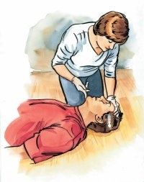
ASSESSING THE SICK OR INJURED
first check and treat any life-threatening conditions according to their priority (primary survey),
then to carry out a detailed assessment looking for injuries that are not immediately apparent (secondary survey).

Slide 34
THE PRIMARY SURVEY
This is an initial rapid assessment of a casualty to establish and treat conditions that are an immediate threat to life.
Airway, Breathing, and Circulation (ABC) principle:
■ Airway
Is the airway open and clear?
The airway is not open and clear if the casualty is unable to speak. An obstructed airway will prevent breathing, causing hypoxia and, ultimately, death.
The airway is open and clear if the casualty is talking to you.
■ Breathing
Is the casualty breathing normally?
If the casualty is not breathing normally, call 112 for emergency help, then start chest compressions with rescue breaths (cardiopulmonary resuscitation/CPR).
If the casualty is breathing, check for and treat any breathing difficulty such as asthma, then move on to the next stage: circulation.
■ Circulation
Is the casualty bleeding severely?
If he is bleeding this must be treated immediately because it can lead to a life threatening condition known as shock.Call 112 for emergency help.
If there is no bleeding, continue to the secondary survey.

Slide 35
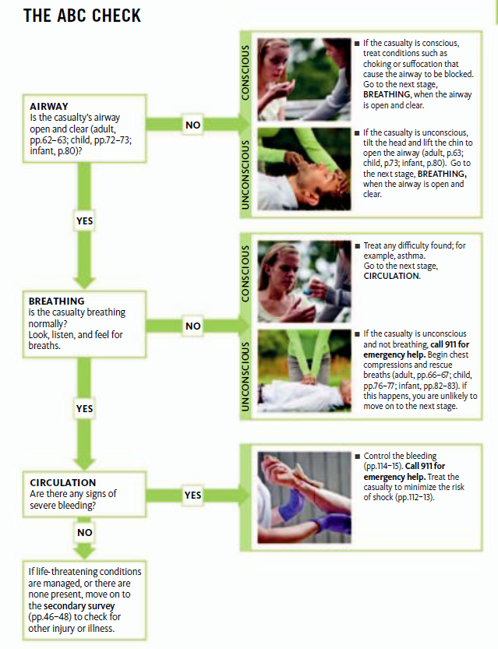

Slide 36
THE SECONDARY SURVEY
This is a detailed examination of a casualty to look for other injuries or conditions that
may not be readily apparent on the primary survey.
To do this, carry out a head-to-toe examination. Your aim is to find out:
■ History
What actually happened and any relevant medical history.
■ Symptoms
Injuries or abnormalities that the casualty tells you about.
■ Signs
Injuries or abnormalities that you can see.

Slide 37
■ History
What actually happened and any relevant medical history.
■ Symptoms
Injuries or abnormalities that the casualty tells y ou about.
■ Signs
Injuries or abnormalities that you can see.
■ Ask what happened; for example, establish whether the incident is due to illness or an accident.
■ Ask about medication the casualty is taking.
■ Ask about medical history. Find out if there are ongoing and previous conditions.
■ Find out if a person has any allergies, including to any medications or latex.
■ Check when the person last had something to eat or drink.
■ Note the presence of a medical warning bracelet—this may indicate an ongoing
medical condition, such as epilepsy, diabetes, or anaphylaxis.

Slide 39
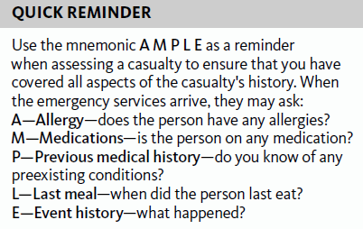
v
v
v
v
v
v

Slide 40
■ History
What actually happened and any relevant medical history.
■ Symptoms
Injuries or abnormalities that the casualty tells you about.
■ Signs
Injuries or abnormalities that you can see.
When you talk to the casualty, ask him to give you as much detail as possible.
For example, if he complains of pain, ask where it is. Ask him to describe the pain (is it constant or intermittent, sharp or dull). Ask him what makes the pain better (or worse), whether it is affected by movement or breathing, and, if it did not result from an injury, where and how it began.
The casualty may describe other symptoms, too, such as nausea, giddiness, heat, cold, or thirst.
Listen very carefully to his answers and do not interrupt him while he is speaking.

Slide 41
■ History
What actually happened and any relevant medical history.
■ Symptoms
Injuries or abnormalities that the casualty tells y ou about.
■ Signs
Injuries or abnormalities that you can see.

Slide 42
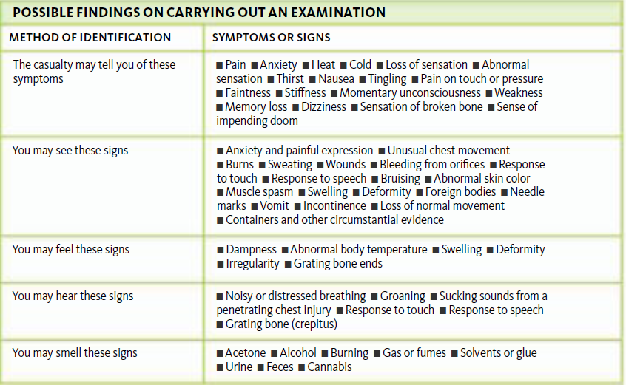
HEAD-TO-TOE EXAMINATION

Slide 43
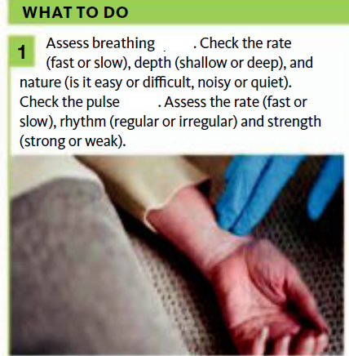
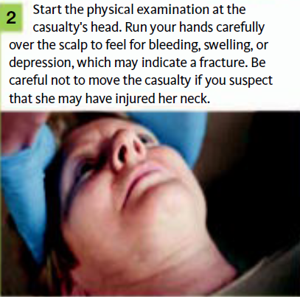

Slide 44
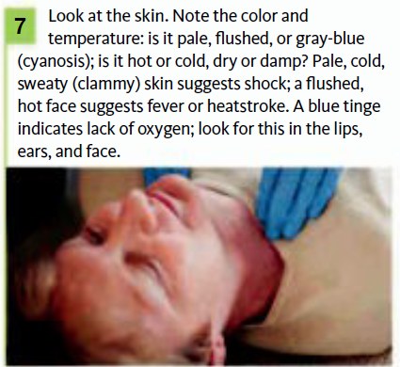
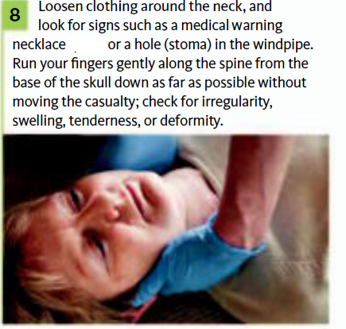

Slide 45
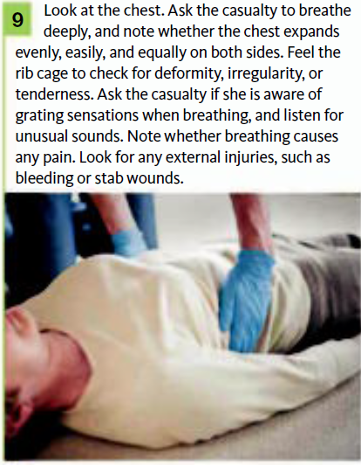
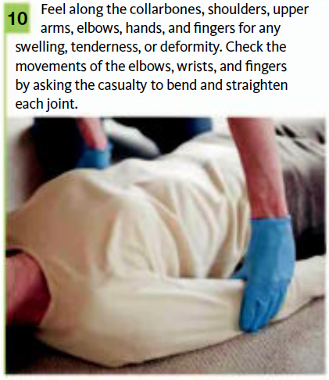

Slide 46
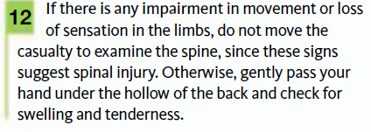
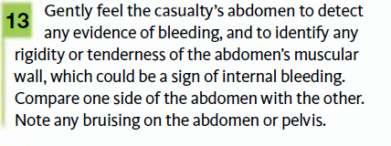
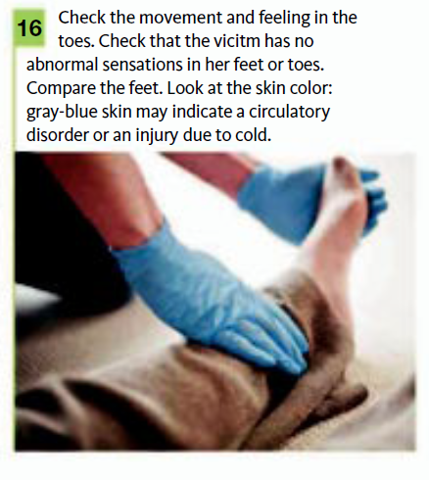
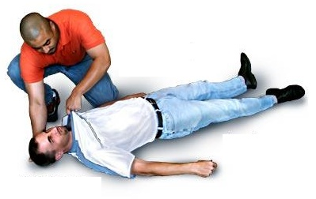

Slide 47
MONITORING VITAL SIGNS
Breathing
Pulse
Level of response

Slide 48
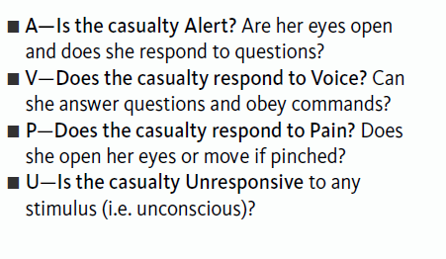
Level of response
v
v
v
v
v
v
v
v

Slide 49
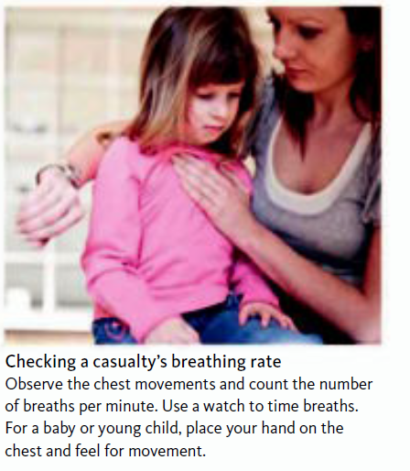
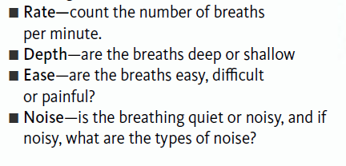
Breathing
An adult’s normal breathing rate is 12–16
breaths per minute;
In babies and young children, it is 20–30 breaths per minute.

Slide 50
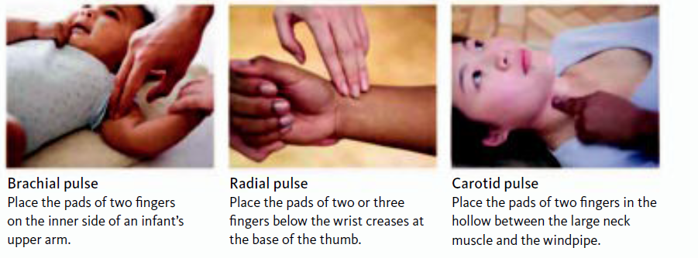
Pulse;
Each heartbeat creates a wave of pressure as blood is pumped along the arteries
The normal pulse rate in adults is
60–100 beats per minute.
The rate is faster in children and may be slower in very fit adults.

Slide 51
Body Temperature
Normal body temperature is 37°C but can be slightly higher or lower.
A temperature above 38ºC is usually caused by infection, but can be the result of heat exhaustion or heatstroke.
A lower body temperature may result from exposure to cold and/or wet conditions—hypothermia or it may be a sign of life-threatening infection or shock

Slide 52
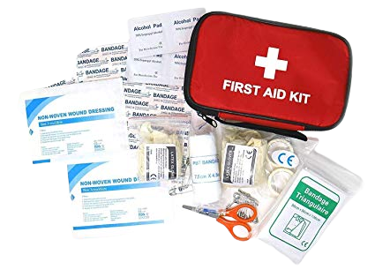
Benadryl (generic Diphenhydramine)
Antibiotic ointment or cream
Activated charcoal (if instructed by the Poison
Control Center)
Antacid (liquid)
Calamine lotion
Antihistamine cream
1% hydrocortisone cream
Povidone-iodine solution
Aspirin, acetaminophen, and ibuprofen
Sterile eye-wash solution
Epinephrine auto-injector kit (if prescribed )
Extra prescribed medications (such as inhalers)

Slide 53
Commercial Band-Aid bandages
Sterile cotton balls
Cotton-tipped swabs
Sterile gauze (pads and rolls)
Elastic bandage rolls
Extra bandage clips
Butterfly bandages
Sterile eye patches
Regular adhesive bandages (multiple sizes)
Adhesive tape (waterproof and stretchable)
Triangular bandages
Large foil-lined bandage

Slide 54
Bulb syringe
Medicine spoon
Small paper cups
Clean cloths and tissues
Hand sanitizer
Digital thermometer (and rectal thermometer for
babies less than one year old)
Small jar of petroleum jelly
Sterile disposable gloves
Disposable CPR face mask
Safety pins
Scissors (the sharp, angular style with rounded end)
Tweezers
Tooth-preservation kit
Space blanket
Penlight
Small pad of paper and pencil
Emergency candle and waterproof matches
Disposable self-activating cold and hot packs
Magnifying glass
Whistle

Slide 55
Transporting the Person Yourself
NEVER transport a person:
■ When the trip may aggravate the injury or illness or cause additional injury.
■ When the person has or may develop a life threatening condition.
■ If you are unsure of the nature of the injury or illness.

Slide 56
Moving an Injured or Ill Person
When you are faced with immediate danger, such as fire, lack of oxygen, risk
of explosion or a collapsing structure.
2. When you have to get to another person who may have a more serious problem. In this case, you may have to move a person with minor injuries to
reach someone needing immediate care.
3. When it is necessary to give proper care. For example, if someone needed CPR, he or she might have to be moved from a bed because CPR needs to be performed on a firm, flat surface. If the surface or space is not adequate to give care, the person should be moved.

Slide 57
Types of Non-Emergency Moves
Walking Assist

Slide 58
Types of Non-Emergency Moves
Two-Person seat carry

Slide 59
Types of Emergency Moves

