Slide 1
Cis platin (CP)Part 2
The effect of cisplatin on cancer cells is linked to its ability to cross-link with purine bases in DNA;
It interferes with DNA repair mechanisms, causing DNA damage, and then triggers programmed cell death apoptosis (a kind of self-destructive mechanism) in cancer cells.

Slide 2
The anticancer activity of CP is due to its transformation into a complex that prevents DNA synthesis by creating intra-helical cross-links in the DNA double helix, that is, crosslinking in the DNA double-chain. Thus, CP inhibits DNA biosynthesis in the tumor cell. The cytotoxic mechanism of CP, its binding and transcription to nuclear DNA.
(Transcription, writing, or software is the process of copying the nucleotide sequence that makes up the DNA as an RNA sequence by the RNA polymerase enzyme. In other words, it is the transfer of genetic information from DNA to RNA)
and / or by interfering with the DNA replication mechanism. CP induces cell death by increasing mitochondrial permeability through various mechanisms. However, the same destruction effect also plays a role in CP toxicity (poison effect on cells).
The mechanism of action of CP is similar to that of bifunctional alkylating drugs. Only the cis isomer is cytotoxic (allergic or poison effect). It is a drug not specific to the period, it can be used to select cells.
Alkylating drugs show synergistic interaction with antimetabolites and some herbal antineoplastic drugs. That is, there is a tendency for chemicals and processes to react together by creating unpredictable combinations, resulting in a significantly stronger or totally different effect than they have alone.
Important and dangerous side effects such as kidney damage, liver damage and inner ear damage have been identified. These effects restrict its use.
Compounds with fewer side effects are currently being investigated
The Mechanism of Cis Platinum (CP) effect on DNA

Slide 3
Interaction of cisplatin with cellular targets
DNA as target
In a research report shortly after the discovery of cisplatin anticancer properties, Rosenberg et al. And Howle and Gale suggested that the cellular target for cisplatin is DNA.
To determine how the drug could interact with DNA, Rosenberg and co-workers first thought that cisplatin could bridge two DNA sequences, such as some organic bifunctional alkylating agents, to form an in-bridge crosslink., however, since the distance is greater than its size, the researchers suggested that a single Ptz2 ion and cisplatin bind two purine bases adjacent to the same DNA strip to form an intra-DNA purine dimer.
Later studies of many researchers supported this initial idea, and detailed studies by Fichtinger-Schepman, Reedijk et al showed that the main add-on was the cis- [Pt (NH₃) ₂] ²⁺ unit linked to the dinucleotide sequence GG. Pt-GG plug-in with smaller amounts of Pt-AG plug-in, both with 1.2 intrastrand cross-linking
These researchers also showed that the drug reacts with guanine bases in the trinucleotide sequences of the GXG type to form a 1.3 intrastrand crosslink, and the platinum ion can also bind both DNA strands to the guanines.
creates a cross-link between layers. In any case, the donor atom of the heterocyclic DNA base used to bind to Pt² ⁺ is the N-7 of guanine or adenine.

Slide 4
While there are many studies in the literature that address the cisplatin binding kinetics and mechanism of DNA, an NMR study by Davies et al. refers to the reaction of the drug with DNA, in this case the guanine regions of the oligonucleotide 50-AATTGGTACCAATT-30. This double-stranded short segment 91 Cisplatin DNA is palindromic, meaning reading from 50 to 30 directions corresponding to the sequence in both strands is the same, and each strand is said to be self-complementary as one strand can be eliminated with another strand like itself to form a Watson. The researchers examined the reaction of cis- [PtCl2 (15NH3) 2] with duplex DNA using 1H-15N HSQC NMR and measuring the velocities of the platinum complex's NMR peak densities. duplex. They proposed the scheme shown in Figure for the reaction compared to the HSQC NMR spectra obtained from the reaction of 15N-labeled cisplatin with other oligonucleotide duplexes and by placing NMR kinetic data in various binding models.

Slide 5
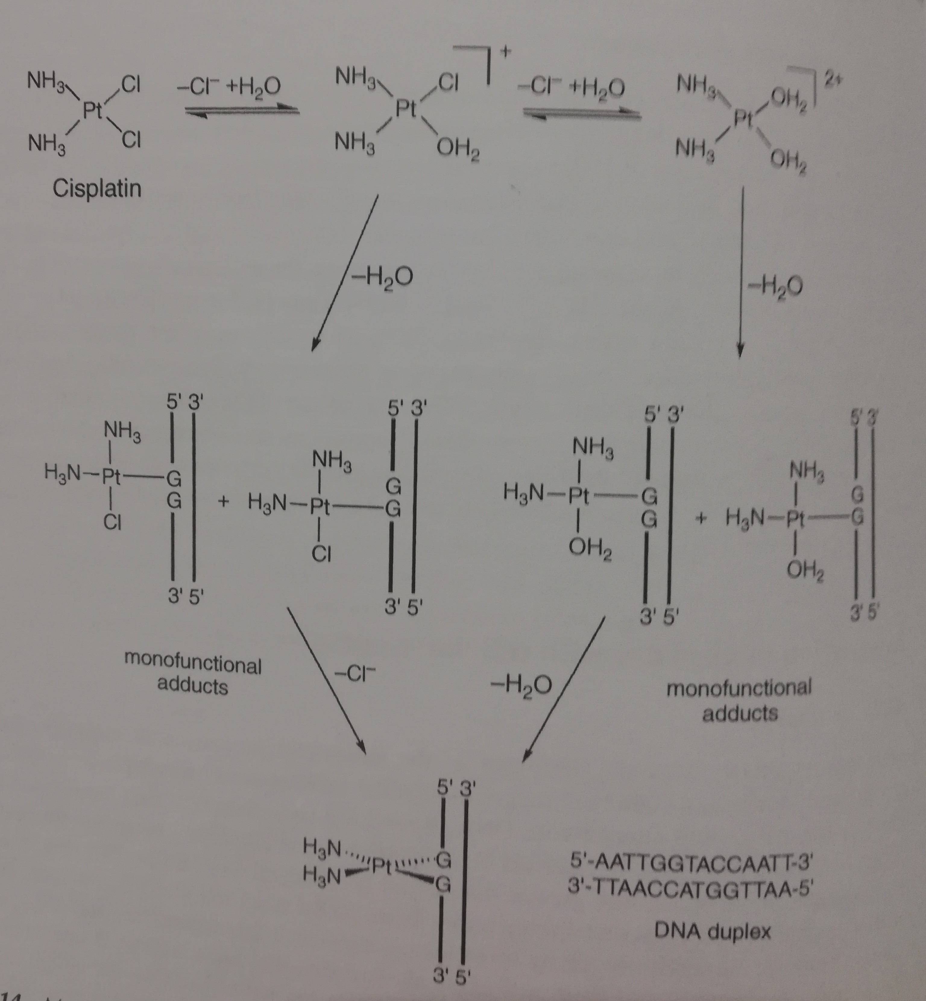
Cis platinum cross-linking mechanism with DNA
1,2 dahili çapraz bağlanma Pt GG

Slide 6
The Importance of Antioxidants in Preventing Toxic Effects of CP
α-tocopherol (vitamin E), vitamin C and Selenium:
Selenium (Se) is one of the essential elements that play an important role in many biological events. Vitamin E is a lipophilic, chain-breaking antioxidant vitamin found in the cell membrane. Vitamin C is also a strong chain breaker antioxidant. Studies have reported that a stronger antioxidant effect is generally observed if vitamin E and C are used together..
Myelosuppression refers to anemia, thrombocytopenia and neutropenia developing in the bone marrow after suppression of erythroid, granulocyte and megakaryocyte serial cells. Serious hematological toxicity development, dose reduction according to chemotherapy protocol,
may cause delay or interruption of the chemotherapy cycle. This may affect the treatment process, especially in patients who are given chemotherapy for the purpose of curing or prolonging their life.

Slide 7
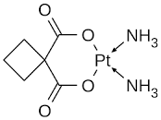
Platinum cancer drugs
Carboplatin:
Carboplatin, [Pt (cbdca-O, O0) (NH₃) ₂], where cbdca is cyclobutane-1,1-dicarboxylate and ligand donor atoms of O and O0, called the second generation platinum. anticancer drug that is much less auto and nephrotoxic than cisplatin. The patented [reported drug was approved by Cleare and Hoeschele in 1973] and later by the U.S. Food and Drug Administration (FDA) under the Paraplatin brand in 1989. The main difference between structures is that the carboplatin and cisplatin have a six-membered dicarboxylate ring, which makes it less chemically reactive than cisplatin due to the chelating effect. Carboplatin alone or in combination with other drugs is used worldwide for the treatment of various different cancers including head and neck cancer and ovarian, breast, small lung cell, testicle, bladder and brain tumors. Although carboplatin is much less auto- and nephrotoxic than cisplatin, it is myelosuppressive, leading to a decrease in the number of white cells in the blood, thereby exposing the patient to infection by various organisms.

Slide 8
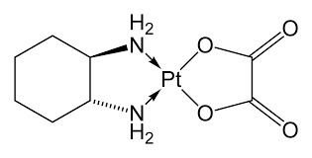
Oxaliplatin
Oxaliplatin (Eloxatin), [Pt (ox-O, O0) ((1R, 2R) -dach-N, N0)], where oxalate and dach are 1,2-diaminocyclohexane (also in Figure), a platinum anticancer in 1999 The drug, which was approved for clinical use in the European Union and the United States in 2002. Oxaliplatin is particularly effective against metastatic colorectal cancer in combination with 5-fluorouracil (5-FU) and is much less nephro and ototoxic than cisplatin. In addition, oxaliplatin can be used to treat cisplatin-resistant tumors and is less myelo suppressive than carboplatin. A limitation of oxaliplatin is that the drug induces peripheral neuropathy (nerve damage) for acute (short) exposure, which occurs immediately after administration and can be reversible, affecting the sense of touch and cooling]. Since the Ca2 + ions are important in the neuronal signaling system, this form of neuropathy can result from the complexing of the oxalate ligand released from the drug, a hard base, with a hard acid, Ca2 +. In the case of chronic (continuous) exposure to oxaliplatin, drug-induced neuropathy is not completely reversible. This form of nerve damage is thought to be associated with the accumulation of the drug in cells located in the dorsal root ganglion of the spine, followed by a decrease in cellular metabolism.

Slide 9
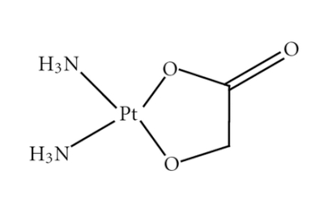
Nedaplatin
Platinum-containing anticancer drug nedaplatin, cis-diamminglikolatoplatinum (II) (Figure) is in clinical use in Japan for the treatment of ovarian and cervical carcinomas, head and neck tumors, and esophageal and bladder cancer. Nedaplatin is similar in some respects to carboplatin as it does not use organic cation carriers to enter the cell and is myelo suppressive, limiting the dose that can be administered to the patient.
Structurally, the non-degradable ligands of nedaplatin are two molecules of cis-ammonia that make half the drug the same as cisplatin and carboplatin. The ligand separated by nedaplatin is the dianionic glycolic form that forms a five-membered chelate ring with P^{t2 +} ion. Two negative charges on glycolic acid depend on the deprotonated carboxylic acid group and the deprotonated alcohol functional group; that is, an alkoxide.

Slide 10
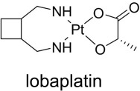
Lobaplatin
As it can be understood from the figure, lobaplatin (R, R / S, S) - (1,2-cyclobutanethanamine) [(2S) -2-hydroxypropanoato, O, O0] platinum (II), which shows little of the side effects of cisplatin, lobaplatin is a mixture of two compounds that are diastereomeric to each other; that is, stereoisomers, but not mirror images. When later separated from the lobaplatin ligand, there is a chiral cyclobutane diamine (racemic), which again forms a seven-membered chelate ring with platinum ion. A seven-membered ring is expected to be less thermodynamically stable than a five or six-membered chelate, while the strength of the metal nitrogen bond indicates that the diamine remains attached to the metal ion when the compound is in the biological environment. .

Slide 11
Heptaplatin:
(heptaplatin), cis-malonato [(4R, 5R)4,5-bis (aminomethyl)-2-isopropyl-1,3-dioxolan] platinum (II) (Fig.) is approved. Diamine bound as the ligand and 5 -with dieter, there is Pt and dianion malonic acid in the center. However, x-ray structural analysis shows that the metal donor portion of the malonato ligand bound to Pt2 + can affect substitution reactions and make it "carboplatin-like" in the chemical reactivity of the compound. Heptaplatin appears to be effective against cisplatin-resistant cancerous sites that may be associated with metallothionine levels in the cell. Heptaplatin and paclitaxel; It is used in combination with stomach cancer, head and neck flat cancers. The drug has mild hepatotoxicity and myelosuppression, and the nephrotoxicity caused by the agent is dose-limiting.

Slide 12
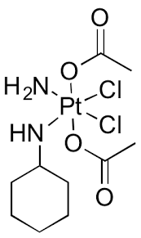
Satraplatin (JM216)
Satraplatin, bis (acetato) amminedichloro (cyclohexylamine) platinum (IV) is a Pt⁴ ⁺ complex currently used in the United States in clinical ways, alone and in combination with other agents (Figure). non-small cell lung cancer, various solid malignancies, and refractory prostate cancer treatment An attractive feature of satraplatin is that the agent can be taken orally in pill form. This feature, which can be used without the need for medical personnel, is seen as an advantage in platinum chemotherapy.

Slide 13
Compounds with drug combinations

