Slide 1
Cellular Senescence and Aging
Prof. Dr. Fulya Tekşen

Slide 2
SENESCENCE AND AGING
Biologically, SENESCENCE; is a terminal irreversible stage which is infact, a cellular response that limits the proliferation of aged or damaged cells.
AGING; is the progressive detorioration process observed in the living organisms and CHARACTERIZED by a general decline in the metabolic processes.

Slide 3
Figure1: Senescence and the central hallmark of aging.

Slide 4
Biological Mechanism
The exact mechanism of aging is not precisely known.

Slide 5
AGING;
is directly related with many disorders such as;
- Cancer
- Cardiovascular diseases
- Diabetes mellitus
- Neurodegenerative disorders
- Osteoporosis
- Glaucoma

Slide 6
LIFE SPAN
Genetic or Pharmacological ablation (removal) of senescent cells extends the life span and improves health span.

Slide 7
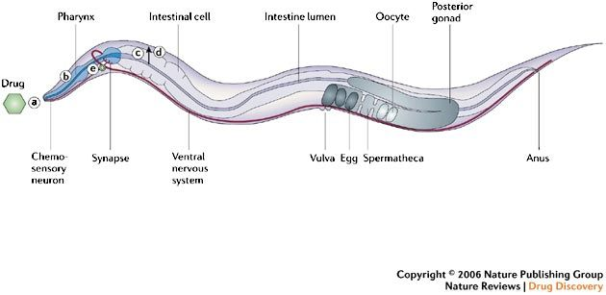
Caenorhabditis elegans (C. Elegans)
Is an important organism (round worm) that is isolated as long-lived strains (1983, Klas) and gives a lot of knowledge about molecular and biological mechanism of aging.

Slide 8
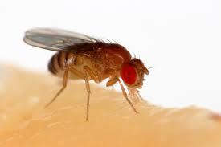
There are other organisms; that can be used in aging studies; such as; Drosofila, Mice etc.
Drosophila melanogaster

Slide 9
Aging hallmarks can be divided into categories;
1- PRIMARY: The causes of age-related damage.
2- ANTAGONISTIC: The responses to the damage.
3- INTEGRATIVE: Consequences of the responses.

Slide 10
SENESCENCE induces;
- Stable growth arrest
- Chromatin remodelling
- Metabolic reprogramming
- Increased autophagy
- Implementation of complex proimflammatory secretome.

Slide 11
Factors that lead to SENESCENCE; the Hallmarks of AGING
1- TELOMERE SHORTENING (EROSION)
2- LOSS OF PROTEOSTASIS
3- GENOMIC INSTABILITY
4- MITOCHONDRIAL DYSFUNCTION
5- ALTERED INTERCELLULAR COMMUNICATION
6- EPIGENETIC ALTERATIONS
7- STEM CELL EXHAUSTION - LOSS OF PROTEOSTASIS
8- DEREGULATED NUTRIENT SENSING
9- CELLULAR SENESCENCE

Slide 12
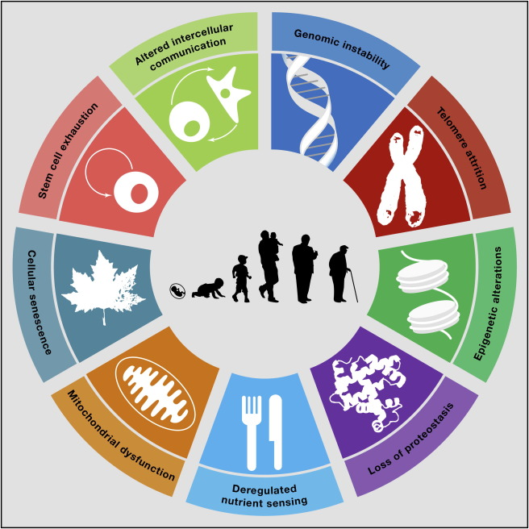
Figure 2: HALLMARKS OF AGING

Slide 13
1-TELOMERE SHORTENING (EROSION):
It is a known fact that; the telomeres which are the repetitive DNA sequences, that take place at the end of chromosomes shortens at every cell division. A specialized DNA Polymerase known as Telomerase solves this problem, but it is not found in adult cells. Also a multiprotein complex, SHELTERIN, prevents DNA repairing enzymes to reach the telomeres.
In mice, similar experimental results are reported.

Slide 14
Telomerase deficiency;
is associated with diseases such as;
- Pulmonary fibrosis
- Dyskeratosis congenita
- Aplastic anemia

Slide 15
On the other hand;
Experimental studies shows that;
Induction of telomerase enzyme can delay aging in mice.
There are some similar applications in human beings

Slide 16
Figure 3:Telomers in aging process

Slide 17
Why did Dolly die earlier?

Slide 18
2-LOSS OF PROTEOSTASIS
Proteosis is; protein homeostasis.
The excess amount of unfolded, misfolded or aggregated proteins leads to aging process.
Some diseases such as;
Alzheimer’s disease,
Parkinson’s disease
Cataracts
are related with altered proteins.

Slide 19
FİG.4: Loss of Proteostasis

Slide 20
Proteostasis is; the mechanism that regulates
- Stabilization of correctly folded proteins
AND
- The degradation of the proteins by PROTEOSOME or LYSOSOME

Slide 21
3- GENOMIC INSTABILITY
One of the most important characteristics in aging, is the accumulation of genetic (DNA) damage.
The integrity and stability of DNA is affected by both;
Exogeneous Factors
Such as, Physical, Chemical and Biological agents.
Endogeneous Factors
Such as; DNA replication errors, Spontaneous hydrolytic reactions or excess amount of reactive oxygen species

Slide 22
The results of genetic lesions leads to;
- Point mutations
- Translocations
- Chromosomal gains or losses (Aneuploidies and Copy number variations)
- Telomere shortening
- Gene disruption caused by the integration of viruses and transposons

Slide 23
Fig. 5: Genomic Alterations

Slide 24
DNA Alterations may AFFECT;
Essential GENES and TRANSCRIPTIONAL PATHWAYS
Resulting by the formation of DYSFUNCTIONAL CELLS
AND
JEOPARDIZE TISSUE and organismal HOMEOSTASIS if NOT eliminated.

Slide 25
In pathological conditions early senescence is observed (PROGERIA)
- Werner sydrome
- Bloom sydrome
- Hutchinson-Gilford sydrome
- Nestor-Guillermo sydrome

Slide 26
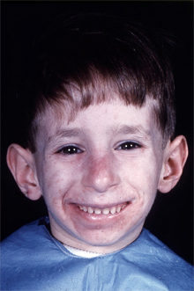
Syndromes
Werner sydrome
Bloom sydrome

Slide 27
4- MITOCHONDRIAL DYSFUNCTION
Aging process leads to;
reduced ATP production
and
The efficiacy of respiratory chain tends to diminish which results in increased electron (e) leakage.

Slide 28
ROS-Reactive Oxygen Species
In the aging process, the ROS are shown to play important roles and mitochondrial free radical theory of aging proposes that; mitochodrial aging results in excess amount of ROS and in turn this fact causes further mitochondrial deterioration and cell damage.
On the other hand, there are some other studies reporting that, Hormetic response (mild toxic treatments trigger beneficial compensatory responces), mild respiratory deficiencies may increase life span.

Slide 29
Figure 6: Metabolic alterations

Slide 30
5-ALTERED INTERCELLULAR COMMUNICATION
In the aging process,
- Endocrine
- Neuroendocrine
- Neuronal
Changes occur
AND
Intercellular communication is very important.

Slide 31
Figure 7: Altered Intercellular Communication

Slide 32
INFLAMMATION
May result from;
- Accumulation of proinflammatory tissue damage
- Failure of immune system to clear pathogens and dysfunctional host cells.
- Secretion of proinflammatory cytokines by the senescence cells

Slide 33
INFLAMMATION
Also leads to;
- Obesity
and
- Type 2 diabetes

Slide 34
6- EPIGENETIC ALTERATIONS
- Histone Modifications
- DNA Methylation
- Chromatin Remodeling
- Transcriptional alterations

Slide 35
Epigenetic Alterations;
May be reversible so, understanding and manipulating these changes can promise for improving age-related diseases.

Slide 36
Fig. 8: Epigenetic Alterations

Slide 37
7-STEM CELL EXHAUSTION
The decrease in the regenerative potential of tissues is another characterictic of aging.
Ex. Decline in Hematopoiesis ---------- Decrease in immune cells

Slide 38
In anti-aging strategies, stem cell rejuvenation may be helpful.

Slide 39
8- DEREGULATED NUTRIENT SENSING
Diet intake is important in aging and it is shown that decreased nutrient signaling extends longevity.

Slide 40
Figure 9: Metabolic alterations

Slide 41
9- CELLULAR SENESCENCE
Is the stable arrest of cell cycle coupled to stereotyped phenotypic changes.

Slide 42
Figure 10: Cellular Senescence

Slide 43
Figure 11: Aging and Diseases

Slide 44
Fıgure 12: How can we extend the life span?

Slide 45
References
Bruce Alberts, Alexander Johnson, Julian Lewis, David Morgan, Martin Raff, Keith Roberts, Peter Walter-Molecular Biology of the Cell-Garland Science (2015)
Geoffrey M. Cooper & Robert E. Hausman-The Cell. A Molecular Approach-Sinauer Associates (2007)
Harvey Lodish, Arnold Berk, Chris A. Kaiser, Monty Krieger, Matthew P. Scott, Anthony Bretscher, Hidde Ploegh, Paul Matsudaira-Molecular Cell Biology (Lodish, Sixth Edition)-W. H. Freeman (2007)
CarlosLópez-Otín, Maria A.Blasco,Linda Partridge,Manuel Serrano, Guido Kroemer. The Hallmarks of Aging. Volume 153, Issue 6, (2013), Pages 1194-1217
Domhnall McHugh and Jesús Gil, Senescence and aging: Causes, consequences, and therapeutic avenues. J Cell Biol. (2018) Jan 2; 217(1): 65–77.

