Slide 1
ISL 459 Contemporary Business Issues
Week 1: The business enterprise in the international environment

Slide 2
Country Focus: Venezuela
An Uncertain Future for foreign multinationals in Venezuela
Venezuela is the world’s largest oil producer, generating huge revenues from growing demand and rising oil prices
Oil accounts for 90% of the country’s export earnings
Yet oli wealth has brought neither the prosperity nor the stability that Venezuelans had hoped for.

Slide 3
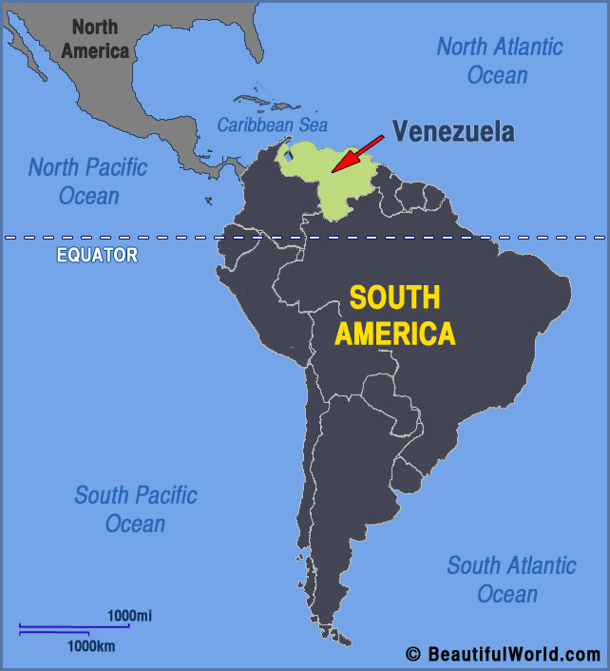
Where is Venezuela?

Slide 4
Who is Hugo Chavez? (b.1954 – d.2013)
Chavez took office in 1999.
President Chavez rose to prominence on a wave of populist and anti-American fervor.
Relations with business interests within the country have been turbulent, as he has embarked radical reform of property rights.
He has asserted Venezuelan sovereighty over its natural resources.
As result the large MNE’s that have invested in its oil industry have encountered increasingly hostile policies.

Slide 5
CRUDE OIL RESERVES (2017)
1.VENEZUELA 300,878 millions of barrels
2.S.ARABIA 266,455 millions of barrels
3. CANADA
4. IRAN
5.IRAQ
6.KUWAIT
7.UAE
8.RUSSIA
9.LIBYA
10.U.S.

Slide 6
Nicolas Madura vs.Juan Guaido (2018)
Corruption failed government- infrastructure crumbled – leaving Venezuela in poverty.
Inflation rate is 10 million %
Venezuela’s monthy salaries can not even buy a single gallon of milk
Production today (crude oil) is even less – 2.3 times than in 1970s.
Venezuela used to be the weathiest country in S. America. (1958-1980)
Oil product is 95% of Venezuela’s export earnings.
2013-2018 – the economy contracted 1/3.

Slide 7
2018…
Venezuelan economu shrunk by 18%. – HYPERINFLATION
Health System is in ruins. Life saving medicines, electricity & clean water are in short supply.
Food is scarce.
Malnurtition is wide spread.
Rising Crude prices in 2000s helped Chavez. However in 2014, oil prices started to decrease.
Maduro was ill prepared to absorb the blow.

Slide 8
Back to Hugo Chavez..
Chavez – pumped 3.5 million barrels of oil/day
Production collapsed to 1/3 today.
During the 1990s when oil prices were low, Venezuela welcomed the large oil companies – eager to benefir from their technical abilities to explore and develop oil fields.
Venezuela is estimated to have the largest reserves of extra heavy crude oil in the Western Hemisphere.
The companies benefited from favourable terms such as low royalty payments to the state,

Slide 9
Petroleos de Venezuela (PDVSA)
PDVSA - the Venezuelan State owned oil company.
The government raised taxes and required foreign energy to convert 32 operating contracts into joint ventures with the PDVSA.
Some companies agreed the terms, but others such as Exxon refused and sold stake.
The government took control over two companies, Total & Eni (French & Italian respectively).

Slide 10
What happened in Venezuela?
Eni threatened to sue PDVSA for a unilateral termination of its contract.
A new hydrocarbons law was passed in 2001, raising taxes on new projects.
Other multinationals have been served bills for back taxes
IBM and Microsoft came under pressure as the Venezuelan tax authority rxamined alleged tax irregularities.
Mobile phone companies Nokiam Ericsson and Siemens – and the car maker Honda were also affected.
THE New policy of “ZERO TAX EVASION” cracked down large MNEs.

