Slide 1
MORAXELLA INFECTIONS

Slide 2
Classification
Kingdom : Bacteria
Phylum : Proteobacteria
Class : Gammaproteobacteria
Order : Pseudomonadales
Family : Moraxellaceae
Genus : Moraxella
M. bovis

Slide 3
Gram negative, coccoid (duplicate), non-spore, immobile, fimbrial
M. bovis
Catalase and oxidase positive
Very susceptible to genetic transformation
Is located in upper respiratory tract in pharynx, mouth and eye mucosa and causes sporadic infections
In cattle, keratoconjunctivitis (Pink Eye, corneal matt) and corneal ulceration occur, resulting in temporary blindness
Tears and nasal discharge, contact, vector flies are important in contagion
The most sensitive races hereford, Holstein and Angus (due to pigmentation of the eyelid)

Slide 4
Tear flow or swab taken from the eye; is supplemented with selective blood agar containing cloxacillin (2.5 mg / kg)
Fimbrial strains are hemolytic on blood agar, hardly lifted from the agar surface and difficultly suspended, create colonies that leave hollows on the agar surface when removed
Strains which do not have fimbria do not form hemolysis

Slide 5
COXIELLA INFECTIONS

Slide 6
Classification
Kingdom : Bacteria
Phylum : Proteobacteria
Class : Gammaproteobacteria
Order : Legionellales
Family : Coxiellaceae
Genus : Coxiella
C. burnetii

Slide 7
Gram negative, very small coccoid-rod
They are microorganisms carried by vectors (Needles), which require live cells (obligat intracellular) for reproduction.
C. burnetii
Causes a zoonotic infection with subclinical and abortive character known as Q fever
Biological weapons (very low dose adequate, respiratory transmission, durable and virulent)

Slide 8
Etiology
Without spore, nonmotile
Not stained well with Gram staining
Produces in the cytoplasm of endothelial and epithelial cells and forms microcolonies
Grow embryonated chicken eggs and plasma tissue
It forms resistant particules similar to the endosporal structure in the development cycle.
This structure is resistant to physical and chemical agents

Slide 9
Epidemiology
Stay alive for years in dry stools
Stay alive 46 days in milk and 41 days in butter
Although the agent does not require intermediate host, ticks are vector.
When the disease is subclinical, the agent spread with vaginal discharge and milk
The aerosol way is seen between people and animals transmission
Domestic ruminants become infected with inhalation, digestion and arthropod bites

Slide 10
VIBRIO INFECTIONS

Slide 11
Gram negative, curved rods
Motile, without spore
Facultative anaerobic
All species are found in sweet and salt water
Known as water bacteria
Grow at 37C, in 24 hours and form S-typed colony
Oxidase positive

Slide 12
There are 63 species in the genus Vibrio
Mesophilic species cause disease in human
V. cholerae is a cholera agent
O: 1 serovar is responsible for epidemics and releases cholera toxin. Toxin destroys the ion transport of small intestine cells and causes severe secretory diarrhea
All species grow at 20 ºC, most of them at 30 ºC, and those who develop infections in the mammals grow at 37 ºC.

Slide 13
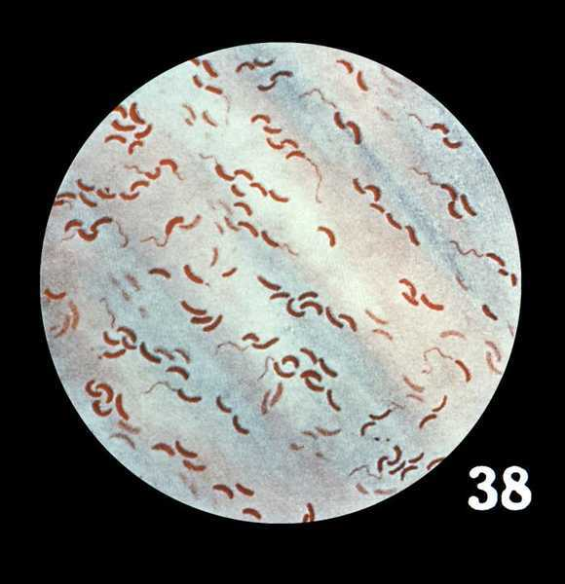

Slide 14
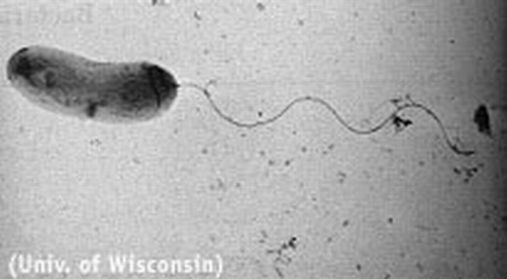

Slide 15
AEROMONAS INFECTIONS

Slide 16
Classification
Kingdom : Bacteria
Phylum : Proteobacteria
Class : Gammaproteobacteria
Order : Aeromonadales
Family : Aeromonadaceae
Genus : Aeromonas
+14 species

Slide 17
Gram negative, curved rod
Motile, non-spore, facultative anaerobic
Infects water animals and various mammals
According to classical phenotypic classification
Moving and mesophilic
A. hydrophila complex
A. caviae complex
A. sobria complex
Differed as nonmotile and psychrophilic
A. salmonicida (Frunkulosis) and its subspecies

Slide 18
Motile and Mesophilic Aeromonas Infections
A. hydrophila complex
A. hydrophila
A. bestiarum
A. caviae complex
A. caviae
A. media
A. enchelia
A. sobria complex
A. sobria
A. veronii
A. landaei
A. trota
Single Flagella
At optimum 28C
Forms S-type colony
Located in the sea and sweet waters
The effect of water animals on bowel and skin flora

Slide 19
Contaminant causes worms and sporadic infections in domestic animals such as cattle, pigs, horses and sheep
Moving aeromonas rate in the water increases during hot seasons, falls during cold seasons
Zoonotic
In animals and humans, septicemia, enteritis,
Abortion and mastitis in cattle, diarrhea in person

Slide 20
In Fish
In fish, hemorrhagic septicemia in the head, fins
Ulcers in the head, fins and abdomen of infected fish and spread of these ulcers to the muscle layer, septicemia and death occurs
A hemorrhagic picture due to septicemia in the internal organs

Slide 21
